Slide 1
EE 4130 – Systems Engineering Chapter 18: SOW and SEMP
Prof Joel Harris
2 May 2018
CSULA – ECST Department

Slide 2
SOW Definition
A Statement of Work (SOW) is a document within a contract that describes the work requirements for a specific project, along with its performance and design expectations. The main purpose of the SOW is to define the liabilities, responsibilities and work agreements between two parties, usually clients and service providers.
SOWs should be written in precise language that is relevant to the field of business. This prevents misinterpretations of terms and requirements. Although detailed, a SOW is a general description of work.
A well-written SOW will define the scope and Key Performance Indicators (KPIs) for the agreement.
© Villanova University

Slide 3
Statement of Work (SOW) Principle Attributes
Summary statement of tasks that need to be accomplished (e.g. objectives)
Listing of the Applicable Specifications necessary to complete the work described in the SOW
Input requirements for other allied tasks falling in the scope of the Statement of Work
What final results need to be accomplished from the effort (e.g. deliverable items)
How the work described shall be paid for
Where will the work be accomplished, what resources are needed, and what facilities are necessary to do the work

Slide 4
SOW General Characteristics
Ambiguity must be avoided – this helps to reduce any misunderstanding between the parties involved
The document/SOW should be short and get to the point very quickly (ideally should be about 2-3 pages in length)
Repetition and inclusion of material not directly affecting the work statement is unnecessary
Include the requirements for completion of the work, but don’t over or under describe them

Slide 5
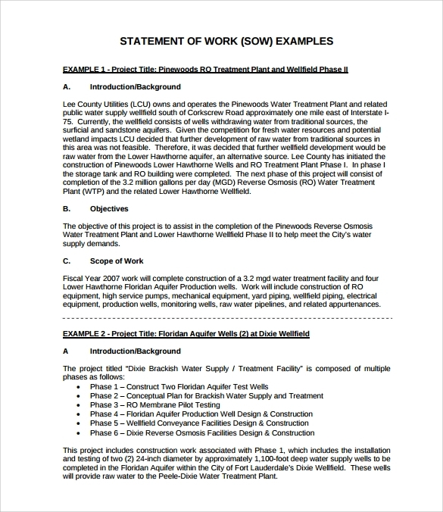
Sample SOW Format

Slide 6
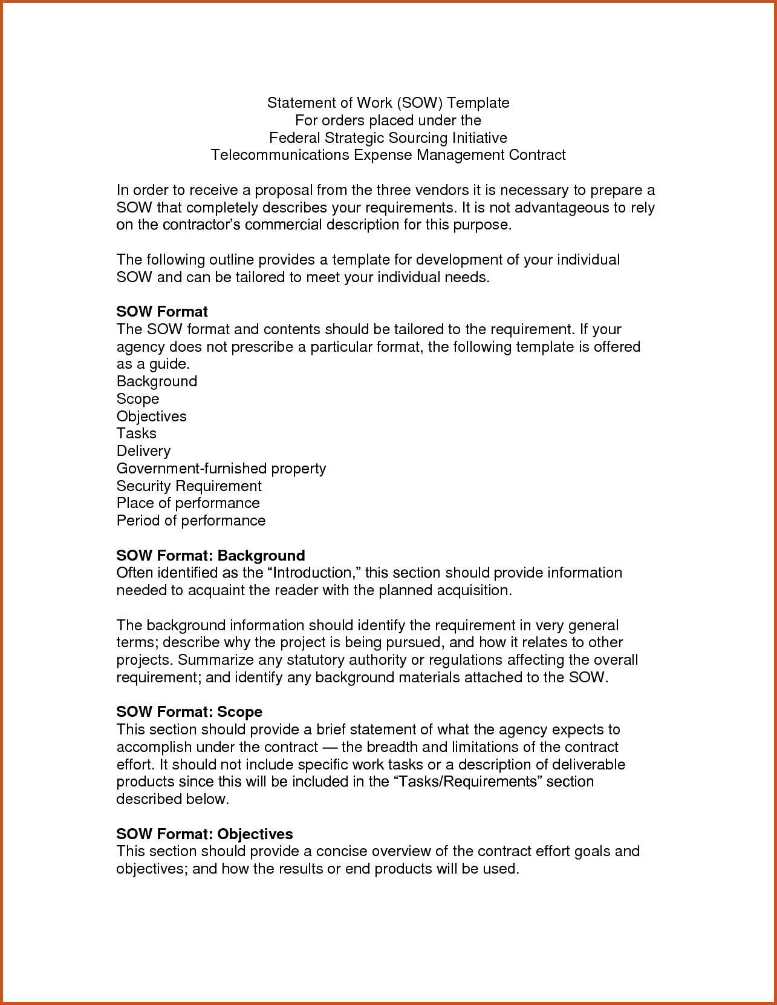
Another SOW Example Format

Slide 7
SEMP Definition
A Systems Engineering Management Plan (SEMP) is a document that addresses a contractor’s overall systems engineering management approach. It provides unique insight into the application of a contractor’s standards, capability models, configuration management, and toolsets to their organization.

Slide 8
The SEMP (Systems Engineering Management Plan) List of Tasks
Define system operational requirements
Create the system level specification (“A” level spec)
Conduct a needs analysis and feasibility study
Do a functional analysis of the system at the top level and then decompose/allocate the requirements to the next level
Plan and coordinate major design reviews
Oversee the system synthesis, analysis and evaluation activities
Create the SEMP document
Make a test and evaluation plan
Oversee any design changes or modifications
Review system test activities and capture test data
Establish lines of communication between client and provider across the full duration of the system life cycle

Slide 9
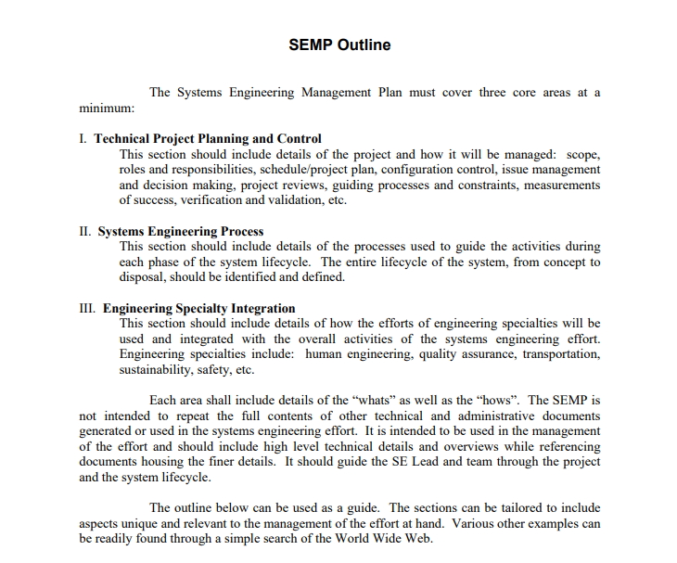
Sample SEMP – Sandia National Labs
© Sandia National Labs 2009

Slide 10
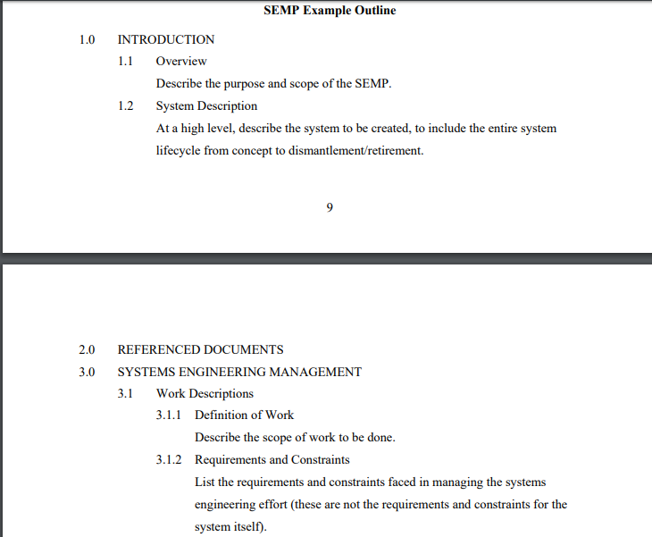
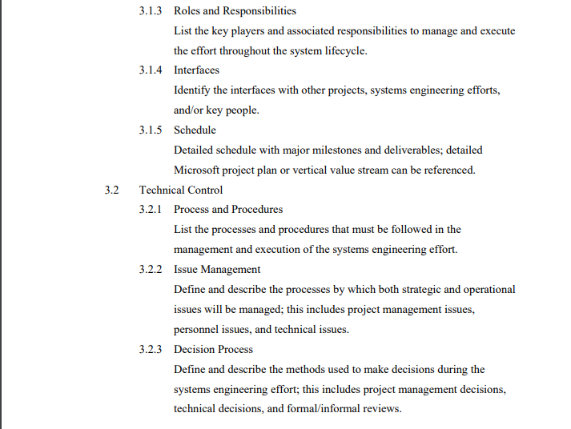
SEMP Format – Sandia (cont’d)
© Sandia National Labs 2009

Slide 11
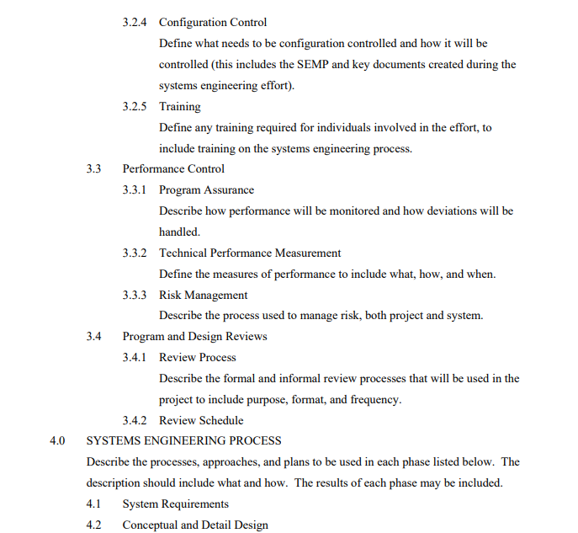
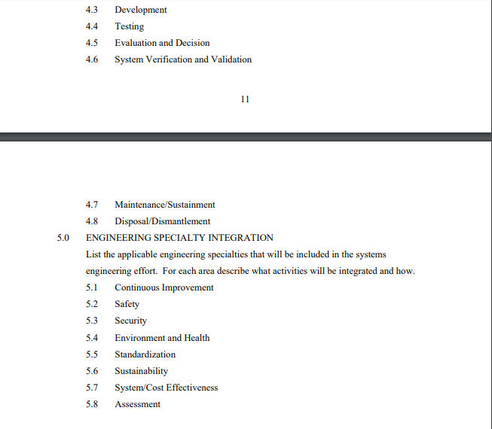
SEMP Example (cont’d)
© Sandia National Labs 2009

