Slide 1
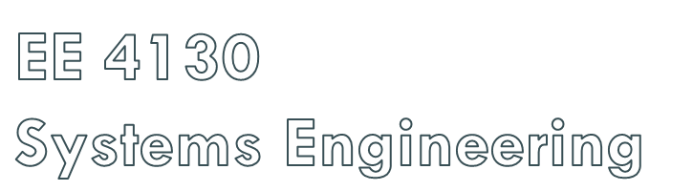
Prof. Joel Harris
11 April 2018
CSULA ECST Department

Slide 2

Project schedules grow out of the basic documents that initiate a project
  The Project Charter includes start and end dates and budget information
  Scope Statement and WBS help define what will be done
Activity definition involves developing a more detailed WBS and supporting explanations to understand all the work to be done so you can develop realistic cost and duration estimates

Slide 3
An “activity list” is a tabulation of activities to be included on a project schedule that includes:
  The activity name
  An activity identifier or number
  A brief description of the activity
Activity attributes provide more information such as predecessors, successors, logical relationships, leads and lags, resource requirements, constraints, imposed dates, and assumptions related to the activity

Slide 4

A milestone is a significant event that normally has no duration
It often takes several activities and a lot of work to complete a milestone
They’re useful tools for setting schedule goals and monitoring progress
Examples include: obtaining customer sign-off on key documents or completion of specific products

Slide 5

Involves reviewing activities and determining dependencies
A dependency or relationship is the sequencing of project activities or tasks
You must determine dependencies in order to use critical path analysis

Slide 6
Mandatory dependencies: inherent in the nature of the work being performed on a project, sometimes referred to as hard logic
Discretionary dependencies: are defined by the project team; sometimes referred to as soft logic and should be used with care since they may limit later scheduling options
External dependencies: involve relationships between project and non-project activities

Slide 7

Network diagrams are the preferred technique for showing activity sequencing
A network diagram is a schematic display of the logical relationships among, or sequencing of, project activities
Two main formats are the arrow and precedence diagramming methods

Slide 8

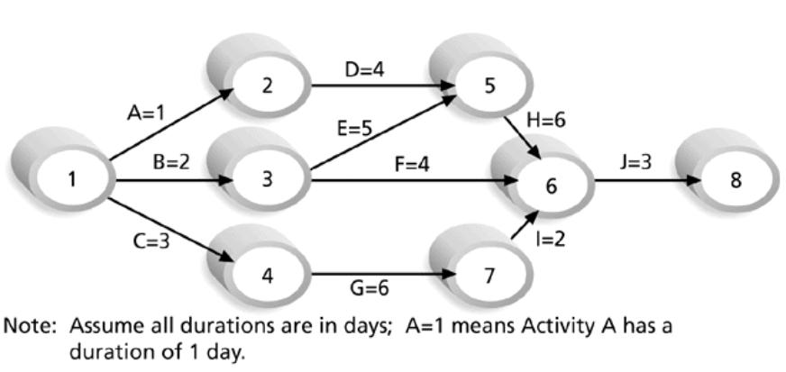

Slide 9

Also called activity-on-arrow (AOA) network diagrams
Activities are represented by arrows
Nodes or circles are the starting and ending points of activities
Can only show “finish-to-start” dependencies

Slide 10
1. Find all of the activities that start at node 1: Draw their finish nodes and draw arrows between node 1 and those finish nodes; put the activity letter or name and duration estimate on the associated arrow
2. Continue drawing the network diagram, working from left to right: Look for bursts and merges
  Bursts occur when a single node is followed by two or more activities
  A merge occurs when two or more nodes precede a single node
3. Continue drawing the project network diagram until all activities are included on the diagram that have dependencies
4. As a rule of thumb, all arrowheads should face toward the right, and no arrows should cross on an AOA network diagram

Slide 11

Activities are represented by boxes
Arrows show relationships between activities
Is more popular than ADM method and used by project management software (e.g. MS Project)
Better at showing different types of dependencies

Slide 12

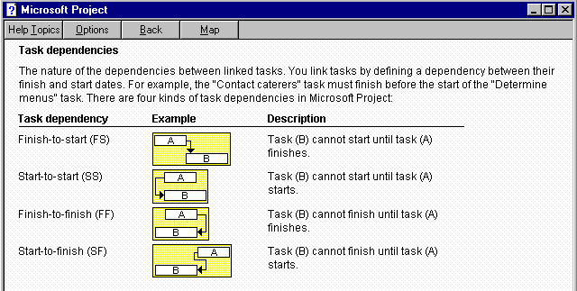

Slide 13
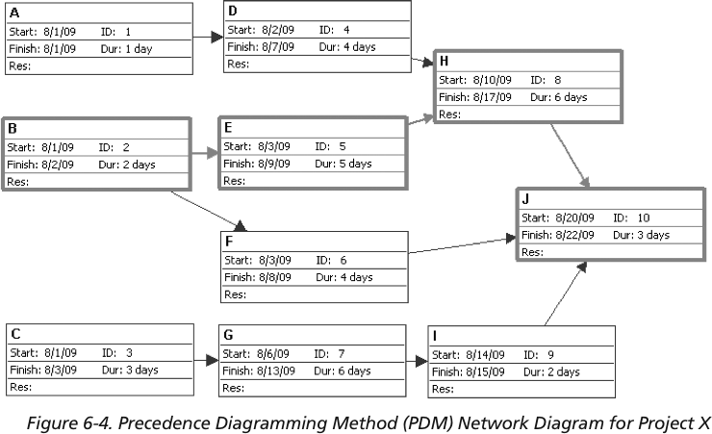

Slide 14

Gantt charts provide a standard format for displaying project schedule information by listing project activities and their corresponding start and finish dates in a calendar format
Symbols include:
  Black diamonds: milestones
  Thick black bars: summary tasks
  Lighter horizontal bars: durations of tasks
  Arrows: dependencies between tasks

Slide 15
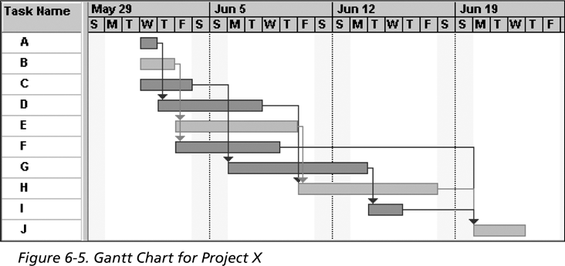
Note: The darker bars would be shown in red in Project 2007 to represent critical tasks

Slide 16
