Slide 1
EE 4130 – SYSTEMS ENGINEERING:
THE ANALYTICAL HIERARCHICAL PROCESS
Prof. Joel Harris
February 28, 2018
CSULA – Dept. of Electrical Engineering/Computer Science/Technology

Slide 2
THE ANALYTIC HIERARCHY PROCESS – ANOTHER METHOD TO MAKE DECISIONS
Used with Multiple-Criteria/Multiple Alternative (MCMA) decision-making
Real-world decision problems
  Considers multiple, diverse criteria, alternatives
  Uses qualitative as well as quantitative information
Helps in comparing “apples and oranges”
  Examples:
  Spend on defense or agriculture?
  Open the refrigerator - apple or orange?
Notes:
1

Slide 3
AHP
Information is decomposed into a hierarchy of alternatives and decision criteria
The information is then synthesized to determine a relative ranking of alternatives
Both qualitative and quantitative information can be compared, using informed judgments to derive weights and priorities (some subjectivity is unavoidable)…

Slide 4
EXAMPLE: A NEW CAR SELECTION
Objective:
  Selecting a new car to purchase
3 Criteria to be applied:
  Style, Reliability, Fuel-economy
4 Vehicle choices: : Honda Civic, Lexus LS, Ford Focus, Mazda 5
Notes:
2

Slide 5
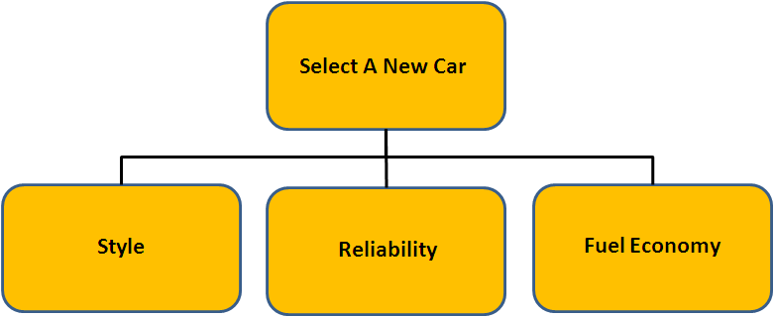
THE HIERARCHICAL TREE
- Civic
- Lexus
- Focus
- Mazda 5
- Civic
- Lexus
- Focus
- Mazda 5
- Civic
- Lexus
- Focus
- Mazda 5
Notes:
3

Slide 6
RANKING OF DECISION CRITERIA
Weights?
AHP
  The method uses pair-wise relative importance. The 5 point scale is:
  [1: Equal, 3: Moderate, 5: Strong]
Style
Reliability
Fuel Economy
Style
1/1 1/2 1/3
Reliability
2/1 1/1 4/1
Fuel Economy
3/1 1/4 1/1
Notes:
4

Slide 7
HOW TO APPROACH RANKING OF PRIORITIES
Eigenvector [Ax = λx]
  Iterate:
  1. Take successive squared powers of matrix
  2. Normalize the row sums
  Continue to do this until the difference between successive row sums is less than a pre-specified value or it reaches a steady state (e.g. the matrix demonstrates an acceptable consistency index, or CI)
Notes:
5

Slide 8
Eigenvector Calculations
1 0.5 0.333
2 1 4
3.0 0.25 1
3.0 1.083 2.666
16 3.0 8.666
6.5 2.0 3.0
squared
Row sums
6.749
27.666
11.50
45.915
Normalized
Row sums
0.1469
0.6026
0.2505
≈ 1.00
Notes:
6

Slide 9
Eigenvector Calculations (cont’d)
3.0 1.083 2.66
16.0 3.0 8.666
6.5 2.0 3.0
squared a
2nd time
43.657 11.83 25.381
152.32 43.66 94.652
71 19.039 43.661
Row sums
80.868
290.632
133.7
505.2
Normalized
Row sums
0.16007
0.5753
0.2646
≈ 1.0
0.1469
0.6026
0.2505
0.16007
0.5753
0.2646
- 0.0132
- 0.0273
- 0.0142
Difference is:
-
=

Slide 10
Eigenvector Summary
Preference
Style 0.1591*
Reliability 0.5782*
Fuel Economy 0.2627*
* values derived after a 3rd squaring
Notes:
7

Slide 11
RANKING THE ALTERNATIVES
(ATTRIBUTE COMPARISONS)
Style
Civic
Lexus
Focus
Mazda 5
Eigenvector
Civic
1/1 1/4 4/1 1/6
.1065
.2583
.0531
.5821
Lexus
4/1 1/1 4/1 1/4
Focus
1/4 1/4 1/1 1/5
Mazda 5
6/1 4/1 5/1 1/1
Reliability
Civic
Lexus
Focus
Mazda 5
Civic
1/1 2/1 5/1 1/1
.3741
.2935
.0737
.2588
Lexus
1/2 1/1 3/1 2/1
Focus
1/5 1/3 1/1 1/4
Mazda 5
1/1 1/2 4/1 1/1
Notes:
8

Slide 12
RANKING THE ALTERNATIVES (cont’d)
(Attribute Comparisons)
Miles/gallon
Normalized
Fuel Economy
(from
manufacturer’s
vehicle
specification
data)
Civic
34
.3010
Lexus
27
.2390
Focus
24
.2124
Mazda 5
28
113
.2478
≈ 1.0
Notes:
9

Slide 13
AHP SELECTION SUMMARY
- Civic .1065
- Lexus .2583
- Focus .0531
- Mazda 5 .5821
- Civic .3741
- Lexus .2935
- Focus .0737
- Mazda 5 .2588
- Civic .3010
- Lexus .2390
- Focus .2120
- Mazda 5 .2478
Notes:
10

Slide 14
RANKING OF ALTERNATIVES
Overall Preference Ranking
Style Reliability Fuel
Economy
Preference
Civic
.1065 .3741 .3010
.2583 .2935 .2390
.0531 .0737 .2120
.5821 .2588 .2478
.1591
.5782
.2627
.3123
.2736
.1067
.3073
Lexus
=
*
Focus
M
Mazda 5
Notes:
11

Slide 15
HANDLING COSTS – DIFFERENT FROM ECONOMIC EVALUATION METHOD(S)
There are some dangers of including cost/$$ as another criterion:
  Potential political, emotional responses?
One should separate Benefits and Costs into different hierarchical trees
Costs vs. Benefits evaluation
  Choosing the alternative with the best benefits/costs ratio
  Should employ either RoR or BEP method to properly consider the decision from a cost POV.
Notes:
12

Slide 16
COST VS. BENEFIT
Normalized
Cost
Cost/Benefit
Ratio**
Cost
MAZDA 5 $25K .1471 2.1230
CIVIC $19K .1118 2.4472
LEXUS $85K .5000 0.21346
FOCUS $41K .2411 1.2746
** = Preference Ranking ÷ Normalized Cost
Notes:
13

Slide 17
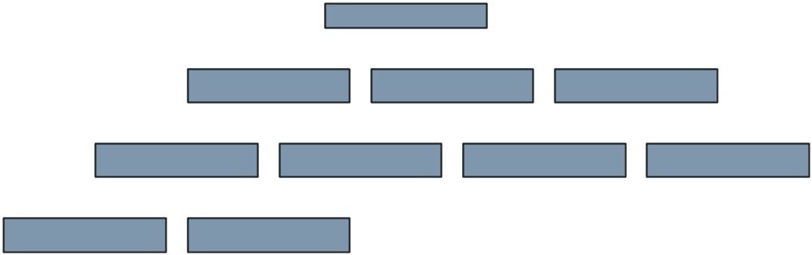
COMPLEX DECISIONS
Many levels of criteria and sub-criteria

Slide 18
SOME APPLICATIONS OF AHP
Sample Application Areas/Decisions:
  Strategic planning
  Resource allocation
  Source selection, program selection
  Business policy
  etc., etc., etc..
AHP software (e.g.: ExpertChoice™)
  Automated computations
  Performs sensitivity analysis
  Creates custom graphs, tables

Slide 19
BACKUP CHARTS…

Slide 20
SAMPLE B.E.P. DECISION PROBLEM
#21: An electronics manufacturer is considering the purchase of one of two types of laser trimming devices. The sales forecast indicates that at least 8000 units will be sold per year. Device A will increase the annual fixed costs by $20,000 and will reduce variable costs by $5.60 per unit. Device B will increase the annual fixed costs by $5000 and will reduce variable costs by $3.60 per unit. If variable costs are now $20 per unit produced, which device should be bought?

Slide 21
SAMPLE INTEREST RATE CALCULATION PROBLEM
A microprocessor based controller can be installed for $30,000 and will have a $3000 salvage value after being in service for 10 years, and is expected to decrease energy consumption by $4000 per year.
  A. What rate of return is expected if the controller is used for the full 10 years?
  B. For what life/duration will the controller give a return of 15%?

