Slide 1
SE Risk Management:
Part I
CSULA – EE 4130
Prof. Joel K. Harris
March 12, 2018

Slide 2
“Terminal Learning Objectives” For Today…
Understand the definition of a risk vs. an issue, & the implications of both
Know the 5 elements of a standard risk management process
Be able to differentiate between qualitative and quantitative risk management approaches
Appreciate the difficulties associated with schedule risks and their mitigation

Slide 3
“Risk Management 101”
A Few Risk Definitions:
  “Project risk is an uncertain event or condition that, if it occurs, has a positive or negative effect on at least one project objective, such as time, cost, scope or quality.”
  - PMI Book of Knowledge (PMBOK) (2004)
  “Risk: a measure of the uncertainty of attaining a goal, objective, or requirement pertaining to technical performance, cost and schedule.”
  - INCOSE SE Handbook, Version 3
  “Risk is a measure of the potential inability to achieve overall program objectives within defined cost, schedule, and technical constraints, and has two components: (1) the probability/likelihood of failing to achieve a particular outcome, and (2) the consequences/impacts of failing to achieve that outcome”
    - DoD Risk Management Guide, Version 3

Slide 4
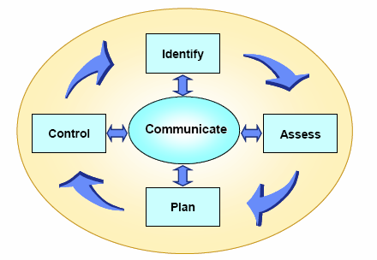
Primary Risk Management Processes
Risk Management as a process consists of 5 main elements:
    Risk Identification
    Risk Assessment/Analysis
    Risk Planning/Handling (acceptance, transfer, mitigation or avoidance)
    Risk Control (tracking)
    Communication
2 fundamental methods of risk assessment are:
    Qualitative
    Quantitative

Slide 5
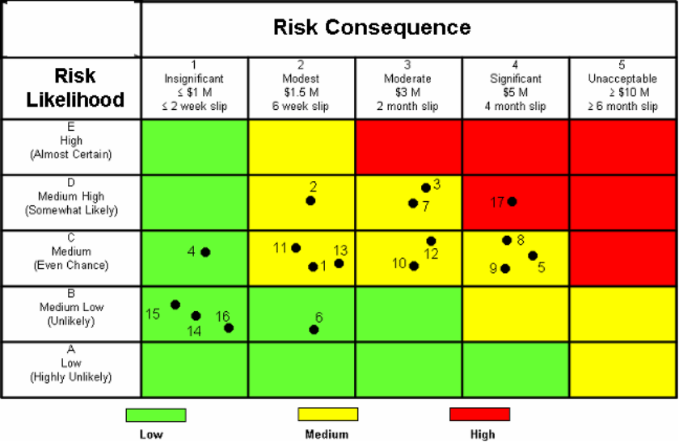
Qualitative Risk Management
The most prevalent form of risk management in use within most industries
  Why: it’s simple, intuitive and easy to learn
  Also, it leverages SME knowledge from experienced IPT members
Uses two parameters to determine a risk threat: 1) risk consequence and 2) likelihood of occurrence
Risk severity is determined by the formula:
  Risk Exposure = Consequence X L_{O} [Likelihood of Occurrence]

Slide 6
Quantitative (PRA*) Risk Management
Not used as extensively as qualitative risk management
  Why: PRA is not meant to manage or determine the status of program risks
  Instead, it is a tool of system safety and reliability engineering disciplines (a predictive tool vs. a descriptive tool)
  Quantitative RM addresses randomness/probability, but not vagueness/impreciseness
  It requires significant knowledge in statistics and/or probability theory
* Probabilistic Risk Assessment

Slide 7
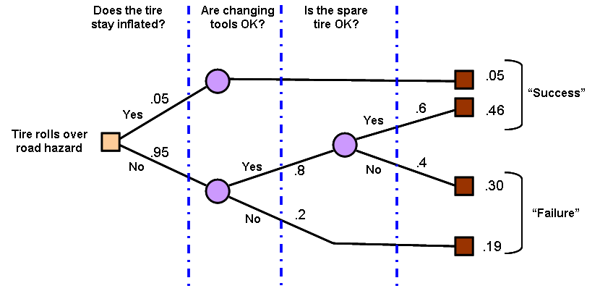
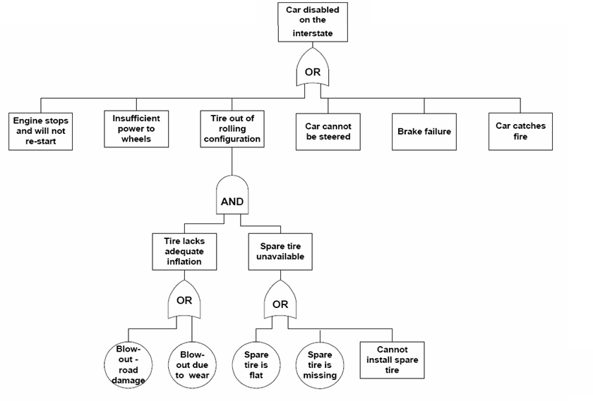
Quantitative/PRA Risk Management Tools (1 of 2)
Decision Tree Analysis
Fault Tree Analysis

Slide 8
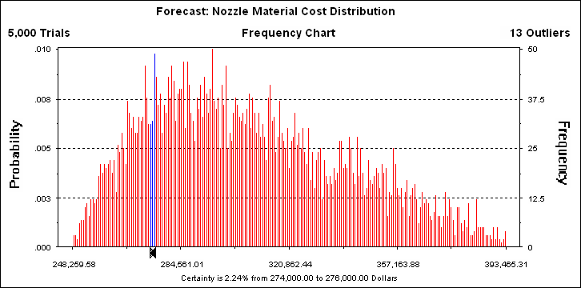
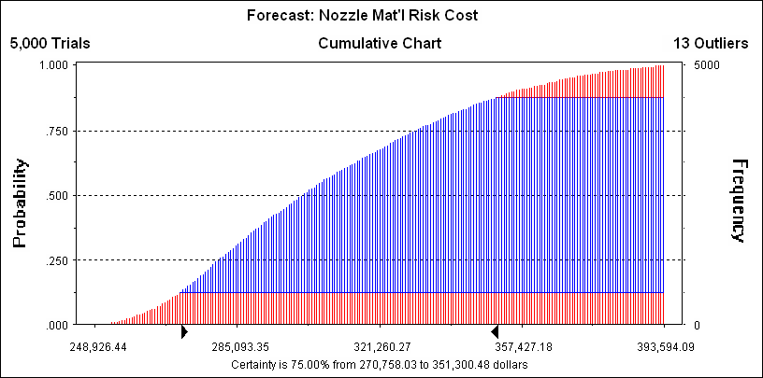
Quantitative/PRA Risk Management Tools (2 of 2)
The primarily quantitative method used in program risk management is the Monte Carlo method (MCM) - developed during the Manhattan Project by John von Neumann
MCM predicts a range of outcomes/scenarios using a random number algorithm to produce a Gaussian/normal distribution/cumulative distribution function, indicating the probability of event outcomes

Slide 9
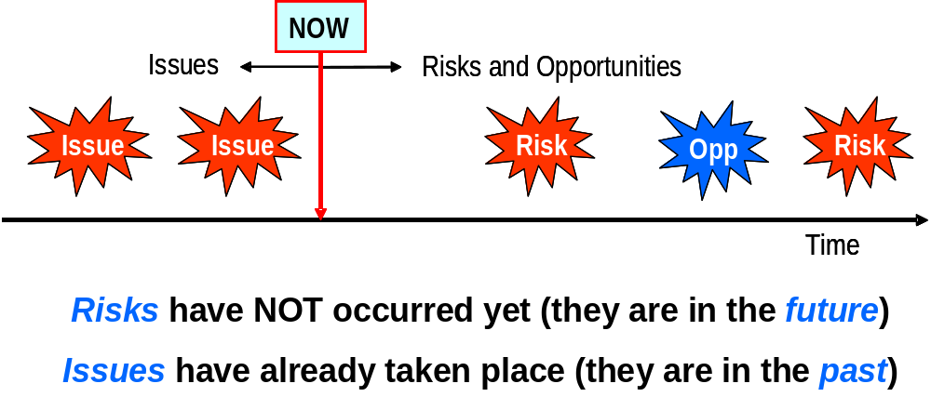
How Risks and Issues Differ
Source: S. Carman - NGST

Slide 10
Risk Management Steps - ∅ One:
Risk Identification
Important points to keep in mind:
  Anyone can identify, propose and contribute a new risk candidate within the risk process
  Risks are not solely technical in character (process, schedule, resource, and capability are valid risk sources)
  All risks progress through discrete stages within the risk process:
    Candidate risk
    “In Process” risk
    Baselined/Active risk (also inactive/watch list risk)
    Closed/mitigated risk

Slide 11
Risk Management Steps - ∅ Two:
Risk Assessment (1 of 2)
The intent of risk assessment is to answer the question: “How significant is this risk?”
There are two parameters we assess each risk item upon:
  Likelihood or probability of the risk occurring
  Impact or consequence(s) suffered, if the risk should be realized
Examples of risk likelihood and impact criteria:
  A typical risk Likelihood scale:
    Frequent - > 1 in 10; Continuously experienced
    Probable - 1 in 10 to 1 in 100; Occurs frequently
    Occasional - 1 in 100 to 1 in 1000; Occurs several times
    Remote - 1 in 1000 to 1 in 1000000; Unlikely, but
    could reasonably be expected to occur
    Improbable - < 1 in 1000000; Unlikely to occur, but
    possible
Source: Mil-Std-882

Slide 12
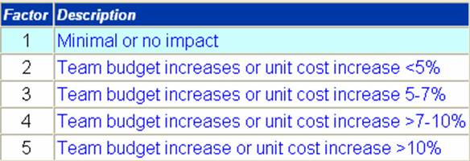
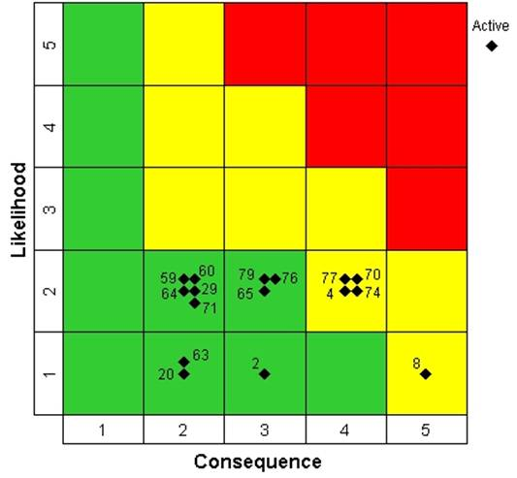
Risk Management Steps - ∅ Two:
Risk Assessment (2 of 2)
Sample risk consequence scale:
Risk Threat Levels
  Red – High Risk (capable of major project disruption)
  Yellow – Moderate Risk (some disruption possible)
  Green – Low Risk (minimum disruption)
Risk Probability Impact Diagram (PID)

Slide 13
Risk Management Steps - ∅ Three:
Risk Handling/Planning (1 of 2)
There are four (4) fundamental risk handling approaches:
  Acceptance – accept the risk and its attendant consequences as part of “doing business”/the project
  Avoidance – change the requirement, alter the design, do something to cause the risk to essentially “go away”
  Transfer – move the risk item to either another discipline area, or another owner/team (note: this does NOT mean simply refusing to accept the risk or “throwing it over the fence”)
  Mitigation – applying program resources (time, $$$, heads) to lessen either/both the potential risk likelihood or impact

