Slide 1
EE 4130 Systems Engineering: Functional Flow Diagrams
Prof. Joel Harris
12 February 2018
CSULA – ECST Department

Slide 2
Concept of Operations (CONOPS) – DoDAF OV-1

Slide 3
DOTMLPF stands for:
– Doctrine: the way we fight, e.g., emphasizing maneuver warfare combined air-ground campaigns
– Organization: how we organize to fight; divisions, air wings, Marine-Air Ground Task Forces (MAGTFs), etc.
– Training: how we prepare to fight tactically; basic training to advanced individual training, various types of unit training, joint exercises, etc.
– Materiel: all the “stuff” necessary to equip our forces, that is, weapons, spares, etc. so they can do operate effectively
– Leadership and education: how we prepare our leaders to lead the fight from squad leader to 4-star general/admiral; professional development
– Personnel: availability of qualified people for peacetime, wartime, and various contingency operations
– Facilities: real property; installations and industrial facilities (e.g. government owned ammunition production facilities) that support our forces
3

Slide 4
Functional Requirements
Top Level Requirements ⇒ Functional Requirements
Functional requirements are the basis for requirements management
Functional requirements = the “what” of the system…
Functional architecture is organic/living and it ⇑ in complexity/detail as requirements decomposition progresses.

Slide 5
The FFBD Schema
Functional requirements are best captured through the use of a FFBD, or Functional Flow Block Diagram
The FFBD is a time-sequenced description of both operational and support sequences for a process or system development
Organized by their “order of execution”

Slide 6
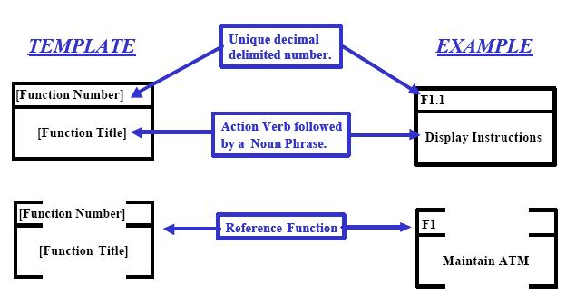
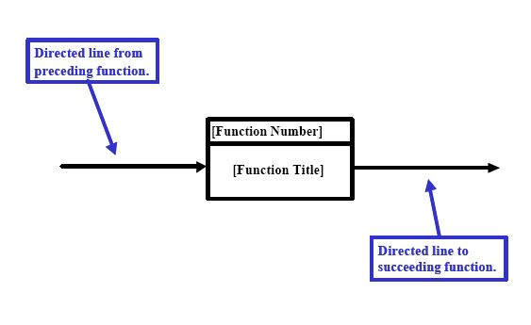
FFBD Architecture

Slide 7
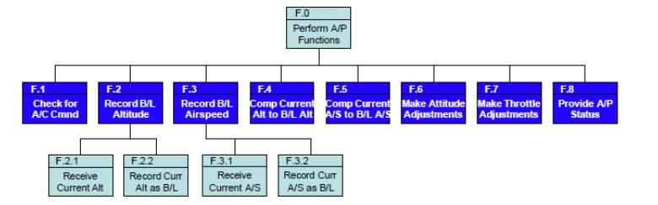
A Sample FFBD Hierarchy

Slide 8
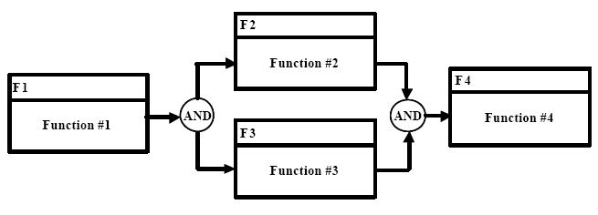
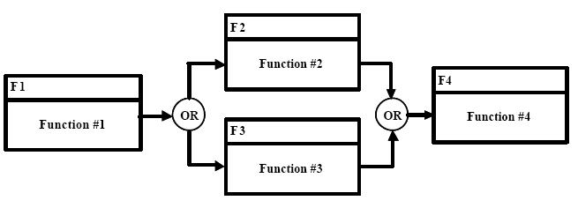
FFBDs Utilize Boolean Logic

Slide 9
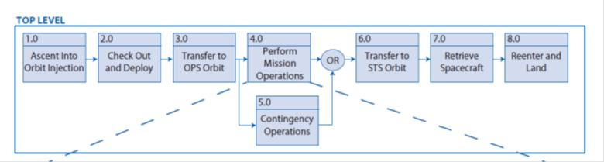
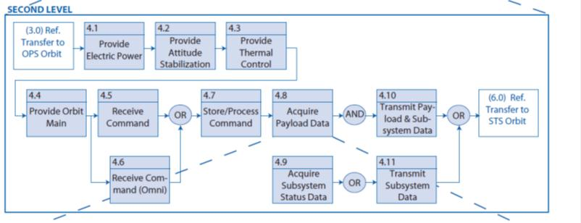
Example: Spacecraft FFBD

Slide 10
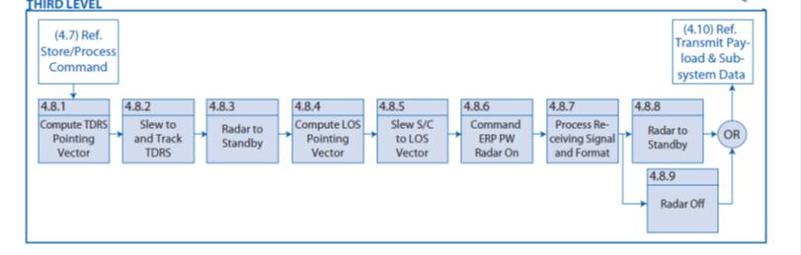
Spacecraft FFBD (cont’d)
• • •

Slide 11
Process Mapping of FFBD Elements

Slide 12
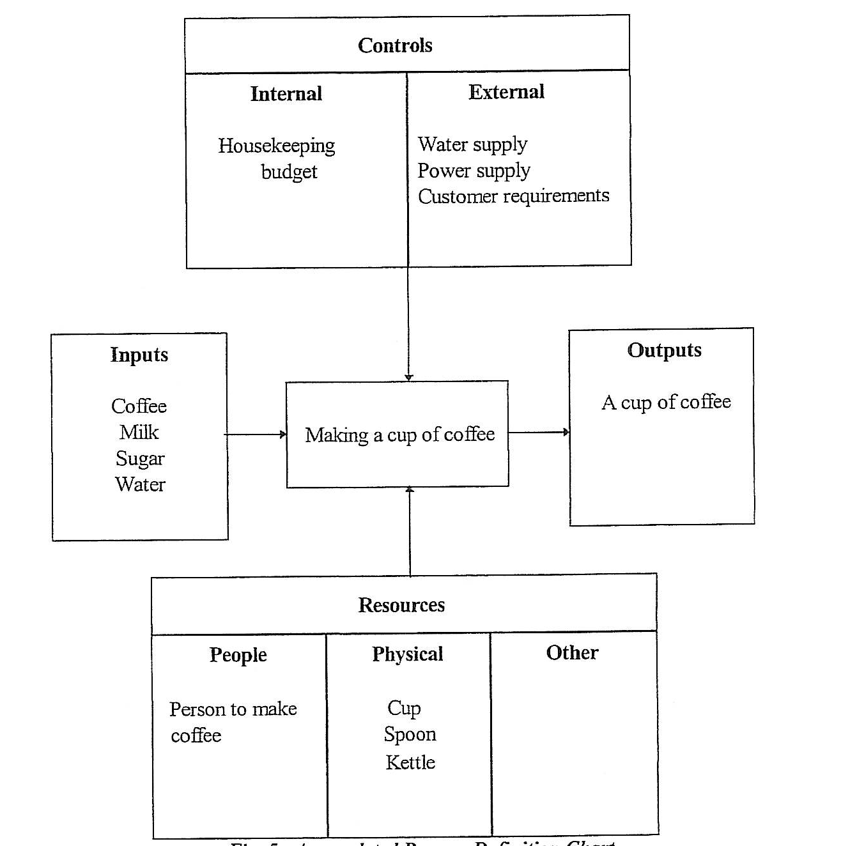
A Sample Process Map: Making Coffee

Slide 13
Benefits/Application of FFBDs
Identify potential trade study Areas of Opportunity (AOOs)
Used to develop, analyze, and flow down requirements to lower levels
Provides a better picture of how the system under development is intended to function/work
Identifies possible areas for operational simplification within the overall system

