Slide 1
EE 4130 Systems Engineering: System Specifications
Prof Joel Harris
21 February 2018
CSULA – ECST Department

Slide 2
Typical specification Tree/Hierarchy

Slide 3
Key specification terms
Hierarchy – the order of precedence or importance of each specification in the entire compliment of specification documents --- usually in a “tree” format
Flow Down – the act of distributing requirements from higher precedence documents to lower level ones, resulting in greater requirement detail/granularity
Traceability – the ability to follow the interconnections between requirements both within a particular specification, and other specifications either higher or lower in precedence.
Configuration Management – the process of maintaining accurate records and current versions of all of a program’s specifications, drawings, and key documentation.

Slide 4
Standard Specification Format
Section 1.0
Introduction, purpose, scope of the specification
Section 2.0
Applicable documents, standards, reference documents
Section 3.0
Specification requirements
Section 4.0
Verification of requirements
Section 5.0
Packaging/Notes, etc.

Slide 5
Example of System Specification Requirement

Slide 6
System Specification Example (cont’d)

Slide 7
Example of a development Specification

Slide 8
Product specification Example

Slide 9
Process Specification Example
Product Manager
The Product Manager will be responsible for communicating with Dr. Lawrence Chung and the TA for any questions that the that Team Obiwan has. The Product Manager is also responsible for drafting the initial requirements, verifying that the customer’s requirements are met, and researching existing products for each team meeting.
Project Manager
The Project Manager will lead the project’s development and testing. They will elaborate on the initial requirements set by the Product Manager and verify that all of the requirements that were given by the Product Manger are met in the code.
Requirements Engineer
The Requirements Engineer will be responsible for assisting the Project Manager in elaborating on requirements and dependencies.
Developer
The Developer will be responsible for assisting the Project Manager in elaborating on requirements and will be responsible for the creation of prototypes.

Slide 10
Example of applicable document citations
Section 2.0 – Applicable Documents
MIL-DTL-15090D 6 - November 1996
Detail Specification, Enamel, Equipment, Light Gray, (Navy Formula No. 111), Department of Defense
MIL-STD-1399-300A Notice 1 -11 March 1992
Military Standard, Interface Standard for Shipboard Systems, Section 300A, Electric Power, Alternating Current, Department of Defense
MIL-STD-1472F Notice 1 - 5 December, 2003
Department of Defense Design Criteria Standard, Human Engineering, Department of Defense

Slide 11
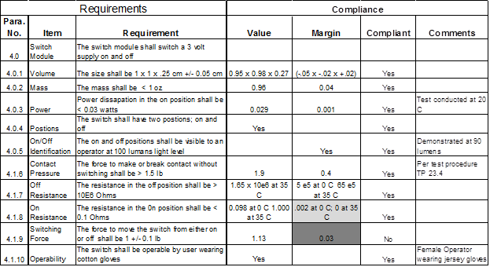
Sample Verification Cross Reference Matrix

