Slide 1
EE 4130 Systems Engineering: “verification and Validation”
Prof. Joel Harris
March 7, 2018
Source: NASA/Saylor Foundation Space Systems Engineering MOOC © 2014

Slide 2
Module Purpose: System Verification
To define verification and validation for requirements and systems.
To distinguish between verification and validation.
To place verification planning and verification in context with the system development lifecycle and the Vee systems engineering model.
To describe and provide examples of a verification matrix.
To describe the four most common verification methods - test, demonstration, analysis and inspection.
To describe typical environmental tests.
To provide examples of the consequences of poor verification.

Slide 3
What Are Validation and Verification ?
Validation is a process of confirming that a set of requirements, design, or system meets the intent of the developer or customer.
Verification is a process of confirming that a requirement or system is compliant.
In other words, system validation asks the question: Does the system meet its requirements?
Requirements verification asks the question: Does the system indeed meet this particular requirement?

Slide 4
Reviews Precede Each Key Decision Point
FORMULATION
IMPLEMENTATION
Pre-A
A
B
C
D
E
F
Project
Phases
Concept
Studies
Concept &
Technology
Development
Preliminary
Design &
Technology Completion
Final
Design &
Fabrication
System Assembly
and Test
Operations &
Sustainment
Closeout
De-commision
Key Decision Points
A
B
C
D
E
F
Concept Review
Systems Requirements Review
Major Reviews
System Definition Review
Preliminary Design Review
Critical Design Review
Independent Cost
Estimates
Systems Integration Review
Operational Readiness Review
Readiness Review
Assessment Review
Decommissioning Review
Notes:
Key Definitions
Formulation: The first part of the NASA management life cycle where system requirements are baselined, feasible concepts are determined, a system definition is baselined for the selected concept(s), and preparation is made for progressing to the Implementation Phase.
Implementation: The part of the NASA management life cycle the detailed design of system products is completed and the products to be deployed are fabricated, assembled, integrated and tested; and the products are deployed to their customers or users for their assigned use or mission.

Slide 5
More on Requirements Validation
Requirement(s) Validation is the process of confirming the completeness and correctness of the requirements.
Requirement(s) Validation answers the question: “ Are the system design requirements correctly defined, and mean what we intended?”
Requirements Validation tends to be oriented toward analysis.
When does requirements validation take place?
Before design and during detailed design, i.e., mostly in Phase B and tapering down in Phase C
Ideally, completed prior to System Requirements Review (SRR)
What is the importance of getting requirements validation right early in the project life cycle?
So when it comes time to verify the system, you are verifying to the right requirements.
Changing requirements late in the game - verification occurs in Phase D - has highly negative impacts to cost and schedule.
Notes:
More validation definitions:
From SMC Systems Engineering Primer and Handbook:
(Design) Validation is the function of ensuring that the design developed for the system will result in a system that meets the operational needs of the customer. This is done before the system is built and then verified. Design is validated against the needs and the system is verified against the design.
From GSFC Green book:
(Requirement) Validation - The process used to ensure that the requirement is justifiable, applicable, traceable, and effective. This can be accomplished by tracing the requirement back to the objectives. The requirement must be proven to be linked to the objectives and make a contribution toward their successful accomplishment.
From the Goddard Systems Engineering Handbook page 16
During the design phases performance predictions, trade studies, analyses are used to validate that the chosen design meets the requirements, when utilized according to the Operations Concept.
(Requirement) Validation also establishes requirements tracing to ensure that the higher level requirements flow to a lower level or child requirement. Requirements validation also makes sure that the lower level requirements have a parent requirement. Orphan requirements, ones without a higher level parent, are evaluated to determine if they are needed.
a. Requirements shall be validated to assure that the system will meet the Mission Objectives, be capable of performing the Measurement Concept, accommodate the Instrument Concept, and operates as defined in the Operations Concept.
b. Each project shall decide on the mechanism for tracking the requirements and who is responsible for the requirements flow and verification.

Slide 6
More on System Validation & System Verification
Validating a system: “Building the right system”: making sure that the system does what it is supposed to do in its intended environment. Validation determines the correctness and completeness of the end product, and ensures that the system will satisfy the actual needs of the stakeholders.
Verifying a system: “Building the system right”: ensuring that the system complies with the system requirements and conforms to its design.
Notes:
Source: Requirements Development, Verification, and Validation Exhibited in Famous Failures; Terry Bahill and Steven J. Henderson; Systems Engineering, Vol. 8, No. 1, 2005
Alternative definition from GSFC Green book:
(Design) Verification - The process of evaluating the design—including hardware and software— to ensure the requirements have, in fact, been met. This is accomplished by analysis, test, inspection, and/or demonstration.

Slide 7
Focus : Requirements Verification
Requirements verification is done in Phase D - as an integral part of integration. In fact the right leg of the “Vee” diagram is called ‘Integration and Verification’ (see following slide).
A preliminary plan for how a requirement will be verified is created when the requirement is generated. This is the preliminary verification matrix.
Verification requirements and plans are established with the completion of a critical design review (CDR).
Notes:
See NPR 7123.1a Appendix G.8 success criteria for CDRs.

Slide 8
Verification is Intertwined with the Integration of Components and Subsystems
Mission
Requirements
& Priorities
System
Demonstration
& Validation
Develop System
Requirements &
System Architecture
Integrate System &
Verify
Performance Specs
Allocate Performance
Specs & Build
Verification Plan
Component
Integration &
Verification
Design
Components
Verify
Component
Performance
Integration &
Verification Sequence
Decomposition &
Definition Sequence
Fabricate, Assemble,
Code &
Procure Parts
Time and Project Maturity

Slide 9
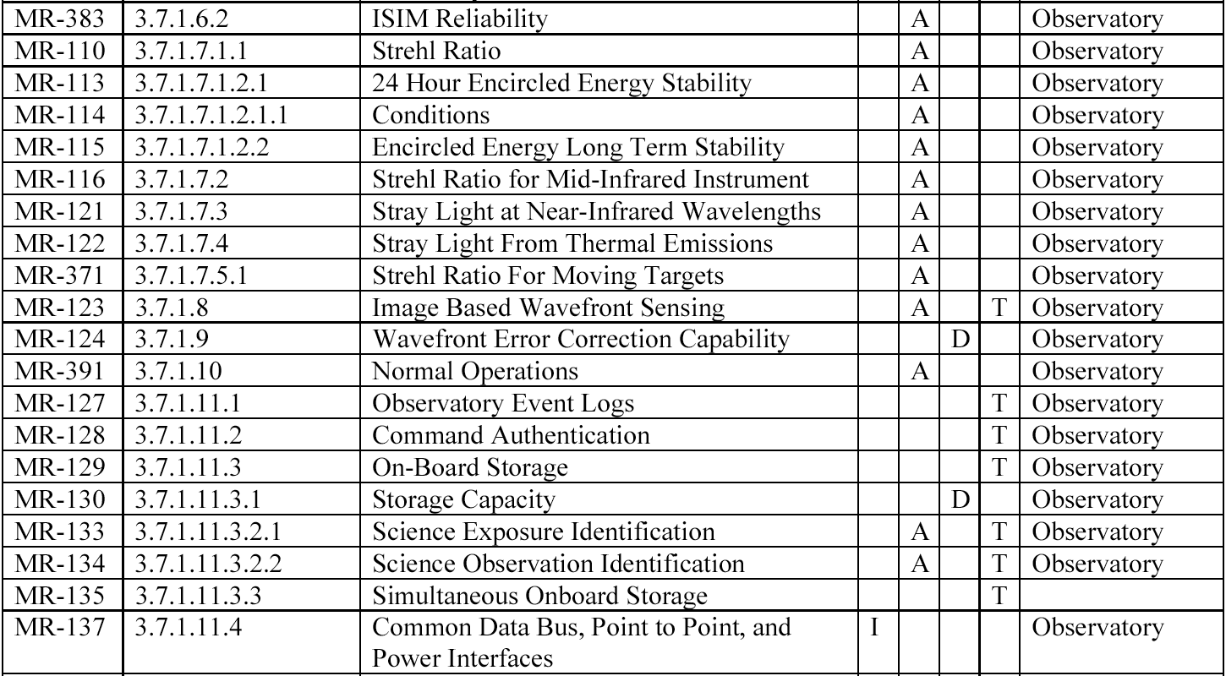
A Preliminary Verification Matrix
This verification matrix is useful -- since it identifies the requirement, the technique that will be used (inspection, analysis, demonstration or test) to verify it and the organization responsible for verification.
Notes:
James Webb Space Telescope Project Mission Requirements Document; JWST-RQMT-000634; Revision P; October 17, 2007; NASA GSFC; Table 4-1
ISIM - Integrated Science Instruments Module
MSE - Mission Systems Engineering
MR - Mission Requirement

Slide 10
Verification Matrix Contents
The verification matrix specifies:
The Requirement Statement
Example: “Vehicle first-mode natural frequency shall be greater than 35 Hz.”
Any associated verification requirement, including “success criteria”
Example: “The vehicle first-mode natural frequency shall be verified by test. The test shall conduct a modal survey of the vehicle using a vibration table. The test shall be considered successful if the measured first-mode is greater than 35 Hz.”
Method of verification: Inspection, Analysis, Demonstration, Test
Example: test
The results of the verification as they become available.
Notes:
See also NASA Systems Engineering Handbook; 2007; Appendix D
Verification requirements define the method and establish the criteria for providing evidence that the system complies with the requirements imposed on it.
One technique for writing a verification requirement statement includes three parts, of which the first and third parts are common to all and the second expands depending upon the verification method(s). These three parts include:
1. The method of verification (inspection, analysis, test or demonstration) being used to assess the function/quality.
2. A description of the verification work to be performed.
a. For an inspection, the specific item to be reviewed and for what quality;
b. For an analysis, the specific source of data required and description of the analysis;
c. For a demonstration, the specific action to be demonstrated;
d. For a test, the very top level test requirements.
3. The success criteria that determines when the verification is complete.
Writing a verification requirement starts by reviewing the originating requirement and trying to concisely state what is being verified. If this can’t be done, the original requirement may not be valid as described above and may need to be re-negotiated or rewritten! It is important at this point not too try to converge too quickly on the verification method(s) to be used. Simply writing the description and success criteria will help to define the most reasonable method(s).

Slide 11
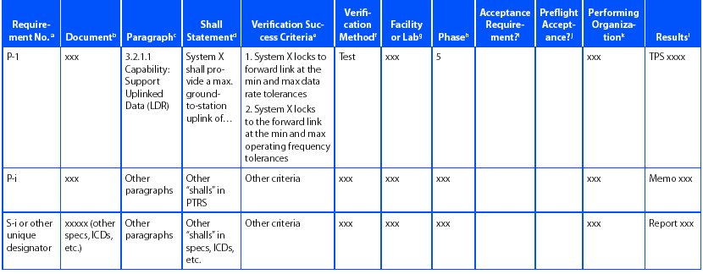
Example: Verification Matrix
Notes:
From NASA Systems Engineering Handbook; 2007.

Slide 12
The Verification Plan
System engineers develop a verification plan when writing the verification requirements.
Importance:
To document a project’s approach to executing verification, including people, schedule, equipment, and facilities.
To ensure not breaking irreplaceable test units or endangering any of the staff.
The verification plan includes system qualification verification, as well site verification, operational verification, and post-operational/disposal verification.
Any needed support equipment is specified in the verification plan
Notes:
Note: Example outline for verification plan: Appendix I, p. 301, NASA Systems Engineering Handbook, 2007.
Need to provide examples for different types of support equipment; to list here in the notes.
Transportation equipment example: super-guppy to transport ISS modules from MSFC to KSC
Ground support equipment example: from the pool at JSC for EVA sims and tests to a bench for mounting flight hw in a test chamber to the HST full scale mock-up for testing form and fit of new instruments.
Flight support equipment example: TBD
Should we mention need for new or upgraded facilities, such as the case with JWST and the thermal vacuum chamber needs.

Slide 13
The Methods of Verification
There are 4 fundamental methods for verifying a requirement:
Inspection
Analysis
Demonstration
Test
Often joked that the top three verification methods are “test, test, and test” - to emphasize the importance of objective, measurable data in verifying a requirement.
Alternatively it is joked that one test is worth a thousand expert opinions - for equal emphasis.

Slide 14
Inspection
Inspections determine conformance to requirements by the visual examination of drawings, data, or the item itself using standard quality control methods, without the use of special laboratory procedures or equipment.
Inspections include a visual check or review of project documentation such as, drawings, vendor specifications, software version descriptions, computer program code, etc.
Inspection includes examining a direct physical attribute such as dimensions, weight, physical characteristics, color or markings, etc.

Slide 15
Analysis
Analysis is the evaluation of data by generally accepted analytical techniques to determine that the item will meet specified requirements.
Analysis techniques: systems engineering analysis, statistics, and qualitative analysis, analog modeling, similarity, and computer and hardware simulation.
Analysis is selected as the verification activity when test or demonstration techniques cannot adequately or cost-effectively address all the conditions under which the system must perform or the system cannot be shown to meet the requirement without analysis.
Notes:
Is verification by similarity an analytic technique? At least this is confusing with the verification technique of ‘similarity’.
Additional information on verification by similarity from Larson Book: Verification by similarity is the process of analyzing the system/item requirements for hardware configuration and application to determine if it is similar or identical in design, manufacturing process, and quality control to an existing system/item that has previously been qualified to equivalent or more stringent requirements. Special effort will be made to avoid duplication of previous tests from this or similar programs. If the previous application is considered to be similar, but not equal or greater in severity, additional qualification tests shall concentrate on the areas of new or increased system/item requirements.
Additional notes regarding analysis from SMC SE Primer:
Analysis may also include assessing the results of lower level qualifications activity. While it is not expected or required that all conditions under which a requirement must be satisfied will be “tested” or “demonstrated” – analysis is expected to show, in those cases, that the limited set of conditions under which the requirement is tested or demonstrated are sufficient to ensure that the requirement is met under all conditions. Verification of the requirement thus requires both analysis and test results to “close” the requirement

Slide 16
Demonstration
Demonstration determines conformance to system/item requirements through the operation, adjustment, or reconfiguration of a test article.
Demonstration generally verifies system characteristics such as human engineering features, services, access features, and transportability.
Demonstration relies on observing and recording functional operation not requiring the use of elaborate instrumentation, special test equipment, or quantitative evaluation of data.

Slide 17
Test (1 of 2)
Test is a verification method in which technical means, such as the use of special equipment, instrumentation, simulation techniques, or the application of established principles and procedures, are used for the evaluation of the system or system components to determine compliance with requirements.
Test consists of operation of all or part of the system under a limited set of controlled conditions to determine that quantitative design or performance requirements have been met.
Tests may rely on the use of elaborate instrumentation and special test equipment to measure the parameter(s) that characterize the requirement.
The analysis of data derived from tests is an integral part of the test program and should not be confused with “analysis” as defined earlier.

Slide 18
Test (2 of 2)
Testing is the preferred method of requirement verification and used when:
Analytical techniques do not produce adequate results,
Failure modes exist which could compromise personnel safety, adversely affect overall systems or system operation, or result in a loss of system objectives, or
For any components directly associated with critical system interfaces.

Slide 19
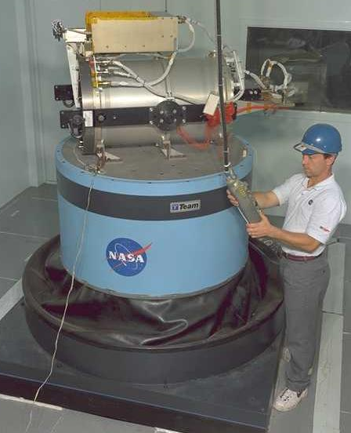
Establishing Confidence With Environmental Test
Verification is about establishing confidence that the system will perform in space.
Ex: because of the unique environment of space and the unique way of getting there, space systems go through rigorous ground-based tests that simulate the launch and space environments.
GSFC 6 degree of freedom shaker

Slide 20
Typical Environmental Test Sequence
Inspection (required before and after each event as appropriate)
Functional test (required before and after each event as appropriate)
Pressure/leakage (repeat after vibration/acoustic and modal survey)
Electro-magnetic compatibility (EMC) and susceptibility
Mass properties - center of gravity/moment of inertia
Fit check
Modal survey (repeat after each level of shock, random vibration and/or static load test)
Shock
Static load test
Acoustic and random vibration test
Separation test
Thermal cycling
Thermal Vacuum

Slide 21
Testing “Lessons Learned”: Mars Polar Lander (MPL) Mission
Why we test => some examples…
Mars Polar Lander Failure
Most Probable Failure Cause – the lander engines prematurely shut down; the lander crashed into Mars’ surface.
The Touchdown Sensing System was vulnerable to spurious signals generated at leg deployment, causing premature engine shutdown.
Mars Polar Lander test program flaw
Touchdown Sensors wiring error in system test
System test was not repeated with new wiring correction
Software design did not include detection/protection for spurious signals.
Lesson Learned: “Test like you operate, operate like you test.”
Notes:
Source:
spaceflight.nasa.gov/spacenews/ releases/2000/mpl/mpl_report_1.pdf

Slide 22
Summary: Verification/Validation
Validation - Did we build the right system?
Verification - Did we built the system right?
Requirements validation - Are the requirements complete, consistent, SMART and do they capture the intent of the system?
Requirements verification is about establishing confidence that the system will perform in its intended environment.
Requirements are verified by test, demonstration, analysis and inspection.
Space systems go through rigorous ground-based tests that simulate the launch and space environment.
Using heritage designs can save development time and money, but they should be validated and verified as if they represented new hardware.
Simple procedural errors - like borrowing another project’s bolts - can lead to multi-million dollar (or life threatening) accidents.

Slide 23
Verification and Validation Definitions
Verifying requirements:
Proving that each requirement has been satisfied. Verification can be done by logical argument, inspection, modeling, simulation, analysis, expert review, test or demonstration. The primary methods, and those that we will discuss are test, demonstration, analysis and inspection.
Validating requirements – Means ensuring that:
the set of requirements is correct, complete, and consistent,
a model can be created that satisfies the requirements, and
a real-world solution can be built and tested to prove that it satisfies the requirements.
Verifying a system: Building the system right: ensuring that the system complies with the system requirements and conforms to its design.
Validating a system: Building the right system: making sure that the system does what it is supposed to do in its intended environment. Validation determines the correctness and completeness of the end product, and ensures that the system will satisfy the actual needs of the stakeholders.
Notes:
Source of definitions: Requirements Development, Verification, and Validation Exhibited in Famous Failures; Terry Bahill and Steven J. Henderson; Systems Engineering, Vol. 8, No. 1, 2005

Slide 24
Backup charts

Slide 25
“The New Horizons Mission”
….And now for some [relatively] “current event” news/sharing…

Slide 26
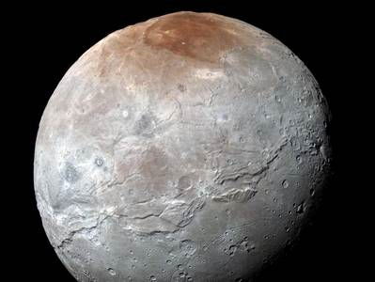
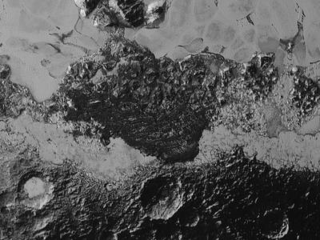
Pluto: the “dwarf” planet
© 2015 – NASA/GSFC

Slide 27
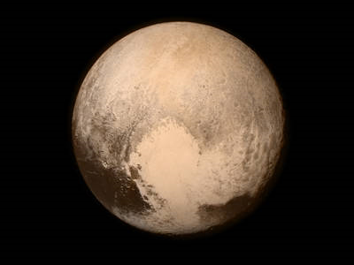
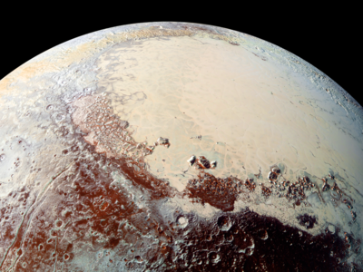
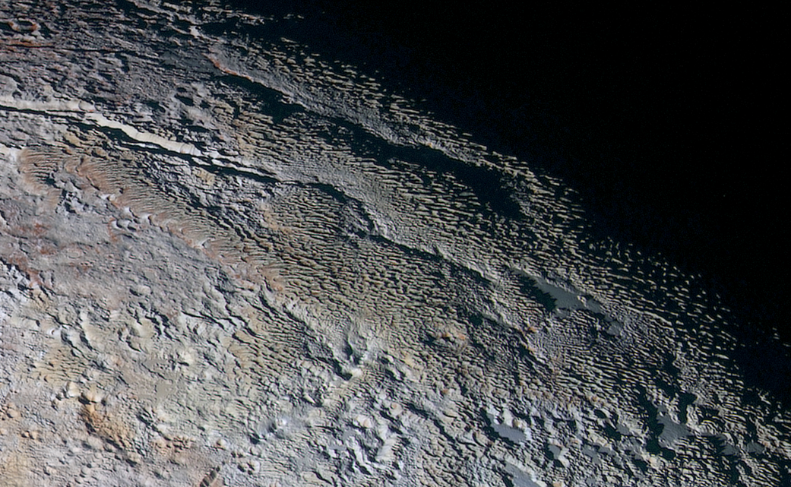
More Pluto images…
© 2015 – NASA/GSFC

Slide 28
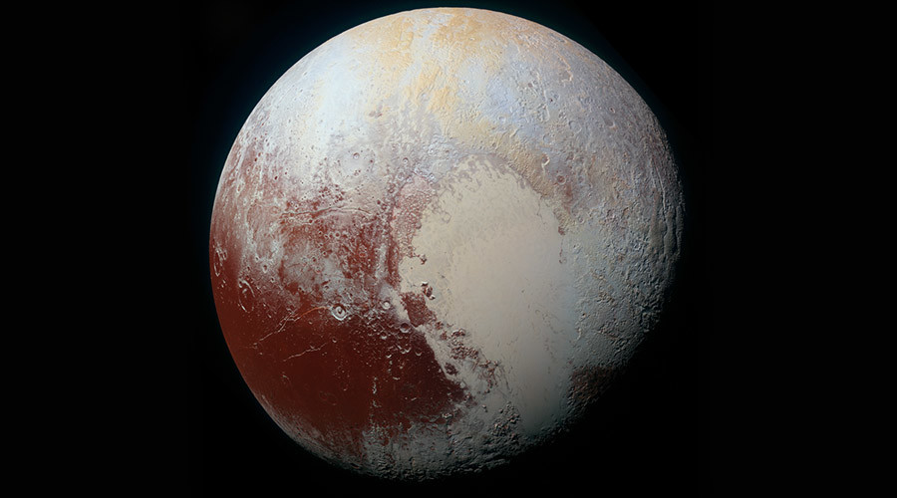
Pluto’s largest satellite – charon
© 2015 – NASA/GSFC

