Slide 1
Brain MRI Segmentation using CNNs
CS736: Course Project
Jay Sawant - 18D070050
Shreshtha Singh - 18D070029
Ruchir Chheda - 18D100016
Guide: Prof. Suyash Awate
Indian Institute of Technology, Bombay
April 28, 2022
Course Project presentation
‹#› / 15

Slide 2
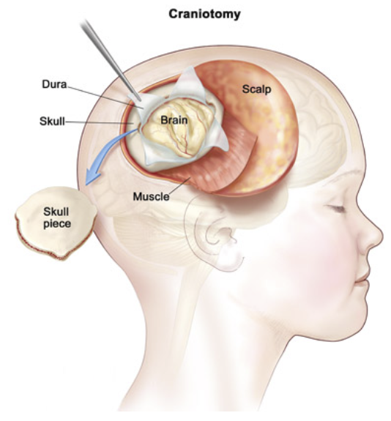
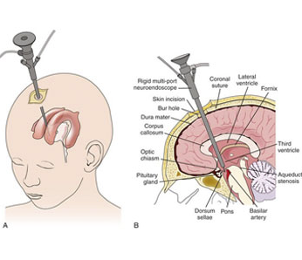
Introduction
Brain tumor segmentation is widely used for applications:-
Surgical planning and simulation
Treatment planning for radiation therapy
Therapy evaluation
Image Neurosurgery
https://www.parashospitals.com/press-releases/paras-hospitals-gurgaon-uses-the-neuronavigation-technique-to-remove-brain-tumor-from-7-year-old-kashmiri-girl
https://www.goutamneurocare.com/neuro-endoscopy-treatment-hyderabad.html
Course Project presentation
2 / 15

Slide 3
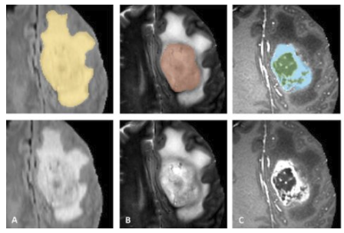
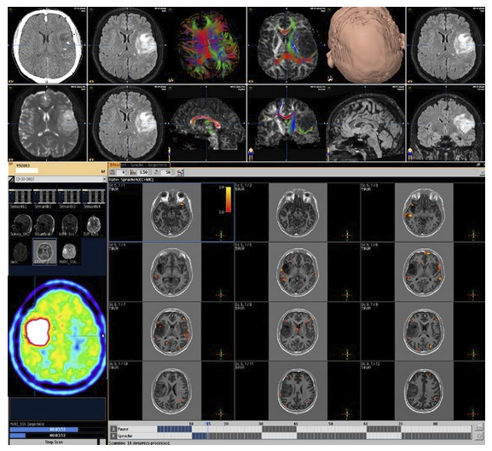
Introduction
Challenges in this domain:-
Manual labelling is a highly skill intensive and laborious task.
The diagnosis is qualitative so accurate, quantitative thresholds are not determined.
The datasets are limited because of the nature of the domain.
The datasets are diverse in terms of location, shapes and sizes.
https://healthcare-in-europe.com/en/news/challenges-in-brain-tumour-segmentation.html
https://www.ncbi.nlm.nih.gov/pmc/articles/PMC3357627/figure/fig4/
Course Project presentation
3 / 15

Slide 4
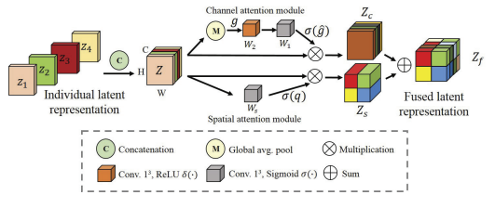
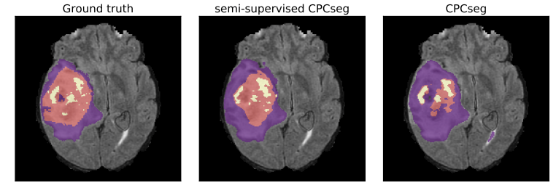
Related Works
Deep Learning based Brain Segmentation:-
Designing Effective Segmentation Network
Dealing with Imbalance Condition
Learning from Multi Modalities
Fusion of multi-modal inputs like T1C, T2-weighted, FLAIR using attention based modules.
Tongxue Zhou, Su Ruan, Yu Guo, Stephane Canu
Multi-task learning methods, to increase the learning of features for better segmentation.
Adel Kermi, Issam Mahmoudi, Mohamed Tarek Khadir
https://arxiv.org/pdf/2007.09479.pdf
https://link.springer.com/content/pdf/10.1007/978-3-030-11726-9_4.pdf
Course Project presentation
4 / 15

Slide 5
DataSet Used
We use the pre-processed version of the The Cancer Imaging Archive (TCIA) Dataset available on kaggle_3m. They correspond to 110 patients included in The Cancer Genome Atlas (TCGA) lower-grade glioma collection
Each patient has a different number of slices per volume, ranging from 20 to 88
Each slice is a 3 channeled image of size 256x256x3 and correspond to it we have a binary segmentation mask where 1’s represent the tumour area in the MRI
Total number of slices available in the dataset is 3929 and we do a train-validation split of 70% and 30% after performing a random shuffle.
Course Project presentation
5 / 15

Slide 6
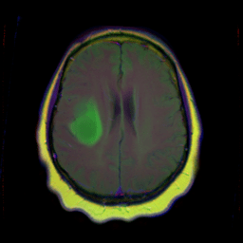
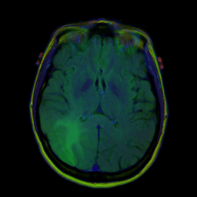
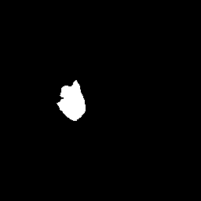
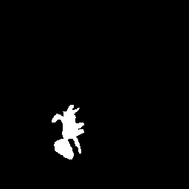
DataSet Used
Sample images and their segmentation masks/labels from the dataset:
Course Project presentation
6 / 15

Slide 7
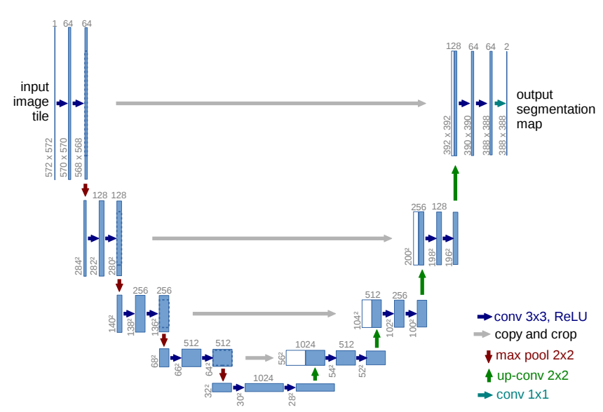
Methodology - Model Architecture
We use the popular U-Net architecture for bio-medical segmentation purpose. The following figure illustrates a U-Net Architecture:
The number of channels is denoted on top of the box
Course Project presentation
7 / 15

Slide 8
Methodology - Training Algorithm
For a batch of size 8 in training set, do
Pre-process each image by the application of percentile stretching
y_pred = U_Net_model(batch)
Dice_loss = Dice_loss(y_pred,y_true)
Calculate gradients and update parameters of the U_Net_model using Adam optimizer with lr=1e-4 and MultiStep learning rate scheduler
Keep track of training and validation losses
Repeat steps 1 to 6 for n=150 epochs
Course Project presentation
8 / 15

Slide 9
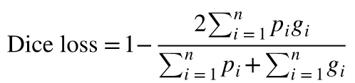

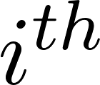
Methodology - Loss Function
For medical image segmentation, the extreme scarcity of foreground examples in an image will force the network to have a strong bias to the background. The above problem exists in the cross-entropy loss function.
Hence, Dice Loss (softer version) is proposed to balance the foreground and the background, which is formulated as follows:
Here, is the predicted probability of the pixel/voxel and
g_i is the ground truth label of the pixel/voxel in the MRI image
Course Project presentation
9 / 15

Slide 10
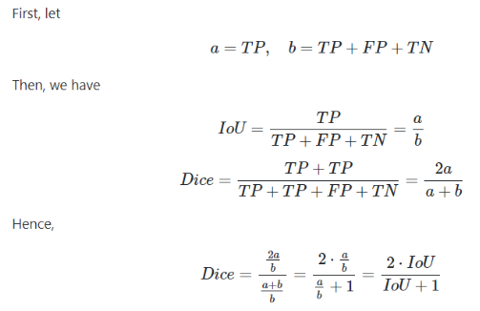
Methodology - Loss Function
Relation between Dice Loss (Harder version) and IoU:
Dice Loss = 1 - Dice = 1 - [2.IoU/(IoU+1)]
Hence, Dice Loss (hard) is monotonically decreasing function of IoU in the range [0,1]
Course Project presentation
9 / 15

Slide 11
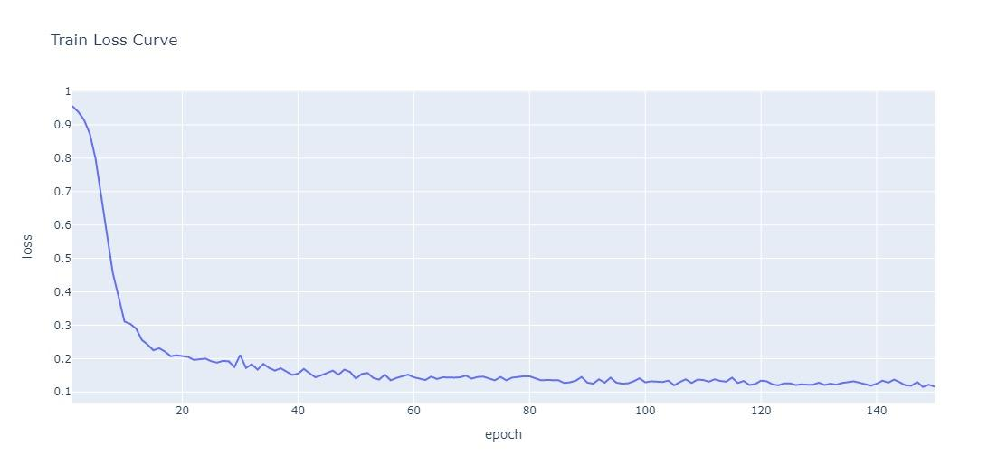
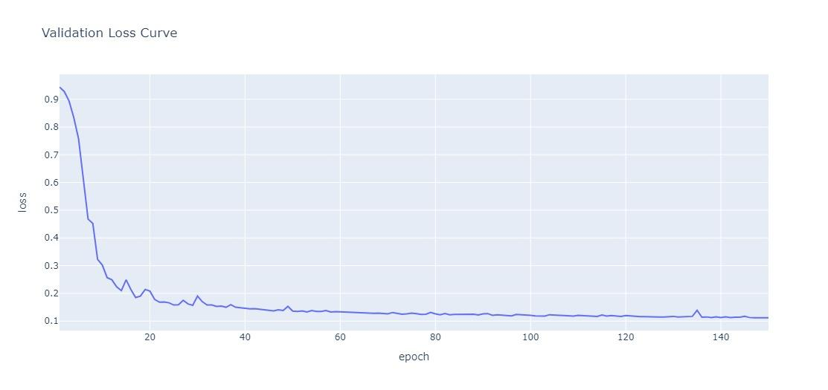
Training and Validation Loss Curves
Course Project presentation
10 / 15

Slide 12
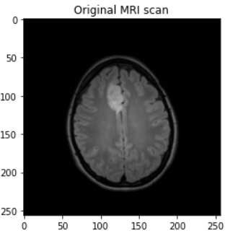
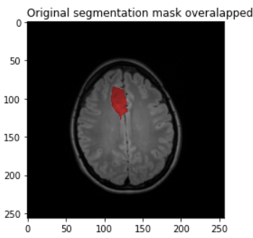
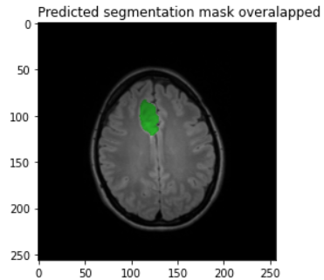
Performance Evaluation
Course Project presentation
11 / 15

Slide 13
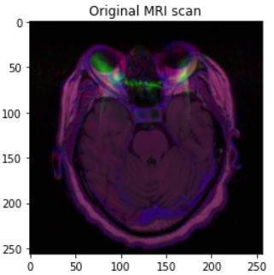
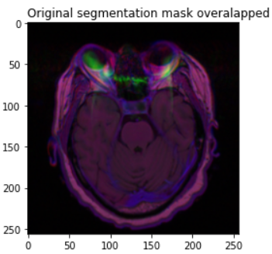
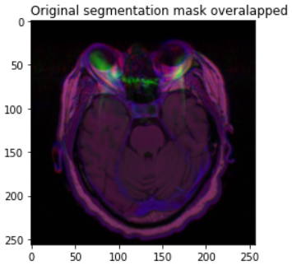
Performance Evaluation
Case where predicted and original segmentation mask don’t show any tumour labels
Course Project presentation
12 / 15

Slide 14
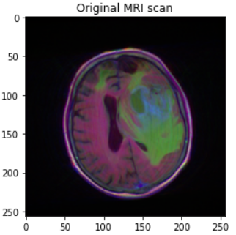
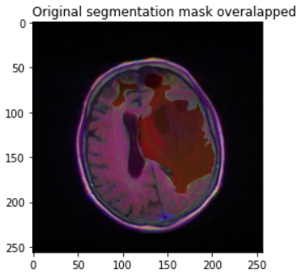
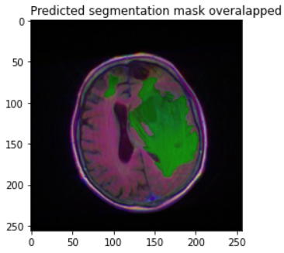
Performance Evaluation
Course Project presentation
13 / 15

Slide 15

Performance Evaluation
Accuracy of classification of tumour presence:
Course Project presentation
13 / 15

Slide 16
Conclusion
The U-net architecture achieves very good performance on biomedical segmentation applications.
Evaluating the performance of the model from classification point of view achieves a very good accuracy of about 96.7% on Validation data
From the training and validation loss curves, we conclude that we achieve a high IoU between predicted and original segmentation mask as the Dice loss is inversely proportional to the IoU.
Course Project presentation
14 / 15

Slide 17
References
[1] [Ronneberger, Fischer, & Brox, 2015] "U-net: Convolutional networks for biomedical image segmentation". International Conference on Medical image computing and computer-assisted intervention.
[2] [Milletari, Navab, & Ahmadi, 2016] "V-net: Fully convolutional neural networks for volumetric medical image segmentation". International Conference on 3D Vision.
Course Project presentation
15 / 15

