Slide 1

Selenium IDE
FFN
Presentby Jay

Slide 2
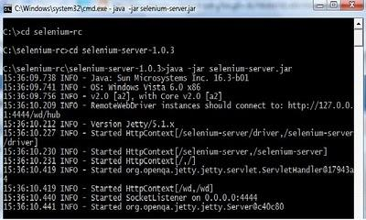



What is selenium?
Selenium RC
Selenium IDE
WebDriver

Slide 3
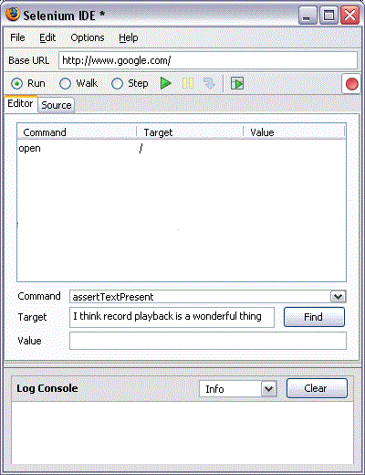
Selenium IDE
Firefox plugin
UI design

Slide 4




Advantage
Simple
Automatic
Format conversion
Extension

Slide 5
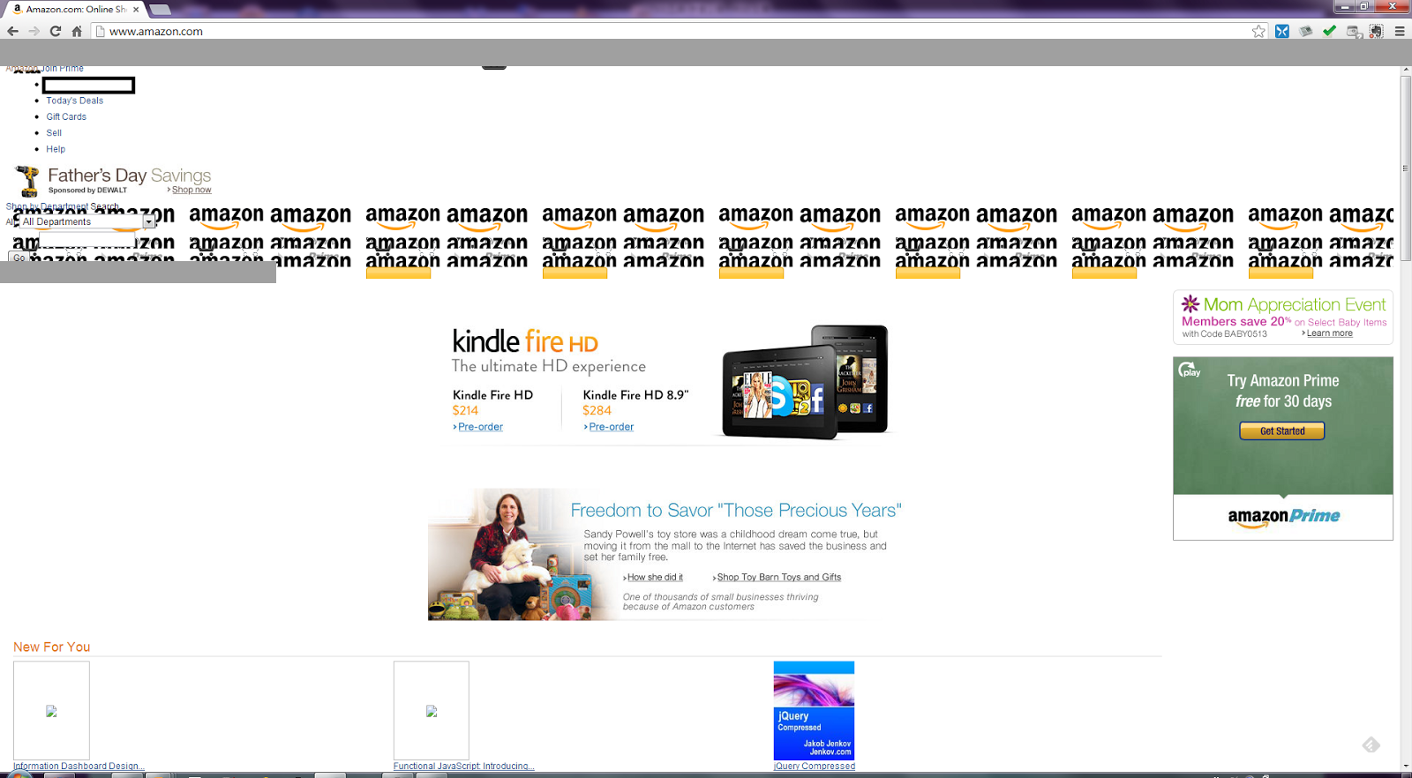
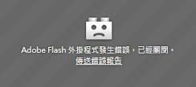
Disadvantage
Deviation
Flash
Location : \n
Fluency
Command detect
(alert or confirm)

Slide 6



Solution
Command : capture
Flash…………….give up
block letter
Run alone
experience

Slide 7
Only firefox ?

Slide 8
How to install? (using python)
1. Install Python 2.7
2. Install Selenium 2.44
3. Install Pip
4. Choose browser
5. Copy and paste codes
Enjoy and finish ! !

Slide 9


Slide 10
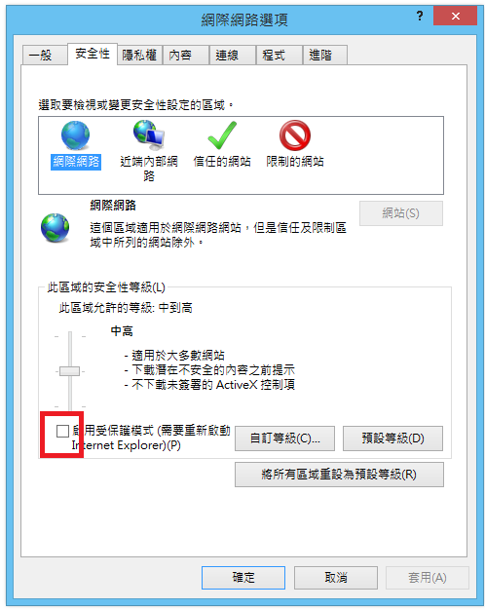
IE 7 ~ IE 10
IE 11
regedit

Slide 11
Data Source
http://www.seleniumhq.org/projects/ide/
https://www.mozilla.org/en-US/mobile/35.0beta/releasenotes/
http://jagayoung.blogspot.tw/2013_05_01_archive.html
http://vovo2000.com/phpbb2/viewtopic-354204.html
http://en.paperblog.com/selenium-rc-tutorial-396114/
http://python.en.softonic.com/
http://ithelp.ithome.com.tw/question/10127659
http://buzzorange.com/techorange/2014/01/28/learn-programming-languages/
http://www.tutorialspoint.com/csharp/csharp_basic_syntax.htm
http://fanny108.mysinablog.com/index.php?op=ViewArticle&articleId=2233445
http://thedroidguy.com/2014/05/vgoogle-chrome-updated-with-many-new-features-92318

Slide 12
http://www.iconpng.com/tag
http://www.wpclipart.com/computer/keyboard_keys/function_key_row/computer_key_Print_Screen.png.html
http://www.baike.com/wiki/%E5%A4%A7%E5%86%99
http://phiphicake.blogspot.tw/2014/09/blog-post_29.html

