Slide 1


Hack-a-Bot
Team 12 Maker 13

Slide 2

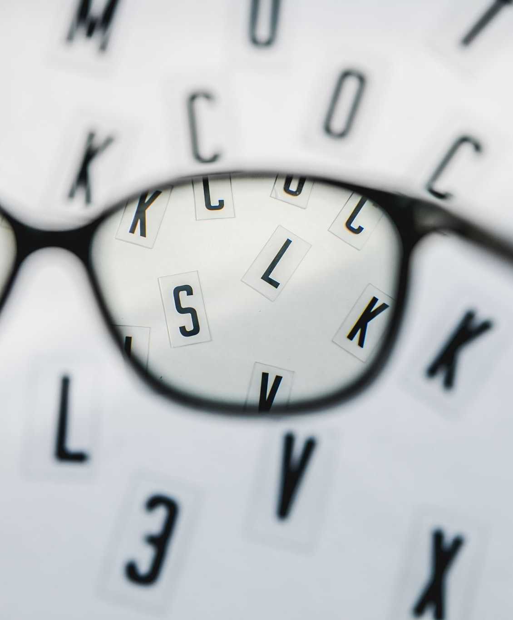
Our Vision
Live Feed
Max 50 people in the MakerSpace
Check for hazards
Tool tracking
Track Recycling
No food or drinks

Slide 3

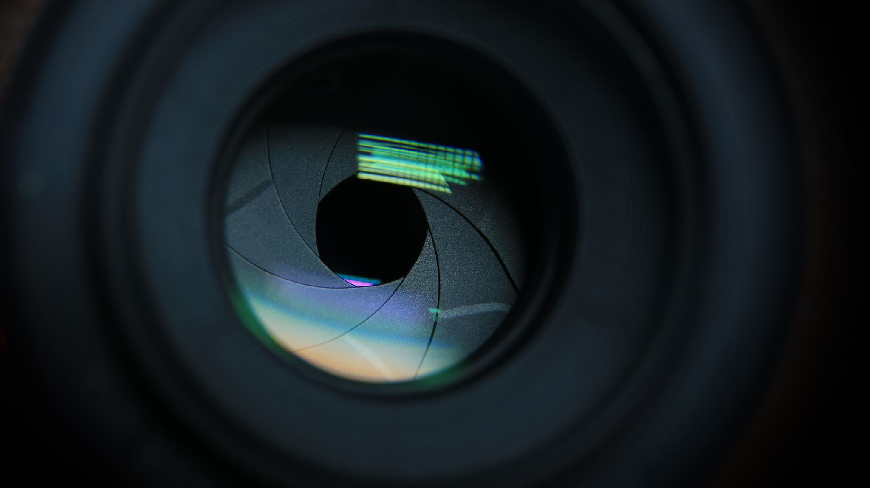
Demo

Slide 4
What we used
Opencv
ImageAI
Arduino
Yolo-h5

Slide 5

Questions

