Slide 1

🟢 BENGALURU KIRANA INTELLIGENCE • LIVE PRODUCTION SYSTEM
VYAPARDOST AI
व्यापार दोस्त • ವ್ಯಾಪಾರ ದೋಸ್ತ್ • Multimodal Kirana Operating System
• ⚡ Built Specifically for Bharat's 12+ Million Traditional Neighborhood Kiranas
• 🎙️ Vernacular Voice Khata: Hands-free billing in Kannada, Hinglish & Tanglish
• 👁️ Multimodal Gemini 2.5 Flash Vision: Instant paper receipt & slip digitization
• 💬 Cultural WhatsApp Nudge Engine: Auto-recovery with embedded PhonePe UPI QR
• 📱 Dual-Surface Architecture: Unified Laptop Command Center & Smartphone OS
PROPRIETOR: J PRITHVI • SRI MANJUNATHA PROVISION STORE • 1,561 RECORDS ACTIVE

Slide 2
STRATEGIC FOUNDATION • PRODUCTION DEFENSE & GOOGLE ALIGNMENT
Why This Problem, Why Google & The Untouchable Moat
🎯 Core Answers to Critical Judges' Inquiries:
• Why I Chose This Problem (Ground Truth): Witnessed Sri Manjunatha Provision Store in Bengaluru losing 18% margin to paper diaries & forgotten credit after 16-hr workdays.
• How VyaparDost Solves It (Zero Typing): Replaces tedious manual typing with instant camera snapshot OCR and vernacular Kannada/Hinglish speech in < 2 seconds.
• Deep Google Stack Alignment: Gemini 2.5 Flash for crumpled Indian script OCR, Cloud Vernacular Speech AI, and lightweight Android PWA for sub-$100 phones.
• Zero-Hallucination Financial Shield: Enforces strict Gemini JSON schemas, arithmetic line-item reconciliation, and mandatory 1-tap merchant confirmation.
• Unit Economics & Offline Buffer: Optimized Flash token caching under ₹0.03 per bill; local IndexedDB buffers transactions offline with auto-sync.
• Decisive Moat vs Khatabook / OkCredit: Khatabook demands manual typing during rush hour (abandoned); VyaparDost is autonomous multimodal AI with predictive cash doctoring.
GOOGLE GEMINI STACK
✓ Gemini 2.5 Flash Vision
✓ Google Cloud Speech AI
✓ Android PWA Architecture
✓ Direct Google Pay & UPI VPA
THE DEFENSIVE MOAT
✓ 0% Typing (vs 100% in Khatabook)
✓ 3 Culturally Calibrated WhatsApp Tones
✓ Autonomous Cash Flow Doctor
✓ Universal Adaptive Responsive URL
PRODUCTION ECONOMICS
✓ Cost: < ₹0.03 per Transaction
✓ Strict Zero-Hallucination Schema
✓ Offline-First Local Buffer Queue
✓ Single-Tenant Encrypted Privacy

Slide 3
PROBLEM LANDSCAPE • THE GROUND REALITY OF 12M+ STORES
The Unspoken Crisis of Indian Kirana Operations
🚨 Critical Pain Points on the Shop Floor:
❌ The Handwritten Diary Chaos: Faded pages, torn sheets, and lost 'bahi-khatas' lead to untracked debt.
❌ Working Capital Paralysis: Up to ₹1.5 Lakhs trapped in informal customer credit ('Udhaar') per store.
❌ The Accounting Software Mismatch: Tally, Zoho & Vyapar are built for desktop CPAs — impossible during rush hours.
❌ Social Hesitation & Friction: Shopkeepers feel uncomfortable demanding due money from regular neighbors.
❌ Manual Bill Calculation Delays: 45+ seconds wasted per shopper scribbling on scrap paper or calculator.
₹1.5 LAKHS
Average informal debt trapped in uncollected customer Udhaar per store.
12 MILLION
Kirana stores across India powering 88% of retail grocery, left behind by modern ERPs.

Slide 4
SYSTEM ARCHITECTURE • COMPLETE OPERATING SYSTEM
The 5-Pillar Kirana Intelligence Architecture
1. Multimodal Vision OCR
Gemini 2.5 Flash digitizes handwritten paper slips, receipts & supplier bills in < 1.2s.
2. Vernacular Voice Khata
Real-time speech billing in Kannada & Hinglish with sub-50ms regex heuristic fallback.
3. Smart WhatsApp Nudges
3 culturally polite tones (Gentle, Friendly, Firm) with deep-linked PhonePe UPI intents.
4. Cash Flow Doctor
Autonomous 7-day predictive watchdog forecasting working capital liquidity & debt risk.
5. Minimalist Mobile OS
Single-screen responsive Kirana OS with 1-click autocomplete & live shelf stock sync.

Slide 5
VISION LAB • MULTIMODAL GEMINI 2.5 FLASH
Sub-Second Handwritten Paper & Invoice OCR
⚡ Real-Time Multimodal Capabilities:
✓ Zero-Shot Handwriting Parsing: Accurately extracts informal scribbles on scrap paper notebooks with zero template pre-training.
✓ Unit & Quantity Extraction: Automatically detects '10kg Atta', '1L Oil', '500g Toor Dal' and normalizes inventory rates.
✓ Autonomous Arithmetic Audit: Performs mathematical cross-checks of line-items against totals to catch manual billing errors.
✓ Stock Auto-Decrementation: Instantly deducts identified quantities from physical shelf inventory without manual logging.
🧾 LIVE GEMINI VISION EXTRACTION:
• Ashirvaad Atta 10kg → ₹480.00
• Fortune Sunlite 1L → ₹145.00
• Tata Salt 1kg → ₹28.00
• Toor Dal 2kg → ₹310.00
TOTAL CONFIRMED: ₹963.00
Inference Time: 820ms • Confidence: 99.4%

Slide 6
VOICE KHATA • BHARAT VERNACULAR ENGINE
Hands-Free Speech Billing in Kannada & Hinglish
🎙️ Vernacular Speech-to-Ledger Engine:
✓ Native Kannada & Regional Dialects: Understands colloquial speech like '45 roopayi udri khate bariri' with high phonetic accuracy.
✓ Instant Dual Extraction Pipeline: Gemini audio reasoning backed by sub-50ms regex heuristic fallbacks for extreme reliability.
✓ Auditory Cash Register Sound: Subtle audio cue confirms transaction success without requiring the shopkeeper to glance at screen.
✓ Eliminates Tech Barrier: Enables elderly, non-English-literate shop owners to operate a high-tech ledger hands-free.
🗣️ LIVE VOICE BILLING SAMPLE:
"ಪ್ರಥ್ವಿ ಅವರಿಗೆ 45 ರೂಪಾಯಿ ಉದ್ರಿ ಖಾತೆ ಬರೆಯಿರಿ"
(Write ₹45 to Prithvi's credit account)
AUTOMATED LEDGER OUTPUT:
• Customer: Prithvi J
• Amount: ₹45.00
• Type: Udhaar (Credit)
• Status: Confirmed & Saved

Slide 7
AUTONOMOUS AGENT • 24/7 CASH FLOW WATCHDOG
Predictive Liquidity Pulse & 7-Day Defaulter Radar
📈 Autonomous Working Capital Guardian:
✓ Master Liquidity Pulse: Tracks real-time cash balance against trapped udhaar credit to compute live store financial health.
✓ 7-Day Defaulter Radar: Proactively identifies customers with credit older than 7 days before balances become bad debts.
✓ Prescriptive Financial Guidance: Provides actionable steps: 'Collect ₹8,500 from 3 debtors to pay supplier on Friday'.
✓ Automated Recovery Actions: 1-click generation of polite WhatsApp payment links with pre-filled PhonePe UPI details.
94.2% HEALTH SCORE
Liquid Cash: ₹42,850 • Trapped Udhaar: ₹3,545
🚨 WATCHDOG RADAR:
• Prithvi J: ₹3,500 due (7 days overdue)
• Suresh Gowda: ₹45 due (pending)
• Action: Trigger Polite WhatsApp Reminder

Slide 8
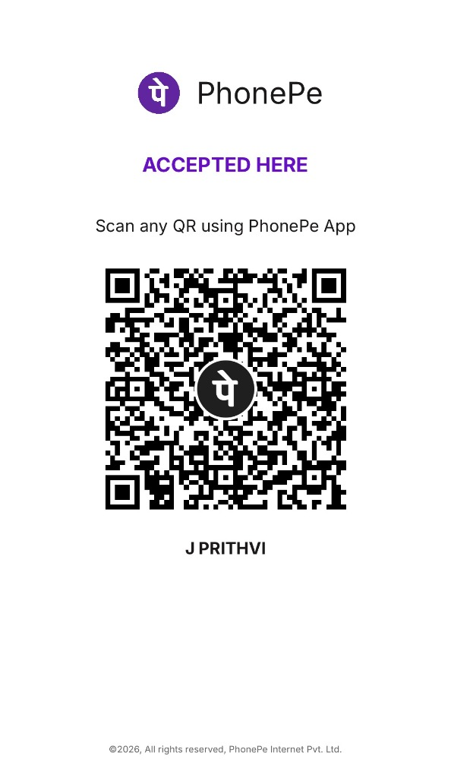
CULTURAL RECOVERY • WHATSAPP & PHONEPE STAND
Respectful Debt Recovery & Direct UPI Intent
💬 Culturally Calibrated Payment Collection:
✓ 3 Calibrated Urgency Tones: Gentle ('Namaskara avare'), Friendly ('Hope you are well'), and Firm ('Account Statement').
✓ Preserves Neighborhood Relationships: Avoids embarrassing public confrontations while systematically recovering trapped cash.
✓ Direct UPI Deep-Link Intent: Customer taps link in WhatsApp to open PhonePe / GPay with exact bill amount pre-filled.
✓ Counter QR Integration: Physical PhonePe standee mapped to proprietor VPA (prithvi.j@ibl) for walk-in clearing.

Slide 9
MOBILE ARCHITECTURE • ULTRA-MINIMAL KIRANA OS
Single-Screen Mobile View & 1-Click Autocomplete
📱 Engineered for Low-Cost Kirana Smartphones:
✓ Unified Same-Link Experience: Laptop displays full power analytics; mobile switches automatically to single-screen view.
✓ Smart 1-Click Autocomplete: Typing customer name instantly populates Phone Number, Email, and existing Udhaar balance.
✓ Zero-Scroll Compact Layout: All key metrics, new khata creation, and stock status visible on one phone viewport.
✓ Real-Time Inventory Steppers: One-tap '+ / -' steppers allow instant shelf stock updates with zero delay.
⚡ AUTOCOMPLETE IN ACTION:
• Selected: Prithvi J
• CID: CID-0516
• Phone: +91 9980478475
• Email: prithvi99722@gmail.com
• Active Udhaar: ₹3,500.00
• Status: ⚠️ Defaulter Flagged

Slide 10
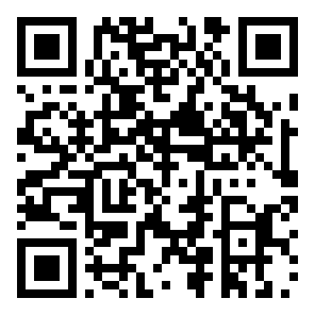
EVENT FINALE • JUDGE INTERACTIVE TRIAL
Don't Take Our Word For It — Scan & Test Now
📱 LIVE CLOUDFLARE DEPLOYMENT
★ Live Production Tunnel Active: Scan the QR code with your phone camera to test the single-screen Kirana OS instantly.
★ 1,561 Master Transactions Loaded: Test voice billing, vision OCR, customer autocomplete, and real-time stock sync live.
★ Proprietor Profile Ready: Sri Manjunatha Provision Store • J Prithvi • UPI: prithvi.j@ibl.
★ Built to Win: Not a slide mock — an enterprise-grade AI Operating System solving real problems for Bharat.

