Slide 1
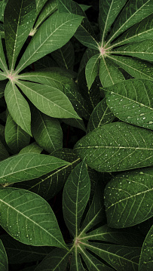
Deep convolutional neural network for Cassava leaf disease CLASSIFICATION
PRSENTED BY:
Aakash Babubhai Gajera (1135742)
Jay Samir Shah (1146105)
Shruti Govani (1143388)
Department of Computer Science
Lakehead University

Slide 2
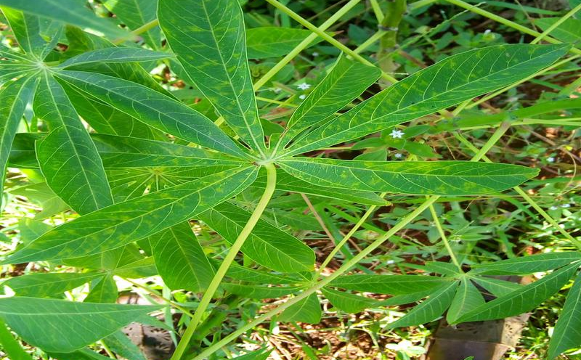
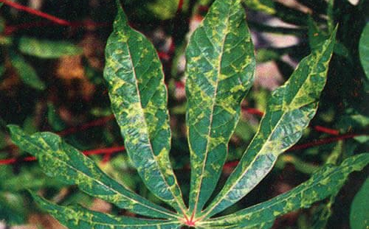
OUTLINE
Introduction
Problem Statement
Solution
Results
Comparisons of various solution
After Action Review

Slide 3
Introduction
Plant diseases are a common occurrence in many plantations across the globe and they
attack almost any kind of plant there is.
Large scale farmers especially in developed countries and some in developing countries
have the capacity to consistently buy inputs/pesticides to counter disease spread every
throughout the duration of a planting to harvest season.
Small and “medium” scale holder farmers especially those in Sub-Saharan Africa who
mostly grow crops on a subsistence scale such as cassava which is a popular crop due to its
high drought tolerance lack the ability to consistently buy pesticides early to prevent these
plant diseases or even the human capital to routinely monitor crops for any pest infections
to stop the disease spread throughout their entire plantations.

Slide 4
PROBLEM Statement
Early detection of diseases among crops in any plantation is crucial to the health and proper growth and yield of crops. Given that cassava is a staple food for many people in
Sub-Saharan Africa, it is important that diseases in this crop are detected early to
‘treat’ them thus ensuring the food security of the people that depend on it for food.
Cassava leaves are some of the crop parts that can be infected by diseases and detecting
these cassava leaf diseases early to inform the kind of treatments/insecticides to apply to
the crops is essential to ensure a healthy and proper growth of the crops.

Slide 5
Solution
Recent advances in the deep learning field and specifically in computer vision have opened doors to new possibilities in health and agriculture and other domains.
We propose an automated deep learning solution to automatically detect different types of cassava leaf diseases. Here we put forward a deep convolutional neural network using the computer vision transfer learning methodology to learn the leaf diseases patterns from a set of cassava leaf diseases so that it can be able to detect these diseases in real time on a farm.

Slide 6
DATASET
Cassava leaf Disease Classification dataset [3] from Kaggle has been used by us for the following project.
It consist of more than 21,000 cassava leaf images falling into 5 categories namely - Cassava Bacterial Blight (CBB) - 0, Cassava Brown Streak Disease (CBSD) - 1, Cassava Green Mottle (CGM) - 2, Cassava Mosaic Disease (CMD) - 3, or Healthy - 4.
The Cassava Mosaic Disease class contains a significant amount of images from the dataset and hence it implies that the dataset is imbalance.

Slide 7
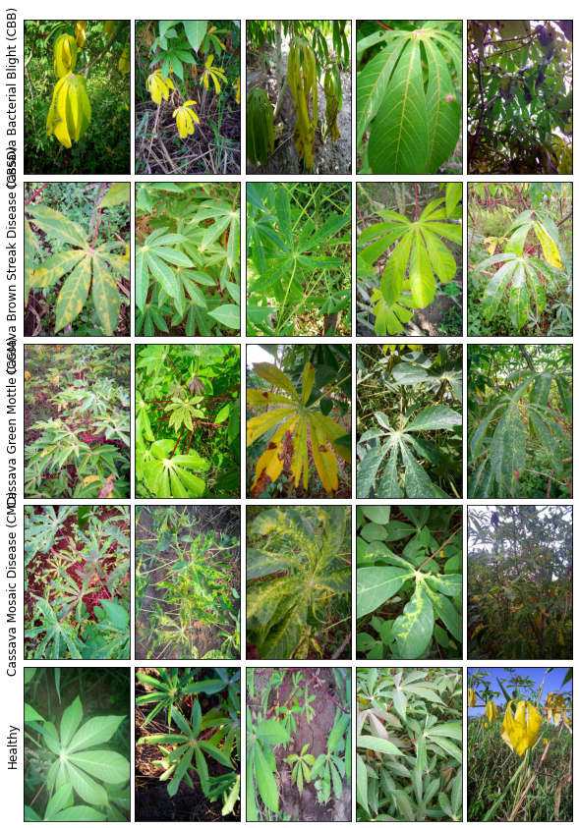
The dataset is divided into this 5 categories
Cassava Bacterial Blight
Cassava Brown Streak
Cassava Green Mottle
Cassava Mosaic
Healthy
25/07/2021
Deep convolutional neural network for Cassava leaf disease CLASSIFICATION

Slide 8
Results
Two model architectures were trained on a dataset of cassava leaf disease images and the
classifications results on the accuracy and f1_score metrics for the test set are shown
below.
efficientNetB3 Model (best model):
Test Accuracy score: 81.46%
Test Macro_F1_score: 0.69
ResNet50 Model:
Test Accuracy score: 66.86%
Test Macro_F1_score: 0.59

Slide 9
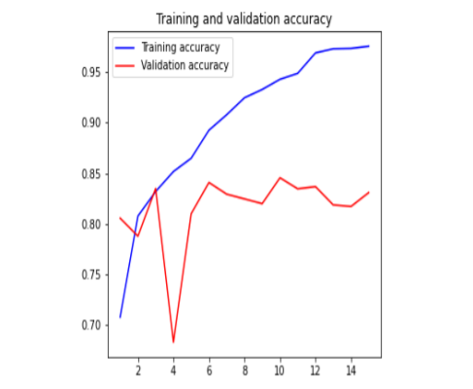
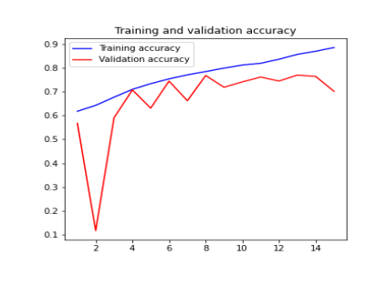
Accuracy Plot
EfficientNet Training Accuracy plot
ResNet50 Accuracy plot

Slide 10
Solution comparisons
The efficientNetB3 model appears to perform well on this relatively imbalanced dataset with a macro average f1 score of 0.69 and an average categorical accuracy of 81.46% across all 5 leaf disease categories.
This is significantly lower that the 95% accuracy reported in Ramancharan et al. [1] but it
should be noted that this is across two different datasets with different distributions and
size. The authors here also use the accuracy metric for model evaluation which doesn’t
convey the actual performance of the model like an F1_score metric does.

Slide 11
After Action Review
Things that went well:
Found a good quality leaf disease dataset
Training different models
Improving test scores

Slide 12
After Action Review
Things that went poorly:
Handling the dataset imbalance didn’t work out well.
Didn’t run more experiments with different model hyperparameters and architectures.
Handling noise in the dataset.

Slide 13
After Action Review
Things we’d change:
Run experiments with more models and different hyperparameters
Source for more data to increase dataset size
Try cross validation techniques for training

Slide 14
REFERENCES
[1] Amanda Ramcharan, Kelsee Baranowski, Peter Mc-Closkey, Babuali Ahmed, James
Legg, and David Hughes (2017). Using Transfer Learning for Image-Based.
Cassava Disease Detection.
[2] Ferentinos, K. P. (2018). Deep learning models for plant disease detection and
diagnosis. Computers and Electronics in Agriculture, 145, 311-318.
[3] https://www.kaggle.com/c/cassava-leaf-disease-classification.
[4] Q. V. L. Mingxing Tan, "EfficientNet: Rethinking Model Scaling for Convolutional Neural Networks," 11 Sept 2020. [Online]. Available: https://arxiv.org/abs/1905.11946.

Slide 15

Thank you

