Slide 1
Infinities Compactified: Penrose Diagrams
Understanding General Relativity through Penrose diagrams and connected concepts

Slide 2
Table of contents
01
03
04
05
06
02
Metric
Introduction
Including Gravity
Lorentz Transformations
Introducing the Minkowski Spacetime
Schwarzchild Metric: the solution to Einstein field equations
Changing the system
Penrose Diagram
Extensions
Kruskal-Szekeres Coordinates
Compactifying the Kruskal-Szekeres and Schwarzchild Metric
Existence of wormholes and alternate universes

Slide 3

01
Introduction

Slide 4
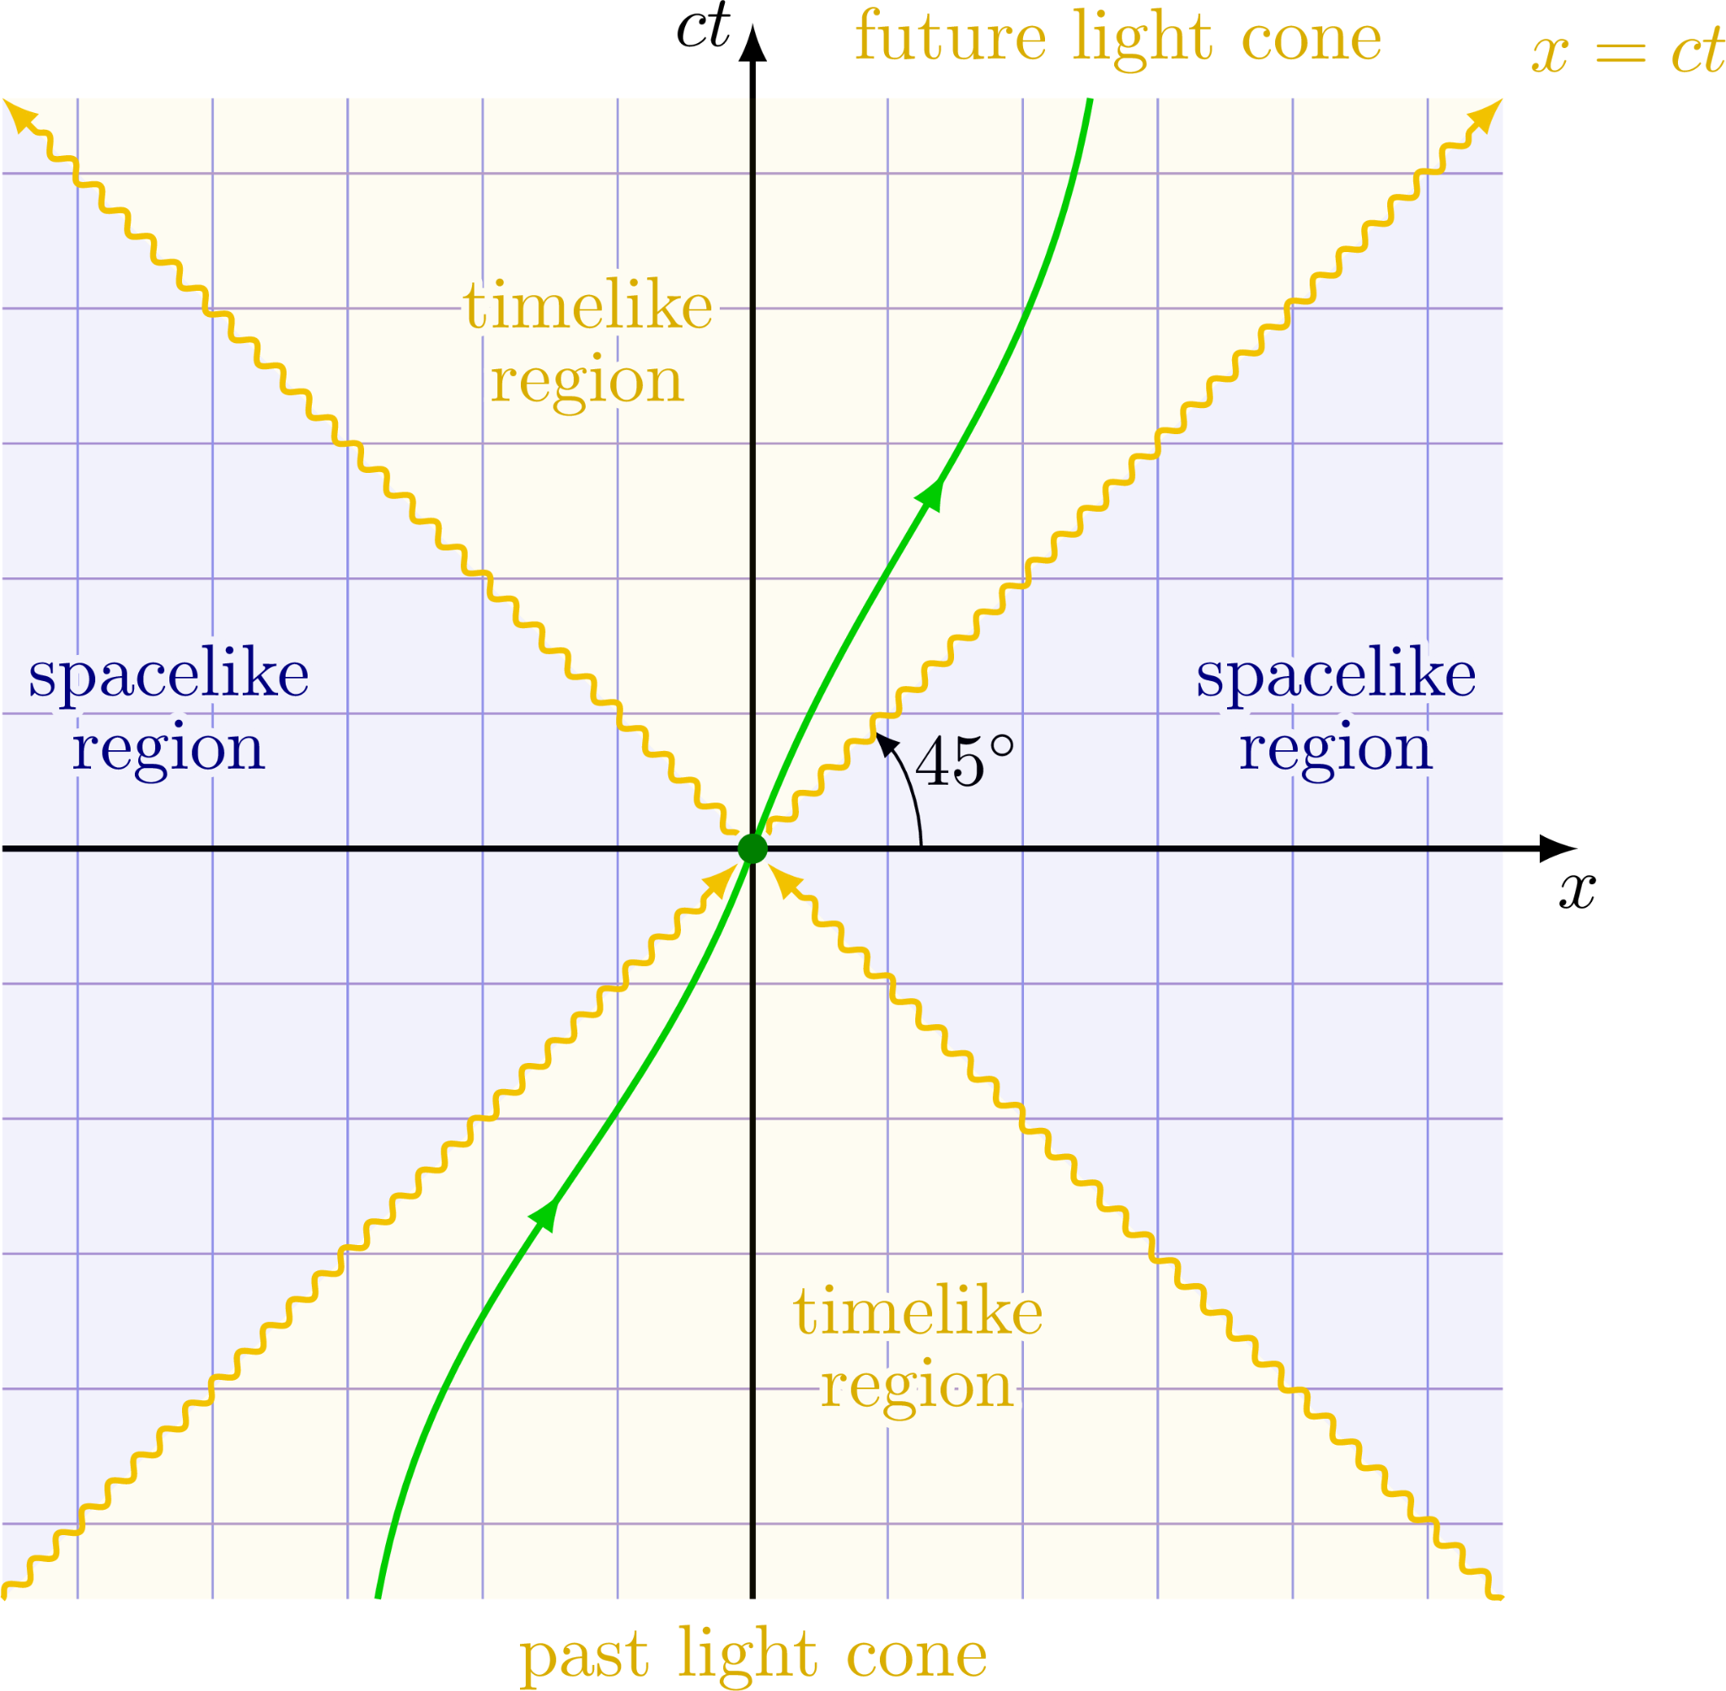
Light cone
In special relativity, a light cone (or null cone) is the surface describing the temporal evolution of a flash of light in Minkowski spacetime. This can be visualized in 3-space if the two horizontal axes are chosen to be spatial dimensions, while the vertical axis is time.^{[3]}
The light cone is constructed as follows. Taking as event p a flash of light (light pulse) at time t₀, all events that can be reached by this pulse from p form the future light cone of p, while those events that can send a light pulse to p form the past light cone of p.

Slide 5
02
Metric
Minkowski Space: The most common mathematical structure on which Special Relativity is formulated

Slide 6
Minkowski Geometry
What is Special Relativity?
What is a metric?
Minkowski space (space-time) terms are used in mathematical physics and special relativity. It is a combination of three-dimensional Euclidean space and time into a four-dimensional multiplex, where space-time interval exists between any two events is not liable on the inertial frame of reference. Space-time is flat everywhere.
The special theory of relativity describes the relationship between physical observations made by different inertial or nonaccelarating observers, in the absence of gravity.
The equation giving the distance between two points in a particular space is called the metric. Once we know the metric of a space, we know almost everything about the geometry of the space, which is why the metric is of fundamental importance.

Slide 7
—Hermann Minkowski
“The views of space and time which I wish to lay before you have sprung from the soil of experimental physics, and therein lies their strength. They are radical. Henceforth space by itself, and time by itself, are doomed to fade away into mere shadows, and only a kind of union of the two will preserve an independent reality."

Slide 8

ds²= c²Δt²- Δx² - Δy² - Δz²
Minkowski Spacetime

Slide 9
03
Including Gravity
How Minskowki’s equation changes when a non-rotating mass is considered.

Slide 10
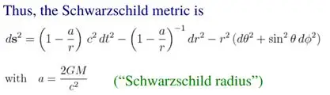
Minkowski Metric
The Minkowski metric is one of the simplest solutions to Einstein's field equations and is used to describe the spacetime in the absence of gravitational effects. It forms the basis of special relativity, which deals with the phenomena that occur when objects move at speeds close to the speed of light.
Swartzchild Metric
The Schwarzschild metric is a solution to Einstein's field equations that describes the spacetime around a spherically symmetric, non-rotating mass. This metric is particularly useful in studying the gravitational field outside a static black hole or a non-rotating planet.

Slide 11
Minkowski Metric
The Minkowski metric is one of the simplest solutions to Einstein's field equations and is used to describe the spacetime in the absence of gravitational effects. It forms the basis of special relativity, which deals with the phenomena that occur when objects move at speeds close to the speed of light.
Swartzchild Metric
The Schwarzschild metric is a solution to Einstein's field equations that describes the spacetime around a spherically symmetric, non-rotating mass. This metric is particularly useful in studying the gravitational field outside a static black hole or a non-rotating planet.

Slide 12
The Schwarzschild metric has a singularity for r = 0, which is an intrinsic curvature singularity. Depending on the point of view, the metric is therefore defined only on the exterior region , only on the interior region or their disjoint union.
Since the Schwarzschild metric is expected to be valid only for those radii larger than the radius R of the gravitating body, there is no problem as long as R > rs.
The Schwarzschild solution, taken to be valid for all r > 0, is called a Schwarzschild black hole. It is a perfectly valid solution of the Einstein field equations, although (like other black holes) it has rather bizarre properties. For r < rs the Schwarzschild radial coordinate r becomes timelike and the time coordinate t becomes spacelike.
The surface r = rs points into the event horizon of the black hole. It represents the point past which light can no longer escape the gravitational field. Any physical object whose radius R becomes less than or equal to the Schwarzschild radius has undergone gravitational collapse and become a black hole.

Slide 13
04
Coordinate systems
The Kruskal-Szekeres coordinates give an alternate image of the black and its event horizon.

Slide 14
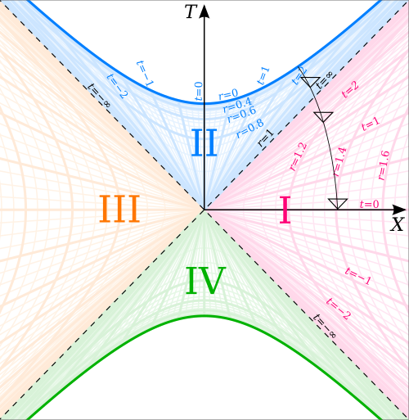
Kruskal–Szekeres diagram, illustrated for 2GM=1. The quadrants are the black hole interior (II), the white hole interior (IV) and the two exterior regions (I and III). The dotted 45° lines, which separate these four regions, are the event horizons. The darker hyperbolas which bound the top and bottom of the diagram are the physical singularities. The paler hyperbolas represent contours of the Schwarzschild r coordinate, and the straight lines through the origin represent contours of the Schwarzschild t coordinate.

Slide 15
The Kruskal–Szekeres coordinates also apply to space-time around a spherical object, but in that case do not give a description of space-time inside the radius of the object. Space-time in a region where a star is collapsing into a black hole is approximated by the Kruskal–Szekeres coordinates (or by the Schwarzschild coordinates). The surface of the star remains outside the event horizon in the Schwarzschild coordinates, but crosses it in the Kruskal–Szekeres coordinates.

Slide 16
05
Penrose Diagram

Slide 17
What is a Penrose Diagram?
In theoretical physics, a Penrose diagram is a two-dimensional diagram capturing the causal relations between different points in spacetime through a conformal treatment of infinity. It is an extension of the Minkowski diagram of special relativity where the vertical dimension represents time, and the horizontal dimension represents a space dimension. Using this design, all light rays take a 45° path.
.

Slide 18
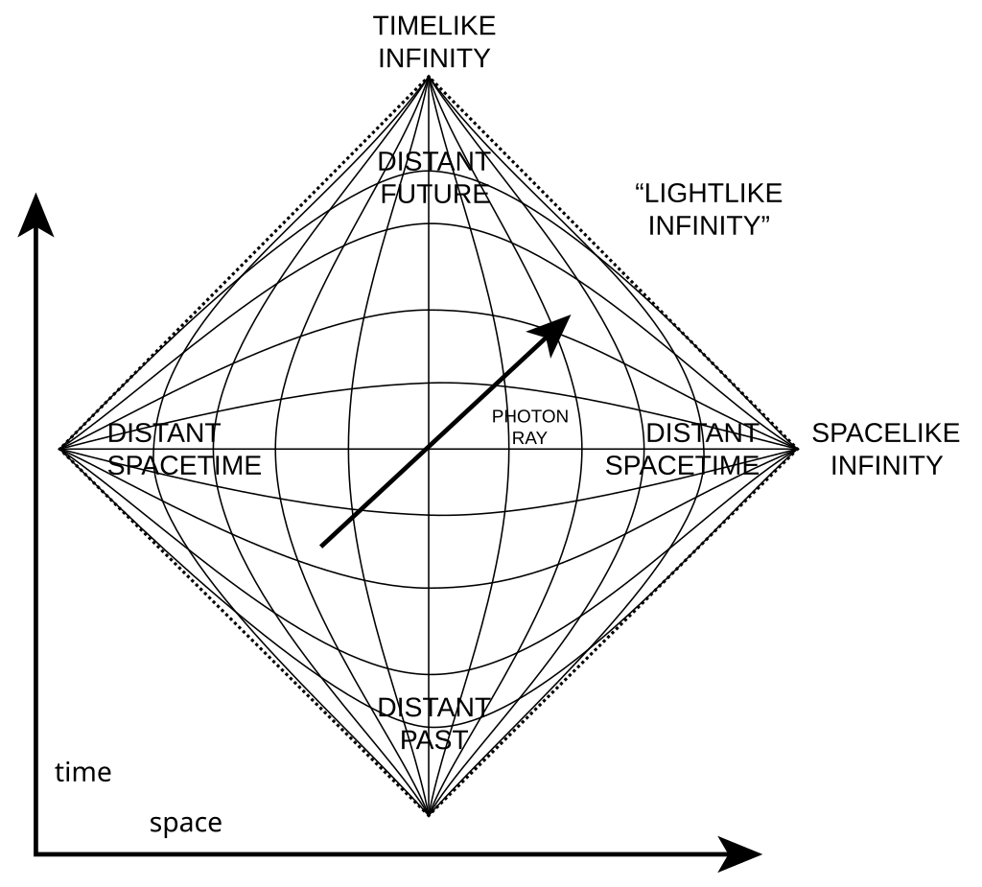
Penrose diagram of an infinite Minkowski universe, horizontal axis u, vertical axis v.
The diagram looks 1 + 1-dimensional, but the convention is that spherical symmetry is assumed, so two more dimensions are hidden, and we’re really portraying 3 + 1 dimensions. A typical point on the interior of the diamond region represents a 2-sphere. On this type of diagram, light cones look just like they would on a normal spacetime diagram of Minkowski space, but distance scales are highly distorted.

Slide 19
06
Extensions
What theories does the Penrose diagram imply?

Slide 20
White holes & Other Universes
Penrose diagrams are often used to illustrate the hypothetical Einstein–Rosen bridge connecting two separate universes in the maximally extended Schwarzschild black hole solution. The precursors to the Penrose diagrams were Kruskal–Szekeres diagrams. (The Penrose diagram adds to Kruskal and Szekeres' diagram the conformal crunching of the regions of flat spacetime far from the hole.) These introduced the method of aligning the event horizon into past and future horizons oriented at 45° angles (since one would need to travel faster than light to cross from the Schwarzschild radius back into flat spacetime); and splitting the singularity into past and future horizontally-oriented lines (since the singularity "cuts off" all paths into the future once one enters the hole).

Slide 21
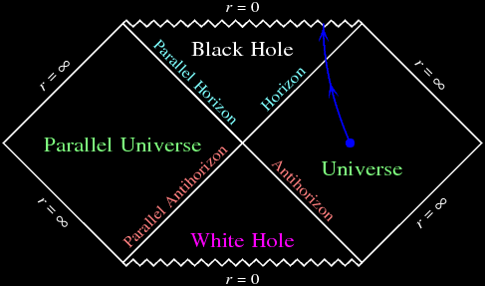
The Schwarzschild geometry has a simple mathematical form, and that form can be extended analytically. The mathematical extension consists of a second copy of the Schwarzschild geometry, reversed in time, glued along the Antihorizon. The complete analytic extension of the Schwarzschild geometry contains not only a Universe and a Black Hole, but also a Parallel Universe and a White Hole. This is simply a mathematical construction, with no basis in reality. Still, it is cute that even the simplest kind of black hole, a Schwarzschild black hole, harbors alien mathematical passageways.

Slide 22
Thank you.

Slide 23
Icon pack

