Slide 1

Coffee Shop Analysis
Using MySQL
This Photo by Unknown Author is licensed under CC BY-SA

Slide 2



Data Cleaning
This Photo by Unknown Author is licensed under CC BY-SA

Slide 3
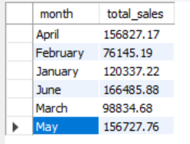

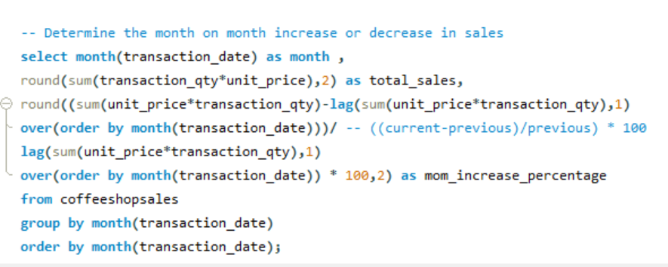
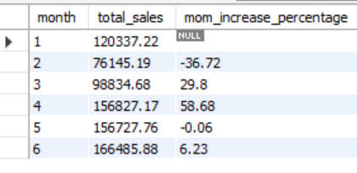
Total Sales Analysis
This Photo by Unknown Author is licensed under CC BY-SA

Slide 4
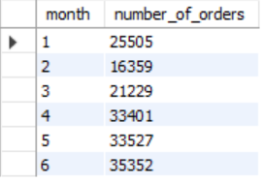

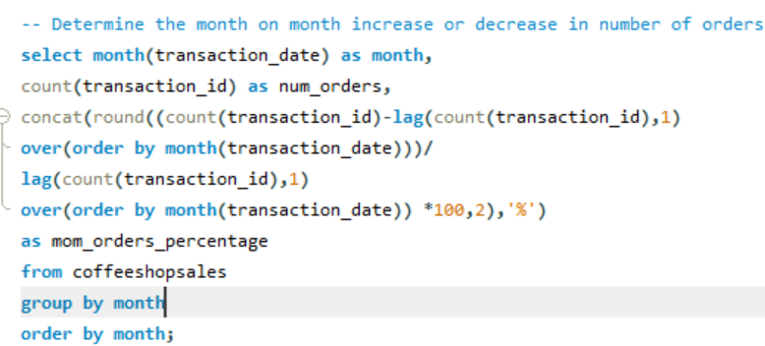
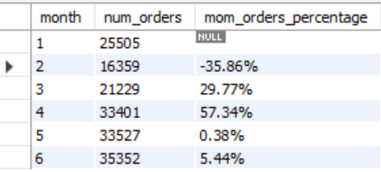
Total Order Analysis
This Photo by Unknown Author is licensed under CC BY-SA

Slide 5
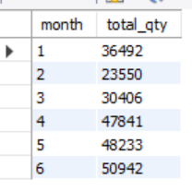
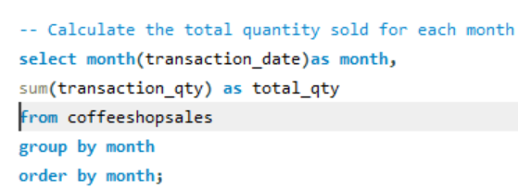
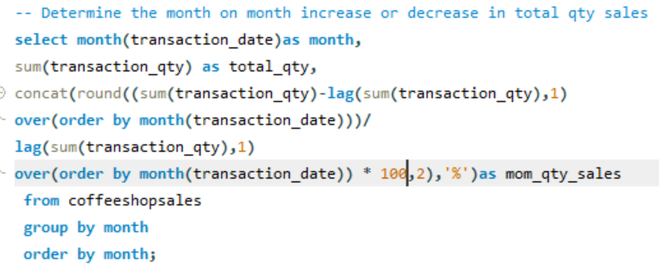
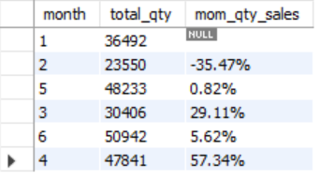
Total Quantity Analysis
This Photo by Unknown Author is licensed under CC BY-SA

Slide 6

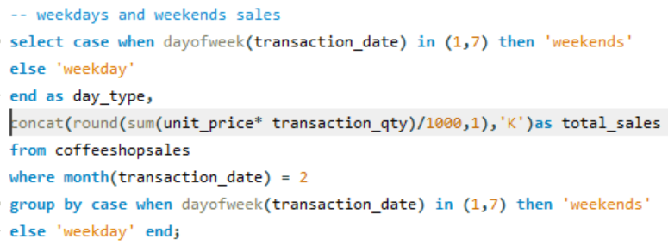

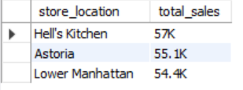
Sales Analysis
This Photo by Unknown Author is licensed under CC BY-SA

Slide 7

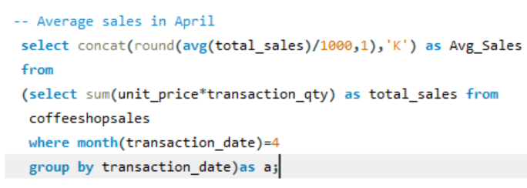
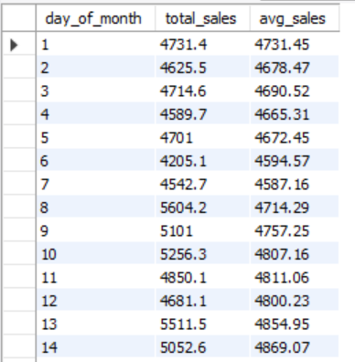
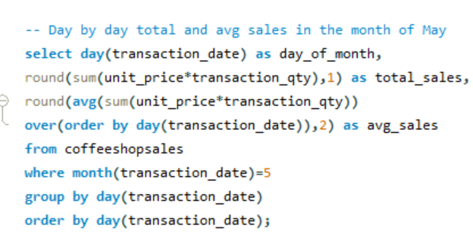
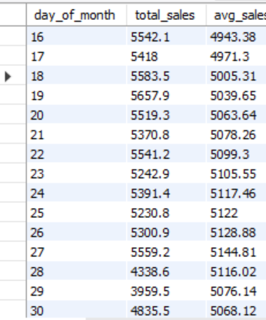
Sales Analysis
This Photo by Unknown Author is licensed under CC BY-SA

Slide 8
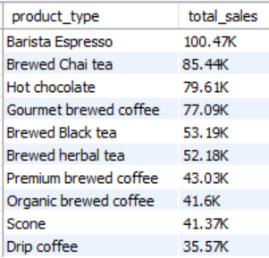
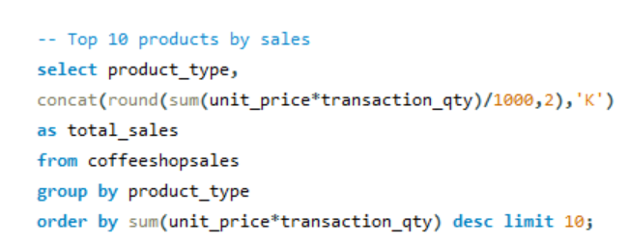
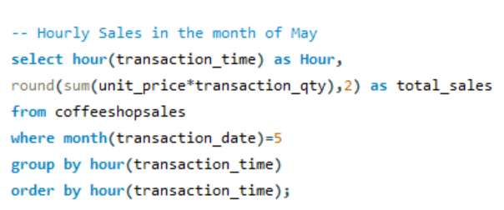
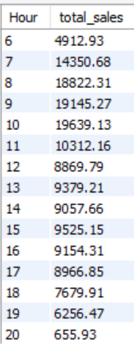
Sales Analysis
This Photo by Unknown Author is licensed under CC BY-SA

Slide 9
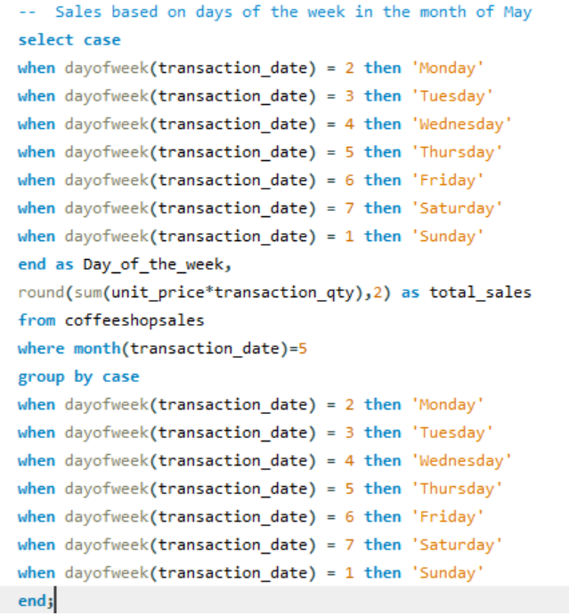
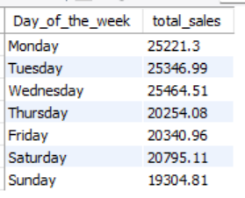
Sales Analysis
This Photo by Unknown Author is licensed under CC BY-SA

Slide 10
Thank you
This Photo by Unknown Author is licensed under CC BY-SA

