Slide 1
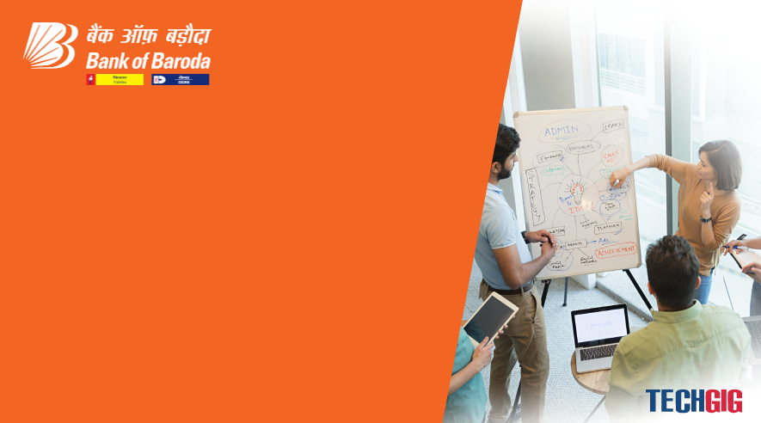

Bank of Baroda Hackathon - 2022
Technology Partner
Your Team Name : Tech Marvels
Your team bio : We have two girl members in our team TechMarvels Niharika Sharma and Jaya Thakur, studying in 3rd Year pursuing B.Tech in Computer Science and Information Technology from Symbiois University of Applied Sciences, Indore.
Date :18-09-22

Slide 2
Automatic Cheque Processing
Why did you decide to solve this Problem statement?
When it comes to the clearance of the bank cheques and monetary transactions, this should not only be reliable and robust but also save time which is one of the major factor for the countries having large population.
Although cheque systems in banks for transactions is one of the most powerful tool, primarily due to its slow processing time, considerable complexities in cheque clearing process and gradually with an immense growth in the technology, the electronic-transactions have created a big shadow on the cheque system to cater the need of the banking sector.

Slide 3
User Segment & Pain Points
Which user /advertiser segment would be early adopter of your product & why?
Certain kinds of customers tend to pay with checks more often than others. For example, many businesses prefer to pay their suppliers with checks. If you make mostly business-to-business sales, you might benefit from accepting check payments.

Slide 4
Pre-Requisite
What are the alternatives/competitive products for the problem you are solving?
The drawer of a cheque must have a bank account;
The drawer must ensure that the payee (beneficiary) accepts payment by cheque (the payee is not obliged to do so);
7 pieces of mandatory information must appear on the cheque for it to be valid:
The word 'cheque', inserted in the text of the cheque;
The name of the paying entity (the bank drawn on);
The place where the payment has to be made. If there is no specific indication thereof, the place indicated alongside the drawee bank’s name is deemed to be the place of payment;
The date and place of writing the cheque;
The signature of the person writing the cheque (drawer);
The simple authorization to pay a specific sum;
The amount to be paid: it must be stated in figures and written out in full.
The drawer’s bank account must have sufficient funds or have a sufficient credit line when the cheque is presented at the bank for collection to ensure that the payment is executed by the bank.

Slide 5
Azure tools or resources
Azure tools or resources which are likely to be used by you for the prototype, if your idea gets selected. 1. DEVOPS Tools. 2. CLOUD COMPUTING.

Slide 6
Any Supporting Functional Documents
Present your solution, talk about methodology, architecture & scalability
URL of Repository: TechMarvels-AutomatedChequeProcessing-BOB_Hackathon/idea/
Name of File: Functional_Document_TechMarvels_Final.pdf

Slide 7
Key Differentiators & Adoption Plan
How is your solution better than alternatives and how do you plan to build adoption?
We proposed a system to overcome the drawbacks of traditional cheque clearance system such as manual process, time consuming, scalability.
The proposed system is aumated and support multillingual language support.
The proposed system is time efficient.
Today, we are working in mobile era and everyone is buying or selling the good using digital currency. So adoption and utilization of such system is not difficult for the end users.
The proposed system has awareness modules and tutorials to be available to understand the overall cheque clearance system.
The UI interface is user friendly and easily portable.

Slide 8
Thank You
Team member names
Niharika Sharma
Jaya Thakur

