Slide 1
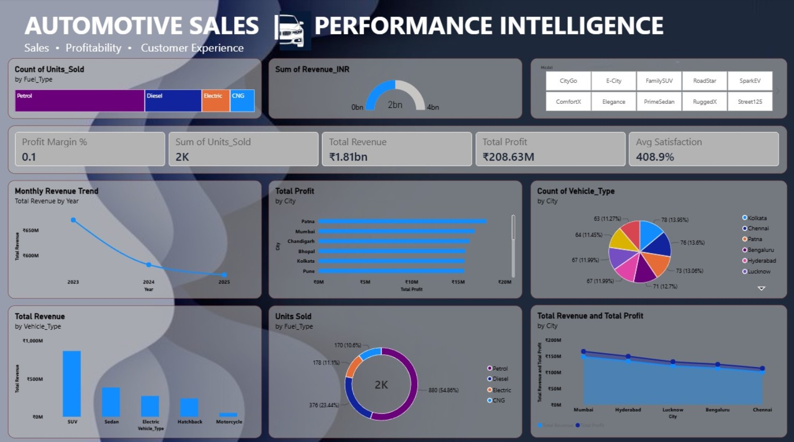
AUTOMOTIVE SALES
PERFORMANCE
INTELLIGENCE
EXECUTIVE DASHBOARD REVIEW
KPI • GRAPHS • SLICERS • BUSINESS INSIGHTS
Chart on the left
Explanation on the right
One visual per slide
A visual guide to automotive sales performance
PREPARED FOR BUSINESS ANALYTICS

Slide 2
Dashboard Overview
A single-page view of sales volume, revenue, profitability, vehicle mix and customer experience.
WHAT THE VISUAL SHOWS
The dashboard combines several performance indicators in one place.
Charts compare revenue, profit, units sold, fuel type, vehicle type and city-level results.
Use the visuals together to identify strong areas and topics that need closer analysis.
AUTOMOTIVE SALES PERFORMANCE • 01

Slide 3
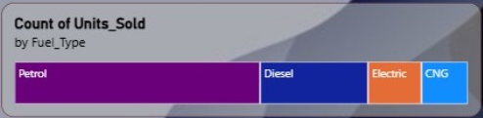
KPI 01 — Units Sold by Fuel Type
KPI visual: count of units sold grouped by fuel type.
WHAT THE VISUAL SHOWS
Petrol is the largest segment in the displayed fuel-type bar.
Diesel contributes the next-largest share, while Electric and CNG are smaller segments.
Use the mix to plan inventory and promotions, and validate the exact totals in the source data.
AUTOMOTIVE SALES PERFORMANCE • 02

Slide 4

KPI 02 — Revenue Gauge
KPI visual: total revenue displayed on a gauge scale.
WHAT THE VISUAL SHOWS
The gauge provides a quick visual of revenue against its displayed scale.
The shown scale runs from 0bn to 4bn, with the indicator around the middle range.
Read this alongside the Total Revenue card and confirm the measure’s currency and aggregation.
AUTOMOTIVE SALES PERFORMANCE • 03

Slide 5
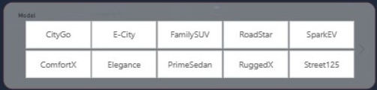
Slicer — Vehicle Model
The model slicer lets viewers filter dashboard visuals by selected model.
WHAT THE VISUAL SHOWS
Choose a model such as CityGo, E-City, FamilySUV, RoadStar or SparkEV.
Other visible choices include ComfortX, Elegance, PrimeSedan, RuggedX and Street125.
Use the slicer to compare selected models consistently across revenue, units and profit visuals.
AUTOMOTIVE SALES PERFORMANCE • 04

Slide 6
KPI 03 — Summary Performance Cards
Headline measures shown across the dashboard.
WHAT THE VISUAL SHOWS
Displayed values include 2K units sold, ₹1.81bn total revenue and ₹208.63M total profit.
The cards also show Profit Margin % as 0.1 and Average Satisfaction as 408.9%.
The margin and satisfaction figures may require a format or calculation check before presenting them as percentages.
AUTOMOTIVE SALES PERFORMANCE • 05

Slide 7
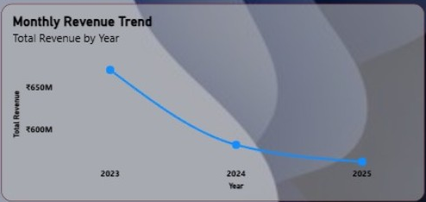
Graph 01 — Monthly Revenue Trend
Line chart: total revenue by year (2023–2025).
WHAT THE VISUAL SHOWS
Revenue decreases from 2023 to 2024 and declines again in 2025 in the displayed chart.
The steepest visible fall appears between 2023 and 2024.
Check whether 2025 represents a complete year and investigate causes before concluding why revenue fell.
AUTOMOTIVE SALES PERFORMANCE • 06

Slide 8
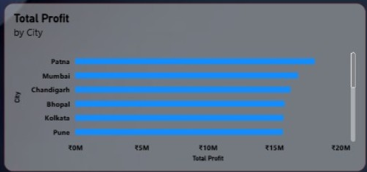
Graph 02 — Total Profit by City
Horizontal bar chart: total profit for each city.
WHAT THE VISUAL SHOWS
Patna has the longest visible bar, followed by Mumbai and Chandigarh.
Bhopal, Kolkata and Pune appear lower among the cities visible in the chart.
Use city-level profitability to guide follow-up analysis; compare with sales volume and costs before allocating resources.
AUTOMOTIVE SALES PERFORMANCE • 07

Slide 9
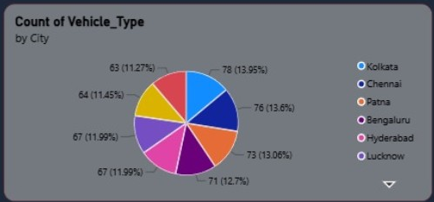
Graph 03 — Vehicle Type by City
Pie chart: count of vehicle type grouped by city.
WHAT THE VISUAL SHOWS
The displayed city counts are relatively close, with visible values from 63 to 78.
Kolkata shows 78 (13.95%) and Chennai 76 (13.6%) among the visible labels.
The distribution looks fairly balanced; check the complete legend and filter state before interpreting the full ranking.
AUTOMOTIVE SALES PERFORMANCE • 08

Slide 10
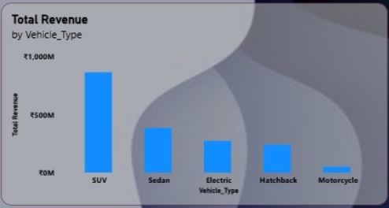
Graph 04 — Revenue by Vehicle Type
Column chart: total revenue grouped by vehicle type.
WHAT THE VISUAL SHOWS
SUV has the tallest revenue bar in the displayed chart.
Sedan, Electric Vehicle and Hatchback follow at lower levels; Motorcycle is the smallest visible category.
Compare revenue with units sold and profit to distinguish high-volume categories from high-value categories.
AUTOMOTIVE SALES PERFORMANCE • 09

Slide 11
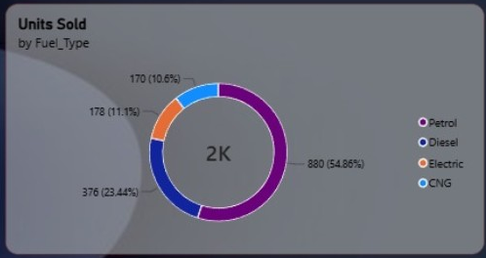
Graph 05 — Units Sold by Fuel Type
Donut chart: units sold by fuel category.
WHAT THE VISUAL SHOWS
Petrol accounts for 880 units (54.86%) in the displayed chart.
Diesel contributes 376 units (23.44%); Electric 178 (11.1%); and CNG 170 (10.6%).
Petrol dominates the mix, while the other fuel categories together make up a substantial minority.
AUTOMOTIVE SALES PERFORMANCE • 10

Slide 12
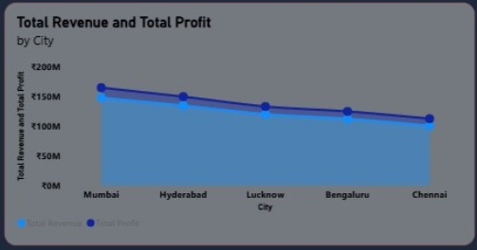
Graph 06 — Revenue and Profit by City
Combined area/line chart comparing total revenue and total profit by city.
WHAT THE VISUAL SHOWS
Both plotted series trend downward from Mumbai through Chennai in the displayed order.
Mumbai is the highest among the listed cities; Chennai is the lowest at the right end.
Because the chart combines two measures, confirm the axes and units before comparing their absolute magnitudes.
AUTOMOTIVE SALES PERFORMANCE • 11

Slide 13
Key Business Insights
Summary of patterns visible across the supplied dashboard.
WHAT THE VISUAL SHOWS
The displayed dashboard reports 2K units sold, ₹1.81bn revenue and ₹208.63M profit.
Petrol is the leading fuel category in the units-sold mix.
SUV is the highest-revenue vehicle type in the shown bar chart.
The revenue trend declines across the displayed years; confirm year completeness and data quality.
AUTOMOTIVE SALES PERFORMANCE • 12

Slide 14
Recommendations
Practical actions suggested by the visual patterns; validate with source data before decisions.
WHAT THE VISUAL SHOWS
Investigate the year-on-year revenue decline and check whether the final year is complete.
Review SUV performance by units, margin and cost to understand the drivers of revenue.
Maintain Petrol availability while tracking customer demand for Diesel, Electric and CNG.
Compare city profit with revenue, sales volume and operating costs before prioritizing markets.
Verify the Profit Margin and Average Satisfaction KPI formats, which appear unusual as displayed.
AUTOMOTIVE SALES PERFORMANCE • 13

Slide 15
Conclusion
From dashboard visuals to evidence-based business action
READ THE GRAPH.
UNDERSTAND THE STORY.
ACT ON THE EVIDENCE.
The dashboard supports comparison across revenue, profit, units sold, fuel mix, vehicle type and city performance.
Validate unusual KPI formats and incomplete periods before using the results for business decisions.
AUTOMOTIVE SALES PERFORMANCE • 14

