Slide 1
Student Success Early Warning System
A reproducible machine-learning prototype for academic-support insights
Jayesh Dabhade
IBM Skillbuild Applied AI Internship
Khizar Nawaz | Applied AI Internship | 1

Slide 2
Problem Statement
Turning multiple student factors into a clear support conversation
• Academic performance is influenced by learning, support, attendance, and social context.
Project boundary
• Manual review may not combine many signals consistently.
Educational prototype
Not a clinical or psychological diagnosis.
Does not replace teachers or guarantee outcomes.
• Early estimates can help educators discuss possible additional support.
• Machine learning can identify historical patterns — not make definitive judgments.

Slide 3
Proposed Solution
An end-to-end local machine-learning workflow
Student
Data
→
Preprocess
→
Regression
Models
→
Evaluate
→
Best
Model
→
Streamlit
Prediction
Output: predicted final grade / 20 • performance category • academic-support indicator

Slide 4
Dataset & Features
Official UCI Student Performance Dataset — Mathematics subset
Dataset facts
Feature groups
Timing decision
395 student records
33 columns
Target: G3 final grade
Grade scale: 0–20
Demographics
Family & school support
Study behaviour
Attendance
Prior-term grades
G1 and G2 are valid when prior-term grades exist.
A second scenario excludes them for earlier prediction.
Source: UCI Machine Learning Repository, Student Performance dataset (dataset id 320).

Slide 5
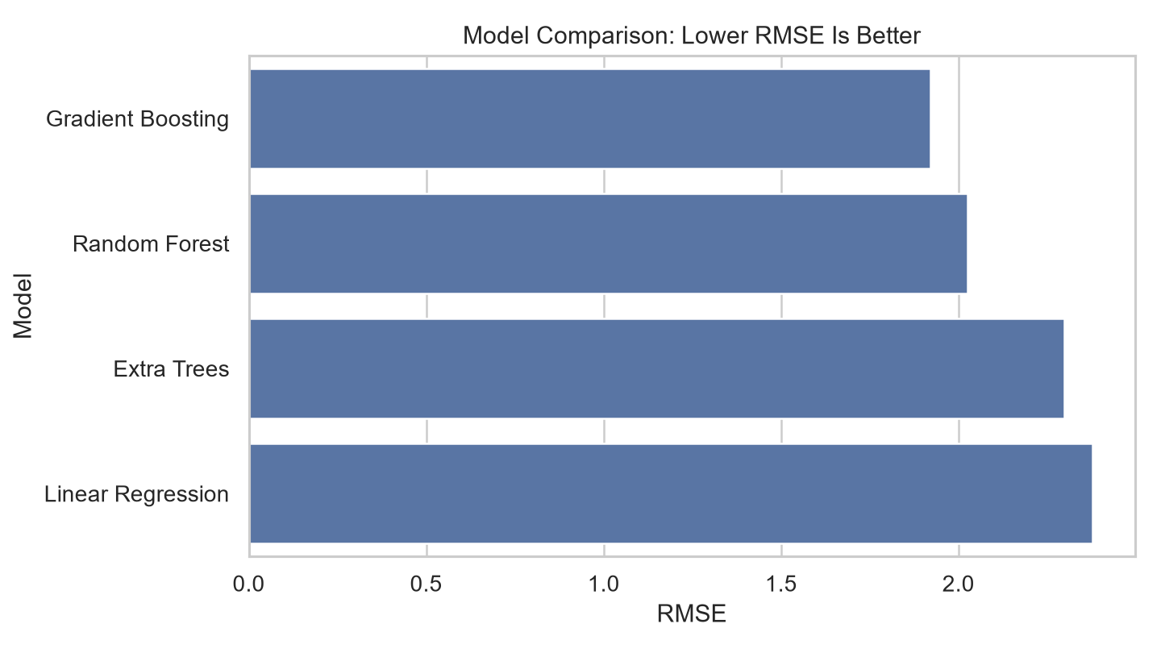
Model Comparison & Results
Actual metrics from the fixed 80/20 holdout split (random_state = 42)
Model | MAE | RMSE | R2
Gradient Boosting | 1.128 | 1.922 | 0.820
Random Forest | 1.215 | 2.026 | 0.800
Extra Trees | 1.390 | 2.297 | 0.743
Linear Regression | 1.647 | 2.378 | 0.724
Selected model
Gradient Boosting
MAE: 1.128
RMSE: 1.922
R²: 0.820

Slide 6
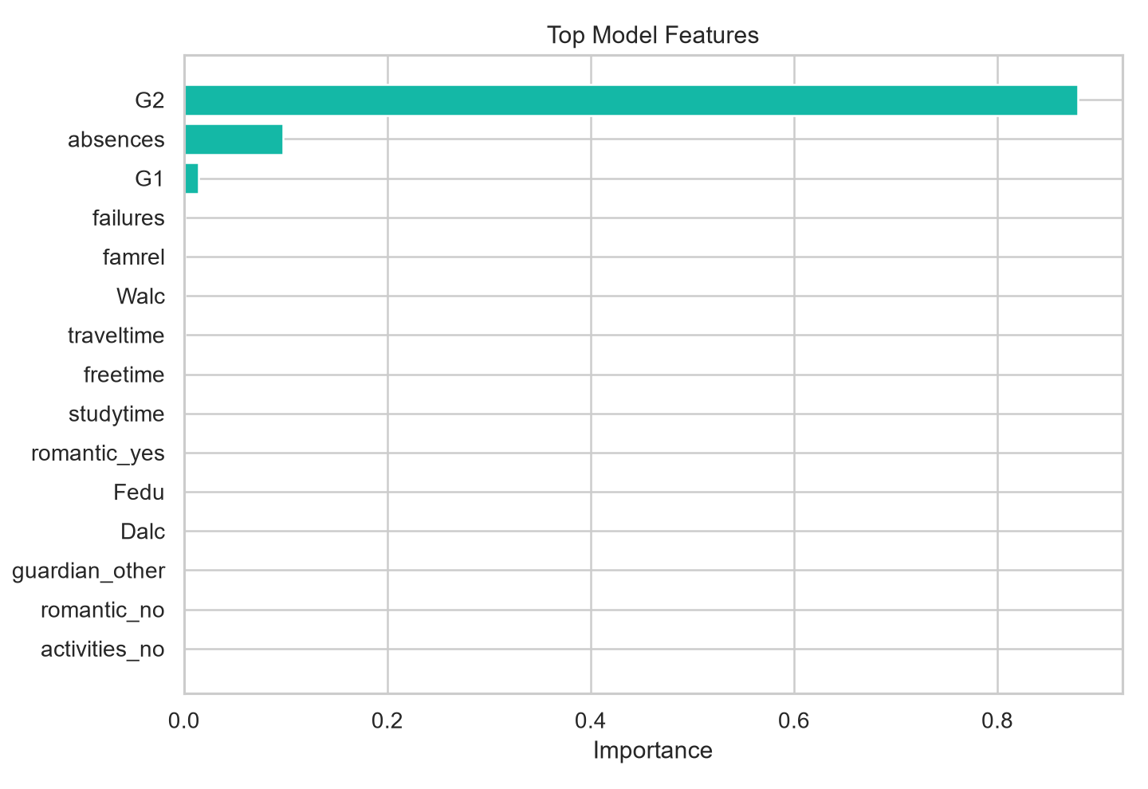
End-to-End Workflow
Reproducible and leakage-safe pipeline
1
Load UCI data
↓
2
Check schema, missing values & duplicates
↓
3
Split train/test data
↓
4
Encode categories and scale numbers in pipeline
↓
5
Train and compare models
↓
6
Save selected full pipeline
↓
7
Evaluate, explain and deploy

Slide 7
Working Demo
What the Streamlit application demonstrates
1
2
Enter grouped student information
Click Predict Performance
3
4
Show predicted final grade
Show performance category
5
6
Show academic-support indicator
Explain important model features

Slide 8
Conclusion & Key Learnings
A complete Applied AI workflow, ready for local demonstration
• Compared multiple regression models using standard, actual evaluation metrics.
Future improvements
• Integrated the best model into a clear Streamlit application.
More representative data
Fairness assessment
Prediction uncertainty
Educator feedback loop
• Made model drivers visible through feature-importance analysis.
• Documented responsible use: support discussions, not definitive decisions.
Thank you

