Slide 1

IBM EMPLOYEE ATTRITION DATA ANALYSIS
CISC7107 DATA MINING AND DECISION SUPPORTING SYSTEM
FINAL PROJECT
JUSTICE ABBAN
MC353070

Slide 2

Table of Content
INTRODUCTION
DATASET
DATA PREPROCESSING
CLASSIFICATION
ATTRIBUTE GAIN
TEXT MINING
CORRELATION
DECISION TREE
CONCLUSION
RECOMMENDATIONS

Slide 3
Introduction
Employee attrition at IBM refers to the voluntary departure of employees from the company. It poses challenges such as increased costs and loss of knowledge. Factors influencing attrition include personal reasons, career opportunities, work-life balance, job satisfaction, compensation, and organizational culture. IBM addresses attrition through retention initiatives and data analytics to identify at-risk employees. The goal is to create a supportive work environment and reduce turnover rates.

Slide 4
Dataset
IBM HR ATTRITION DATASET
Aim: Using a mix of DM tools to Identify key attrition factors by analyzing various features and attributes in the dataset.
Goal: Build predictive models that can forecast attrition risk for individual employees within the organization and also find the relationships between the factors that lead to attrition.
Software:
Weka – Classification, Text Mining, Feature Selection (Information Gain AE)
Orange – Decision Tree, Info Gain, Correlation
Kaggle: https://www.kaggle.com/datasets/pavansubhasht/ibm-hr-analytics-attrition-dataset
Employee Review: IBM Reviews: What Is It Like to Work At IBM? | Glassdoor

Slide 5
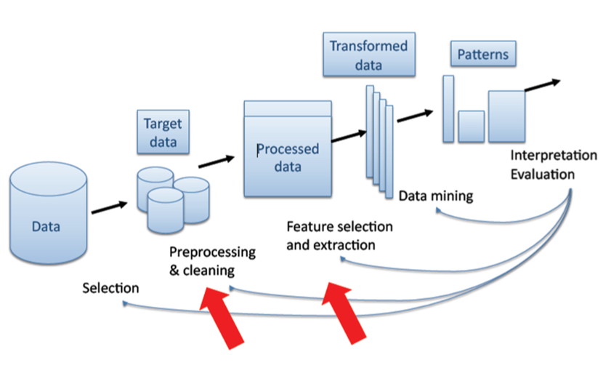
Data Preprocessing
1. Data Selection: In this stage, relevant data is selected from various sources for analysis.
2. Data Preprocessing: The selected data is cleaned, transformed, and preprocessed to ensure its quality and consistency.
3. Data Transformation: The preprocessed data is transformed into a suitable format for analysis.
4. Data Mining: This stage involves applying various data mining techniques, such as clustering, classification, association rule mining, or anomaly detection, to extract meaningful patterns, relationships, and insights from the data.
5. Interpretation and Evaluation: The patterns and insights obtained from the data mining stage are interpreted, evaluated, and validated to assess their usefulness and reliability.
6. Knowledge Presentation: The final stage involves presenting the discovered knowledge and insights in a meaningful and understandable manner, often through visualization or reports.
Notes:
In this phase, we first did some basic cleaning and find outliners and extreme values in our dataset. Then we divided it into the training(80%) and test(20%) set. We used different Data Mining tools such as Weka and Orange software for this processes. We also built and evaluated my classification model, and text mining models using Weka software. The correlation, Decision Tree and some part of the Info Gain was done by Orange software. Finally, we get the results of our experiment and had to some interpretations in a form of reports.

Slide 6
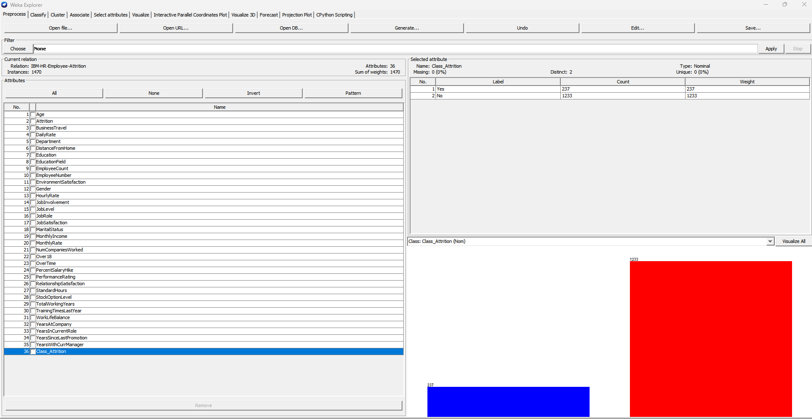
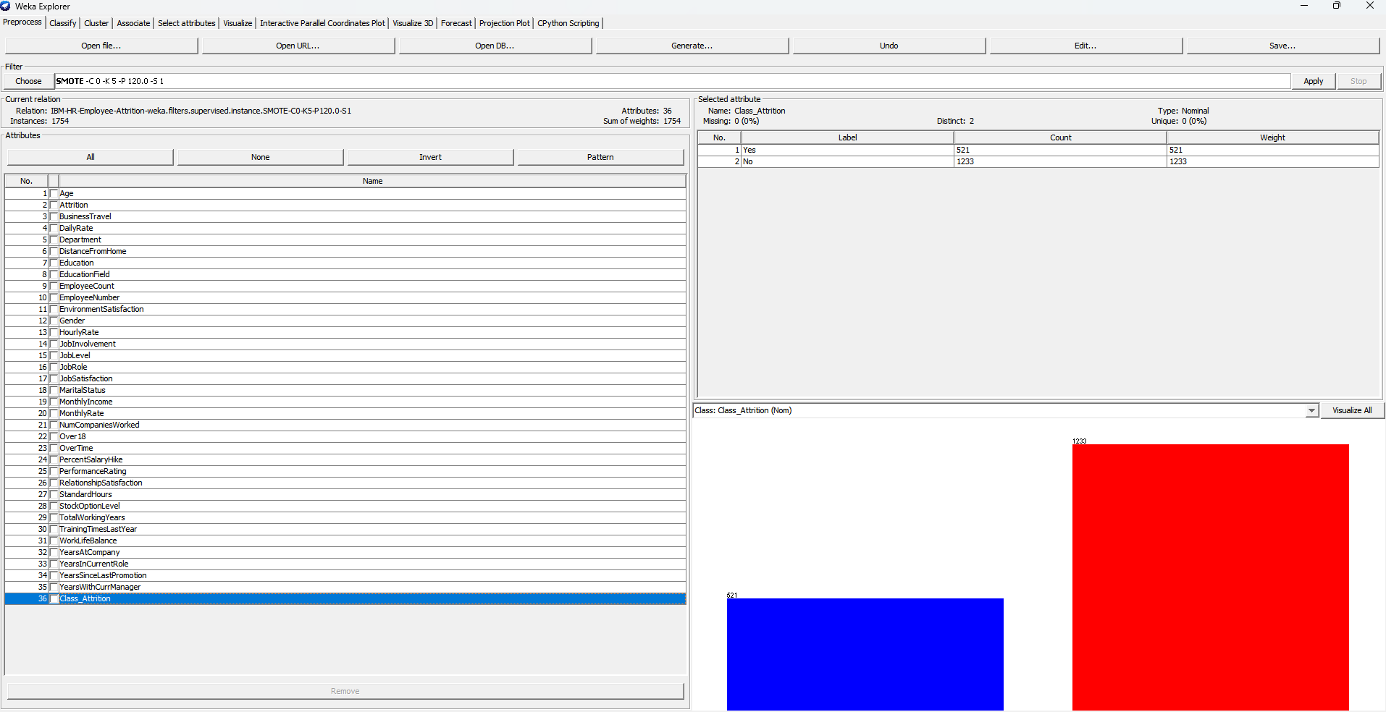
Data Preprocessing
Notes:
In this phase I used the SMOTE function to balance my Dataset for enhance me get an accurate model. The No class had fewer instances compared to the Yes so we had to do re balance the dataset.

Slide 7
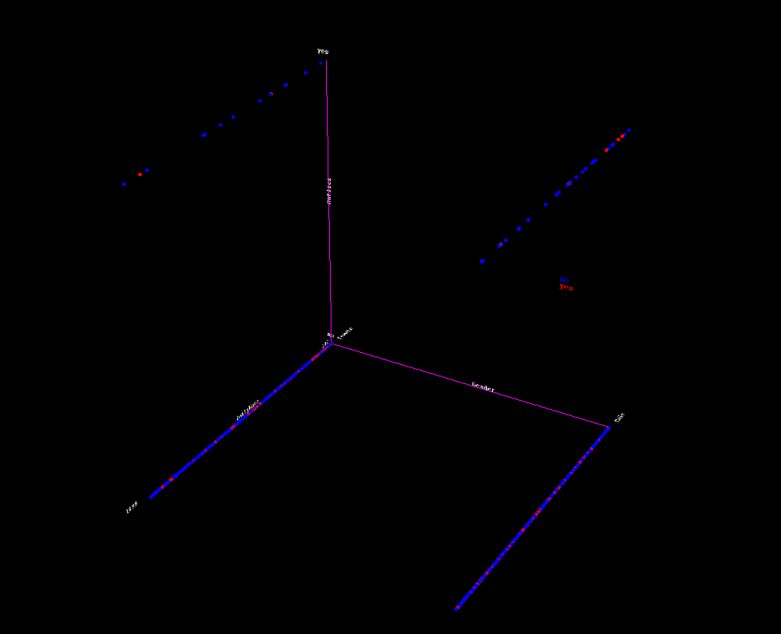
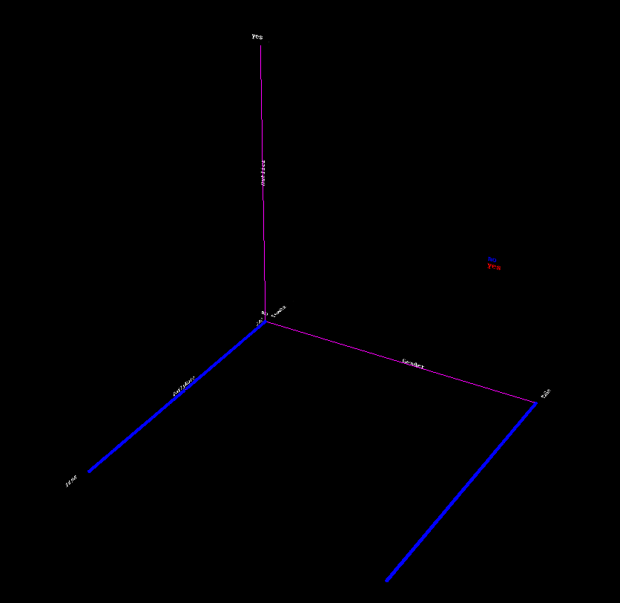
Data Preprocessing cont.
Notes:
Cleaning of Outliners and Extreme values from my Dataset. In the First Figure we can see the place with the circles indicate the level of Extremevalues and outliners present in our dataset. On the other Figure we ca also see that all the outliners were successfully removed.

Slide 8
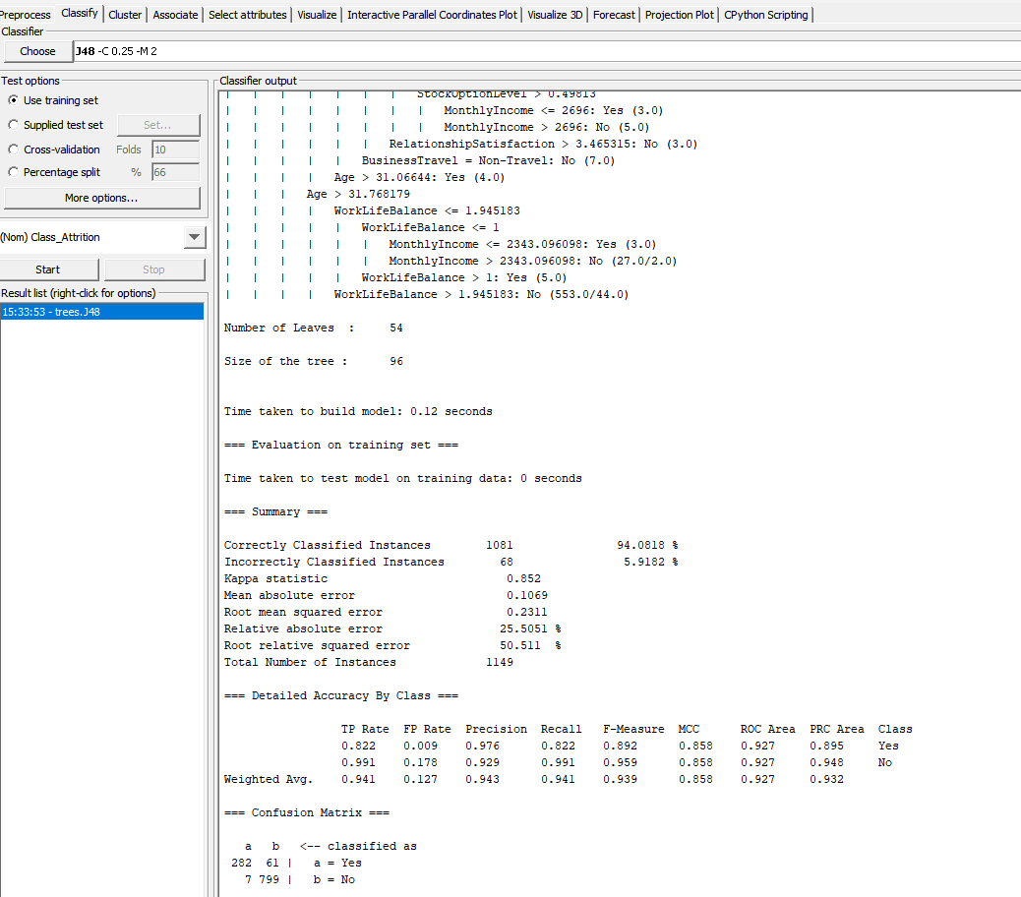
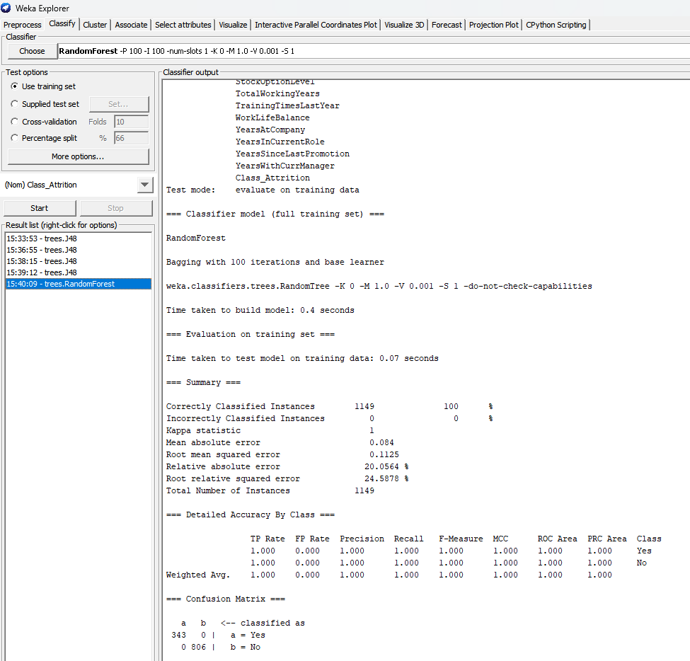
Classification Models (Best Models RF & J48)
Notes:
After building various models using algorithms such as Random Forest, J48 and SMO, we happen to get the best result from Random Forest with100% accuracy. Also J48 had the second accuracy with 94%.

Slide 9
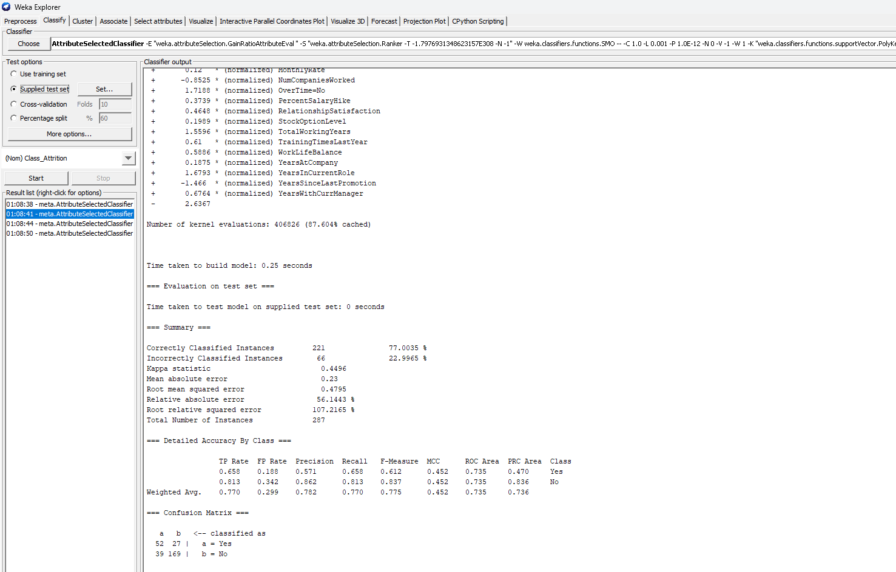
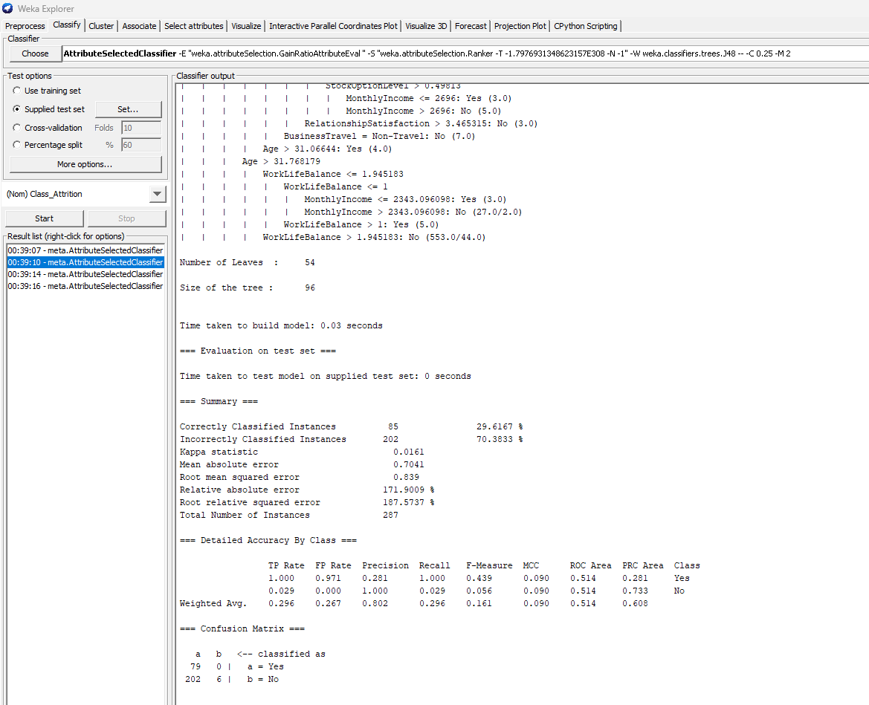
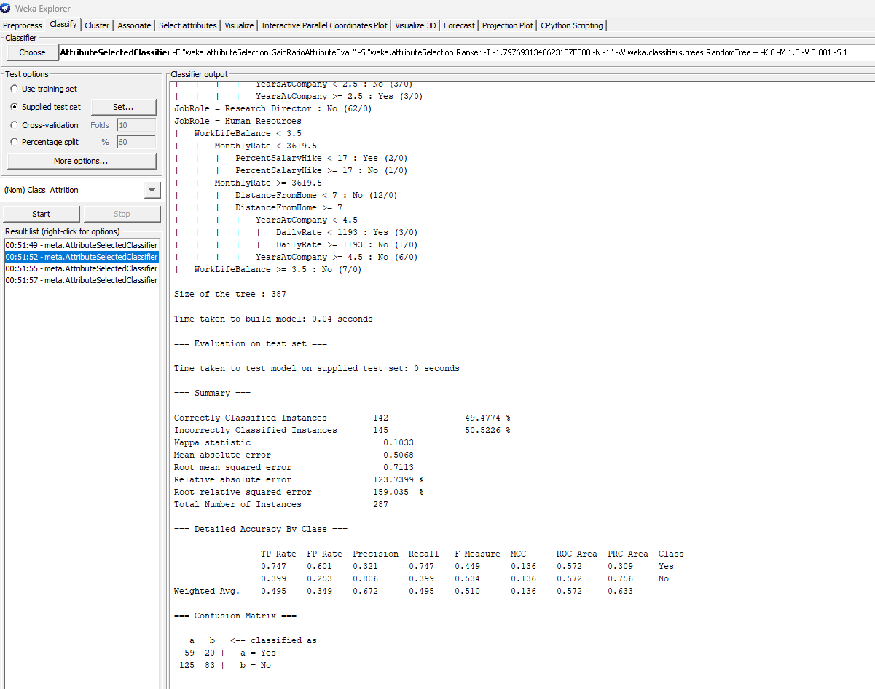
Attribute Selected Classifier
Notes:
Also we can see that in Diagram that SMO performance for supplied test set vas very good and more accurate than Random Forest and J48 although it didn’t perform well on the training set. We can conclude that We can rely only on one Test Option to judge a model but also explore other options that can give you the best performance and accuracy.

Slide 10
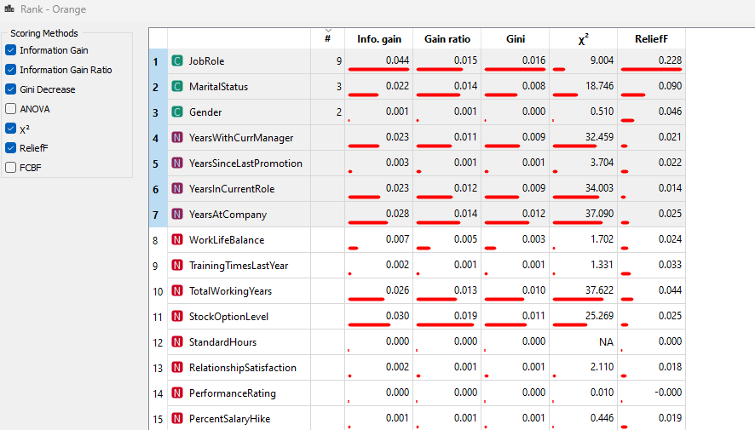
Info Gain
Notes:
Leveraging on the Info Gain attribute to find the significant feature in our attributes. Here we can also observe that JobRole has the highest number in our figure. We can also see that YearsWithCurrManager and Job Role also has a relationship which means has great impact on our classification class.

Slide 11
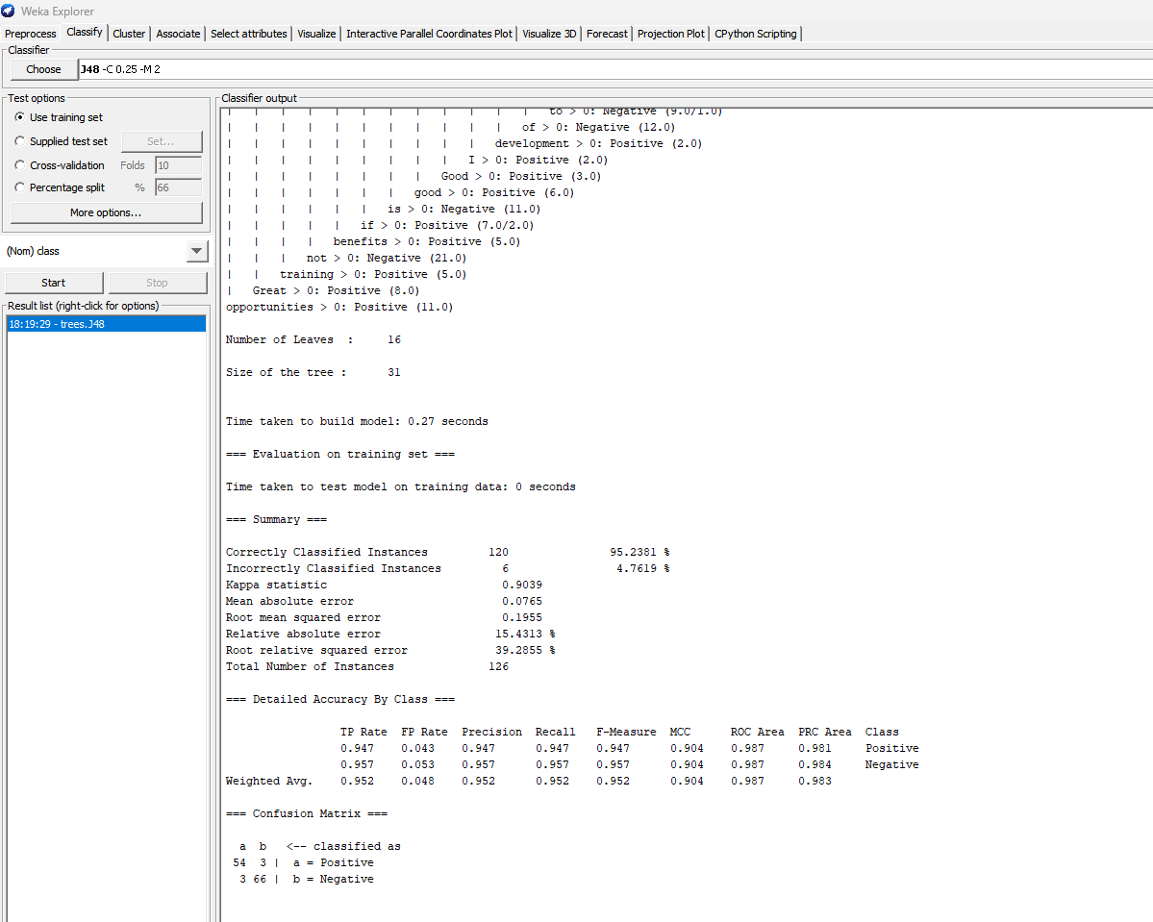
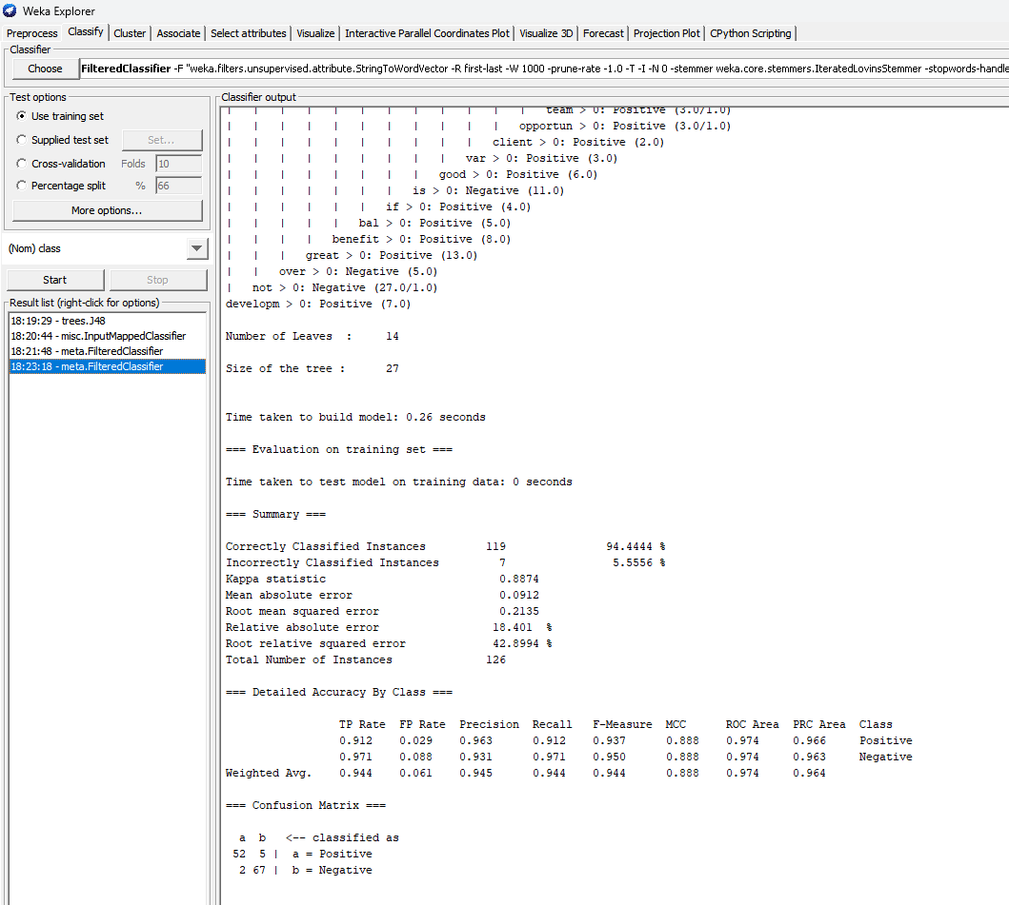
Text Mining – Original/Optimized
Notes:
The first figure shows the original training test performance using J48. In this experiment the accuracy was 95.2381%. The second figure shows the accuracy after optimization where the accuracy dropped to 94.444%. The only difference we had here was that the number of trees in the optimized decreased to 14 as compared to the original one which was had 16 number of trees.

Slide 12
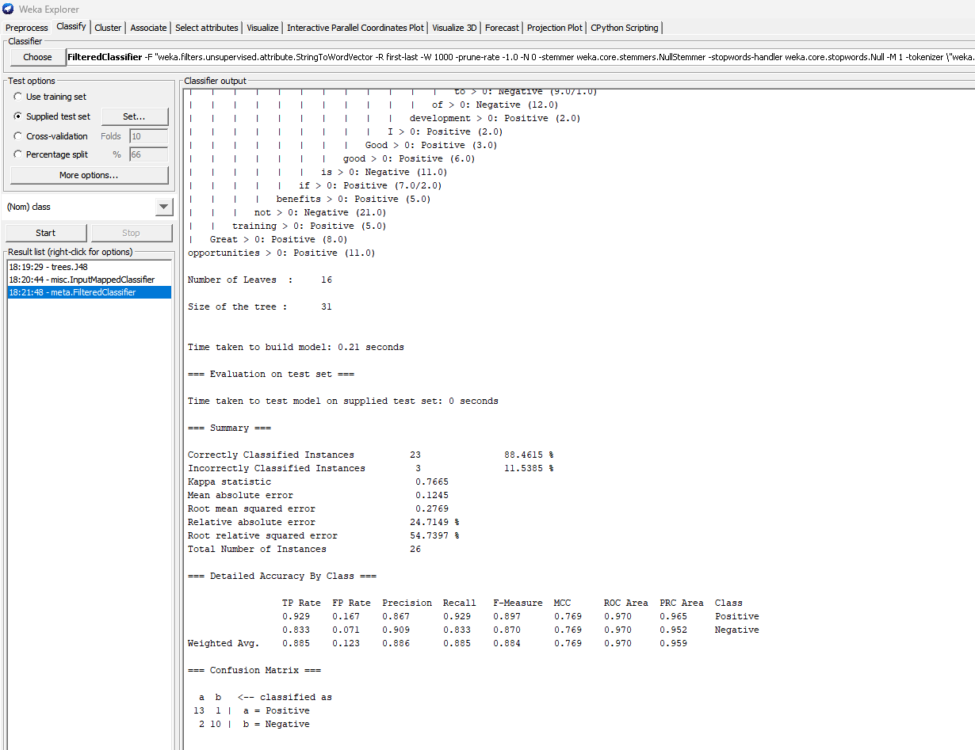
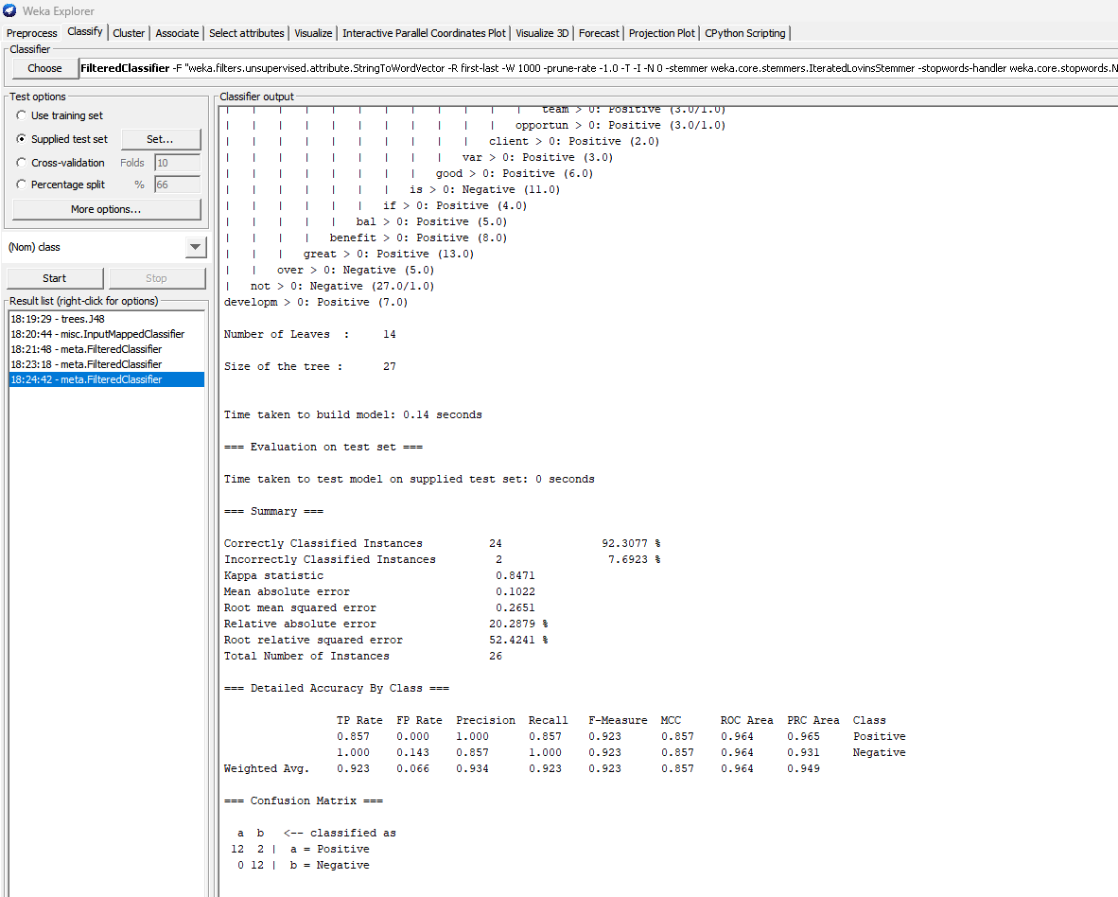
Text Mining – Original/Optimized cont.
Notes:
The first figure shows the original supplied test set performance using J48. In this experiment the accuracy was 88.4615%. The second figure shows the accuracy after optimization using the Filtered Classifier where the accuracy increased to 92.3077%. Here we notice that the performance after the optimization increased comparing to the performance on the training test. The Optimization model decreased.

Slide 13

Visual Mining
Notes:
This figure shows some of the important keywords, identifying patterns, the positive and negative comments by using word cloud to visually represent, analyze and quickly recognize patterns that may require further investigation, insights and hypotheses leading to better understanding and decision-making.

Slide 14
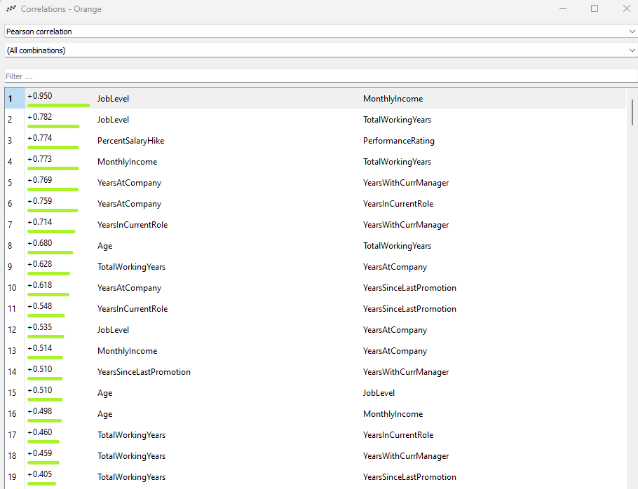
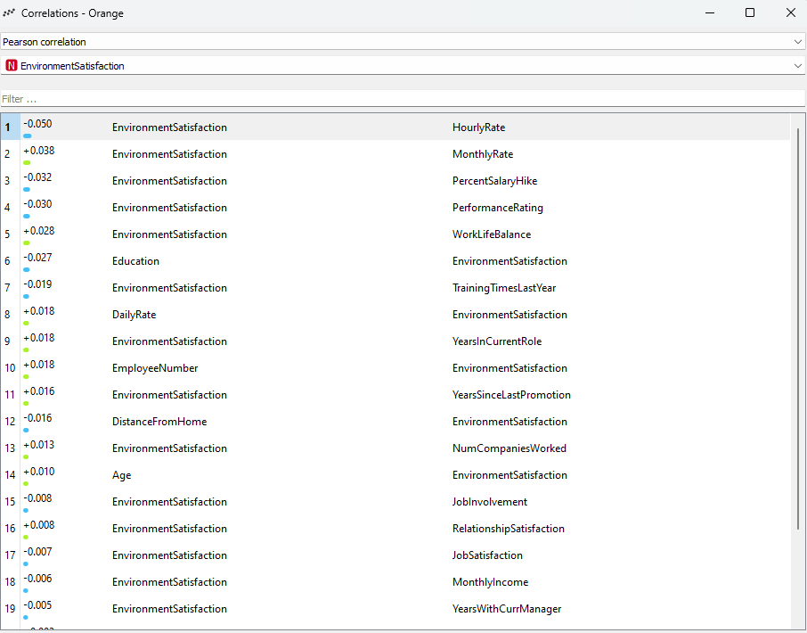
Correlation
Notes:
This correlation analysis measure the positive and negative strength and direction of the relationship between the variables.

Slide 15
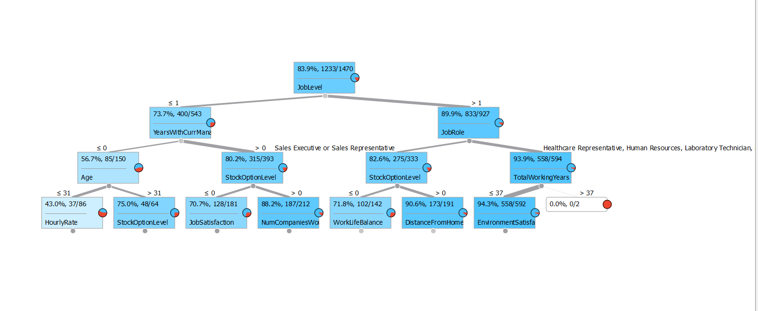
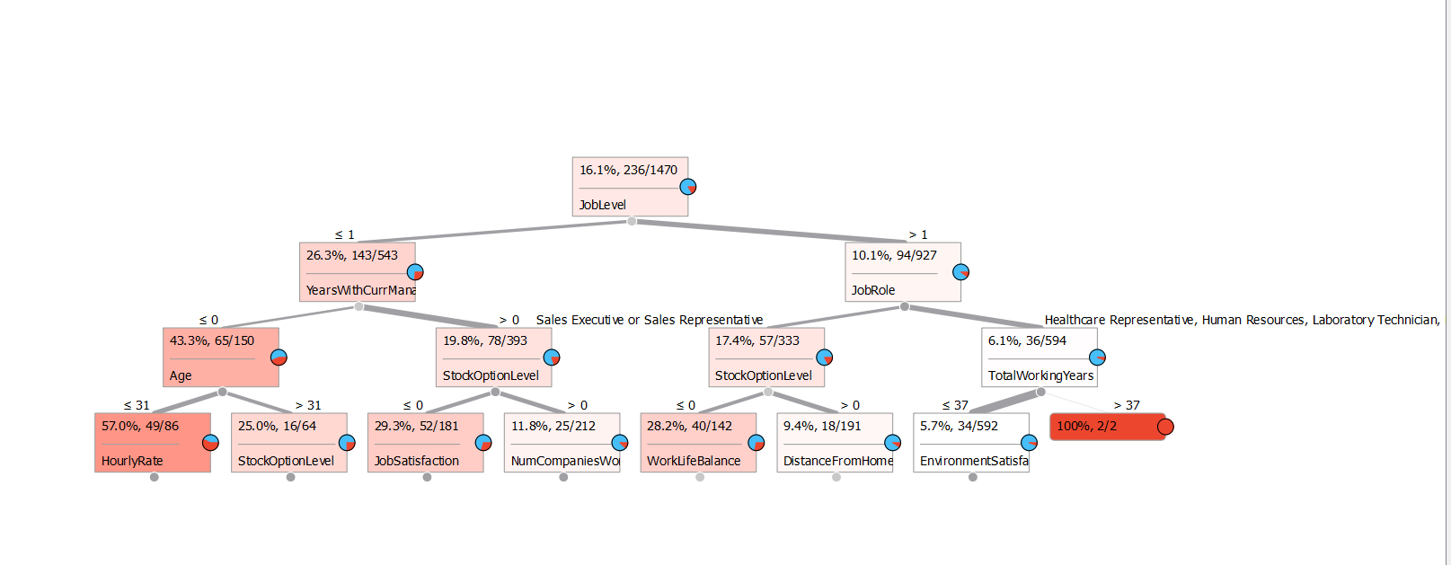
Decision Tree
Notes:
In this decision tree we can see that JobLevel is the best predictor to classify the Attrition Rate(NO class). Followed by YearsWithCurrManager and JobRole. This Decision Tree helps us know the important features within our dataset. Each internal node represents a feature or attribute, each branch represents a decision rule, and each leaf node represents the outcome or class label.

Slide 16
Conclusion
According to my classification model results, we can know that our finding are in line with people’s behavior in the real world. I utilized Random Forest, J48 and SMO classifier to build my model. Random Forest had the best result of 100% accuracy and prediction, followed by J48 with 94% accuracy. I used Text Mining techniques to again find the relationships between the features to fish out some key attributes that can possibly lead to iteration in IBM. I noticed that MontlyIncome, JobInvolvement, EnvironmentSatisfaction, Relationship Satisfaction, YearsWithCurManager and YearsIncurrent role plays a vital role when it comes to employee attrition. Then I found Age, high job level, high job satisfaction, high monthly income, number of years worked with the company and also years worked with current manger, these kinds of people are not likely to leave. However, different people have various intention, we need to do further and detailed analysis to find relationships by using correlation and attribute gain . In my correlation analysis, I found out that JobLevel and MonthlyIncome, JobLevel and TotalWorking Years, Years at Company and Years With Company, Age and JobLevel, Age and MonthlyIncome were highly correlated. This means that people are likely to resign if they don’t fall into these categories or find themselves lower than the category. Finally, there are other interesting findings in my analysis in terms of number of companies worked, people who worked in 2 - 4 companies are less likely to leave. To evaluate the model performance, we trained and tested the dataset to predict the employee attrition, split it into two parts(80% for training, 20% for testing ), and recorded the test set’s accuracy. Random Forest and J48 accuracy were 1.0 and 0.94, respectively, which meant J48 fitted better and was more suitable for prediction in our dataset.

Slide 17
Recommendations
Since attrition has been a serious problem for IBM, data analysts would like to estimate whether their employees are leaving IBM to avoid further increases in the attrition rate and keep the employees in their positions. With the data collected recording the employees’ basic information, classification models can be built to estimate their attrition status of them, and by looking into the results, analysts will be able to figure out the reasons why some of the employees have left and provide better working conditions to prevent others from resignation. Also I want to make some suggestions to the company through this analysis, hoping that they will care more about their employees and improve their job satisfaction. The company should allow employees to have enough time to rest and spend time with their families. There is a general belief that employees who take regular breaks are more productive.

Slide 18
Thank You

