Slide 1
Data Analytics Vs. Data Analysis Vs. Data Science

Slide 2
Contents
Data Analytics vs. Data Analysis
What is Data Science

Slide 3
Data Analytics vs. Data Analysis
Data is information processed or reserved by a computer. This information or may be in the form of text, images, audio, programs, or other types of data.
Data can be of a gigabyte, petabyte, Exabyte or even more this type of data come under big data.
Big Data follows the principle of 4Vs that are high volume, high-velocity high variety and high veracity information that wants cost-effective, unconventional forms of information processing for aggrandizing insight and decision making.
Big data can be used in many domains like banking, media, telecommunication, retail and wholesale, government, insurance, transportation. With the help of data, one can perform data analytics and data analysis both.
Data analysis is a procedure of investigating, cleaning, transforming, and training of the data with the aim of finding some useful information, recommend conclusions and helps in decision-making.
Data analysis tools are Open Refine, Tableau public, KNIME, Google Fusion Tables, Node XL and many more.
Analytics is utilizing data, machine learning, statistical analysis and computer-based models to get better insight and make better decisions from the data.

Slide 4
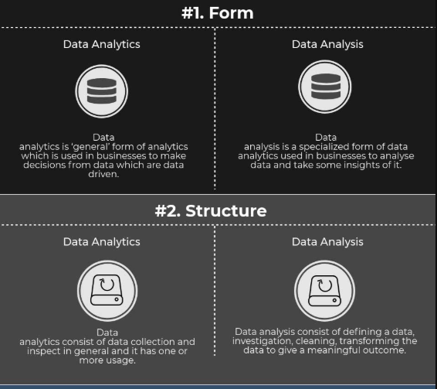
Data Analytics vs. Data Analysis
Analytics is defined as “a process of transforming data into actions through analysis and insight in the context of organizational decision making and problem-solving.” Analytics is supported by many tools such as Microsoft Excel, SAS, R, Python(libraries), tableau public, Apache Spark, and excel.

Slide 5
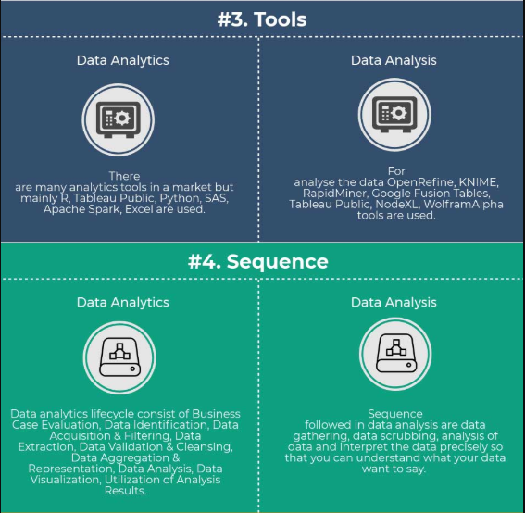
Data Analytics vs. Data Analysis

Slide 6
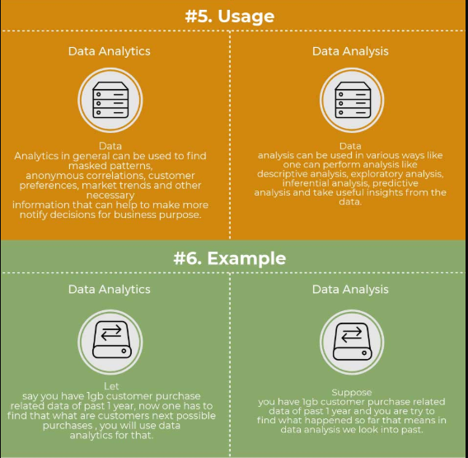
Data Analytics vs. Data Analysis

Slide 7
Data Analytics vs. Data Analysis
Analysis is separating out a whole into parts, study the parts individually and their relationships with one another.
For example - if we have a whole data set and we are doing analysis on it means we pull sample data set from the whole data and then learn more about it and how it is related to the other samples.
Analytics is the principle or logic that drives the analysis.
For example - As mentioned in above example when we pull the sample and do analysis on it, the techniques or logic we are using to analyse the sample is analytics.
Data Analysis. This process (and I stress ‘process’) largely involves the collection, manipulation and examination of data. Data Analysis can be broken down into a few component parts…
Gathering data. This can involve drawing data from a number of disparate sources, including data centers or even locally.
Separating data into component parts. This involves dividing data sets into related categories, even if they are from different sources.
Examining the data for insights. What can you learn from your newly organized data sets? What insights are hidden there?

Slide 8
Data Analytics vs. Data Analysis
Data Analytics. This is similar to Data Analysis in that we are looking at examined / manipulated data. But it is much more. Data Analytics is taking the data we have unearthed and analysed, and presenting it to management and other team members in a meaningful and useful way, such as clearly designed and intuitive dashboards - (here are some great examples). This is where we begin to look into the future to help make better informed business decisions

Slide 9
Data Science
Data Science is the art and science of extracting actionable insight from raw data. We can define data science as a multidisciplinary blend of data inference, algorithm development, and technology in order to solve analytically complex problems.
“Data Science is when you are dealing with Big Data, large amounts of data”.
Data Science is mining large amounts of structured and unstructured data to identify patterns.
Data Science includes a combination of programming, statistical skills, Machine Learning Algorithm.
Data science is all about uncovering findings from data through a different process, tools, and techniques involved to identify patterns from raw data. These raw data are basically Big Data in form of structured, semi-structured and unstructured data.
Data science is the study of where information comes from, what it represents and how it can be turned into a valuable resource in the creation of business and IT strategies. Mining large amounts of structured and unstructured data to identify patterns can help an organization rein in costs, increase efficiencies, recognize new market opportunities and increase the organization’s competitive advantage.
Data scientist work depends on a requirement, business needs, market requirement and exploring more business from black data.
Data science is a concept used to tackle and monitor huge amounts of data, or 'big data.' Data science includes processes like data cleansing, preparation, and analysis. A data scientist collects data from multiple sources like surveys, physical data plotting's, etc. They then pass the data through vigorous algorithms to extract critical information from the data and make a data set. This dataset could be further fed to analyzing algorithms to make more meaning out of it. This is where data analytics comes in.

Slide 10
Data Science
Data Science is a field that encompasses related to data cleansing, preparation, and analysis. Data science is an umbrella term in which many scientific methods apply.
For example mathematics, statistics, and many other tools scientists apply to data sets. Scientist applies the tools to extract knowledge from data.
It is a tool to tackle Big Data. And then extract information from it. First Data scientist gathers datasets from multi-disciplines and compiles it. After that, apply machine learning, predictive and sentimental analysis.
Data scientist understands data from a business point of view. His work is to give the most accurate prediction. He takes charge of giving his predictions. The prediction of data scientist is very accurate.
In artificial intelligence and machine learning, Data scientist has a great role to play. For Data scientist, knowledge of machine learning is the must.
In simple words, data science is the processing and analysis of data that you generate for various insights that will serve a myriad of business purposes.
This data will be used by a data scientist at the backend to understand your behavior and push you retargeted advertisements and deals to get you purchase what you browsed.
Data science involves the processes of
Data extraction / Loading
Data Cleansing / Scrubbing / Manipulation / Transformation
Analysis - ML
Analytics - ML
Visualization – Python Libraries (MatPlotLib)

Slide 11
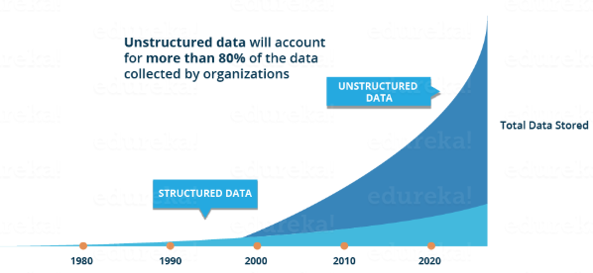
Data Science
Traditionally, the data that we had was mostly structured and small in size, which could be analyzed by using the simple BI tools. Unlike data in the traditional systems which was mostly structured, today most of the data is unstructured or semi-structured. Let’s have a look at the data trends in the image given below which shows that by 2020, more than 80 % of the data will be unstructured.
This data is generated from different sources like financial logs, text files, multimedia forms, sensors, and instruments. Simple BI tools are not capable of processing this huge volume and variety of data. This is why we need more complex and advanced analytical tools and algorithms for processing, analyzing and drawing meaningful insights out of it.

Slide 12
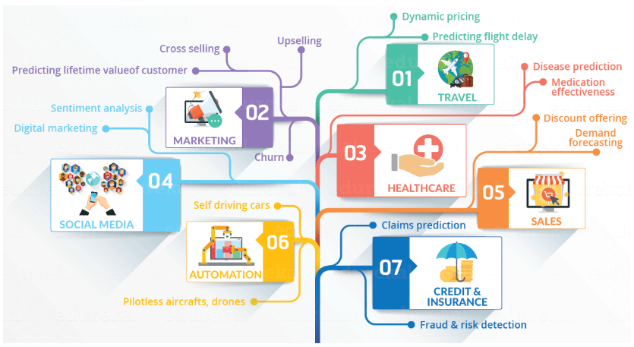
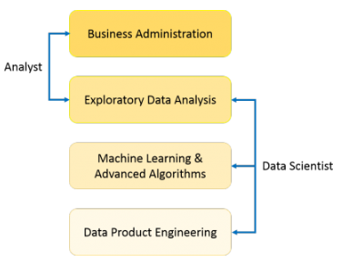
Data Science

Slide 13
Data Science
Data Science is a discipline that utilizes a combination of mathematical, statistical, and computational tools to acquire, process, and analyze Big Data.
Data scientists and data analysts use statistical inference and data visualization techniques along with their domain expertise to not only extract hidden and useful patterns from large datasets but also to communicate those insights into business-oriented directives.
Data Science involves the following five processes:
Data extraction
Data Cleansing
Analysis
Visualization
Generation of Actionable Insights
Data Science involves the processing of big data (both structured and unstructured) including the preparation, analysis, cleansing of the data. It also involves programming, mathematics, statistics, problem-solving, capability to view things differently, intuitively capturing data etc.
You can say that data science is a broader term for the techniques involved in retrieving insights and information from the data.

Slide 14
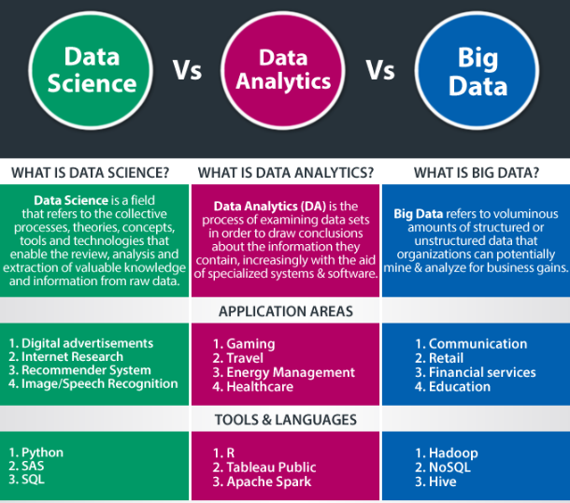
Data Science

Slide 15
Data Science
What Skills Are Required to Be a Data Scientist?
Deep knowledge of Python, R.
Knowledge of databases like SQL.
Good knowledge in the field of mathematics and statistics.
Understanding of analytical functions.
Knowledge and experience in machine learning.
What Skills Are Required to Be a Data Analyst?
Sound knowledge of R and Python
Communication and Data visualization skills.
In-depth knowledge in Data wrangling skills
In-depth knowledge of HIVE
Mathematics and Statistical skills

Slide 16
Data Science
Data Science vs Data Analytics – Responsibilities
A Data Scientist Responsibilities
Data cleansing and processing.
Prediction of the business problem. His roles are to give future results of that business.
Develop machine learning models and analytical methods.
Find new business questions that can then add value to the business.
Data mining using state-of-the-art methods.
Presenting results in a clear manner and doing the ad-hoc analysis.
Data Analyst Responsibilities
Identify any data quality issues in data acquisition.
Solving business problems. By mapping and then tracing the data.
A Data analyst should coordinate with engineers to gather new data.
Perform statistical analysis of business data.
Documenting the types and structure of the business data.

Slide 17
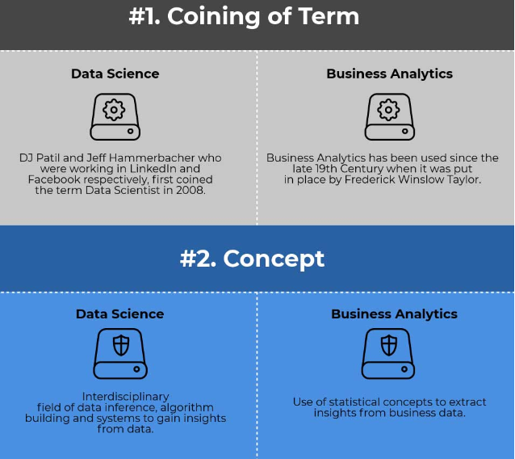
Data Science vs. Data Analytics

Slide 18
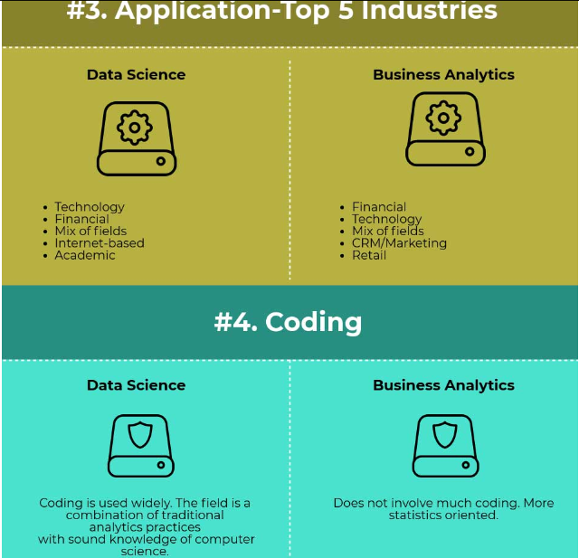
Data Science vs. Data Analytics

Slide 19
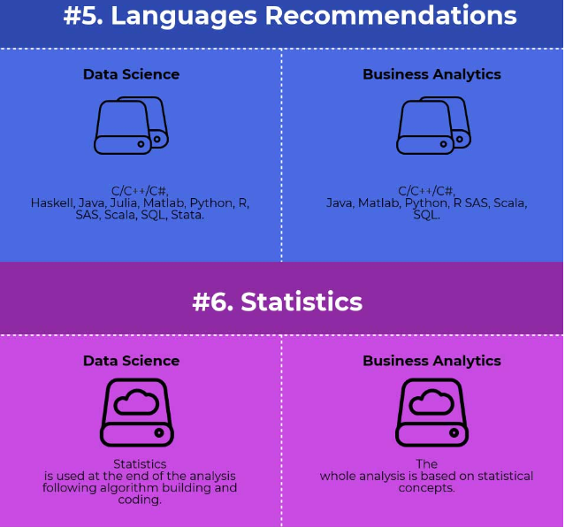
Data Science vs. Data Analytics

Slide 20
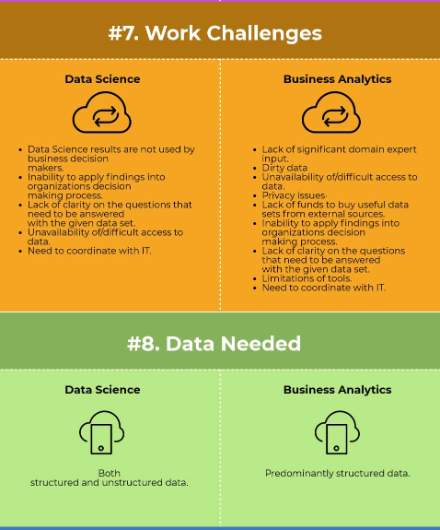
Data Science vs. Data Analytics

Slide 21
Data Science vs. Data Analytics

Slide 22
Data Science vs. Data Analytics
Data Science is the art and science of extracting actionable insight from raw data. We can define data science as a multidisciplinary blend of data inference, algorithm development, and technology in order to solve analytically complex problems.
“Data Science is when you are dealing with Big Data, large amounts of data”.
Data Science is mining large amounts of structured and unstructured data to identify patterns.
Data Science includes a combination of programming, statistical skills, Machine Learning Algorithm.
Data science is all about uncovering findings from data through a different process, tools, and techniques involved to identify patterns from raw data. These raw data are basically Big Data in form of structured, semi-structured and unstructured data.
Data science is the study of where information comes from, what it represents and how it can be turned into a valuable resource in the creation of business and IT strategies. Mining large amounts of structured and unstructured data to identify patterns can help an organization rein in costs, increase efficiencies, recognize new market opportunities and increase the organization’s competitive advantage.
Data scientist work depends on a requirement, business needs, market requirement and exploring more business from black data.

Slide 23
Data Science vs. Data Analytics
Data Analytics, or data analysis, is similar to data science, but in a more concentrated way. Data analytics is a data science. The purpose of data analytics is to generate insights from data by connecting patterns and trends with organizational goals. Comparing data assets against organizational hypotheses is a common use case of data analytics, and the practice tends to be focused on business and strategy.
Data analytics deals less in AI, machine learning, and predictive modeling, and more with viewing historical data in context.
Data analysts are not commonly responsible for building statistical models or deploying machine learning tools.
Data Analytics uses basic query expressions like SQL to slice and dice data.
Data Analysts are less likely to be versed in big data settings.
Data Analysts wrangle data that are either localized or smaller in footprint.
Data analysts have less freedom in scope and practice and practice a more focused approach to analyzing data. They’re also much less involved in the culture of data work.

