Slide 1
WASTE COLLECTION
AND MANAGEMENT
Team No: []
2620030154 | RAMADUGULA ADITYA
2620030072 | ADITYA KIRAN PESINGI
2620030031 | JAYACHANDRA PERUGU

Slide 2
Abstract
OVERVIEW
Waste Collection and Management is a Java-based project for recording waste quantities across different areas. It stores area names and waste amounts, calculates the total collected waste, and helps identify high-priority areas. A menu-driven interface supports registering and displaying records. Methods and method overloading make calculations reusable, while inheritance extends collection features. Input validation and exception handling help manage invalid entries, and an ArrayList maintains a flexible list of registered areas. The project demonstrates how core Java concepts can support more organized waste monitoring, collection planning, and reporting.
KEY FOCUS • Record areas • Calculate totals • Flag priorities • Validate input

Slide 3
Understanding the Problem Statement
Waste details can be difficult to track when area names, quantities, and collection priorities are recorded inconsistently
THE CHALLENGE
THE NEED
THE APPROACH
Manual records can be hard to update, total, and compare across areas.
A simple system to register areas, store waste amounts, and summarize data.
A Java menu-driven program with arrays, methods, decisions, and validation.
PROJECT GOAL
To make waste records easier to maintain, calculate total collected waste accurately, and highlight areas that may require priority collection.

Slide 4
CO 1 — Data Types, Operators & Scanner
MODULE 1
DATA TYPES
OPERATORS & INPUT
total += wasteAmounts[i] adds each amount to the running total.
Scanner sc = new Scanner(System.in) accepts user input.
Double.parseDouble(sc.nextLine()) converts the entered quantity to a number.
double amount — stores a waste quantity
int count — stores the number of areas
String name — stores an area name
CO application: capture waste data and calculate totals from user-provided values.

Slide 5
CO 2 — Loops & Conditional Statements
MODULE 2
IF–ELSE
SWITCH & BREAK
if (wasteAmounts[i] >= 100) identifies areas with high waste quantities.
switch (choice) routes the selected menu operation; break ends a case.
FOR LOOP
DO–WHILE LOOP
for (int i = 0; i < count; i++) processes each registered area.
Repeats the menu until choice != 7 is false, allowing repeated operations.
CO application: control program flow and process multiple records efficiently.

Slide 6
CO 3 — Methods, Arrays & Method Overloading
MODULE 3
METHODS
ARRAYS
OVERLOADING
addArea() registers a new area.
displayAreas() displays stored records.
Reusable methods keep tasks organized.
areaNames[] stores area names.
wasteAmounts[] stores quantities.
Matching indexes link each area to its waste amount.
calculateTotalWaste()
calculateTotalWaste(double extraWaste)
Two signatures support normal and additional-waste totals.
CO application: structure the program, manage multiple entries, and reuse total calculations.

Slide 7
CO 4 — Inheritance & Exception Handling
MODULE 4
INHERITANCE
EXCEPTION HANDLING
class PriorityCollection extends WasteCollection
The child class reuses suitable fields and methods from the parent class.
PriorityCollection(int size) calls super(size) to initialize the parent portion.
A try-catch block handles invalid numeric input.
catch (NumberFormatException e)
This helps prevent a malformed number from terminating the program unexpectedly.
CO application: extend functionality through inheritance and make input handling more robust.

Slide 8
CO 5 — String Operations
MODULE 5
STRING DECLARATION
trim()
String name and String type store area names and waste categories.
sc.nextLine().trim() removes leading and trailing spaces from input.
isEmpty()
STRING CONCATENATION
if (name.isEmpty()) checks whether the entered area name is empty.
"Area: " + areaNames[i] combines a label with the stored area name for reports.
CO application: clean, validate, and present text data clearly.

Slide 9
CO 6 — ArrayList
MODULE 6
DYNAMIC REGISTRATION
COMMON OPERATIONS
ArrayList<String> registeredAreas = new ArrayList<>();
The list can grow as area names are registered, without defining a fixed size in advance.
registeredAreas.add(name) adds an area.
registeredAreas.isEmpty() checks whether the list has entries.
for (String area : registeredAreas) displays every registered area.
CO application: maintain and display a flexible list of successfully registered areas.

Slide 10
Conclusion
SUMMARY
• The project organizes waste quantities and area names in a structured Java program.
• Loops, conditions, and a menu help users process records and identify high-priority areas.
• Methods, arrays, and overloading support reusable calculations and efficient data handling.
• Inheritance, exception handling, String operations, and ArrayList improve extensibility and input management.
Outcome: a clear foundation for more systematic waste collection and reporting.

Slide 11
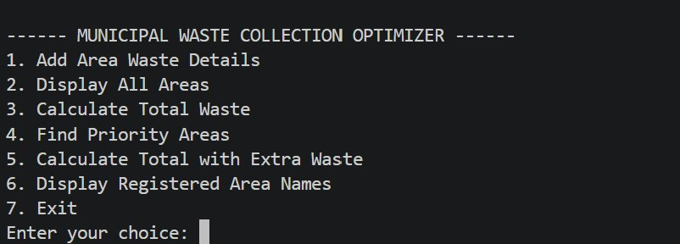
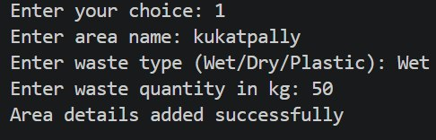
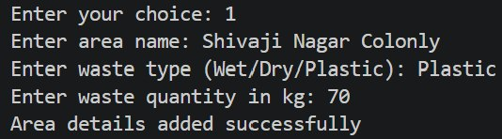
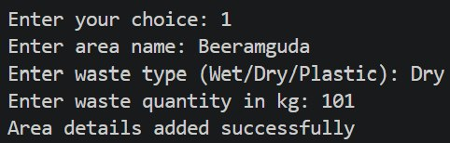
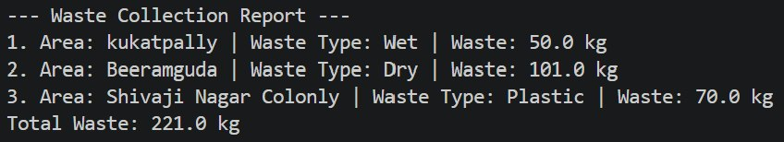
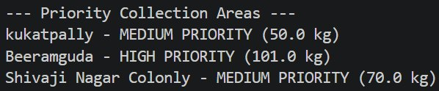


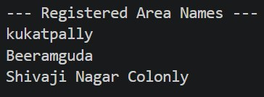
Program Screenshots

Slide 12
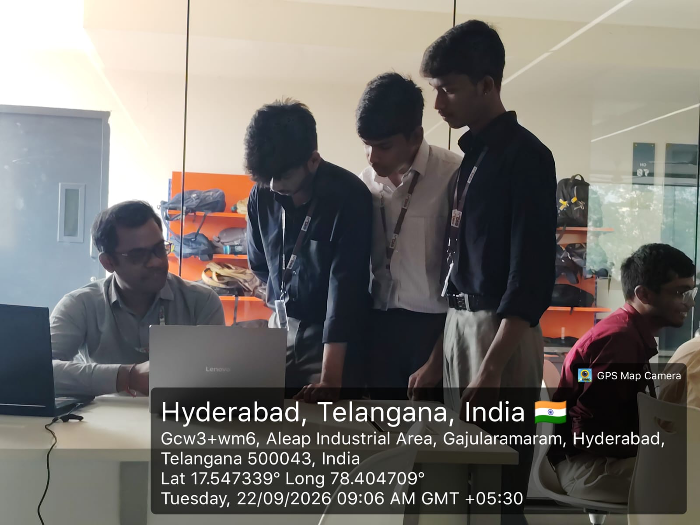
Geo-Tagged Photo & GitHub Link
GEO-TAGGED PROJECT PHOTO
GitHub - jayachandra2009/KLH-CSE-PSPJAVA-25-MunicipalWasteCollectionOptimizer: PSPJAVA Municipal Waste Collection Optimizer · GitHub
GITHUB REPOSITORY

