Slide 1

SREE RAMA ENGINEERING COLLEGE
(AUTONOMOUS)
Accredited by NAAC with ‘A’ Grade
(Approved by AICTE, New Delhi - Affiliated to JNTUA, Ananthapuramu)
An ISO 9001:2015 & ISO 14001:2015 certified Institution
Rami Reddy Nagar, Karakambadi road, Tirupati-517507
Department of Computer Science and Engineering
First Review
Title: Injury Risk Prediction in Soccer Using
Machine Learning
(IEEE Xplore International Conference on Cloud Computing & Data Science 2024 )
Presented By:
Name Roll No.
T.Lakshmi 214C1A05H1
P.Suresh 214C1A05E2
RS.Sai suvarna 214C1A05E4
J.Jaya Chandra 224C5A0506
M.Om sree 204C1A05A0
Guide :
Mr.T.Kattaiah ,
Associate Professor ,
Department of CSE ,
Sree Rama Engineering College.

Slide 2
CONTENTS
Abstract
Introduction
Existing System and its Disadvantages
Proposed System and its advantages
System Architecture
Algorithms
Coding
Front End Screenshot
Back End Screenshot

Slide 3
ABSTRACT
Injuries in professional soccer are a major problem for both players and clubs. Serious injuries have the potential to cause detrimental effects on a player's career, or even end it prematurely.
Clubs also suffer when key players are injured; their game tactics may need to be changed to better fit the limited team members available, which can severely affect performance, especially in competitive leagues.
The goal of this research is to demonstrate the feasibility of using a large dataset to train an accurate Machine Learning model to predict injuries in professional-level soccer.

Slide 4
INTRODUCTION
Machine Learning (ML) is the field of study of design and development of algorithms that allow computers to learn and carry out human-like behaviors.
Their utility extends through all aspects of society including that of sports science. In recent years ML has become extensively researched as a tool to make sense of the chaotic world of sports.
Many applications of ML have been discovered thus far: predicting player performance, risk of injury, and future talent to name a few.
Specifically, ML has shown great promise as a useful predictor for musculoskeletal injuries in elite soccer players.

Slide 5
EXISTING SYSTEM
Existing systems utilizing machine learning for risk prediction include:
credit scoring models in finance, healthcare risk prediction systems for disease likelihood (like the Framingham Risk Score), fraud detection systems in banking, insurance risk assessment models, and predictive maintenance systems in manufacturing.
All of which leverage various machine learning algorithms to analyze data and predict the probability of future risky events based on historical patterns.

Slide 6
DISADVANTAGES
High set-up costs.
Dependence on technology.
Difficulty in adapting to changing needs.
Leading to inefficiency and inaccuracies.

Slide 7
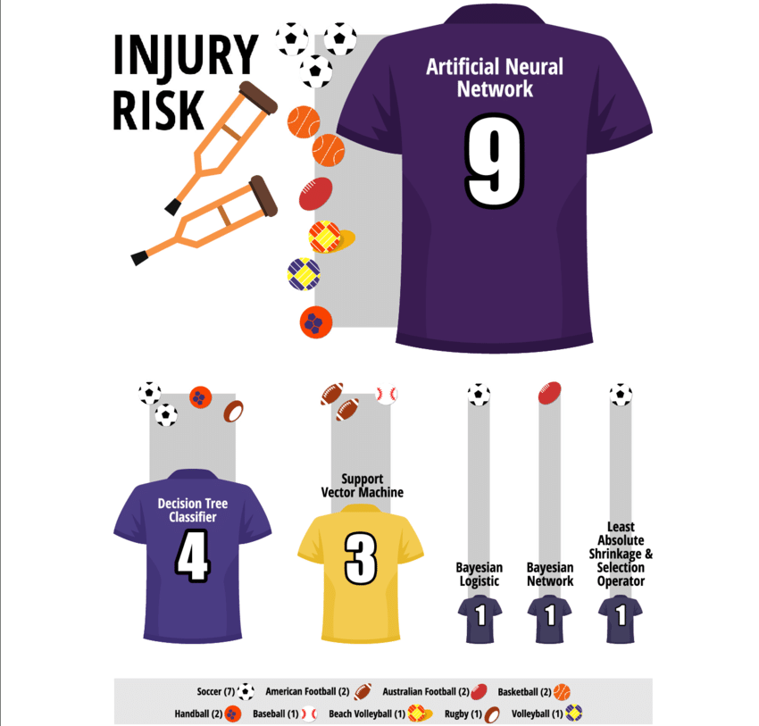
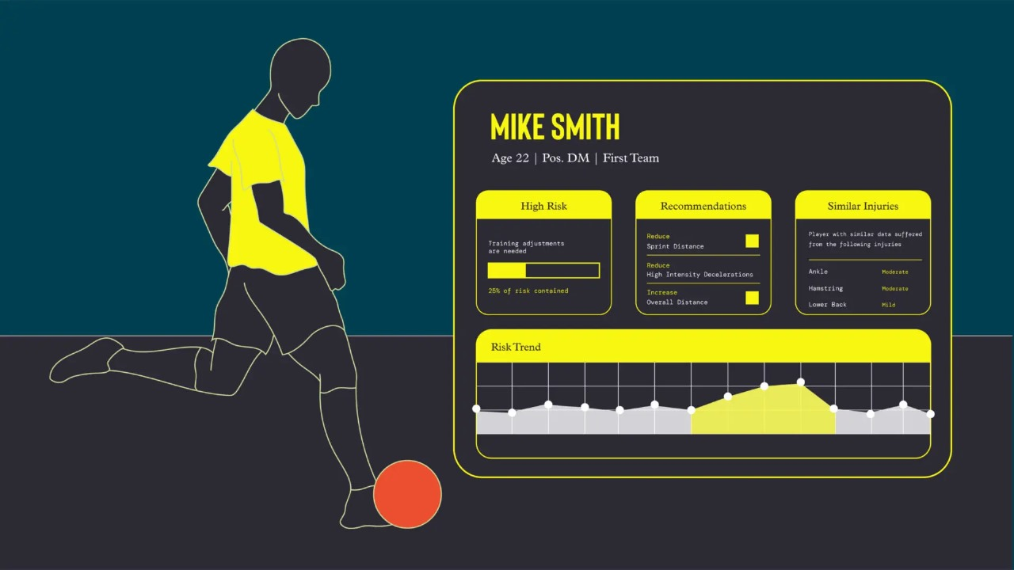
PROPOSED SYSTEM
A proposed system for risk prediction using machine learning would involve :
collecting relevant data from various sources, cleaning and pre-processing it, then applying machine learning algorithms like Logistic Regression, Decision Trees, Random Forests, or Neural Networks to identify patterns and predict the likelihood of a specific risk occurring based on the input data.
Allowing for proactive interventions and informed decision-making.

Slide 8
ADVANTAGES
Speed
Efficiency
Improved communication
Easy to generate reports

Slide 9
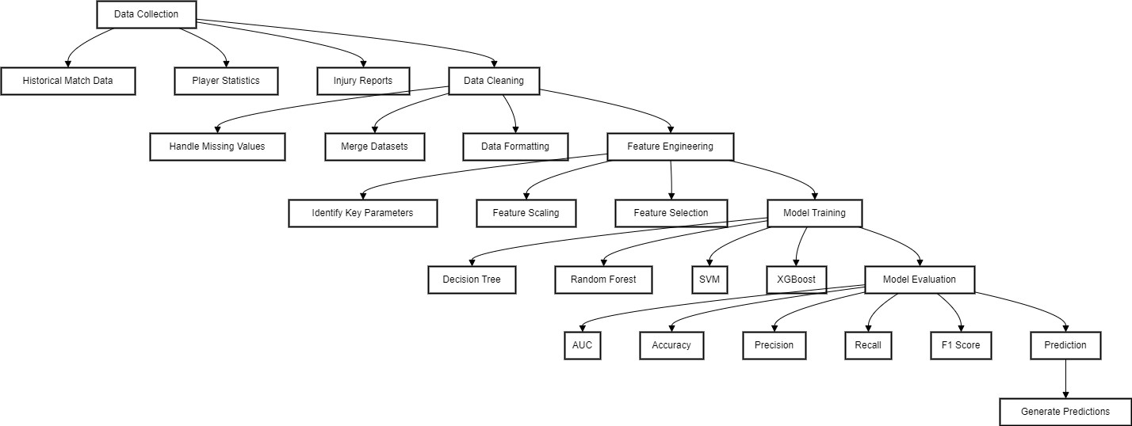
SYSTEM ARCHITECTURE

Slide 10
ALGORITHMS
1. Gradient Boosting Algorithms (XGBoost, LightGBM, CatBoost)
Most commonly used for structured injury datasets.
Handles missing data well, reduces overfitting, and ranks the most important features influencing injury risk.
2. Random Forest
Good for feature importance analysis, helping teams understand which factors contribute most to injuries.
Works well with tabular, time-series, and categorical data from tracking devices.

Slide 11
3. Long Short-Term Memory (LSTM) & Recurrent Neural Networks (RNNs)
Best for sequential/time-series data (e.g., player movement, workload trends, heart rate variations).
Captures long-term dependencies in data, making it useful for monitoring injury risk over weeks/months.

Slide 12
CODING
Base.html:
{% load static %}
<!DOCTYPE html>
<html lang="en-us">
<head>
<meta charset="utf-8">
<title>Project Name | Admin Base Page</title>
<meta name="viewport" content="width=device-width, initial-scale=1, maximum-scale=1">
<!-- theme meta -->
<meta name="theme-name" content="dot" />
<!-- ** CSS Plugins Needed for the Project ** -->
<!-- Bootstrap -->
<link rel="stylesheet" href="{% static 'plugins/bootstrap/bootstrap.min.css' %}">
<!-- themefy-icon -->

Slide 13
<link rel="stylesheet" href="{% static 'plugins/themify-icons/themify-icons.css' %}">
<!--Favicon-->
<link rel="icon" href="images/favicon.png" type="image/x-icon">
<!-- fonts -->
<link href="https://fonts.googleapis.com/css?family=Lato:300,400,700&display=swap" rel="stylesheet">
<!-- Main Stylesheet -->
<link href="{% static 'assets/style.css' %}" rel="stylesheet" media="screen" />
</head>
<body>
<!-- header -->
<header class="banner overlay bg-cover" data-background="images/banner.jpg">
<nav class="navbar navbar-expand-md navbar-dark">
<div class="container">
<a class="navbar-brand px-2" href="">Project Name</a>
<button class="navbar-toggler border-0" type="button" data-toggle="collapse" data-target="#navigation"
aria-controls="navigation" aria-expanded="false" aria-label="Toggle navigation">
<span class="navbar-toggler-icon"></span>
</button>
<div class="collapse navbar-collapse text-center" id="navigation">
<ul class="navbar-nav ml-auto">
<li class="nav-item">
<a class="nav-link text-dark" href="{% url 'HomePage' %}">Home</a>
</li>
<li class="nav-item">
<a class="nav-link text-dark" href="{% url 'viewusers' %}">View-Users</a>
</li>
<li class="nav-item">
<a class="nav-link text-dark" href="#">results</a>
</li>
<li class="nav-item">
<a class="nav-link text-dark" href="{% url 'HomePage' %}">Logout</a>
</li>

Slide 14
</ul>
</div>
</div>
</nav>
<!-- banner -->
<div class="container section">
<div class="row">
<div class="col-lg-8 text-center mx-auto">
<h1 class="text-white mb-3">You're at Admin Home Page</h1>
<p class="text-white mb-4">something about project and its features</p>
</div>
</div>
</div>
<!-- /banner -->
</header>
<!-- /header -->
{% block content %}
{% endblock %}
<!-- ** JS Plugins Needed for the Project ** -->
<!-- jquiry -->
<script src="{% static 'plugins/jquery/jquery-1.12.4.js' %}"></script>
<!-- Bootstrap JS -->
<script src="{% static 'plugins/bootstrap/bootstrap.min.js' %}"></script>
<!-- match-height JS -->
<script src="{% static 'plugins/match-height/jquery.matchHeight-min.js' %}"></script>
<!-- Main Script -->
<script src="{% static 'assets/script.js' %}"></script>
</body>
</html>

Slide 15
Views.py:
from django.shortcuts import render, redirect, get_object_or_404
from django.contrib import messages
import os
from django.conf import settings
from Injury_prediction.models import UserRegistration
#-----------------------------------------------------------------------------------
def MainPage(request):
return render(request,'base.html')
#-----------------------------------------------------------------------------------
def UseCodePage(request):
return render(request,'usecode.html')
#-----------------------------------------------------------------------------------
def RegisterPage(request):
if request.method == 'POST':
username = request.POST['username']
email = request.POST['email']
password = request.POST['password']
phone = request.POST['phone']
address = request.POST['address']
user = UserRegistration.objects.create(
username=username,

Slide 16
email=email,
password=password,
phone=phone,
address=address
)
user.save()
messages.success(request, 'Registration Successful')
return render(request,'register.html')
#----------------------------------------------------------------------------------
def LoginPage(request):
if request.method =='POST':
username = request.POST['username']
password = request.POST['password']
print('Username:', username, 'Password:', password)
try:
loguser = UserRegistration.objects.get(username=username, password=password)
if loguser.is_active:
request.session['username'] = username
messages.success(request, f'Welcome-{username}')
return redirect('userhome')
else:
messages.error(request, 'Account is not activated')
return redirect('login')
except UserRegistration.DoesNotExist:
messages.error(request, 'Invalid username or password')
return redirect('login')
return render(request,'login.html')
#------------------------------------------------------------------------------------

Slide 17
def AdminLogin(request):
if request.method == 'POST':
username = request.POST['username']
password = request.POST['password']
print("Admin:" , username , password)
if username == 'admin' and password == 'admin':
messages.success(request,'Welcome Admin')
return render(request, 'admin/adminhomepage.html')
else:
messages.error(request,'Please Enter valid Details')
return redirect('adminlogin')
return render(request,'adminlogin.html')
#-------------------------------------------------------------------------------------
def ViewUsersList(request):
users = UserRegistration.objects.all()
return render(request,'admin/viewusers.html',{'users':users})
#--------------------------------------------------------------------------------------
def UserHomePage(request):
return render(request,'users/userhomepage.html')
#-----------------------------------------------------------------------------------------
def ActivateUser(request, pk):
user = get_object_or_404(UserRegistration, id=pk)
if user:
user.is_active = True
user.save()
messages.success(request, f'User {user.username} has been activated.')

Slide 18
return redirect('viewusers')
#-----------------------------------------------------------------------------------------
def DeactivteUser(request, pk):
user = get_object_or_404(UserRegistration, id=pk)
if user:
user.is_active = False
user.save()
messages.success(request, f'User {user.username} has been Deactivated.')
return redirect('viewusers')
#----------------------------------------------------------------------------------------------
def PreprocessedData(request):
import pandas as pd
path = os.path.join(settings.MEDIA_ROOT,'injury.csv')
data = path
df = pd.read_csv(data)
df.drop(['p_id2','start_year'],axis=1,inplace=True)
df_html = df.to_html()
return render(request,'users/preprocesseddata.html', {'data':df_html})
#-----------------------------------------------------------------------------------------------------
from django.shortcuts import render
from joblib import load
from .utility.prediction import load_and_predict # Adjust the import based on your project structure

Slide 19
def UserPredictionPage(request):
prediction_result = None
error_message = None
if request.method == 'POST':
try:
height = float(request.POST.get('height', 0.0))
weight = float(request.POST.get('weight', 0.0))
work_rate = float(request.POST.get('work_rate', 0.0))
pace = float(request.POST.get('pace', 0.0))
physic = float(request.POST.get('physic', 0.0))
position = float(request.POST.get('position', 0.0))
age = float(request.POST.get('age', 0.0))
cumulative_minutes_played =
float(request.POST.get('cumulative_minutes_played', 0.0))
minutes_per_game = float(request.POST.get('minutes_per_game', 0.0))
avg_days_injured = float(request.POST.get('avg_days_injured', 0.0))
injured_per_seasons = float(request.POST.get('injured_per_seasons', 0.0))
cumulative_days_injured = float(request.POST.get('cumulative_days_injured', 0.0))
user_input = [height, weight, work_rate, pace, physic, position, age, cumulative_minutes_played,
minutes_per_game, avg_days_injured, injured_per_seasons, cumulative_days_injured]

Slide 20
# Predict using the final model
predictions = load_and_predict([user_input])
print("Predicted injury categories:", predictions)
# Assuming predictions is what you want to display in the template
prediction_result = predictions # Update prediction_result with actual predictions
except ValueError as e:
error_message = f"Error: {e}. Please check your input values."
context = {
'prediction_result': prediction_result,
'error_message': error_message,
}
return render(request, 'users/prediction.html', context)
#---------------------------------------------------------------------------------------------------
Prediction.html
{% extends 'users/userbase.html' %}
{% block content %}
<div class="container mt-5">
<h2 class="mb-4">Soccer Injury Risk Prediction</h2>

Slide 21
<div class="card" style="background-color: #91c0f0;">
<div class="card-body ">
{% if prediction_result %}
<h2 class="alert alert-success">Prediction Result: {{ prediction_result }}</h2>
{% endif %}
{% if error_message %}
<div class="alert alert-danger" role="alert">
{{ error_message }}
</div>
{% endif %}
<form method="post">
{% csrf_token %}
<div class="row mb-3">
<div class="col">
<label for="height_cm" class="form-label">Height (cm)</label>
<input type="number" class="form-control" id="height_cm" name="height"
placeholder="Enter height in cm" required>
</div>
<div class="col">
<label for="weight_kg" class="form-label">Weight (kg)</label>
<input type="number" class="form-control" id="weight_kg" name="weight"
placeholder="Enter weight in kg" required>
</div>
</div>
<div class="row mb-3">
<div class="col">
<label for="work_rate_numeric" class="form-label">Work Rate</label>
<input type="number" class="form-control" id="work_rate_numeric" name="work_rate"
placeholder="Enter work rate" required>
</div>
<div class="col">

Slide 22
<label for="pace" class="form-label">Pace</label>
<input type="number" class="form-control" id="pace" name="pace" placeholder="Enter pace"
required>
</div>
</div>
<div class="row mb-3">
<div class="col">
<label for="physic" class="form-label">Physic</label>
<input type="number" class="form-control" id="physic" name="physic" placeholder="Enter physic"
required>
</div>
<div class="col">
<label class="form-label">Position</label>
<input type="number" class="form-control" id="position" name="position" placeholder="Enter Position"
required>
</div>
</div>
<div class="row mb-3">
<div class="col">
<label class="form-label">Age</label>
<input type="number" class="form-control" id="age" name="age" placeholder="Enter player Age"
required>
</div>
<div class="col">
<label for="cumulative_minutes_played" class="form-label">Cumulative Minutes Played</label>
<input type="number" class="form-control" id="cumulative_minutes_played"
name="cumulative_minutes_played" placeholder="Enter minutes played" required>
</div>

Slide 23
</div>
<div class="row mb-3">
<div class="col">
<label class="form-label">Minutes per Game (Previous Seasons)</label>
<input type="number" class="form-control" id="minutes_per_game" name="minutes_per_game"
placeholder="Enter minutes per game played" required>
</div>
<div class="col">
<label class="form-label">Avg Days Injured (Previous Seasons)</label>
<input type="number" class="form-control" name="avg_days_injuried"
placeholder="Enter Avg days injured" required>
</div>
</div>
<div class="row mb-3">
<div class="col">
<label class="form-label">Injury Per Season</label>
<input type="number" class="form-control" name="injured_per_seasons"
placeholder="Enter injuries per seasons" required>
</div>
<div class="col">
<label class="form-label">Cumulative Days Injured</label>
<input type="number" class="form-control" name="cumulative_days_injured"
placeholder="Enter cumulative days injured" required>
</div>
</div>
<center><button type="submit" class="btn btn-primary">Predict</button></center>
</form>
</div>
</div>
</div>
{% endblock %}

Slide 24
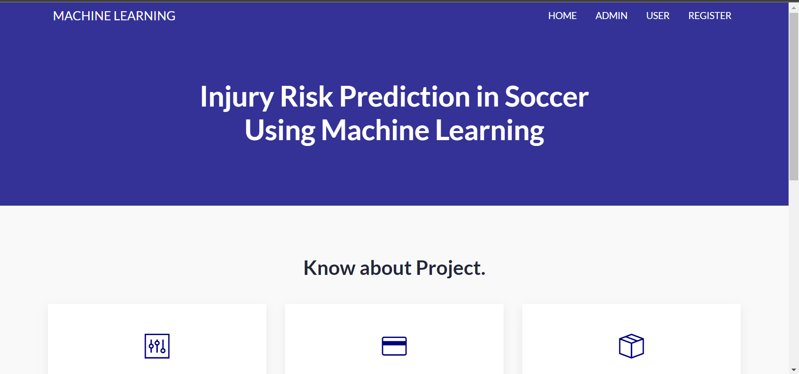
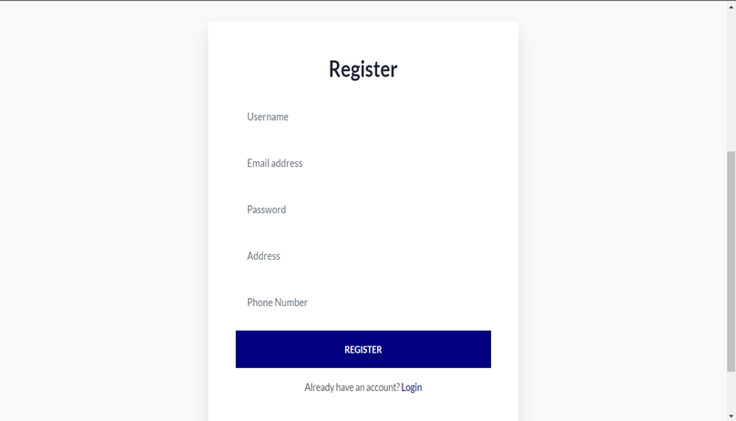
FRONT END SCREENSHOT
Register Form
Home page

Slide 25
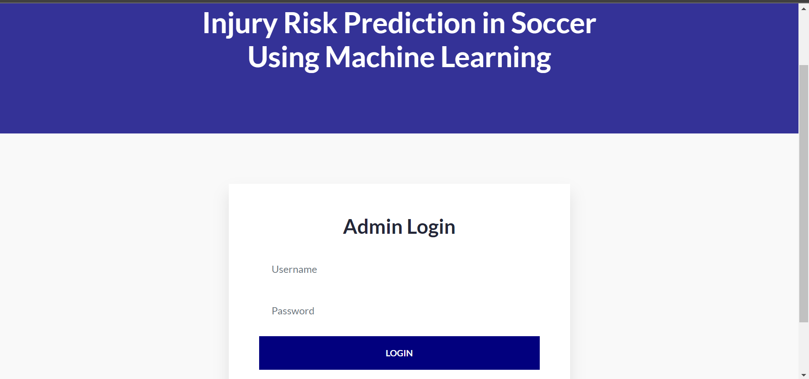
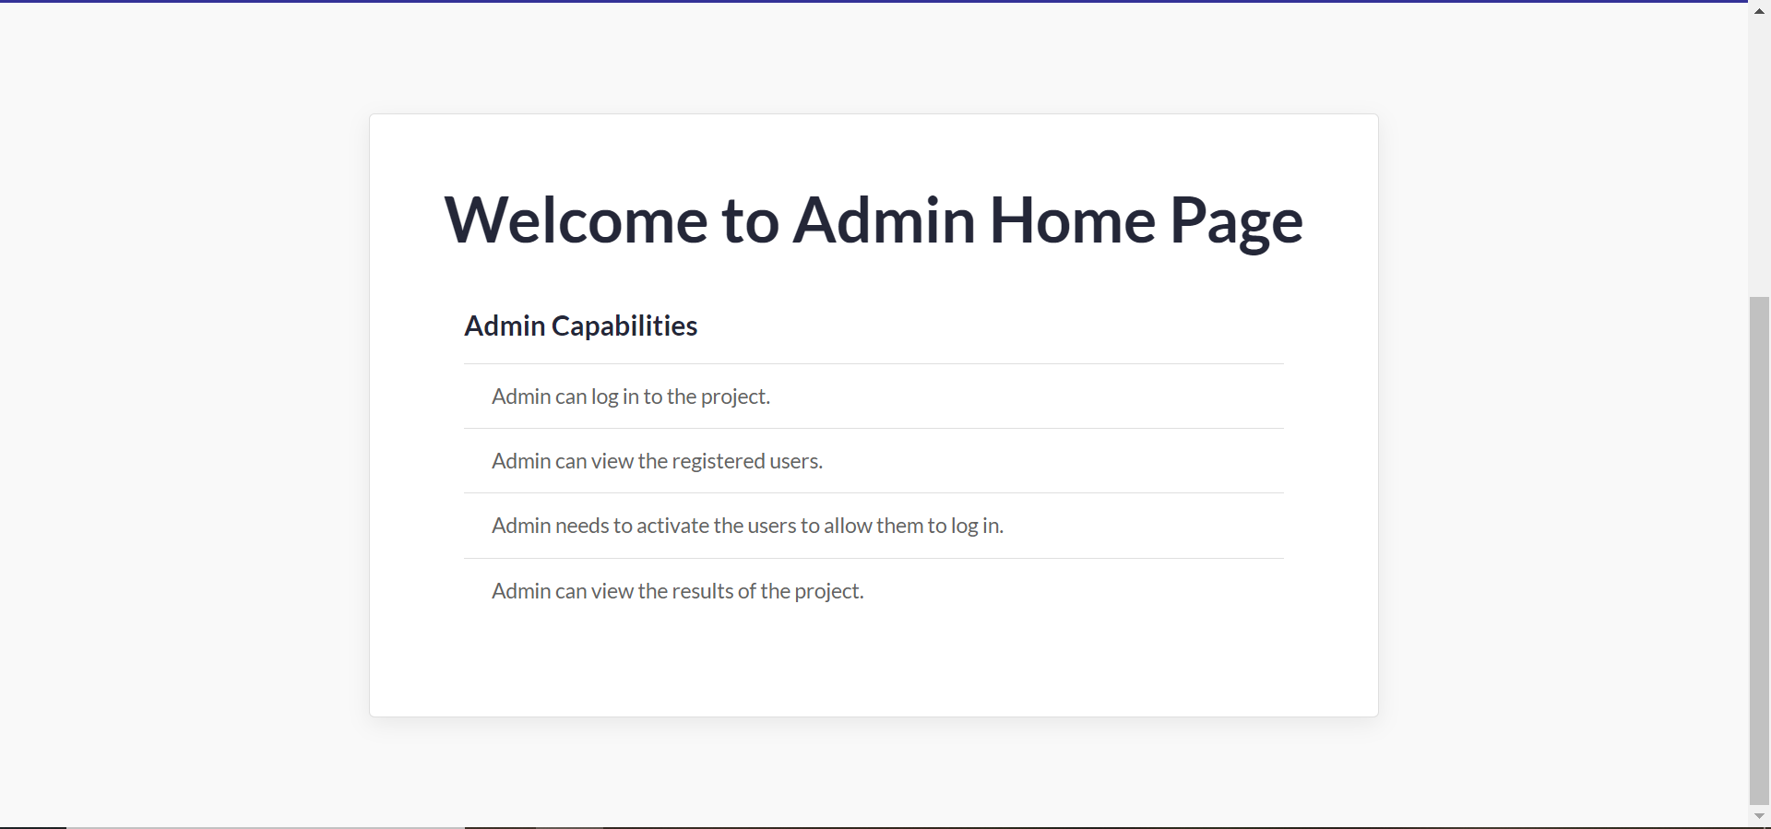
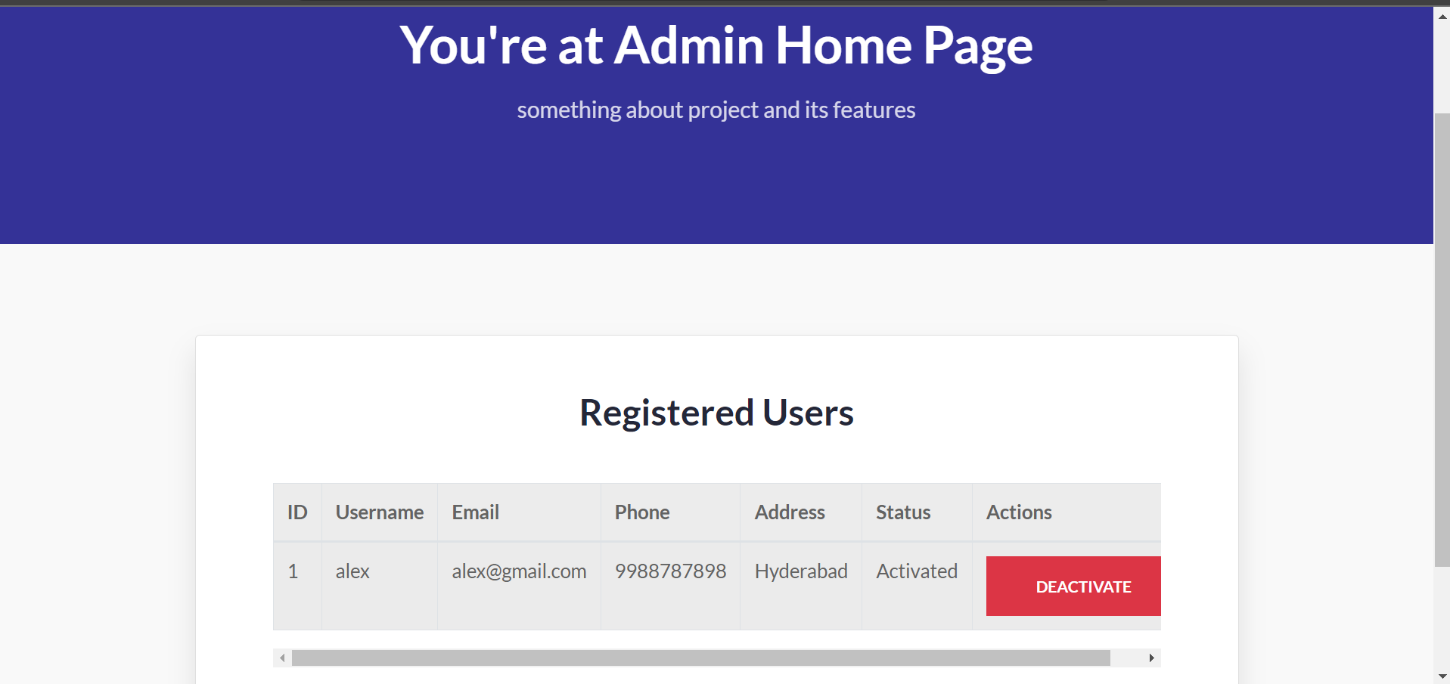
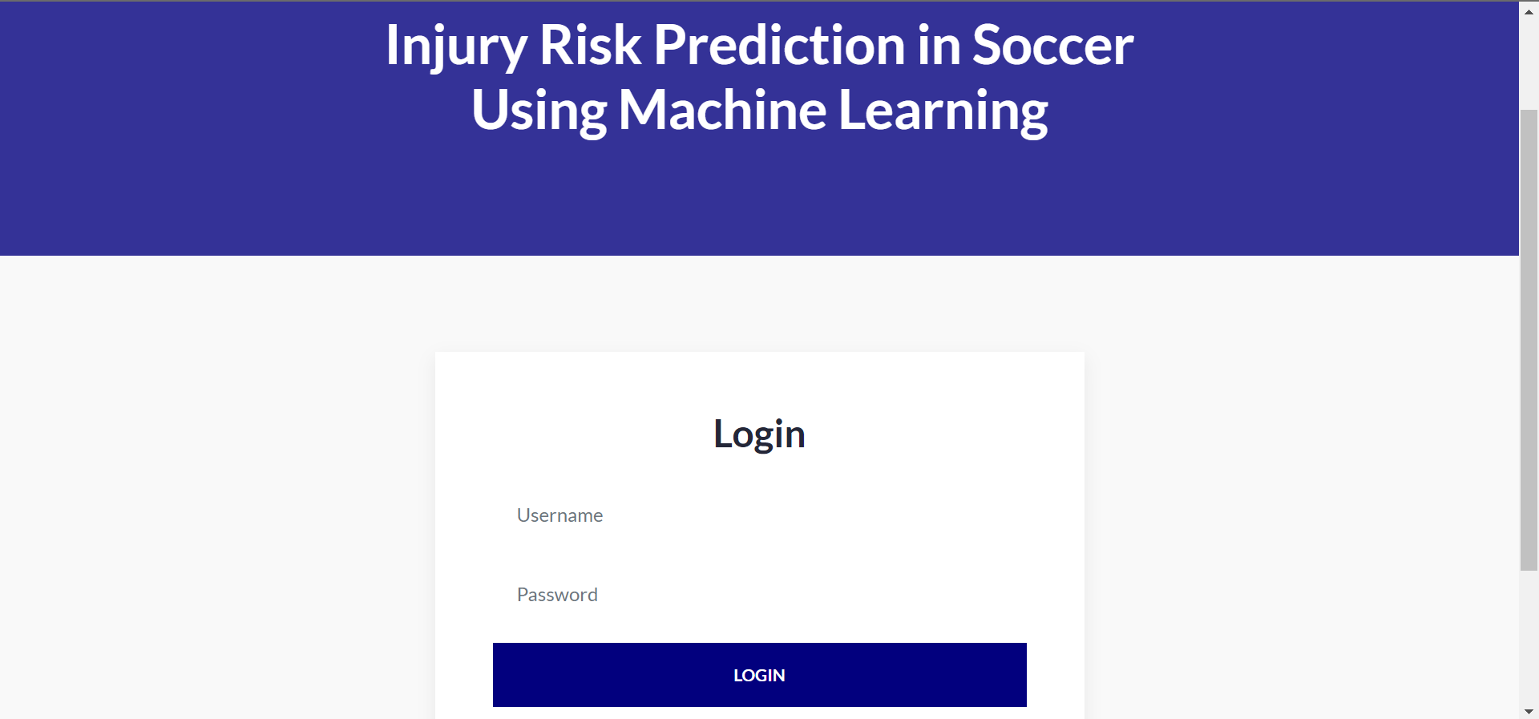
Admin Login Page
Admin Home Page
Activate User
User Login Page:

Slide 26
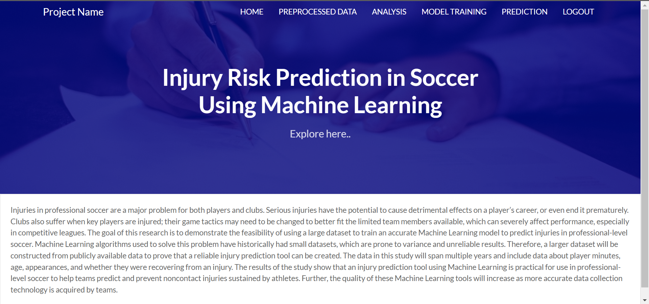
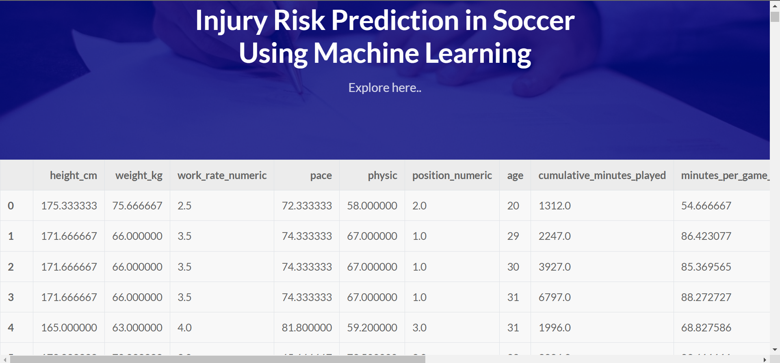
User Home Page:
Pre-Processed Data Set:

Slide 27
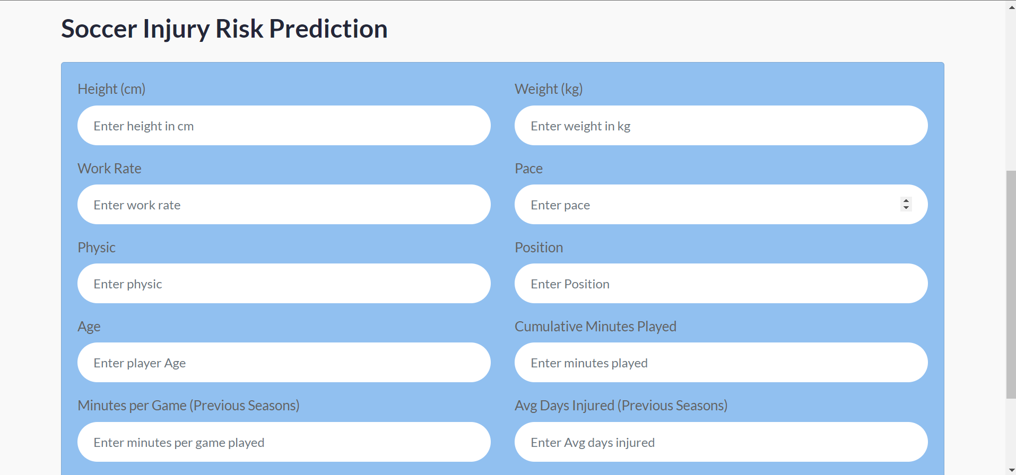
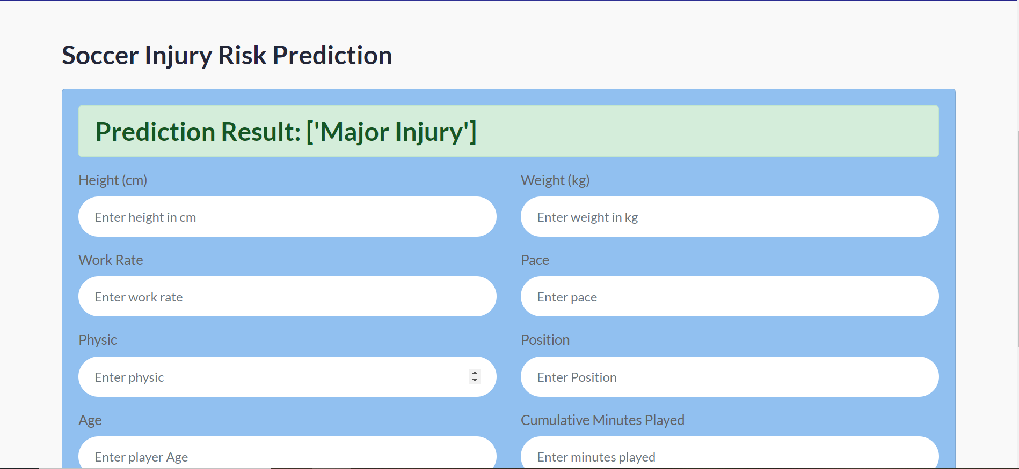
BACKEND SCREENSHOT
Prediction Form.
Prediction Label 1:

Slide 28
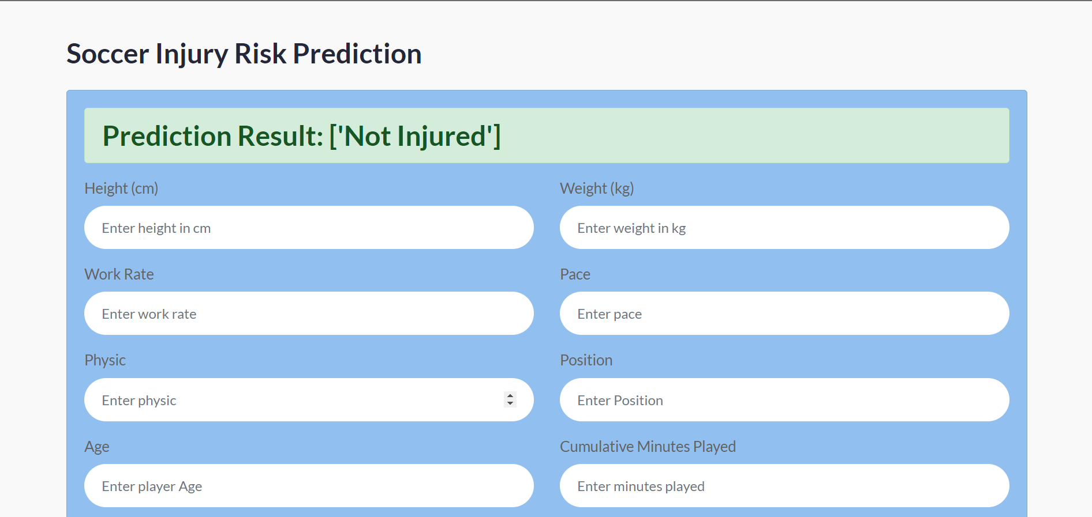
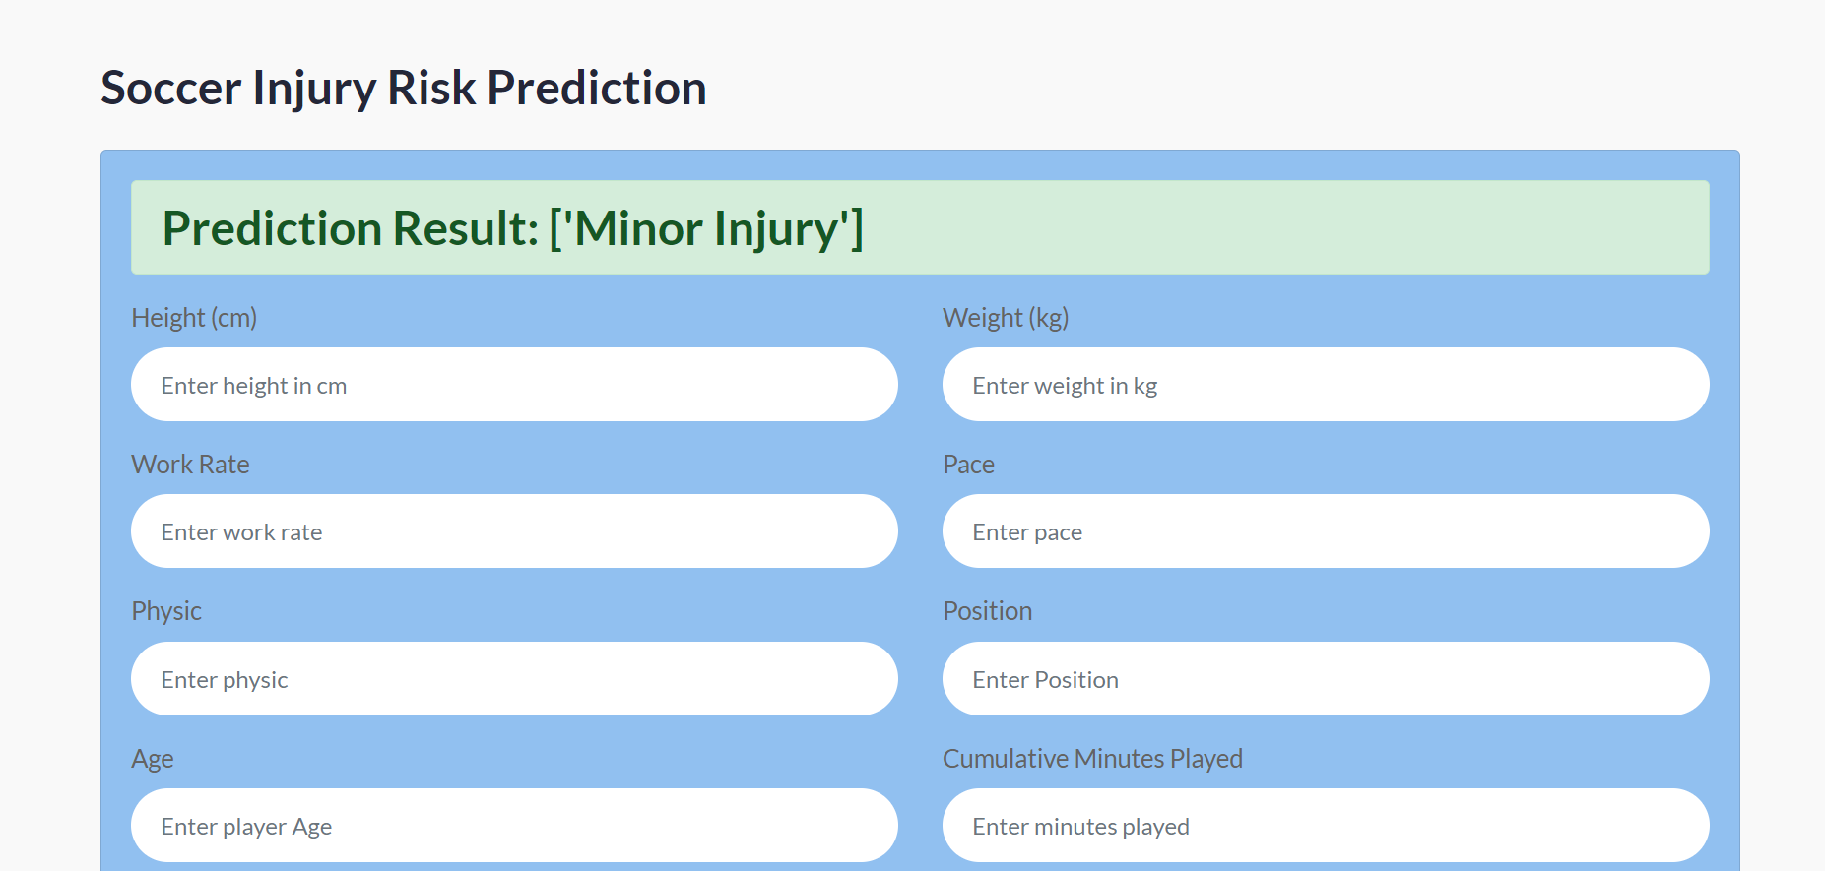
Predicted Label 2:
Predicted Label 3:

Slide 29
SYSTEM REQUIREMENTS
SOFTWARE REQUIREMENTS
HARDWARE REQUIREMENTS
Data integer tools: Apache NiFi, Apache Kafka,AWS for collecting data.
Data storage: Relational database.
Data preprocessing libraries: pandas,Numpy
GPS device: GPS device with accelerometer, gyroscopes and magnetometer.
Video cameras: High-resolution video camera to caputure player movements,game footage.
Sensor system: Wearable sensors muscle activity.

Slide 30
THANK YOU

