Slide 1



Introduction to Scalable and Cost-Effective Web Applications on AWS
Explore the power of AWS cloud platform to build scalable, resilient, and cost-effective web applications. Discover how to leverage AWS services for rapid development, seamless scalability, and optimized resource utilization.
by Jaya chandra reddy Vattipally
192211440

Slide 2
Understanding the AWS Cloud Platform
Fundamentals
1
Explore the core AWS services and their capabilities
Scalability
2
Discover how to build highly scalable solutions
Reliability
3
Leverage AWS's robust infrastructure for high availability
The AWS cloud platform offers a comprehensive suite of services that empower developers to build scalable, reliable, and cost-effective web applications. From compute and storage to database and networking, AWS provides the foundational building blocks to design and deploy innovative cloud solutions tailored to your business needs.

Slide 3



Architectural Considerations for Scalability
Modular Design
Load Balancing
Auto Scaling
Build your application with a modular architecture, allowing you to scale individual components independently.
Leverage AWS Elastic Load Balancing to distribute traffic across multiple EC2 instances, ensuring your application can handle increased demand.
Implement Auto Scaling policies to automatically provision or remove resources based on real-time application demand, optimizing for cost and performance.
To build a scalable web application on AWS, it's crucial to consider architectural patterns that enable dynamic scaling. This includes designing a modular, loosely coupled application, leveraging load balancing services, and implementing auto scaling policies to automatically adjust resources as needed.

Slide 4



Serverless Computing with AWS Lambda
Event-Driven Scalability
1
Scale your application instantly without managing servers
Pay-per-Use Pricing
2
Only pay for the compute time you consume
Automatic Provisioning
3
AWS Lambda handles all the infrastructure management
AWS Lambda is a serverless computing service that allows you to run your code without provisioning or managing servers. With Lambda, you can build scalable, event-driven applications that automatically scale up or down based on demand, without worrying about infrastructure provisioning or maintenance. This pay-per-use model enables cost-effective scaling, as you only pay for the compute time your code actually uses.

Slide 5
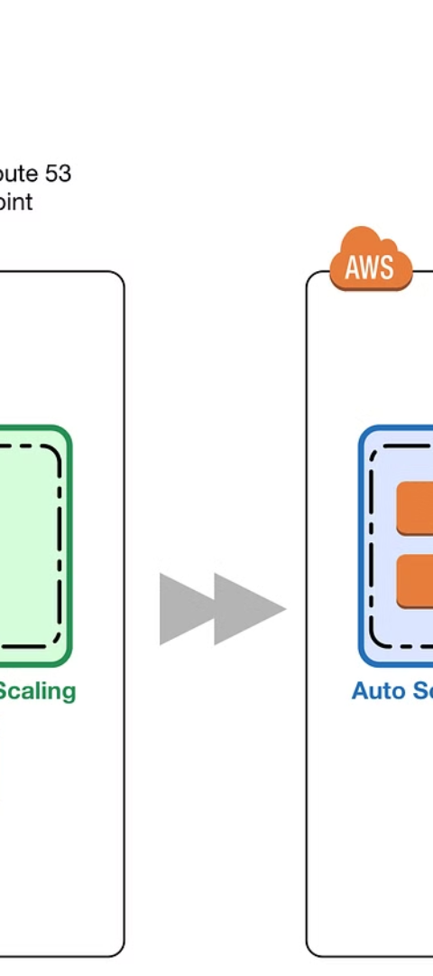



Elastic Load Balancing and Auto Scaling
Distribute Traffic
AWS Elastic Load Balancing automatically distributes incoming application traffic across multiple EC2 instances, ensuring your web application can handle increased demand.
Scale Dynamically
Auto Scaling continually monitors your application's resource utilization and automatically adds or removes EC2 instances based on your scaling policies, keeping performance optimal.
Maximize Efficiency
By combining Elastic Load Balancing and Auto Scaling, you can efficiently scale your infrastructure up or down in response to real-time traffic changes, optimizing costs.

Slide 6
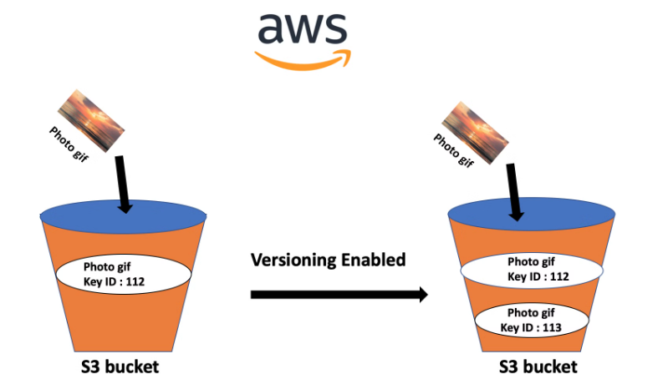
Amazon S3 for Scalable Data Storage
Amazon S3 (Simple Storage Service) is a highly scalable and durable object storage service offered by AWS. It provides virtually unlimited storage capacity, allowing you to securely store and retrieve any amount of data from anywhere on the web.
With S3, you can easily scale your web application's storage needs, from gigabytes to petabytes, without upfront investments or infrastructure management. Its pay-as-you-go pricing model ensures cost-effective storage tailored to your usage, making it an ideal choice for storing static files, backups, and other unstructured data.

Slide 7
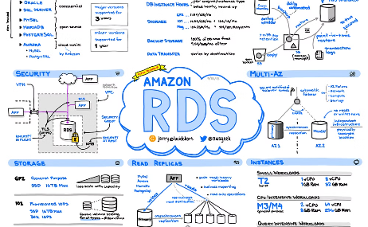
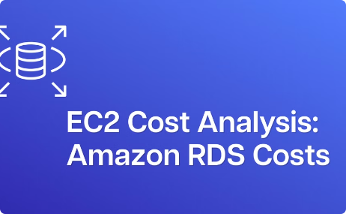
Amazon RDS for Relational Database Management
Scalable Database Provisioning
High Availability and Failover
Cost-Effective Scaling
RDS provides built-in high availability features, such as multi-Availability Zone deployments and automated backups, ensuring your mission-critical data remains highly available and protected.
RDS offers flexible pricing models, including on-demand and reserved instances, enabling you to optimize your database costs based on your application's usage patterns and requirements.
Amazon RDS simplifies the process of setting up, operating, and scaling a relational database in the cloud. It handles the heavy lifting of database management, allowing you to focus on building your application.

Slide 8
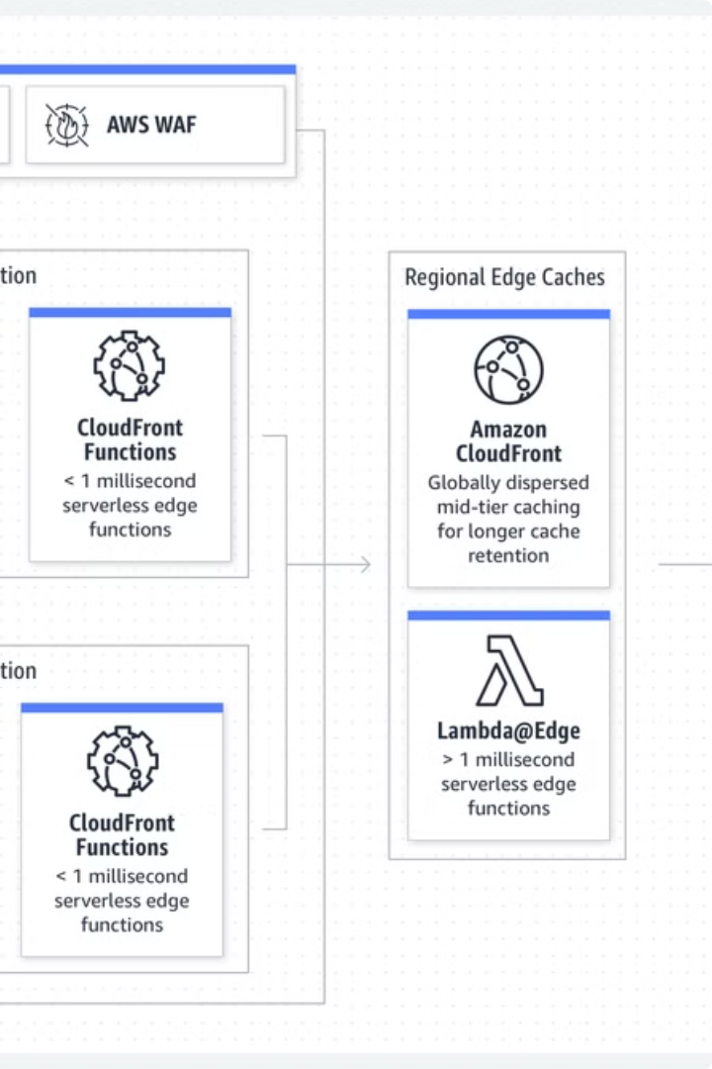
AWS CloudFront for Content Delivery
AWS CloudFront is a fast content delivery network (CDN) that securely distributes data, videos, applications, and APIs to customers globally with low latency and high transfer speeds. By caching content at edge locations worldwide, CloudFront ensures your web applications deliver an optimal experience for users, no matter their location.

Slide 9
Monitoring and Optimization Strategies
1
Track Key Metrics
2
Leverage AWS Monitoring Tools
Continuously monitor critical performance metrics like response times, throughput, and error rates to identify bottlenecks and opportunities for optimization.
Utilize AWS CloudWatch to collect and analyze metrics, set alarms, and gain visibility into the health and performance of your web application.
3
Optimize Resource Utilization
4
Implement Continuous Improvement
Regularly review your resource usage patterns and adjust Auto Scaling policies, EC2 instance types, and other configurations to maximize cost-efficiency.
Adopt a culture of continuous testing, profiling, and optimization to iteratively enhance your web application's performance and scalability over time.

Slide 10

Conclusion and Key Takeaways
In conclusion, leveraging the power of the AWS cloud platform enables you to build scalable, cost-effective, and highly available web applications. By embracing serverless computing, elastic load balancing, and auto scaling, you can dynamically adapt your infrastructure to meet fluctuating user demand.

