Slide 1



Camada 1.
Rápido
Entender
A programar
Codeando con el
Teacher
Notes:
This game plays just like the popular board game, Battleship®.

Slide 2




1
2
3
4
5
6
7
8
A
B
C
D
Questions:
A1
A2
A3
A4
A5
A6
A7
A8
B1
B2
B3
B4
B5
B6
B7
B8
C1
C2
C3
C4
C5
C6
C7
C8
D1
D2
D3
D4
D5
D6
D7
D8
© 2012
Notes:
Notes: You do not need to edit this slide in order to play the game.

Slide 3


TARGET: A1
¿Qué diferencia existe en library y Framework?
Return to Board
© 2012
Notes:
Setup Notes: Enter your question into the “Type review question here.” text box.

Slide 4
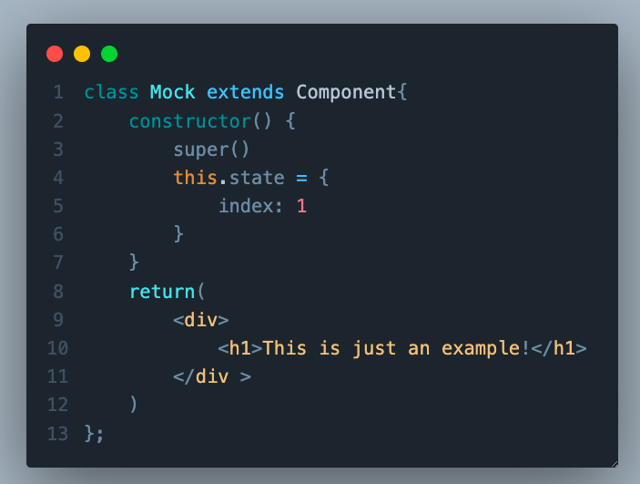
TARGET: A2
En este componente de clase, por qué no funcionaría el código?
Return to Board
© 2012
Notes:
Setup Notes: Enter your question into the “Type review question here.” text box.

Slide 5
TARGET: A3
¿Para qué sirve el método Constructor en react?
Return to Board
© 2012
Notes:
Setup Notes: Enter your question into the “Type review question here.” text box.

Slide 6
TARGET: A4
¿Qué differencias evidentes hay entre el contenido de un componente de clase y uno de función?
Return to Board
© 2012
Notes:
Setup Notes: Enter your question into the “Type review question here.” text box.

Slide 7
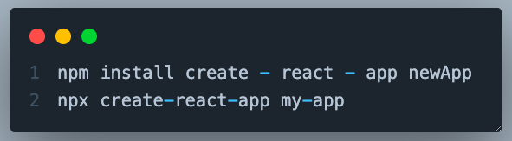
TARGET: A5
¿Con cuál commando iniciamos la instalación default para un nuevo Proyecto?
Return to Board
© 2012
Notes:
Setup Notes: Enter your question into the “Type review question here.” text box.

Slide 8
TARGET: A6
¿Qué beneficios tiene iniciar un Proyecto con npx create-react-app?
Return to Board
© 2012
Notes:
Setup Notes: Enter your question into the “Type review question here.” text box.

Slide 9
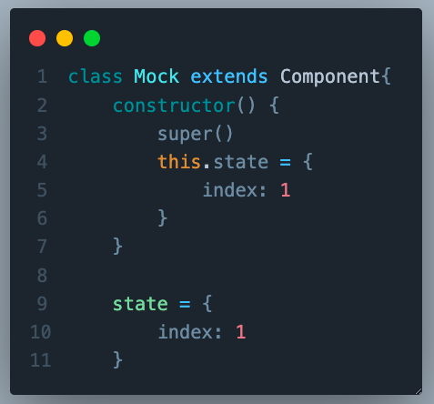
TARGET: A7
¿Cuál de las dos declaraciones de State es correcta?
Return to Board
© 2012
Notes:
Setup Notes: Enter your question into the “Type review question here.” text box.

Slide 10
TARGET: A8
¿Cómo se llama la función que nativamente, modifica el State de un componente?
Return to Board
© 2012
Notes:
Setup Notes: Enter your question into the “Type review question here.” text box.

Slide 11
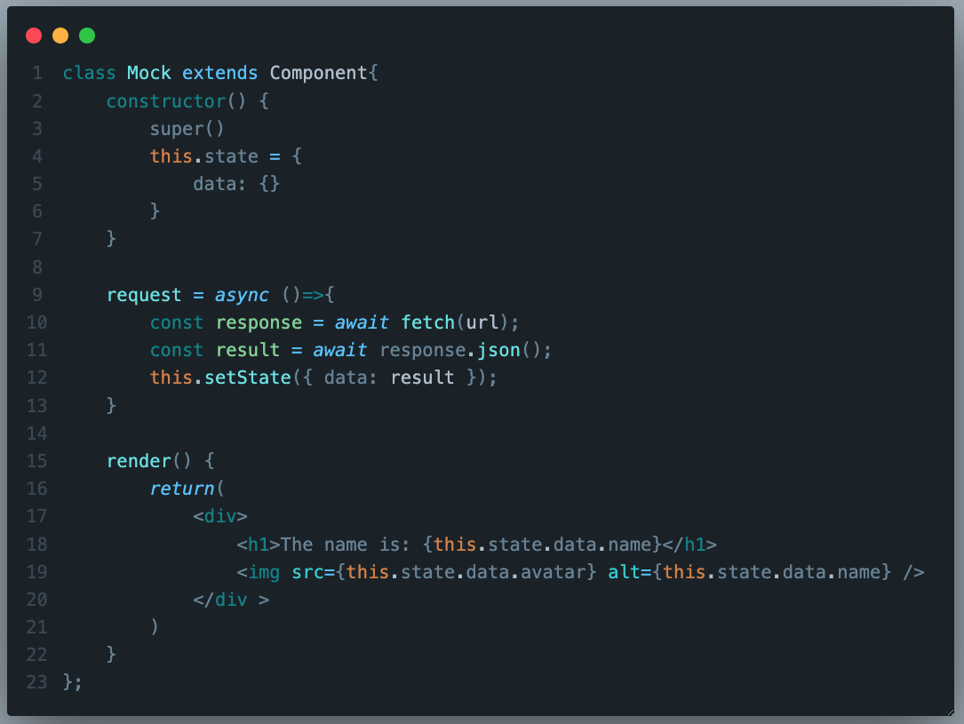
TARGET: B1
¿Por qué no se mostraría nada en el Componente?
Return to Board
© 2012
Notes:
Setup Notes: Enter your question into the “Type review question here.” text box.

Slide 12
TARGET: B2
¿Qué métodos de manejo de State existen en Class Components?
Return to Board
© 2012
Notes:
Setup Notes: Enter your question into the “Type review question here.” text box.

Slide 13
TARGET: B3
¿Qué útil es ComponentDidMount?
Return to Board
© 2012
Notes:
Setup Notes: Enter your question into the “Type review question here.” text box.

Slide 14
TARGET: B4
¿Qué útil es ComponentDidUpdate?
Return to Board
© 2012
Notes:
Setup Notes: Enter your question into the “Type review question here.” text box.

Slide 15
TARGET: B5
¿Qué argumentos recibe ComponentDidUpdate?
Return to Board
© 2012
Notes:
Setup Notes: Enter your question into the “Type review question here.” text box.

Slide 16
TARGET: B6
¿Para qué sirven los argumentos que recibe ComponentDidUpdate?
Return to Board
© 2012
Notes:
Setup Notes: Enter your question into the “Type review question here.” text box.

Slide 17
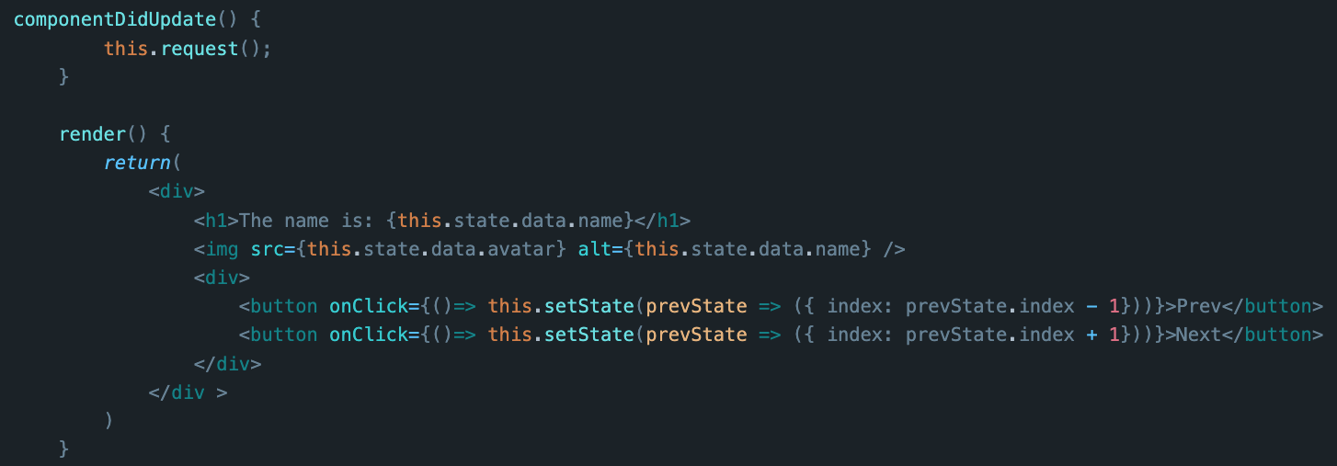
TARGET: B7
¿Por qué se ciclaría?
Return to Board
© 2012
Notes:
Setup Notes: Enter your question into the “Type review question here.” text box.

Slide 18
TARGET: B8
¿Qué es el ciclo de vida de un componente?
Return to Board
© 2012
Notes:
Setup Notes: Enter your question into the “Type review question here.” text box.

Slide 19
TARGET: C1
¿A qué se le llama Data Flow en React?
Return to Board
© 2012
Notes:
Setup Notes: Enter your question into the “Type review question here.” text box.

Slide 20
TARGET: C2
¿Qué eventos son necesarios en un formulario?
Return to Board
© 2012
Notes:
Setup Notes: Enter your question into the “Type review question here.” text box.

Slide 21
TARGET: C3
¿Qué tipos de estilos pueden ser utilizados en components de React?
Return to Board
© 2012
Notes:
Setup Notes: Enter your question into the “Type review question here.” text box.

Slide 22
TARGET: C4
¿Qué beneficios nos da usar module css || SASS?
Return to Board
© 2012
Notes:
Setup Notes: Enter your question into the “Type review question here.” text box.

Slide 23
TARGET: C5
¿Qué es el Wrapper hell?
Return to Board
© 2012
Notes:
Setup Notes: Enter your question into the “Type review question here.” text box.

Slide 24

TARGET: C6
¿Qué diferencia hay entre estas dos importaciones?
Return to Board
© 2012
Notes:
Setup Notes: Enter your question into the “Type review question here.” text box.

Slide 25
TARGET: C7
¿Qué se conoce como Estado Compuesto?
Return to Board
© 2012
Notes:
Setup Notes: Enter your question into the “Type review question here.” text box.

Slide 26
TARGET: C8
Explique los tipos de props y sus diferencias.
Return to Board
© 2012
Notes:
Setup Notes: Enter your question into the “Type review question here.” text box.

Slide 27
TARGET: D1
¿Qué hook para suplantar los métodos de ciclo de vida de componentes de clase?
Return to Board
© 2012
Notes:
Setup Notes: Enter your question into the “Type review question here.” text box.

Slide 28
TARGET: D2
¿Qué librería Podemos instalar en react, popular, para majenar API requests?
Return to Board
© 2012
Notes:
Setup Notes: Enter your question into the “Type review question here.” text box.

Slide 29
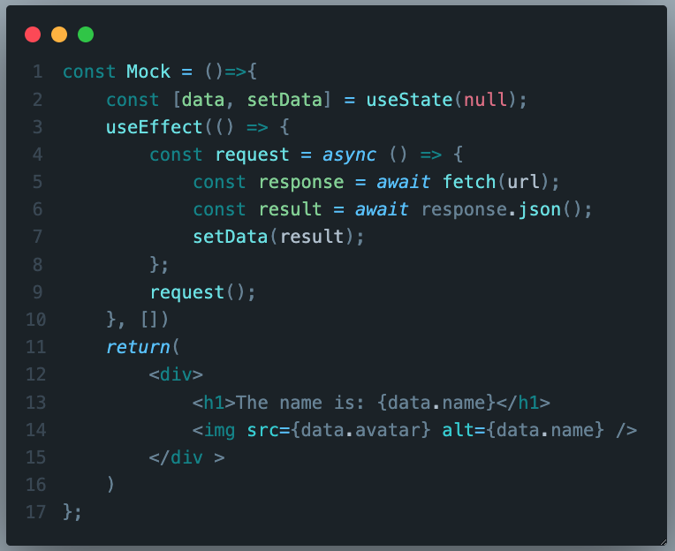
TARGET: D3
En el primer render, el componente se rompe… ¿Por qué?
Return to Board
© 2012
Notes:
Setup Notes: Enter your question into the “Type review question here.” text box.

Slide 30
TARGET: D4
¿Cómo se llama el “[ ]” en el useEffect, y para qué sirve?
Return to Board
© 2012
Notes:
Setup Notes: Enter your question into the “Type review question here.” text box.

Slide 31
TARGET: D5
¿Cuál palabra es clave en components de clase?
Return to Board
© 2012
Notes:
Setup Notes: Enter your question into the “Type review question here.” text box.

Slide 32
TARGET: D6
¿Qué se conoce como HOC? Y en qué consisten?
Return to Board
© 2012
Notes:
Setup Notes: Enter your question into the “Type review question here.” text box.

Slide 33
TARGET: D7
¿Cuál es la mayor ventaja de los components funcionales?
Return to Board
© 2012
Notes:
Setup Notes: Enter your question into the “Type review question here.” text box.

Slide 34
TARGET: D8
¿Qué problemas en components de clase motivaron la migración a components funcionales?
Return to Board
© 2012
Notes:
Setup Notes: Enter your question into the “Type review question here.” text box.

