Slide 1


State of the Map Europe 2025
Title of Talk
Optional subtitle
Mr Speaker Name
Company Affiliation

Slide 2
Template Slideshow
A collection of slide styles for you to use at State of the Map Europe 2025
Containing fonts, colours, and graphics of the event branding.
With helpful information for speakers.

Slide 3
You can use bullet points
Room information
Image/map example
Computer information
  Providing your slides
End slide

Slide 4
Room information
“Area” is a large tiered lecture room (1516)
  Handheld and lapel microphones will be available.
“Way” is a flat classroom (1001)
  Microphones will be used for the video recording but not for in-person sound.
“Node” is a flat classroom (1004)
  Chairs at the back will be arranged for discussion groups
  No recording is planned for this room
Short video clips and photos may be taken in any room
  There may also be some “live drawing” done by an artist (to be confirmed)

Slide 5
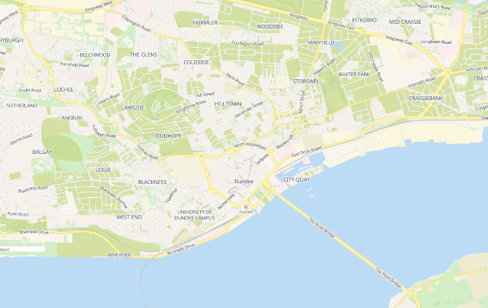
Including maps is great
Delegates enjoy seeing a good map!
Don’t forget to give attribution on the same slide, or credit all images on an end slide.
This map is a screenshot from OpenStreetMap.org
Clap or cheer if you see a good map during a talk.
© OpenStreetMap contributors, “Shortbread” style

Slide 6
Computer infromation
The projectors are 16:9 ratio
The computers use Windows 11 and Microsoft Powerpoint M365
  A screen is on the lectern for speaker view/notes
  Edge web-browser is available
  Edge can be used to open PDF slideshows
USB sockets available to use your own clicker

Slide 7
Providing your slides
At the start of the break before your session, please meet the session-host at the front of the room.
Provide your talk on a USB-stick, or use the provided one to copy it across.
Filenames with your talk title will make organisation easier for us.
12 – 1pm | Lunch
1pm | Talk C | Speakers for these talks should go to the room at 12pm with their slides, and to meet the session host.
1:30pm | Talk D
2pm | Talk E
2:30 - 3pm | Tea & Coffee
3pm | Talk F | Speakers for these talks should go to the room at 2:30pm
3:30pm | Talk G
Actual schedule timings are on the website
© OpenStreetMap contributors, “Shortbread” style

Slide 8
State of the Map Europe 2025
Title of Talk
Optional subtitle
Mr Speaker Name
Company Affiliation
https://2025.stateofthemap.eu
Mastodon: en.osm.town/sotmeu
Instagram: openstreetmapuk

