Slide 1
Supply Chain Visibility System with Optimization Analytics Group 1
An interactive Power BI-based solution for analyzing supply chain performance and generating meaningful business insights.
Team Member: Kapu Tejaswini
Internship: Infosys Springboard Virtual Internship 7.0
Mentor: Ms. Nityasree

Slide 2
PROJECT OBJECTIVE
Project Objective
To analyze supply chain performance using real-world supply chain data.
To clean and transform raw data into an analysis-ready format.
To analyze sales, products, customers, delivery, shipping, orders, discounts, and profitability.
To develop interactive dashboards for data-driven decision-making.
Project Modules
Data Collection & Understanding
Data Preprocessing & Cleaning
Power BI Dashboard Development
Business Analysis & Insights
Recommendations & Reporting

Slide 3
PROJECT EXECUTION MILESTONES
Milestone 1 – Data Preprocessing & Cleaning
Collected and studied the DataCo Supply Chain Dataset, performed data preprocessing and cleaning using Power Query Editor, removed unnecessary data, corrected data types, handled duplicates and prepared the final analysis-ready dataset.
Milestone 2 – Initial Dashboard Development
Developed the Supply Chain Performance Dashboard and Product Performance & Pricing Dashboard to analyze overall supply chain performance, products, categories, departments, pricing and sales.
Milestone 3 – Detailed Business Analysis
Developed the Customer & Geographic Analysis Dashboard, Delivery & Shipping Performance Dashboard, and Regional & Market Performance Dashboard to analyze customers, geography, delivery, shipping, markets and regional performance.
Milestone 4 – Final Dashboard Development
Developed the Order & Discount Performance Dashboard and Profitability & Order Insights Dashboard, completing the seven-dashboard analysis covering orders, discounts, departments, shipping modes, profitability and order status.

Slide 4
CHALLENGES & RESOLUTIONS
Challenges
The raw dataset contained a large number of columns and records, making it difficult to identify the required information.
Some columns required data-type corrections, transformations, and cleaning before analysis.
Different business aspects had to be represented using suitable and non-repetitive Power BI visualizations.
Resolutions
Studied the dataset structure and identified relevant columns based on the dashboard requirements.
Used Power Query Editor to clean, transform, rename, and prepare the dataset.
Selected appropriate Power BI visuals for each analysis and divided the project into seven focused dashboards.

Slide 5
FUTURE ENHANCEMENTS & KEY INSIGHTS
Future Enhancements
Integrate real-time supply chain data for continuous monitoring.
Add sales and demand forecasting capabilities.
Develop predictive analysis for potential late deliveries.
Introduce advanced analytics and automation for better decision-making.
Key Insights
More than 180K orders were analyzed, indicating large-scale supply chain activity.
Europe emerged as a strong-performing market in terms of sales.
Late deliveries highlighted an important area for logistics improvement.

Slide 6
CONCLUSION
The Supply Chain Visibility System with Optimization Analytics project successfully transformed the DataCo Supply Chain Dataset into an interactive Power BI-based Business Intelligence solution.
Technical Skills
Power BI & Dashboard Development
Power Query Data Preprocessing
Data Visualization & Business Analysis
Soft Skills
Problem Solving
Communication
Time Management
Presentation

Slide 7
ACKNOWLEDGEMENTS & REFERENCES
Acknowledgements :
Infosys Virtual Internship 7.0
Project Mentor : Nityasree
Team Members
References :
DataCo Supply Chain Dataset
Microsoft Power BI Documentation
Microsoft Power Query Documentation
Infosys Springboard Learning Materials

Slide 8
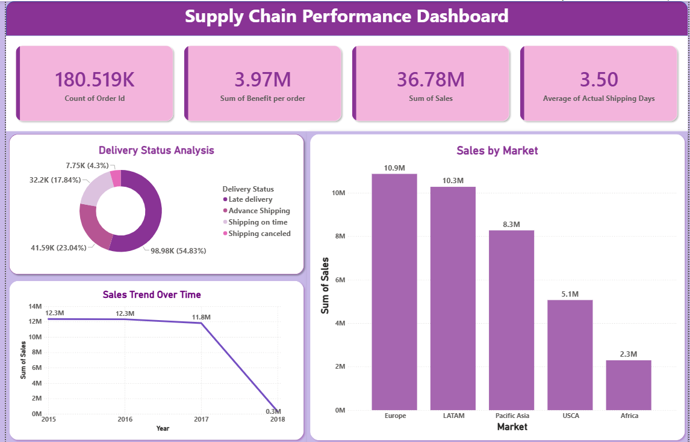
Dashboard-1 : Supply Chain Performance Dashboard

Slide 9
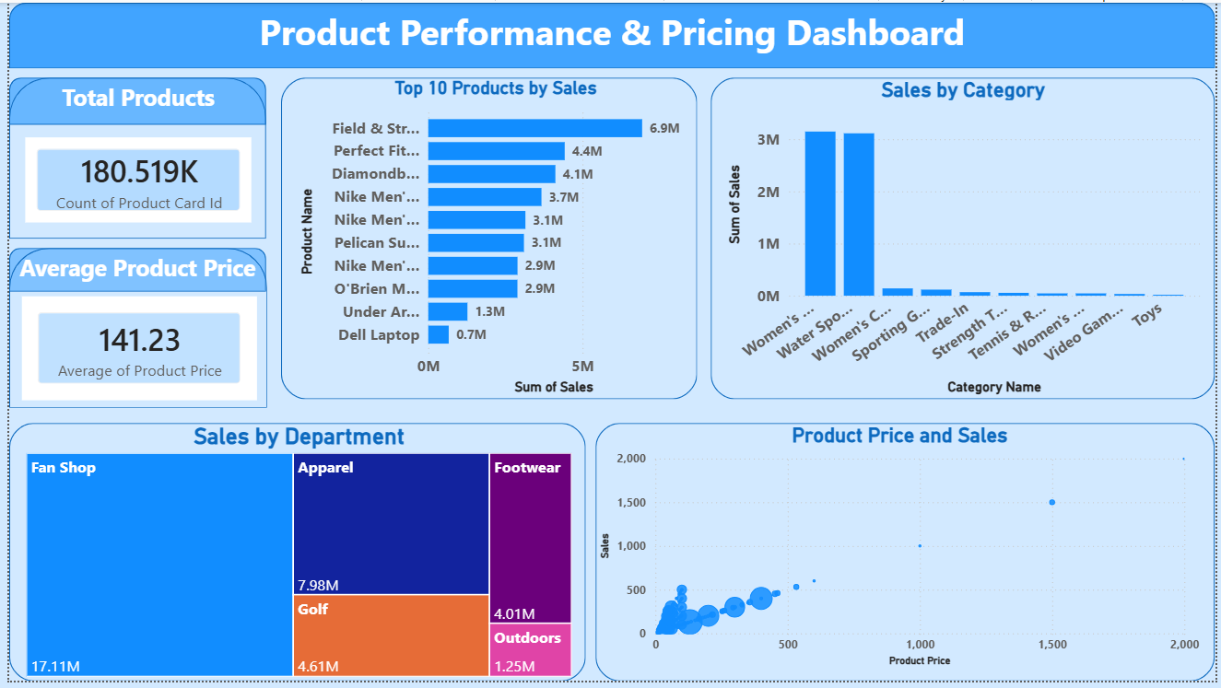
Dashboard-2 : Product Performance & Pricing Dashboard

Slide 10
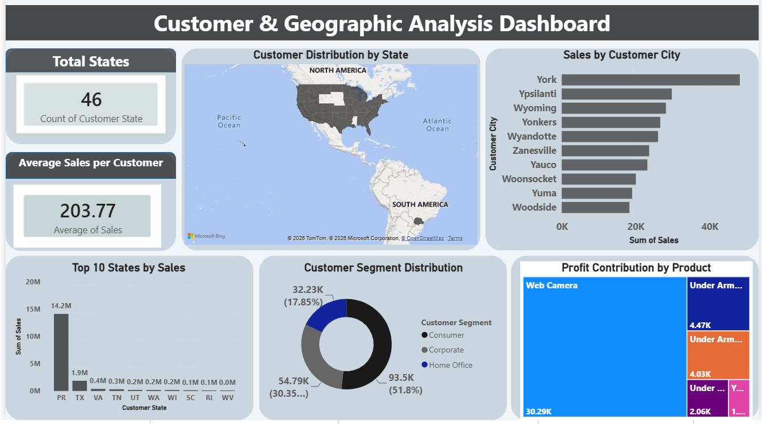
Dashboard-3 : Customer & Geographic Analysis Dashboard

Slide 11
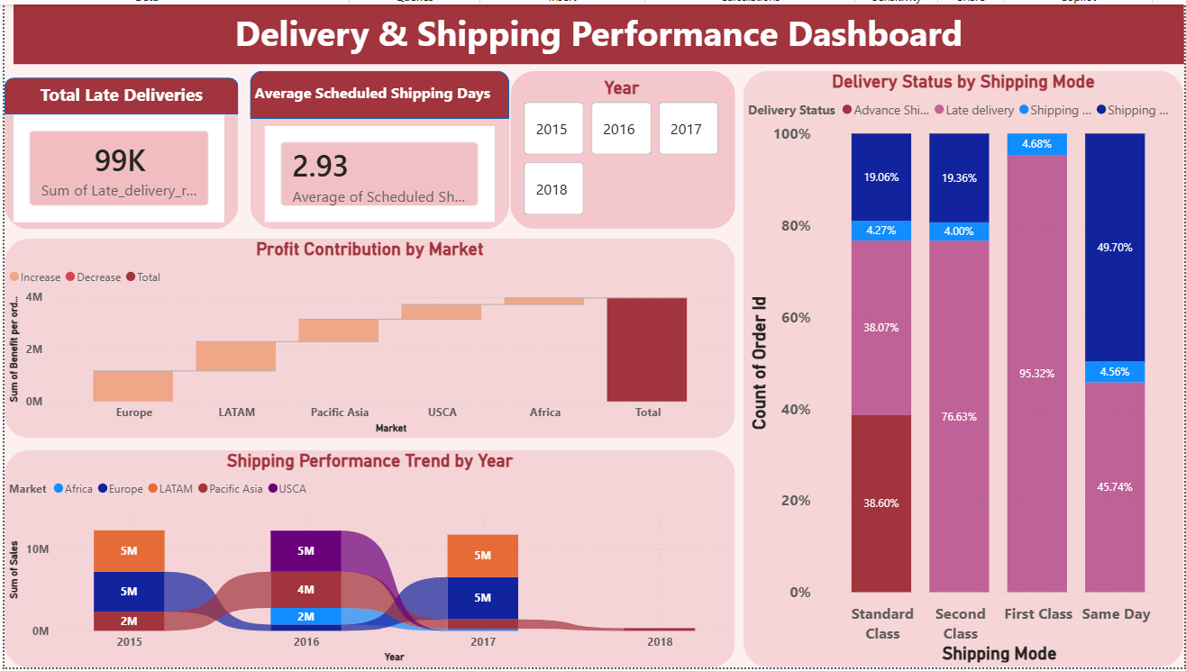
Dashboard-4 : Delivery Status by Shipping Mode

Slide 12
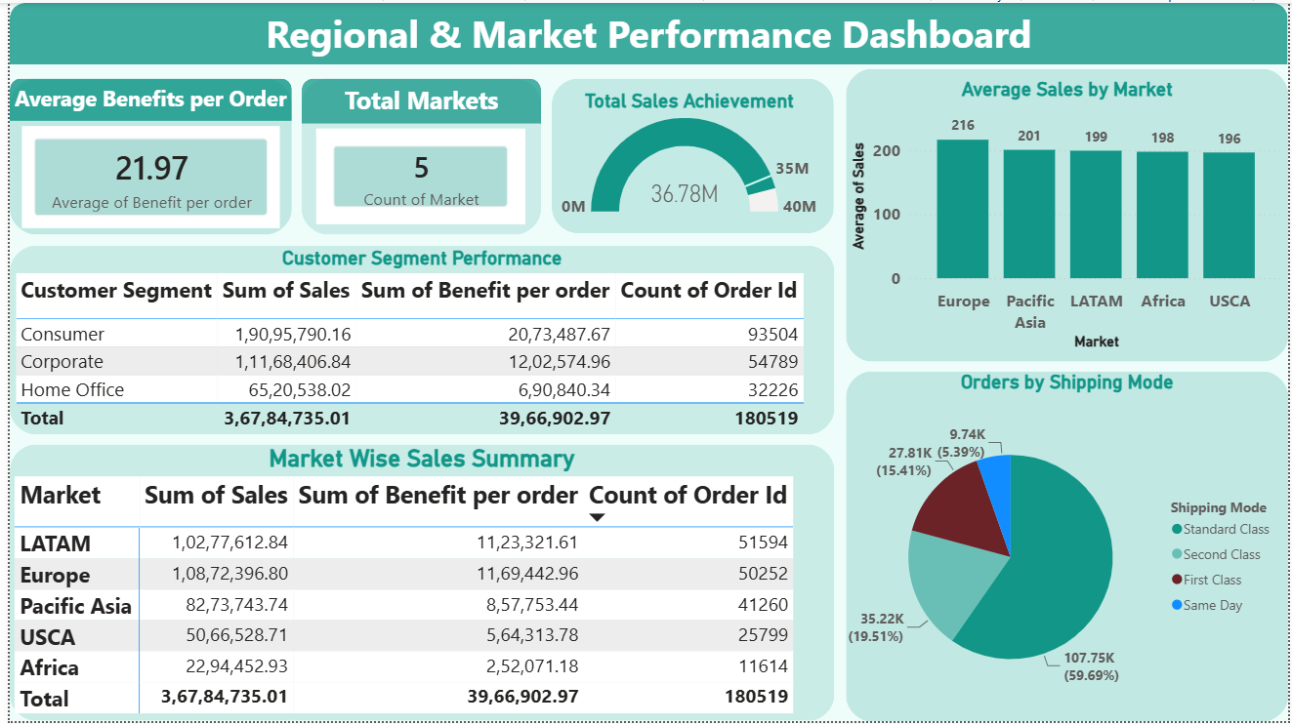
Dashboard-5 : Regional & Market Performance Dashboard

Slide 13
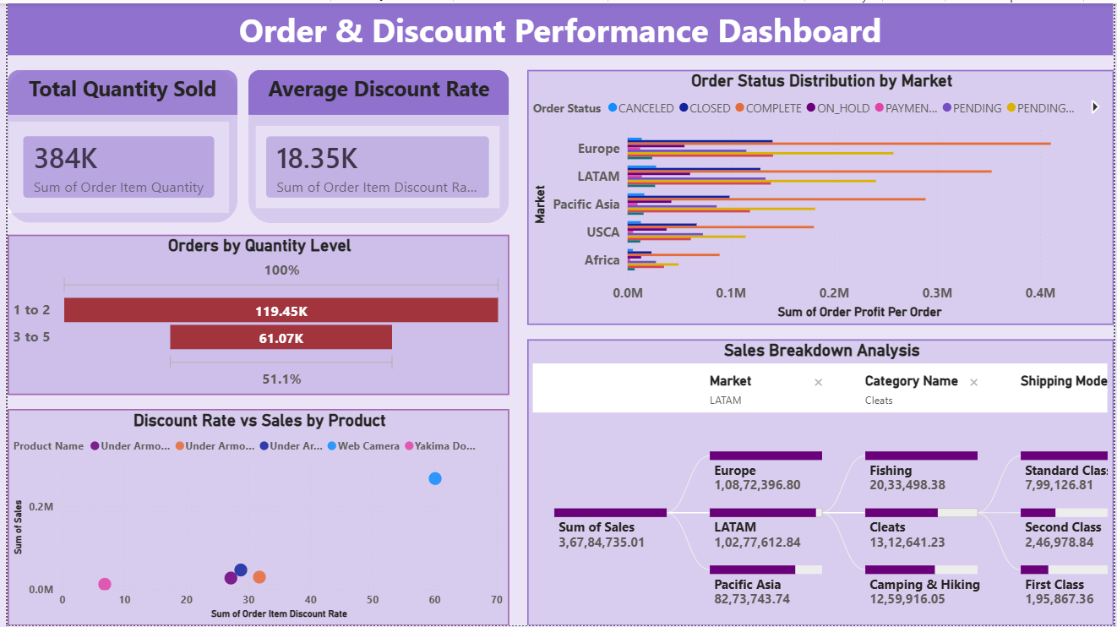
Dashboard-6 : Order & Discount Performance Dashboard

Slide 14
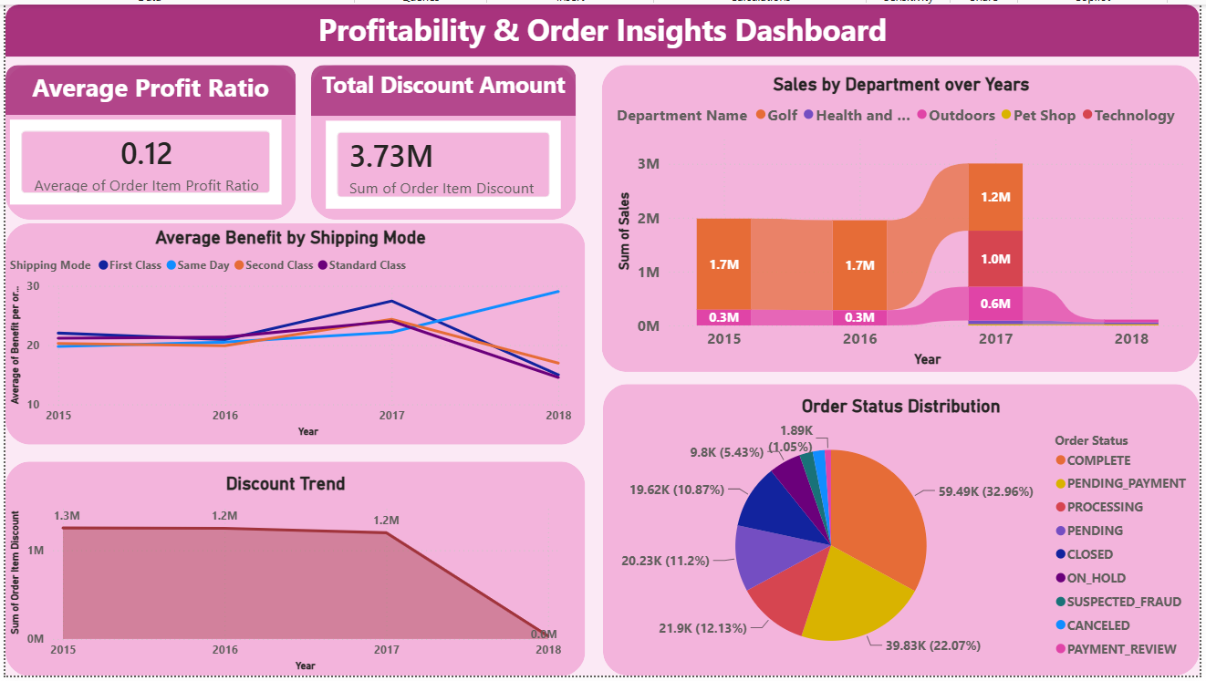
Dashboard-7 : Profitability & Order Insights Dashboard

Slide 15


