Slide 1
The Mover’s Guide: Toronto to New York

Slide 2
A Guide for Relocation
In the age of globalization, migration of people is common between metropoles for employment, education and recreation.
Toronto and New York are the two most populous cities of Canada and USA respectively.
A guide provides the convenience of choosing neighbourhoods when moving between Toronto and New York.

Slide 3
Data Acquisition
Geographical data for the neighbourhoods in Toronto and New York can be obtained online, from websites such as Wikipedia.
Close to 300 neighbourhoods were compared in this guide, including all neighbourhoods of Toronto and the three most populous boroughs of New York.
Foursquare API data was used to extract upto 485 different attributes of each neighbourhood.

Slide 4
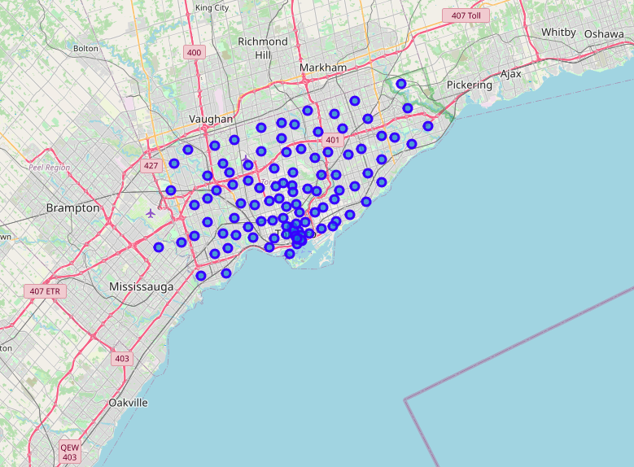
Neighbourhoods of Toronto

Slide 5
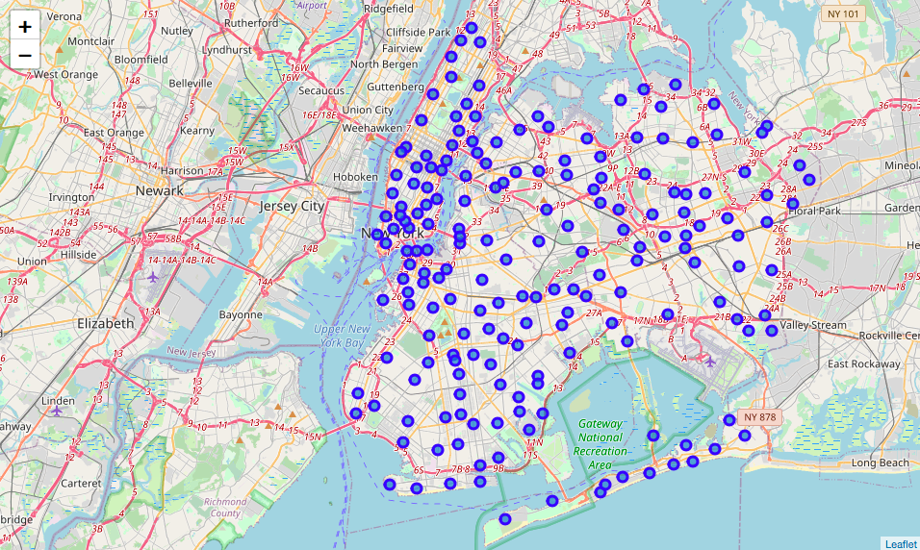
Neighbourhoods of New York

Slide 6
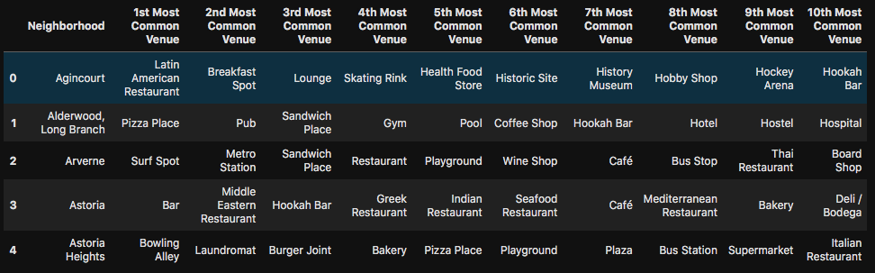
Common Attributes of Neighbourhoods
Data from Foursquare can be used to obtain occurrences of various establishments in each neighbourhood.

Slide 7
Clustering
A machine learning technique used to group the dataset into clusters based on similarity of features.
The number of clusters is chosen by hand and the machine picks the best grouping possible.
In our case, clustering can be used to group neighbourhoods based on their similarity.
Ideal for users looking to move to similar neighbourhoods, but in different cities.

Slide 8
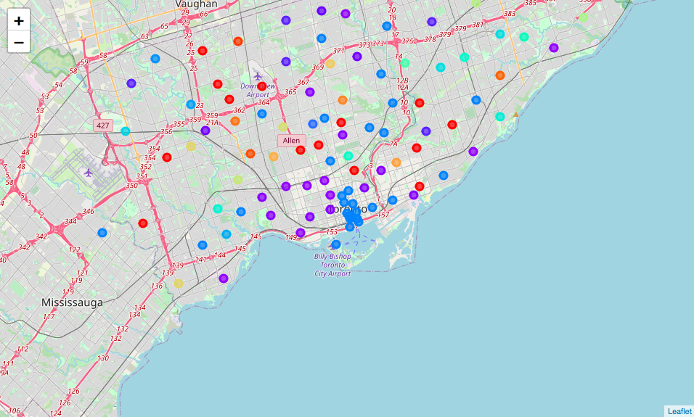
Similar Neighbourhoods in Toronto and NY - 1
Toronto

Slide 9
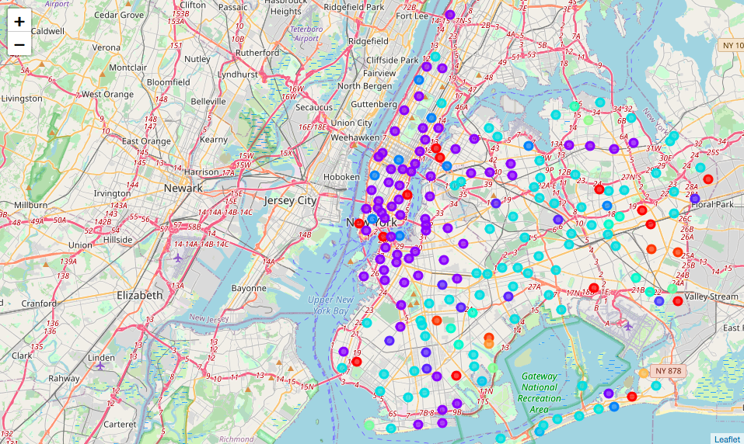
Similar Neighbourhoods in Toronto and NY - 2
New York

Slide 10
Conclusion
Versatile guide for people moving between Toronto and New York as well as within either city.
Recommendations can be made directly by visualization provided by the Folium maps.
Future improvements could include comparison between any two cities, as long as the geographical coordinates and Foursquare data for those locations are available.

