Slide 1

AI-POWERED HEALTHCARE & MACHINE LEARNING
DIABETES RISK ASSESSMENT & PREDICTION AI
REVIEW NO : 0 07.08.2026 BATCH NO: 02
PRESENTED BY:
KESHAVSN R
JAYADEV RAJA SV

Slide 2
OBJECTIVE
Automate early diabetes risk assessment using Machine Learning classification.
Predict patient risk status based on 8 core biomedical metrics (Glucose, BMI, Age, etc.).
Deliver a modern glassmorphism web UI with real-time confidence scoring.
Eliminate complex manual risk calculations with instant automated diagnosis.
Provide live input validation, keyboard shortcuts, and dual light/dark theme.
Maintain digital logging of diagnostic evaluations for efficient record keeping.
Empower healthcare practitioners and patients with accessible preventative health insights.

Slide 3
PROJECT DESCRIPTION
The Diabetes Risk Assessment & Prediction AI is a full-stack machine learning web application that automates early diabetes detection. It replaces static paper clinical forms with an intelligent, data-driven diagnostic workflow. Users enter 8 standardized health parameters, and the system instantly evaluates diabetes risk probability.
Developed using Python (Flask API), scikit-learn (Logistic Regression with StandardScaler), HTML5, CSS3 (Glassmorphism UI), and JavaScript (ES6 Fetch API). The system delivers real-time confidence scores, visual risk indicators, and a seamless user experience across desktop and mobile devices.

Slide 4
EXISTING PROJECT
In traditional healthcare setups, diabetes risk evaluation relies heavily on manual blood lab result analysis, physical patient charts, and static paper forms. Clinical data is recorded manually across paper files or basic spreadsheets, making rapid preliminary screening difficult for large patient populations. This manual approach often leads to human evaluation errors, delayed risk reporting, and inconsistent workload distribution among medical staff. Re-evaluating updated patient health metrics requires manual recalculation, causing delays and confusion during preliminary health checkups.

Slide 5
PROBLEM DEFINITION
Diabetes mellitus is a silent chronic metabolic disorder that frequently remains undetected until advanced complications arise. Traditional diagnostic workflows require doctors to manually correlate multiple interdependent metrics (such as glucose, blood pressure, skin fold thickness, and genetic pedigree), which is time-consuming and prone to subjective error.
The absence of an automated, accessible screening platform results in diagnostic delays, reduced screening capacity, and heightened workload for healthcare staff during routine check-ups. Therefore, there is a critical need for an intelligent computerized system that can instantly process patient data, calculate risk probabilities, and present actionable insights.
The proposed DiabetesAI Web Application solves these challenges by providing an automated, highly reliable, and accessible platform to streamline preliminary diabetes risk assessment.

Slide 6
PROPOSED SYSTEM
The proposed DiabetesAI is a machine-learning-driven web application designed to simplify and accelerate early diabetes risk assessment. Unlike traditional manual evaluation, users submit patient health parameters via a web form, and the system automatically outputs a precise risk classification with a confidence score.
The system utilizes a Logistic Regression model trained on the Pima Indians Diabetes Dataset, paired with a StandardScaler pipeline to ensure normalized feature processing and high inference accuracy.
Key features of the proposed system include:
• Automated ML risk prediction with probability scoring.
• StandardScaler feature normalization for reliable accuracy.
• Interactive Glassmorphism UI with live input validation.
• Real-time light/dark theme toggle and animated result indicators.
• Lightweight RESTful Flask API backend with CORS support.
Thus, the proposed system enhances accuracy, efficiency, and diagnostic reliability in healthcare management while reducing administrative effort.

Slide 7
REQUIREMENT SPECIFICATION
Hardware & Software Requirements: The system runs on an Intel Core i3 processor, 4 GB RAM, and 250 GB storage. It operates on Windows or Linux OS using Python 3.8+ (Flask, scikit-learn, joblib, NumPy, Pandas, Flask-CORS) for backend logic and HTML5, CSS3, and JavaScript for frontend UI, accessible via Chrome, Edge, or Firefox.
Functional & Non-Functional: Functionally, the system validates 8 patient metrics, applies StandardScaler normalization, executes model prediction, returns JSON API response, and animates UI cards. Non-functionally, it ensures sub-second response (<100ms), frosted-glass UI elegance, intuitive error handling, and high reliability.

Slide 8
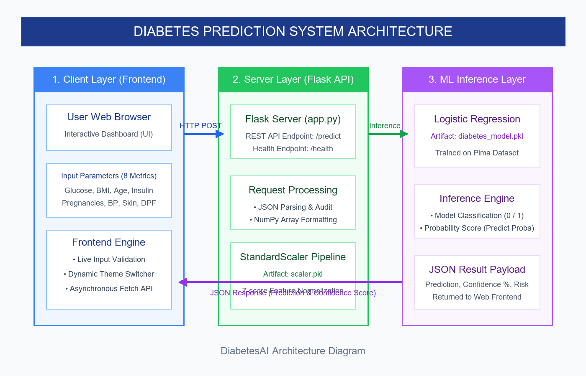
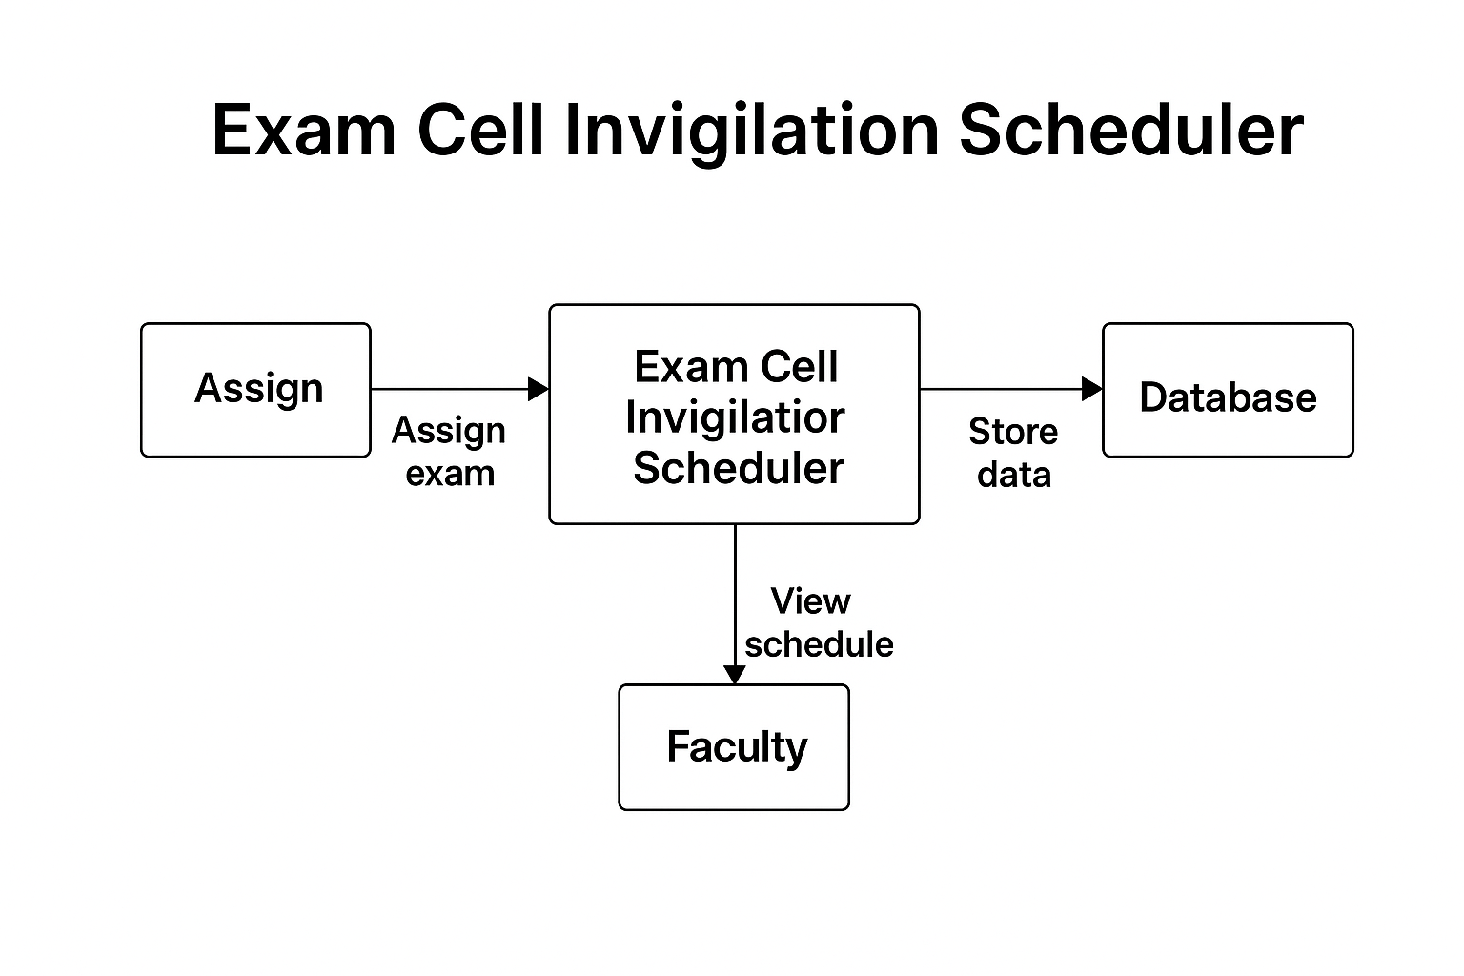
ARCHITECTURE DIAGRAM

Slide 9
MODULE DESCRIPTION
The Diabetes Risk Assessment Web Application consists of three core integrated modules:
• ML & Training Module: Preprocesses dataset, trains Logistic Regression model, fits StandardScaler, and exports binary artifacts (diabetes_model.pkl, scaler.pkl).
• Flask API Backend Module: Serves HTTP REST endpoints (/predict and /health), parses input JSON payloads, formats NumPy arrays, and executes model inference.
• Interactive Frontend Module: Renders glassmorphism UI, handles live input validation, executes async Fetch API calls, and animates results.
This modular separation ensures clean architecture, rapid inference execution, and effortless maintenance.

Slide 10
REFERENCES
scikit-learn Documentation - Official Scikit-learn Machine Learning Library
Flask Web Development Framework Documentation - Pallets Projects
Pima Indians Diabetes Database - NIDDK & World Health Organization (WHO)
Research Papers on Logistic Regression for Clinical Decision Support Systems
MDN Web Docs - Modern HTML5, CSS Glassmorphism, and ES6 JavaScript Standards

Slide 11
THANKYOU

