Slide 1

UDEMY COURSES
ANALYSIS
OF

Slide 2

Agenda
Introduction
Project Overview
Data Exploration and Preprocessing
Analysis and Insights
Conclusion

Slide 3

Introduction
Data analysis and visualization refer to the methods and techniques used to study and interpret data, uncovering patterns and insights that aid in decision-making.
Through visualization, data is presented in a graphical format, making it easier to understand and communicate complex information.

Slide 4

PROJECT OVERVIEW
Let’s dive in

Slide 5
OVERVIEW
The project aims to analyze a dataset
containing information about online
courses to uncover trends and insights that
can help decision-making in the
e-learning industry.
The analysis focuses on exploring various
aspects of the dataset, such as course
subjects, pricing, enrollment numbers, and
student reviews, to gain a comprehensive
understanding of the courses on udemy.

Slide 6
DATA EXPLORATION AND PRE-PROCESSING
Let’s dive in

Slide 7
DATA EXPLORATION
DATA PRE-PROCESSING
This data set has been collected from Kaggle.
The initial phase involves gaining insights into the dataset, including its structure, variables, and distributions, through exploratory data analysis (EDA) techniques such as summary statistics and visualization.
Preprocessing steps include handling missing values, handling outliers , removing duplicates, and converting data types to ensure the dataset's quality and integrity for further analysis.
We’ve used the functions provided by numpy and pandas to detect and handle the duplicates , missing values and outliers.

Slide 8
RESULTS OF EDA
Course Metrics:
The dataset contains information about 2302 courses.
The mean price of courses is approximately 57.76, with a standard deviation of 53.98.
On average, courses have around 699 subscribers, 16 reviews, and 24 lectures.
The mean content duration is approximately 2.13 hours.
The total sales for courses range from 0 to 641,200, with a mean of 44,335.36.
Price Distribution:
Course prices range from free (0) to 200, with most falling between 20 and 70.
25% of courses are priced at 20 or below, while 25% are priced at 70 or above.
Subscriber and Review Distribution:
Subscriber counts vary widely, with some courses having no subscribers and others having up to 3,258 subscribers.
The number of reviews ranges from 0 to 101.
Content Duration:
The content duration of courses spans from 0 to 6 hours, with an average of approximately 2.13 hours.
50% of courses have a content duration between 1 to 3 hours.
Year Distribution:
Courses in the dataset span from 2012 to 2017, with the majority released in 2015 and 2016.

Slide 9
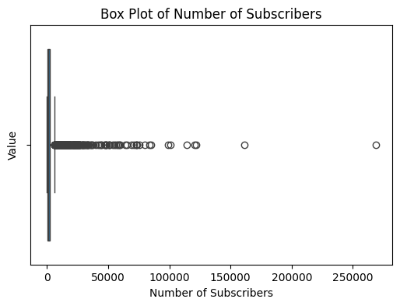
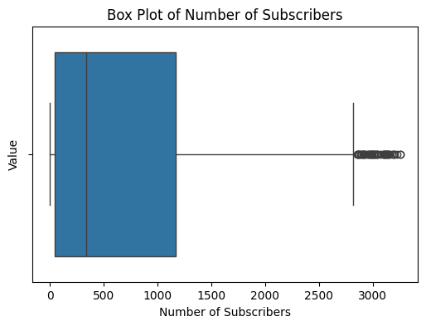
HANDLING OUTLIERS
WITH OUTLIERS
AFTER HANDLING OUTLIERS

Slide 10
ANALYSIS AND INSIGHTS
Let’s dive in

Slide 11
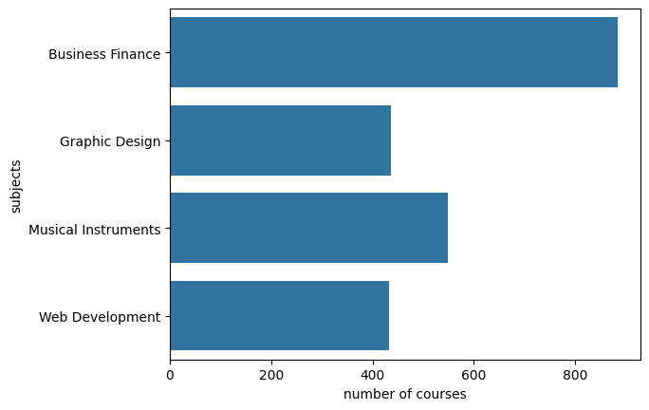
COURSES PER SUBJECT
Business finance courses have a lot of competition

Slide 12
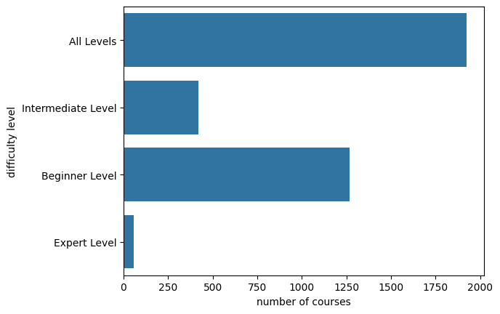
COURSES IN EACH DIFFICULTY
There are a very few expert and intermediate level courses

Slide 13
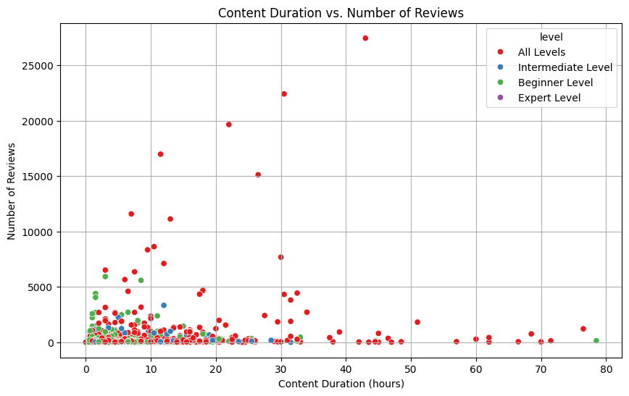
DURATION VS REVIEWS
Most of the courses are having duration less than 20hrs and number of reviews is almost same for almost all the durations

Slide 14
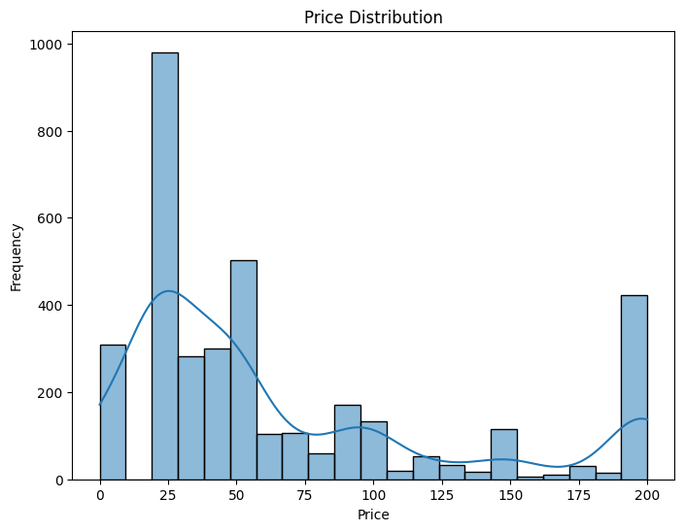
PRICE DISTRIBUTION
Most of the courses are priced at lower cost

Slide 15
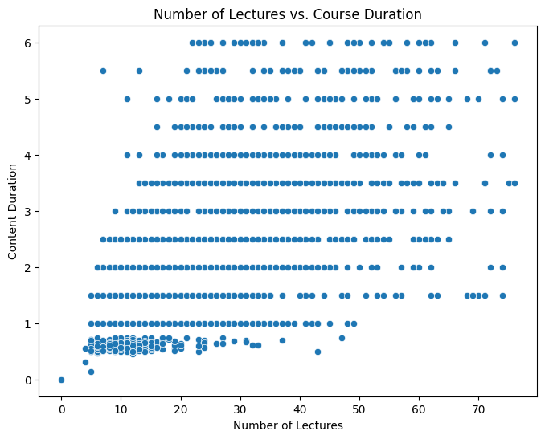
LECUTURES VS DURATION
Number of lectures are positively correlated to the course duration

Slide 16
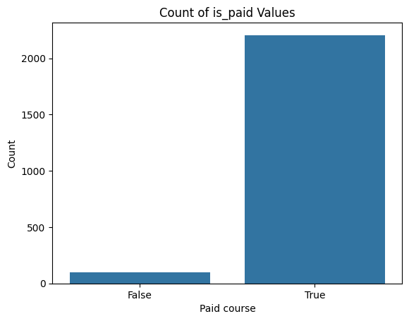
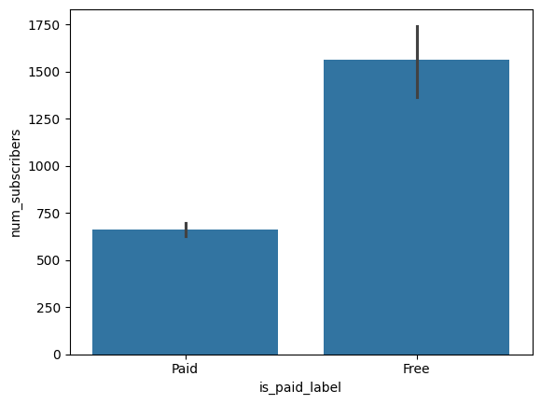
PAID COURSES VS FREE COURSES
NUMBER OF COURSES
NUMBER OF SUBSCRIBERS
Even though the number of paid courses is more than the free courses, people are more interested in taking the free courses.

Slide 17
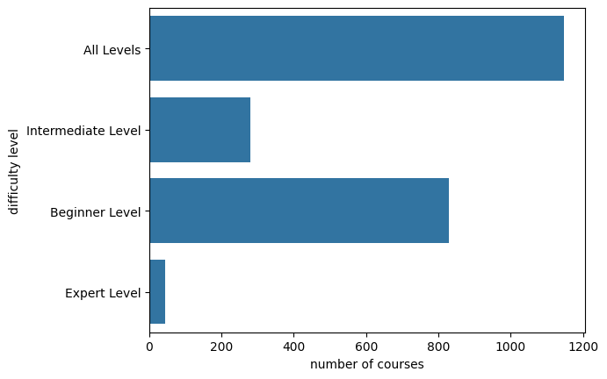
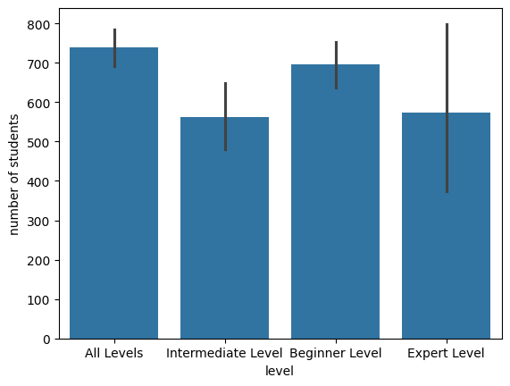
LEVEL OF COURSES
NUMBER OF COURSES
NUMBER OF SUBSCRIBERS
There are less number of courses at beginner and intermediate level, but the number of subscribers is on par with others, so instructors can get good sales if they launch higher level courses as the competition is less but demand is more

Slide 18
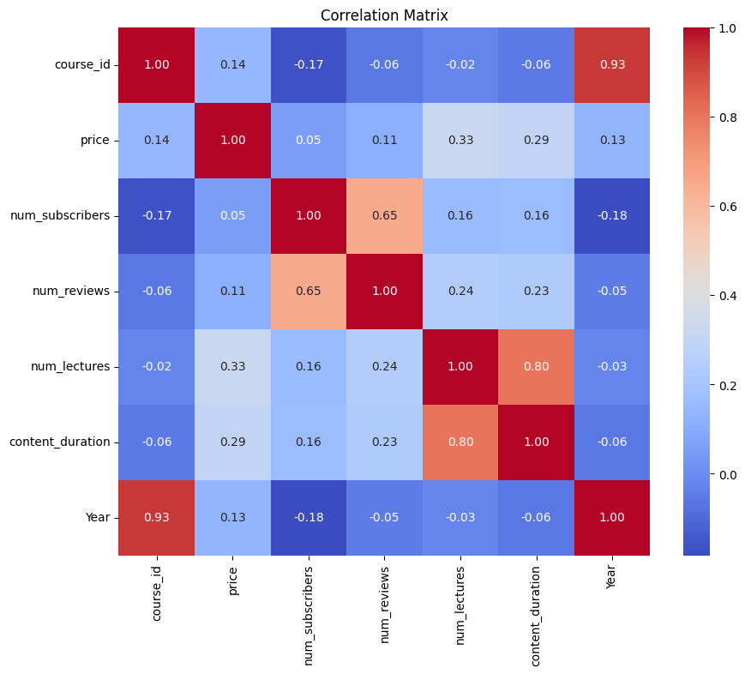
CORRELATION MATRIX

Slide 19
There is a strong positive correlation between price and num_subscribers, which means that courses with higher prices tend to have more subscribers.
There is a moderate positive correlation between price and num_lectures, which means that courses with more lectures tend to have higher prices.
There is a moderate positive correlation between num_subscribers and num_lectures, which means that courses with more lectures tend to have more subscribers.
There is a weak positive correlation between content_duration and num_lectures, which means that courses with more lectures tend to have longer content duration.
There is a weak positive correlation between content_duration and price, which means that courses with higher prices tend to have longer content duration.

Slide 20
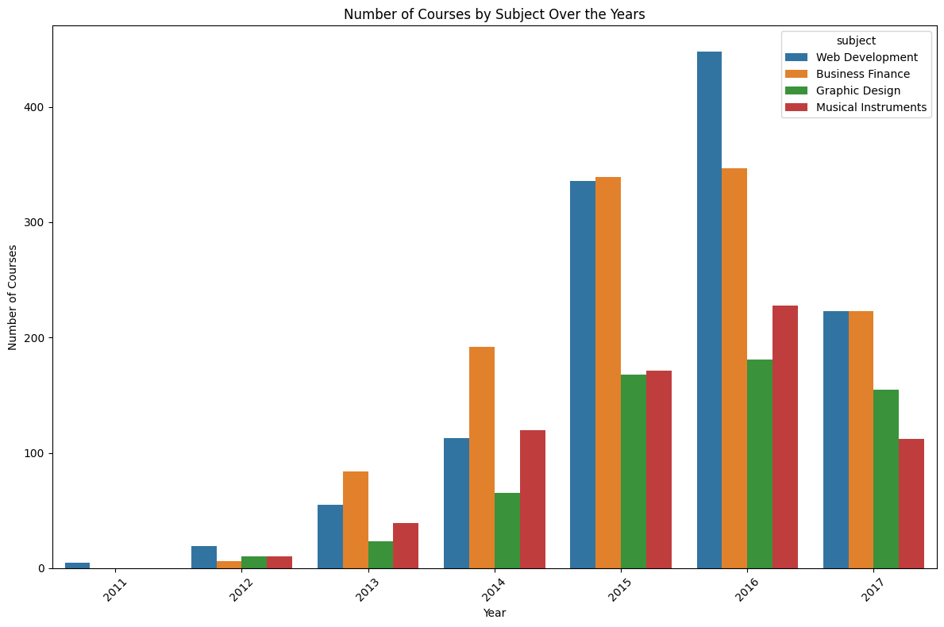
CATEGORY WISE COURSES PER YEAR

Slide 21






Summary
Comprehensive survey of Udemy course offerings and instructor data, with a focus on emerging trends and popular topics.
Creation of informative data visualizations to highlight key findings and patterns in the Udemy course landscape.
Identification of the most in-demand course categories, from cutting-edge technology to timeless business essentials and creative pursuits.
Rigorous cleaning and standardization of the dataset to ensure accuracy and reliability.
In-depth examination of numerical and categorical features to uncover insights into course pricing, enrollment, and instructor performance.
Hands on experience with the libraries of python for analysis and visualization of data

Slide 22

Conclusion
The project's results revealed significant trends and patterns in the dataset, shedding light on key insights and correlations. Through comprehensive data analysis and visualization techniques, we gained a deeper understanding of the underlying dynamics. These findings provide valuable insights for decision-making and lay the groundwork for future explorations and improvements.

Slide 23
PRESENTATION BY:
160122737191
160122737173
160122737188

