Slide 1

UDEMY COURSES
ANALYSIS
OF

Slide 2
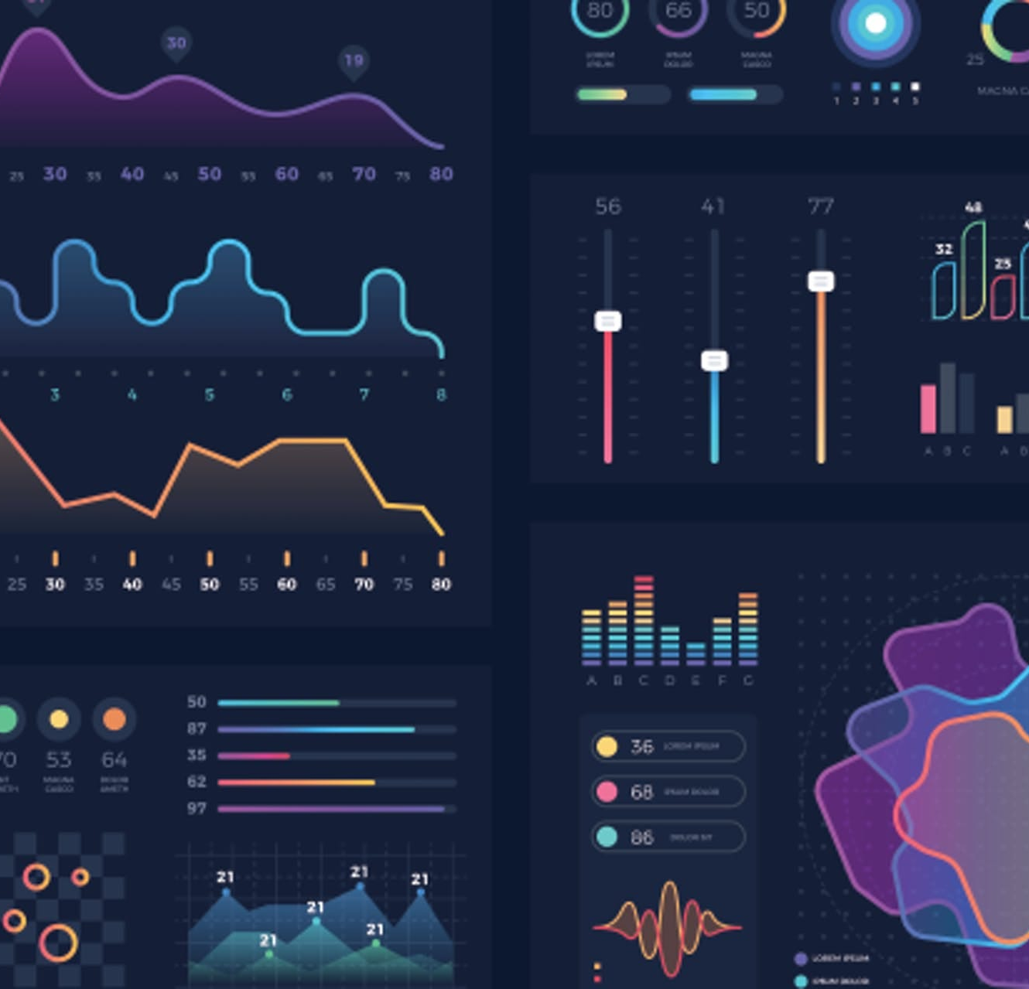
Agenda
Introduction
Project Overview
Data Exploration and Preprocessing
Analysis and Insights
Conclusion

Slide 3

Introduction
Data analysis and visualization refer to the methods and techniques used to study and interpret data, uncovering patterns and insights that aid in decision-making.
Through visualization, data is presented in a graphical format, making it easier to understand and communicate complex information.

Slide 4

PROJECT OVERVIEW
Let’s dive in

Slide 5
OVERVIEW
The project aims to analyze a dataset
containing information about online
courses to uncover trends and insights that
can inform decision-making in the
e-learning industry.
The analysis focuses on exploring various
aspects of the dataset, such as course
subjects, pricing, enrollment numbers, and
student reviews, to gain a comprehensive
understanding of the online learning
landscape.

Slide 6
DATA EXPLORATION AND PRE-PROCESSING
Let’s dive in

Slide 7
DATA EXPLORATION
DATA PRE-PROCESSING
The initial phase involves gaining insights into the dataset, including its structure, variables, and distributions, through exploratory data analysis (EDA) techniques such as summary statistics and visualization.
Preprocessing steps include handling missing values, removing duplicates, and converting data types to ensure the dataset's quality and integrity for further analysis.

Slide 8
ANALYSIS AND INSIGHTS
Let’s dive in

Slide 9
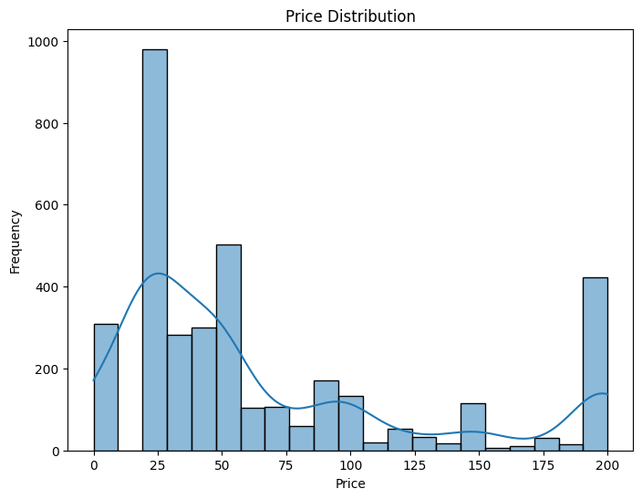
PRICE DISTRIBUTION

Slide 10
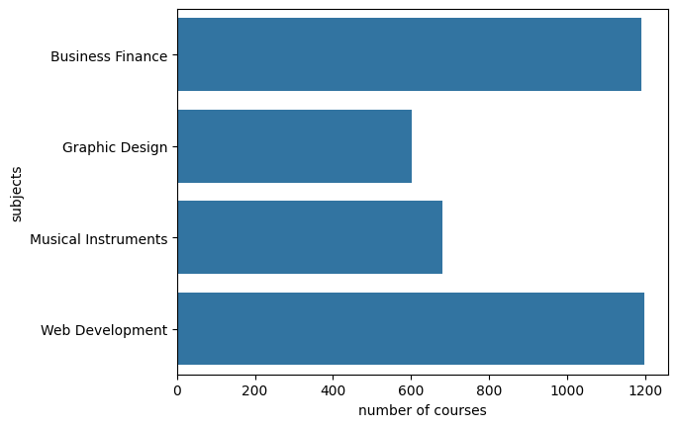
COURSES PER SUBJECT

Slide 11
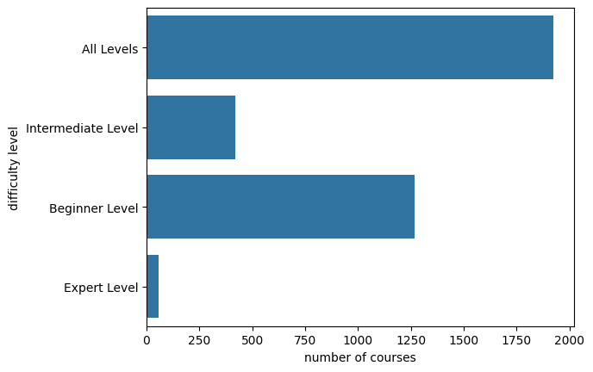
COURSES IN EACH DIFFICULTY

Slide 12
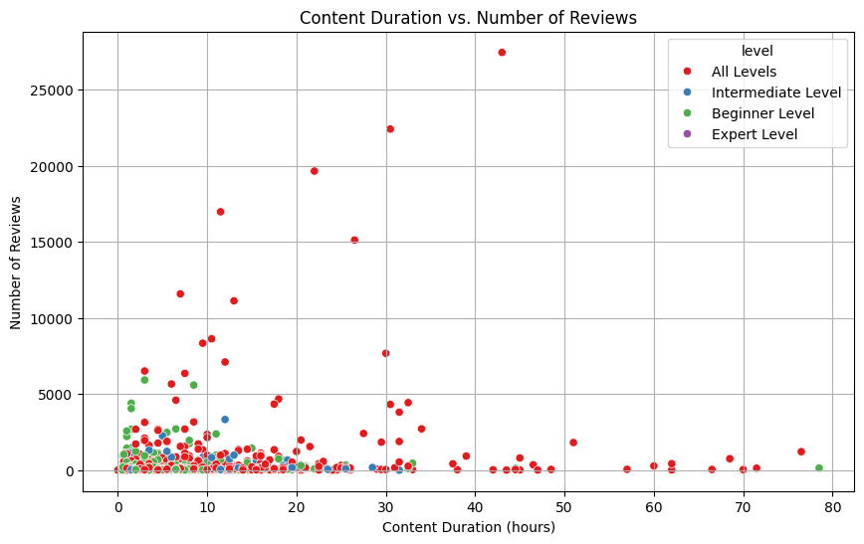
DURATION VS REVIEWS

Slide 13
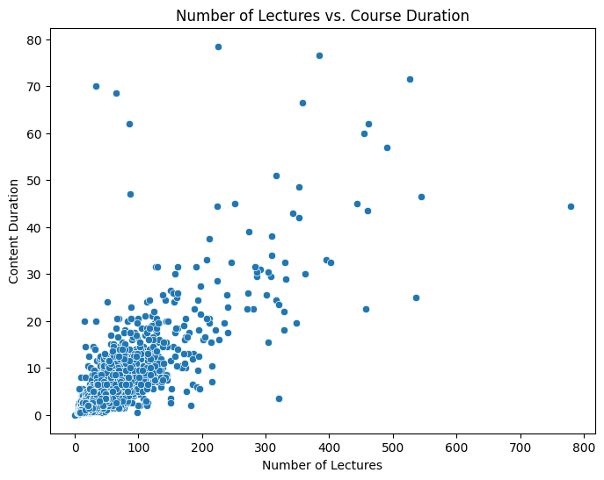
LECUTURES VS DURATION

Slide 14
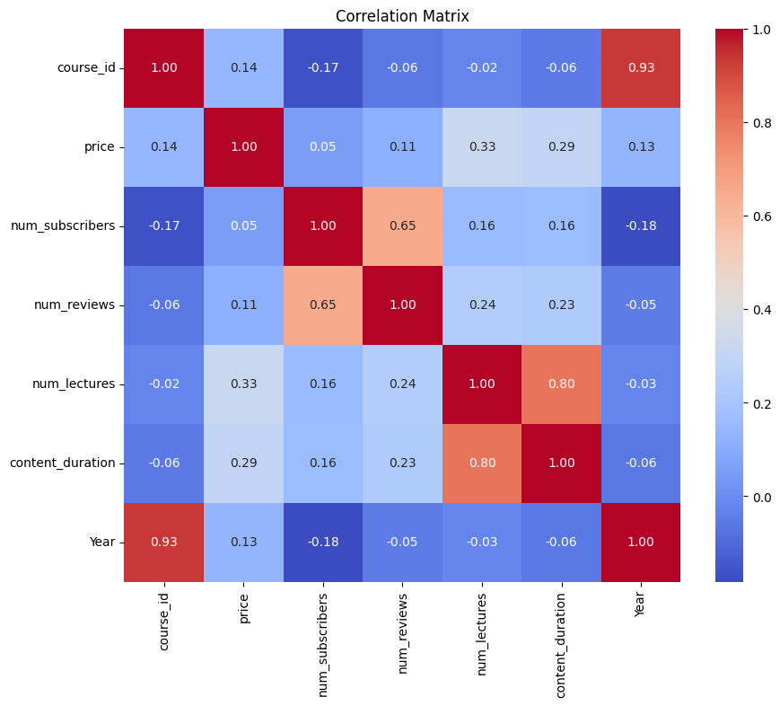
CORRELATION MATRIX

Slide 15
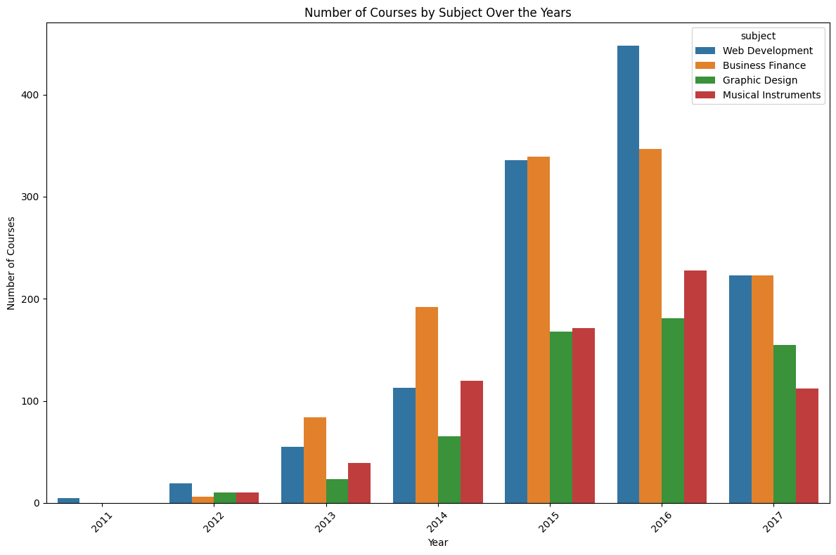
CATEGORY WISE COURSES PER YEAR

Slide 16






Summary
We’re delivering for our customers
Last year we supported thousands of customers and sold 60,000 units
Our business is good
Profits are up in the last quarter by 3%
Our customers keep coming back
We increased customer retention by 4%
We’re getting our work done
We finished the consolidation project
Our team is growing
We welcomed 3 new team members last quarter
We’re leaders
We are top leaders in the industry across the board

Slide 17

Conclusion
The project's results revealed significant trends and patterns in the dataset, shedding light on key insights and correlations. Through comprehensive data analysis and visualization techniques, we gained a deeper understanding of the underlying dynamics. These findings provide valuable insights for decision-making and lay the groundwork for future explorations and improvements.

