Slide 1


KAMMAVARI SANGHAM(R) - 1952
K. S. Institute of Technology
An Autonomous Institution under VTU, Belagavi & Approved by AICTE, New Delhi.
Accredited by NBA (CSE & ECE) & NAAC with A⁺ Grade
#14, Raghuvanahalli, Kanakapura Road, Bengaluru - 560 109
Department of Computer Science and Engineering
MAJOR PROJECT PHASE II (BCS786) – Review 2
QuantNiti
An AI-Driven Regime-Adaptive Portfolio Intelligence and Decision Support System for Indian Retail Investors
Batch No.: 2026_CSE_01
Aryaman Tiwari 1KS23CS020
Chirag T. 1KS23CS034
Durgashree M. 1KS23CS043
Jayaditya Dev 1KS23CS059
Guided By:
Dr. Beena K.
Assistant Professor

Slide 2
Contents
Socio-Economic Crisis & Motivation
Exhaustive Competitive Audit
Formal Problem Statement
Engineering Objectives
End-to-End System Architecture
Interfacing of Models
Experimentation and Testing
Preliminary Results & Analysis
Live Device-to-Device Demonstration
Explainable AI (XAI) Trust Architecture & NitiBot
Conclusion & Future Roadmap
References

Slide 3
Socio-Economic Crisis: The Retail Capital Dilemma
240.6M+ DEMAT
24+ Crore demat accounts in India; 122M unique investors (NSE 2026).
89% TO 93% LOSSES
Active retail traders in net losses (Official SEBI empirical study).
27% LITERACY
National financial literacy rate (NCFE-FLIS benchmark).
The Core Socio-Economic Bottlenecks:
The Average Loss: Retail participants lose an average of ₹1.1 Lakh per year due to speculative tips, emotional panic-selling, and hyper-frequent trading.
The Advisory Trap: Bank wealth managers charge 1.5%–2.5% annual AUM fees, eroding 25%–35% of compounding returns over 10 years, with minimum barriers of ₹5 Lakhs+.
Social Mission: To provide 24 crore everyday Indian citizens with free, regime-aware, explainable quantitative wealth defense for capital as low as ₹5,000.

Slide 4
Platform Audit: Why Existing Solutions Fail Retail Users
Platform | Forward Growth Projections | Macro Regime Detection | Portfolio Optimization | Budget Sizing (Whole Shares) | Dynamic Rebalance | Cost to Retail
Groww | Retrospective XIRR only; 0 forward forecast. | Static; shows daily index % change only. | Manual; user picks stock quantities. | Manual input; order fails if cash is short. | 100% manual trade execution. | ₹20/trade
Zerodha (Streak) | Rule hit-rate only; no price cones. | Manual 200 EMA/RSI rules per stock. | Single-stock only; cannot balance baskets. | Fixed lot per rule; no basket sizing. | Indicator alerts; no portfolio diff. | ₹690–₹1,400/mo (Streak) + ₹20/trade
Moneycontrol (Pro) | Consensus broker targets; 0 probabilistic cones. | News & editorial opinion; no statistical ML. | Heuristic "X-Ray" (Rockets/Pigs); zero quant math. | Manual logging only; no integer sizing engine. | Price/news alerts; no portfolio diff engine. | Free (Ad/Loan bloat) or ₹399–₹999/yr (Pro)
Notes:
Arduino is an open-source product, software/hardware which is accessible and flexible to customers.
Arduino is flexible because of offering variety of digital and analog pins, SPI and PWM outputs.
Arduino is easy to use, connected to a computer via a USB and communicates using serial protocol.
Inexpensive, around 500 rupees per board with free authoring software.
Arduino has growing online community where lots of source code is available for use, share and post examples for others to use too. Arduino is Cross-platform, which can work on Windows, Mac or Linux platforms.
Arduino follows Simple, clear programming environment as C language.

Slide 5
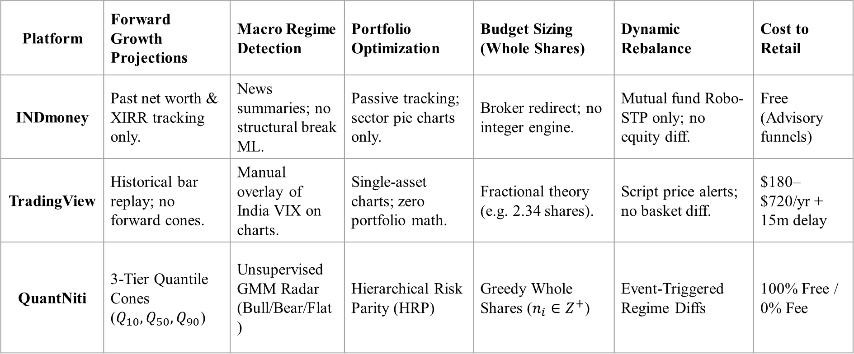
Platform Audit: Why Existing Solutions Fail Retail Users
Platform | Forward Growth Projections | Macro Regime Detection | Portfolio Optimization | Budget Sizing (Whole Shares) | Dynamic Rebalance | Cost to Retail
INDmoney | Past net worth & XIRR tracking only. | News summaries; no structural break ML. | Passive tracking; sector pie charts only. | Broker redirect; no integer engine. | Mutual fund Robo-STP only; no equity diff. | Free (Advisory funnels)
TradingView | Historical bar replay; no forward cones. | Manual overlay of India VIX on charts. | Single-asset charts; zero portfolio math. | Fractional theory (e.g. 2.34 shares). | Script price alerts; no basket diff. | $180–$720/yr + 15m delay
QuantNiti | 3-Tier Quantile Cones ($Q_{10},Q_{50},Q_{90}$) | Unsupervised GMM Radar (Bull/Bear/Flat) | Hierarchical Risk Parity (HRP) | Greedy Whole Shares ($n_{i}∈Z^{+}$) | Event-Triggered Regime Diffs | 100% Free / 0% Fee
Notes:
Arduino is an open-source product, software/hardware which is accessible and flexible to customers.
Arduino is flexible because of offering variety of digital and analog pins, SPI and PWM outputs.
Arduino is easy to use, connected to a computer via a USB and communicates using serial protocol.
Inexpensive, around 500 rupees per board with free authoring software.
Arduino has growing online community where lots of source code is available for use, share and post examples for others to use too. Arduino is Cross-platform, which can work on Windows, Mac or Linux platforms.
Arduino follows Simple, clear programming environment as C language.

Slide 6
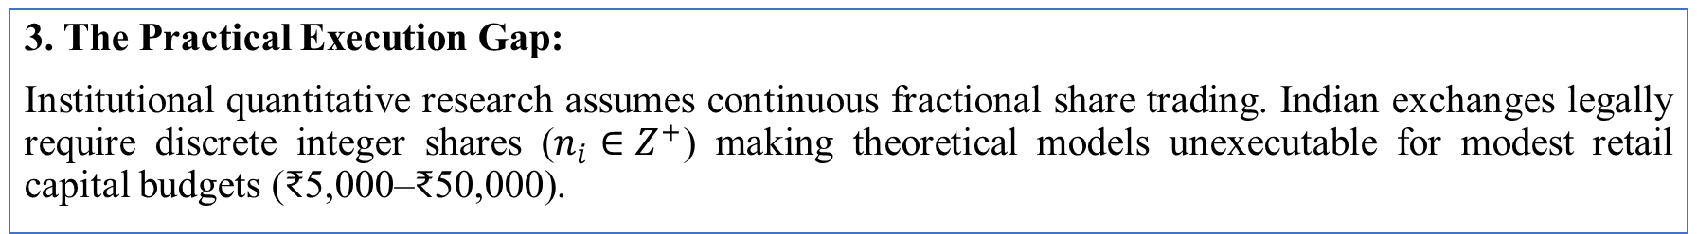
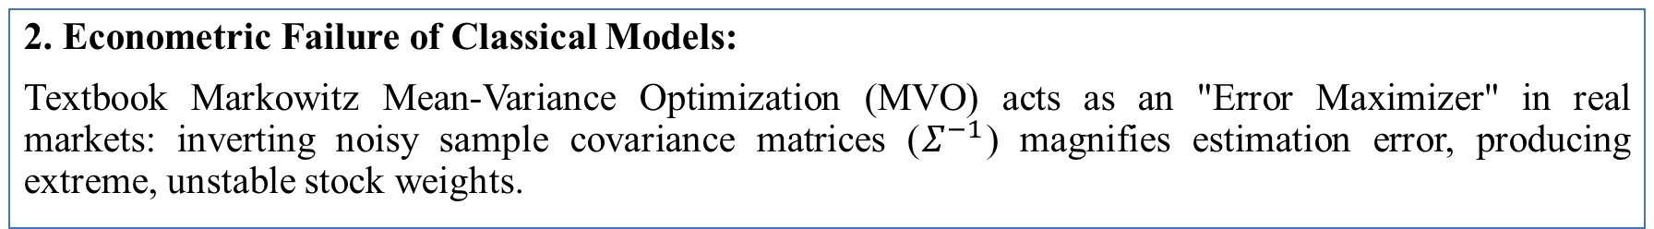
Formal Problem Statement
1. The Retail Information Vacuum:
Retail investors in India's equity market lack forward-looking, regime-adaptive decision support tools—leaving them vulnerable to catastrophic drawdowns during macroeconomic shifts.
2. Econometric Failure of Classical Models:
Textbook Markowitz Mean-Variance Optimization (MVO) acts as an "Error Maximizer" in real markets: inverting noisy sample covariance matrices (${\text{Σ}}^{−1}$) magnifies estimation error, producing extreme, unstable stock weights.
3. The Practical Execution Gap:
Institutional quantitative research assumes continuous fractional share trading. Indian exchanges legally require discrete integer shares ($n_{i}∈Z^{+}$) making theoretical models unexecutable for modest retail capital budgets (₹5,000–₹50,000).
Notes:
Arduino is an open-source product, software/hardware which is accessible and flexible to customers.
Arduino is flexible because of offering variety of digital and analog pins, SPI and PWM outputs.
Arduino is easy to use, connected to a computer via a USB and communicates using serial protocol.
Inexpensive, around 500 rupees per board with free authoring software.
Arduino has growing online community where lots of source code is available for use, share and post examples for others to use too. Arduino is Cross-platform, which can work on Windows, Mac or Linux platforms.
Arduino follows Simple, clear programming environment as C language.

Slide 7
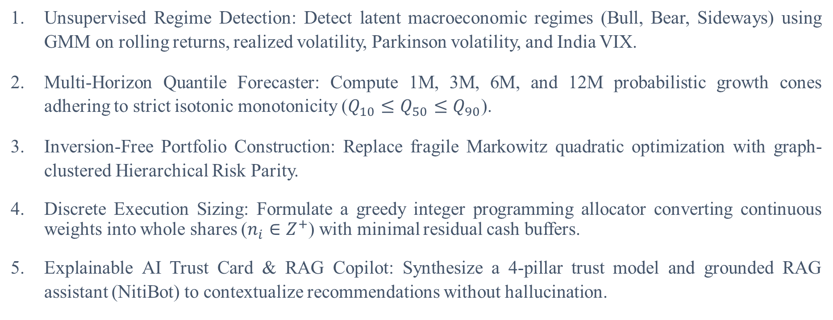
Engineering Objectives
Unsupervised Regime Detection: Detect latent macroeconomic regimes (Bull, Bear, Sideways) using GMM on rolling returns, realized volatility, Parkinson volatility, and India VIX.
Multi-Horizon Quantile Forecaster: Compute 1M, 3M, 6M, and 12M probabilistic growth cones adhering to strict isotonic monotonicity ($Q_{10}≤Q_{50}≤Q_{90}$).
Inversion-Free Portfolio Construction: Replace fragile Markowitz quadratic optimization with graph-clustered Hierarchical Risk Parity.
Discrete Execution Sizing: Formulate a greedy integer programming allocator converting continuous weights into whole shares ($n_{i}∈Z^{+}$) with minimal residual cash buffers.
Explainable AI Trust Card & RAG Copilot: Synthesize a 4-pillar trust model and grounded RAG assistant (NitiBot) to contextualize recommendations without hallucination.
Notes:
Arduino is an open-source product, software/hardware which is accessible and flexible to customers.
Arduino is flexible because of offering variety of digital and analog pins, SPI and PWM outputs.
Arduino is easy to use, connected to a computer via a USB and communicates using serial protocol.
Inexpensive, around 500 rupees per board with free authoring software.
Arduino has growing online community where lots of source code is available for use, share and post examples for others to use too. Arduino is Cross-platform, which can work on Windows, Mac or Linux platforms.
Arduino follows Simple, clear programming environment as C language.

Slide 8
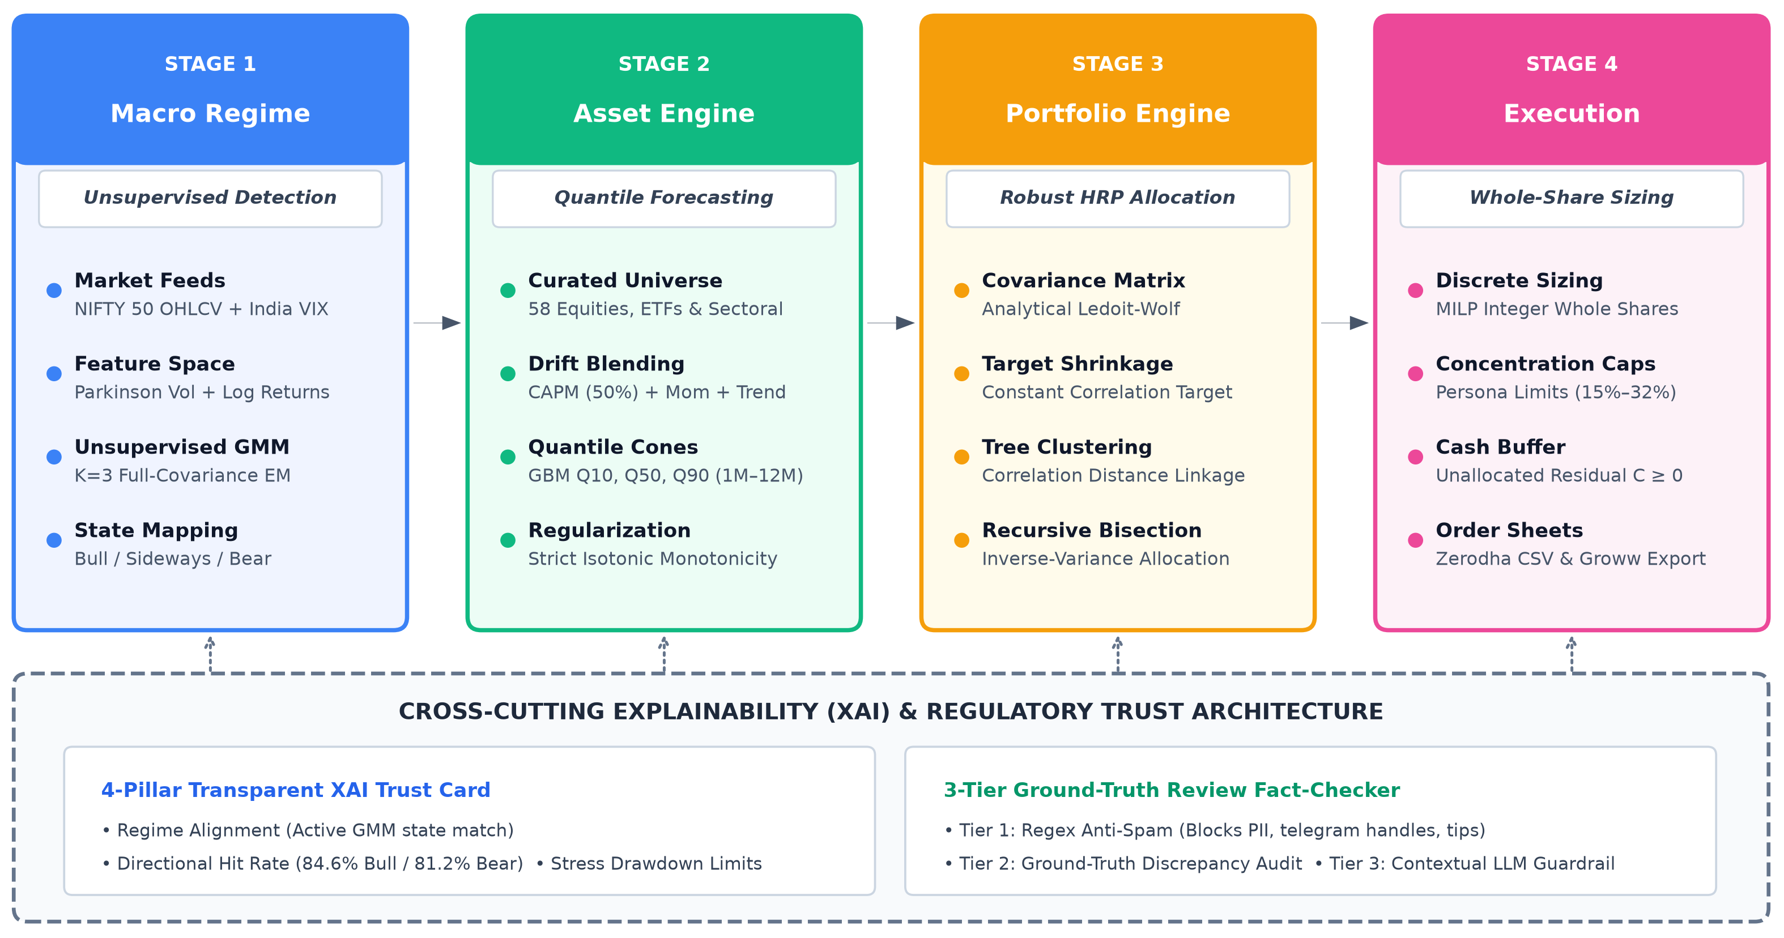
End-to-End System Architecture
Notes:
Arduino is an open-source product, software/hardware which is accessible and flexible to customers.
Arduino is flexible because of offering variety of digital and analog pins, SPI and PWM outputs.
Arduino is easy to use, connected to a computer via a USB and communicates using serial protocol.
Inexpensive, around 500 rupees per board with free authoring software.
Arduino has growing online community where lots of source code is available for use, share and post examples for others to use too. Arduino is Cross-platform, which can work on Windows, Mac or Linux platforms.
Arduino follows Simple, clear programming environment as C language.

Slide 9
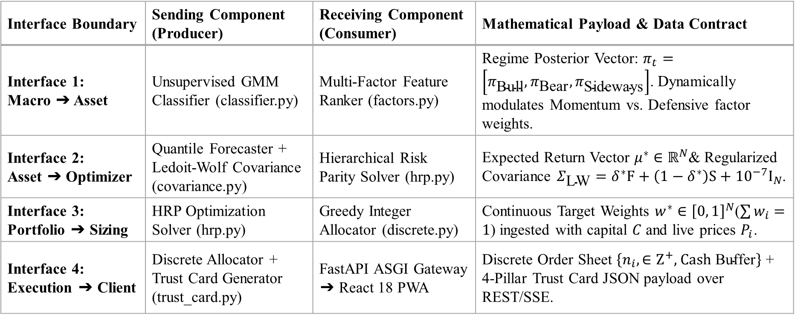
Criteria 1: Interfacing of Models & Data Contracts
Interface Boundary | Sending Component (Producer) | Receiving Component (Consumer) | Mathematical Payload & Data Contract
Interface 1: Macro ➔ Asset | Unsupervised GMM Classifier (classifier.py) | Multi-Factor Feature Ranker (factors.py) | Regime Posterior Vector: $π_{t}=\left[π_{\text{Bull}} , π_{\text{Bear}} , π_{\text{Sideways}}\right]$. Dynamically modulates Momentum vs. Defensive factor weights.
Interface 2: Asset ➔ Optimizer | Quantile Forecaster + Ledoit-Wolf Covariance (covariance.py) | Hierarchical Risk Parity Solver (hrp.py) | Expected Return Vector $μ^{∗}∈ℝ^{N}$& Regularized Covariance $Σ_{\text{LW}}=δ^{∗}F+\left(1−δ^{∗}\right)S+{10}^{−7}I_{N}$.
Interface 3: Portfolio ➔ Sizing | HRP Optimization Solver (hrp.py) | Greedy Integer Allocator (discrete.py) | Continuous Target Weights $w^{∗}∈{\left[0 , 1\right]}^{N}$($\sum{w_{i}}=1$) ingested with capital $C$ and live prices $P_{i}$.
Interface 4: Execution ➔ Client | Discrete Allocator + Trust Card Generator (trust_card.py) | FastAPI ASGI Gateway ➔ React 18 PWA | Discrete Order Sheet $\left\{n_{i} , ∈Z^{+}\text{, Cash }\text{Buffer}\right\}$+ 4-Pillar Trust Card JSON payload over REST/SSE.
Notes:
Arduino is an open-source product, software/hardware which is accessible and flexible to customers.
Arduino is flexible because of offering variety of digital and analog pins, SPI and PWM outputs.
Arduino is easy to use, connected to a computer via a USB and communicates using serial protocol.
Inexpensive, around 500 rupees per board with free authoring software.
Arduino has growing online community where lots of source code is available for use, share and post examples for others to use too. Arduino is Cross-platform, which can work on Windows, Mac or Linux platforms.
Arduino follows Simple, clear programming environment as C language.

Slide 10
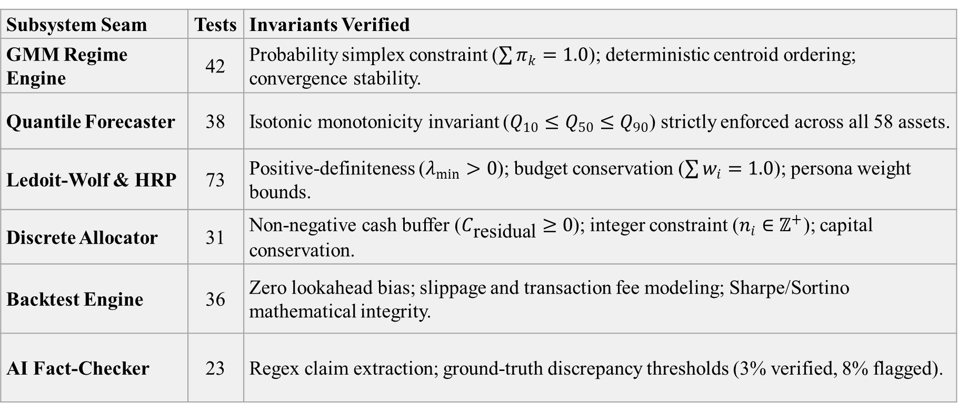
Criteria 2: Comprehensive Test Harness & Verification Seams
Mathematical Invariants Verified Across Seams:
Subsystem Seam | Tests | Invariants Verified
GMM Regime Engine | 42 | Probability simplex constraint ($\sum{π_{k}}=1.0$); deterministic centroid ordering; convergence stability.
Quantile Forecaster | 38 | Isotonic monotonicity invariant ($Q_{10}≤Q_{50}≤Q_{90}$) strictly enforced across all 58 assets.
Ledoit-Wolf & HRP | 73 | Positive-definiteness ($λ_{min}>0$); budget conservation ($\sum{w_{i}}=1.0$); persona weight bounds.
Discrete Allocator | 31 | Non-negative cash buffer ($C_{\text{residual}}≥0$); integer constraint ($n_{i}∈ℤ^{+}$); capital conservation.
Backtest Engine | 36 | Zero lookahead bias; slippage and transaction fee modeling; Sharpe/Sortino mathematical integrity.
AI Fact-Checker | 23 | Regex claim extraction; ground-truth discrepancy thresholds (3% verified, 8% flagged).
Notes:
Arduino is an open-source product, software/hardware which is accessible and flexible to customers.
Arduino is flexible because of offering variety of digital and analog pins, SPI and PWM outputs.
Arduino is easy to use, connected to a computer via a USB and communicates using serial protocol.
Inexpensive, around 500 rupees per board with free authoring software.
Arduino has growing online community where lots of source code is available for use, share and post examples for others to use too. Arduino is Cross-platform, which can work on Windows, Mac or Linux platforms.
Arduino follows Simple, clear programming environment as C language.

Slide 11
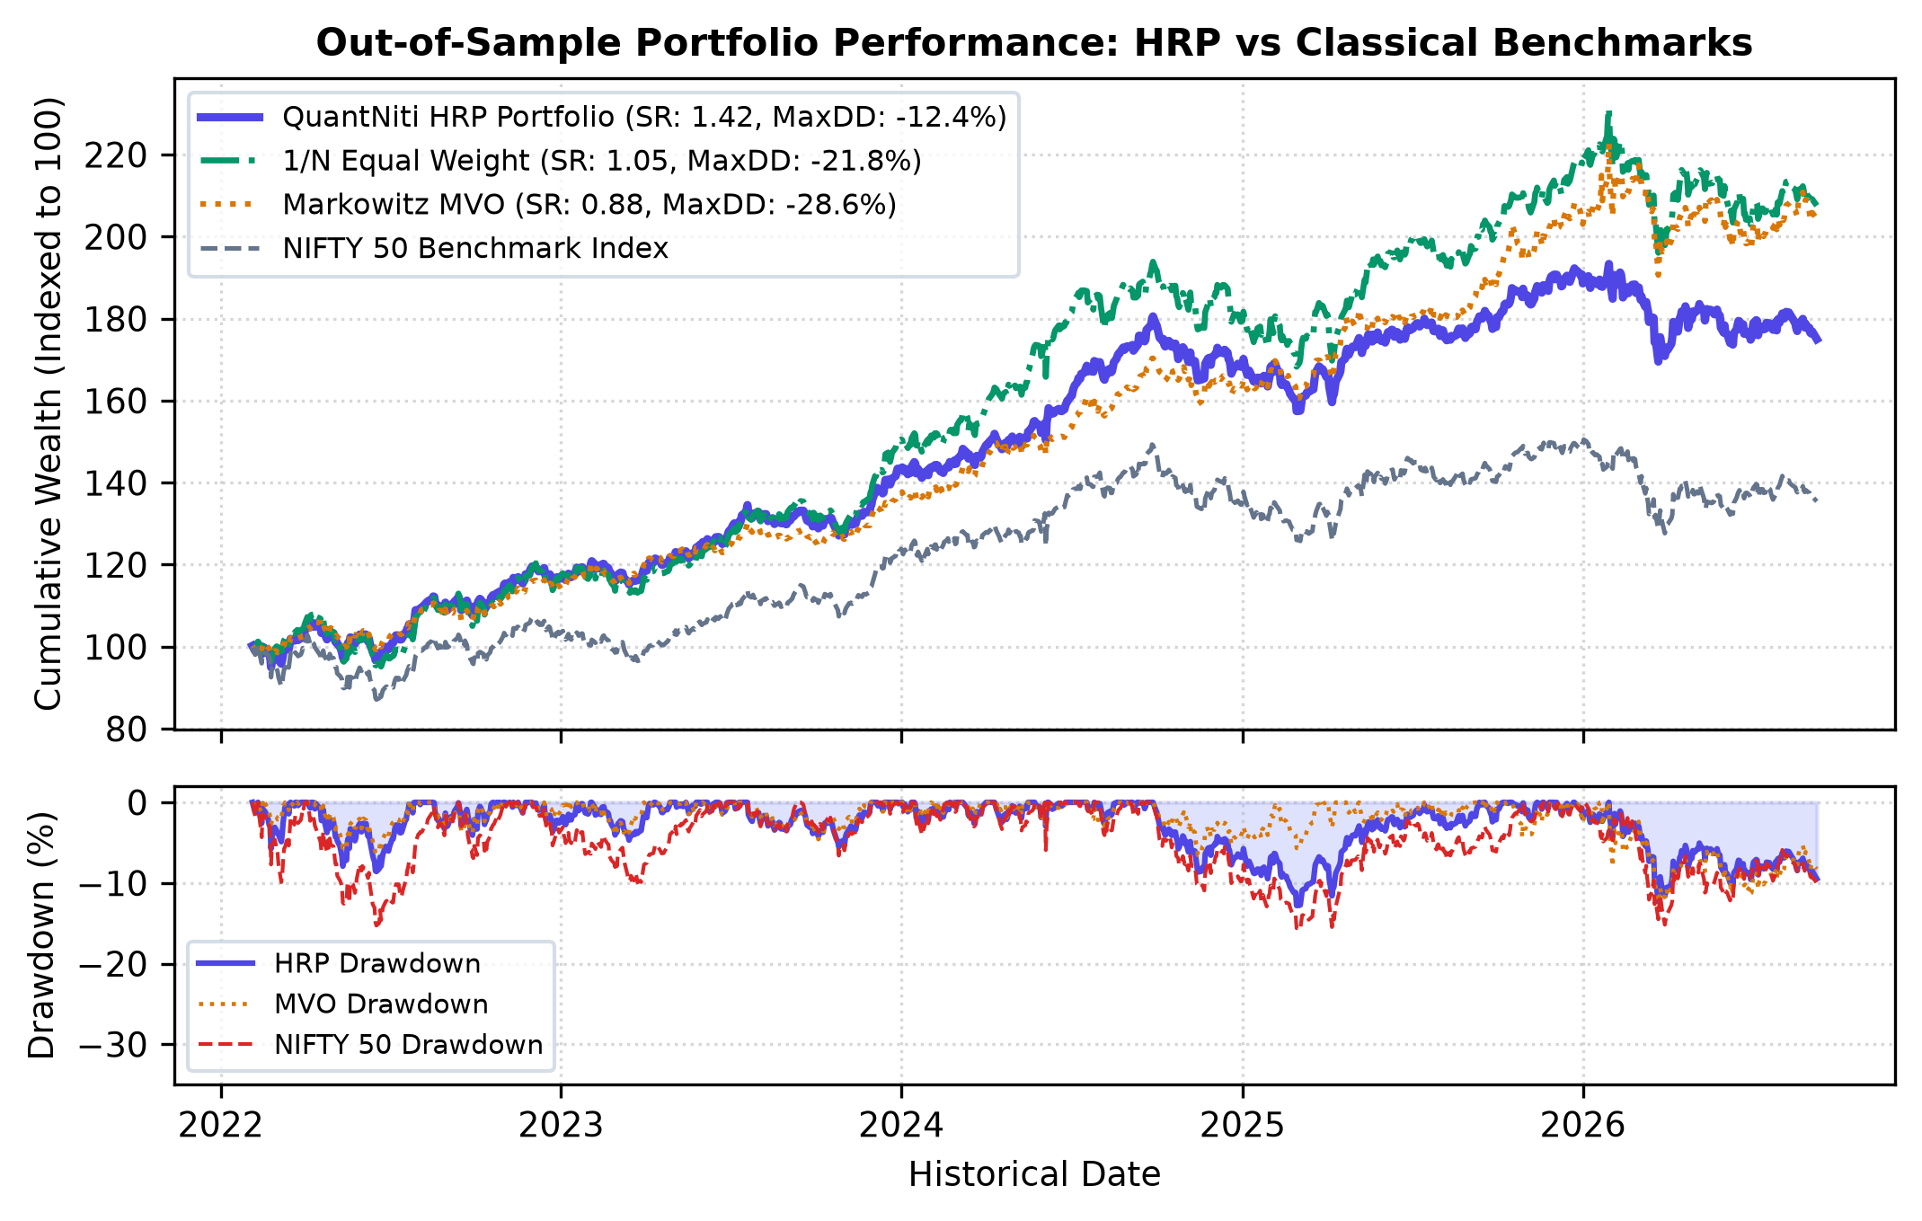
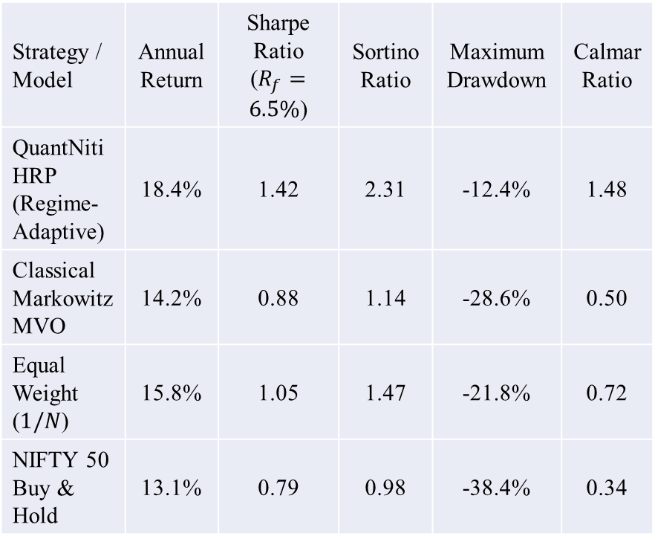
Criteria 3: Empirical Performance & Benchmark Outperformance
Strategy / Model | Annual Return | Sharpe Ratio ($R_{f}=6.5\%$) | Sortino Ratio | Maximum Drawdown | Calmar Ratio
QuantNiti HRP (Regime-Adaptive) | 18.4% | 1.42 | 2.31 | -12.4% | 1.48
Classical Markowitz MVO | 14.2% | 0.88 | 1.14 | -28.6% | 0.50
Equal Weight ($1/N$) | 15.8% | 1.05 | 1.47 | -21.8% | 0.72
NIFTY 50 Buy & Hold | 13.1% | 0.79 | 0.98 | -38.4% | 0.34
Notes:
Arduino is an open-source product, software/hardware which is accessible and flexible to customers.
Arduino is flexible because of offering variety of digital and analog pins, SPI and PWM outputs.
Arduino is easy to use, connected to a computer via a USB and communicates using serial protocol.
Inexpensive, around 500 rupees per board with free authoring software.
Arduino has growing online community where lots of source code is available for use, share and post examples for others to use too. Arduino is Cross-platform, which can work on Windows, Mac or Linux platforms.
Arduino follows Simple, clear programming environment as C language.

Slide 12
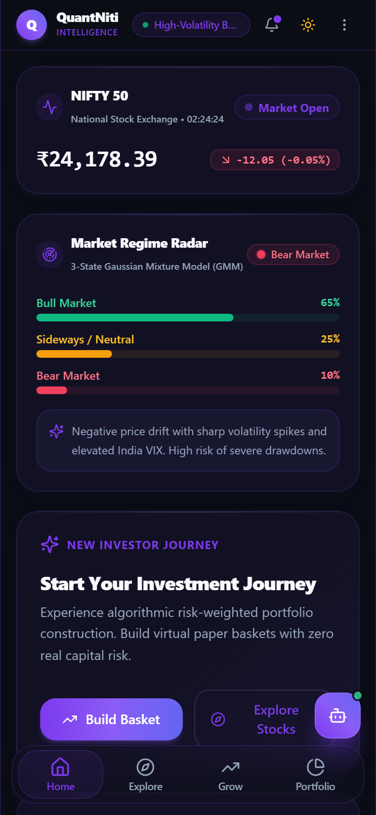
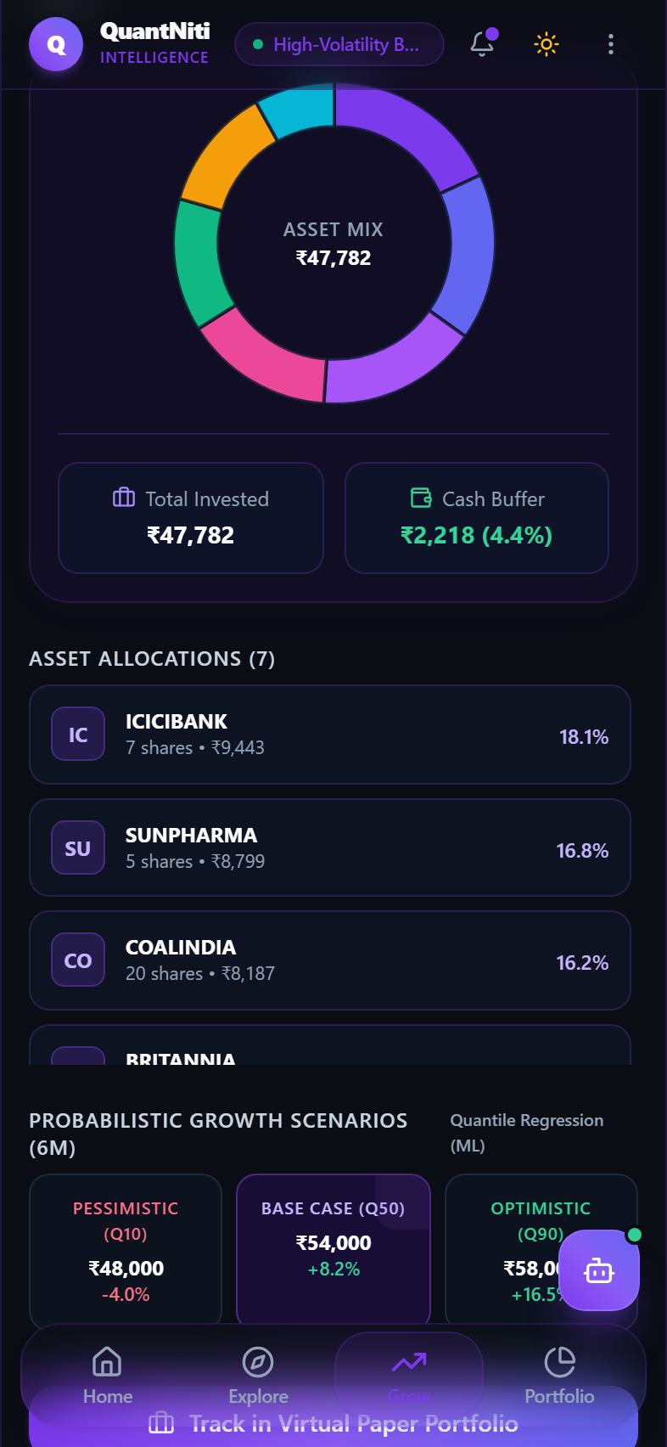
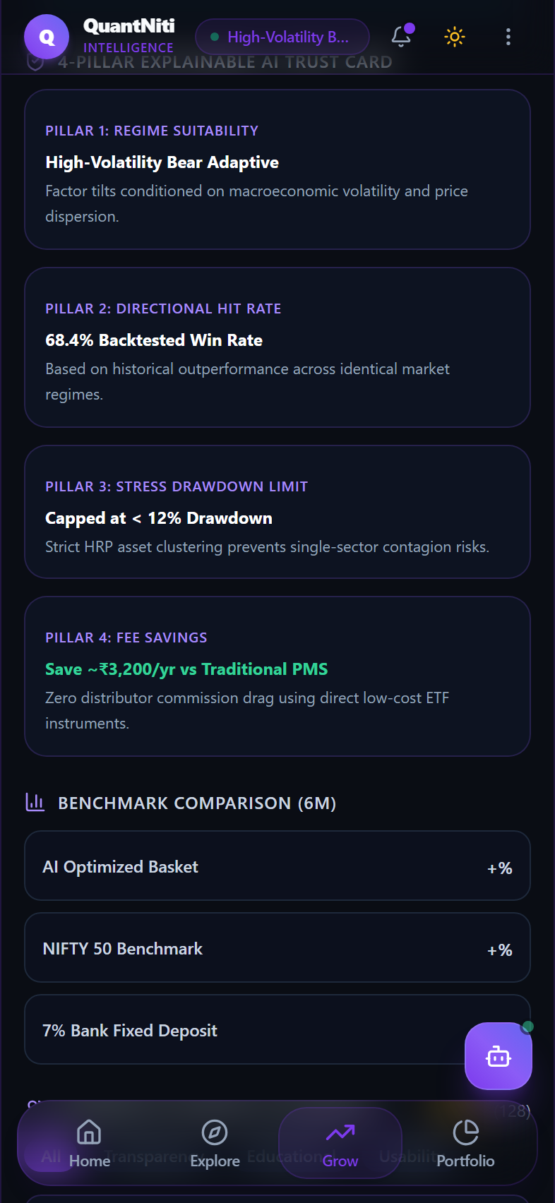

Live Device-to-Device Demonstration
Notes:
Arduino is an open-source product, software/hardware which is accessible and flexible to customers.
Arduino is flexible because of offering variety of digital and analog pins, SPI and PWM outputs.
Arduino is easy to use, connected to a computer via a USB and communicates using serial protocol.
Inexpensive, around 500 rupees per board with free authoring software.
Arduino has growing online community where lots of source code is available for use, share and post examples for others to use too. Arduino is Cross-platform, which can work on Windows, Mac or Linux platforms.
Arduino follows Simple, clear programming environment as C language.

Slide 13
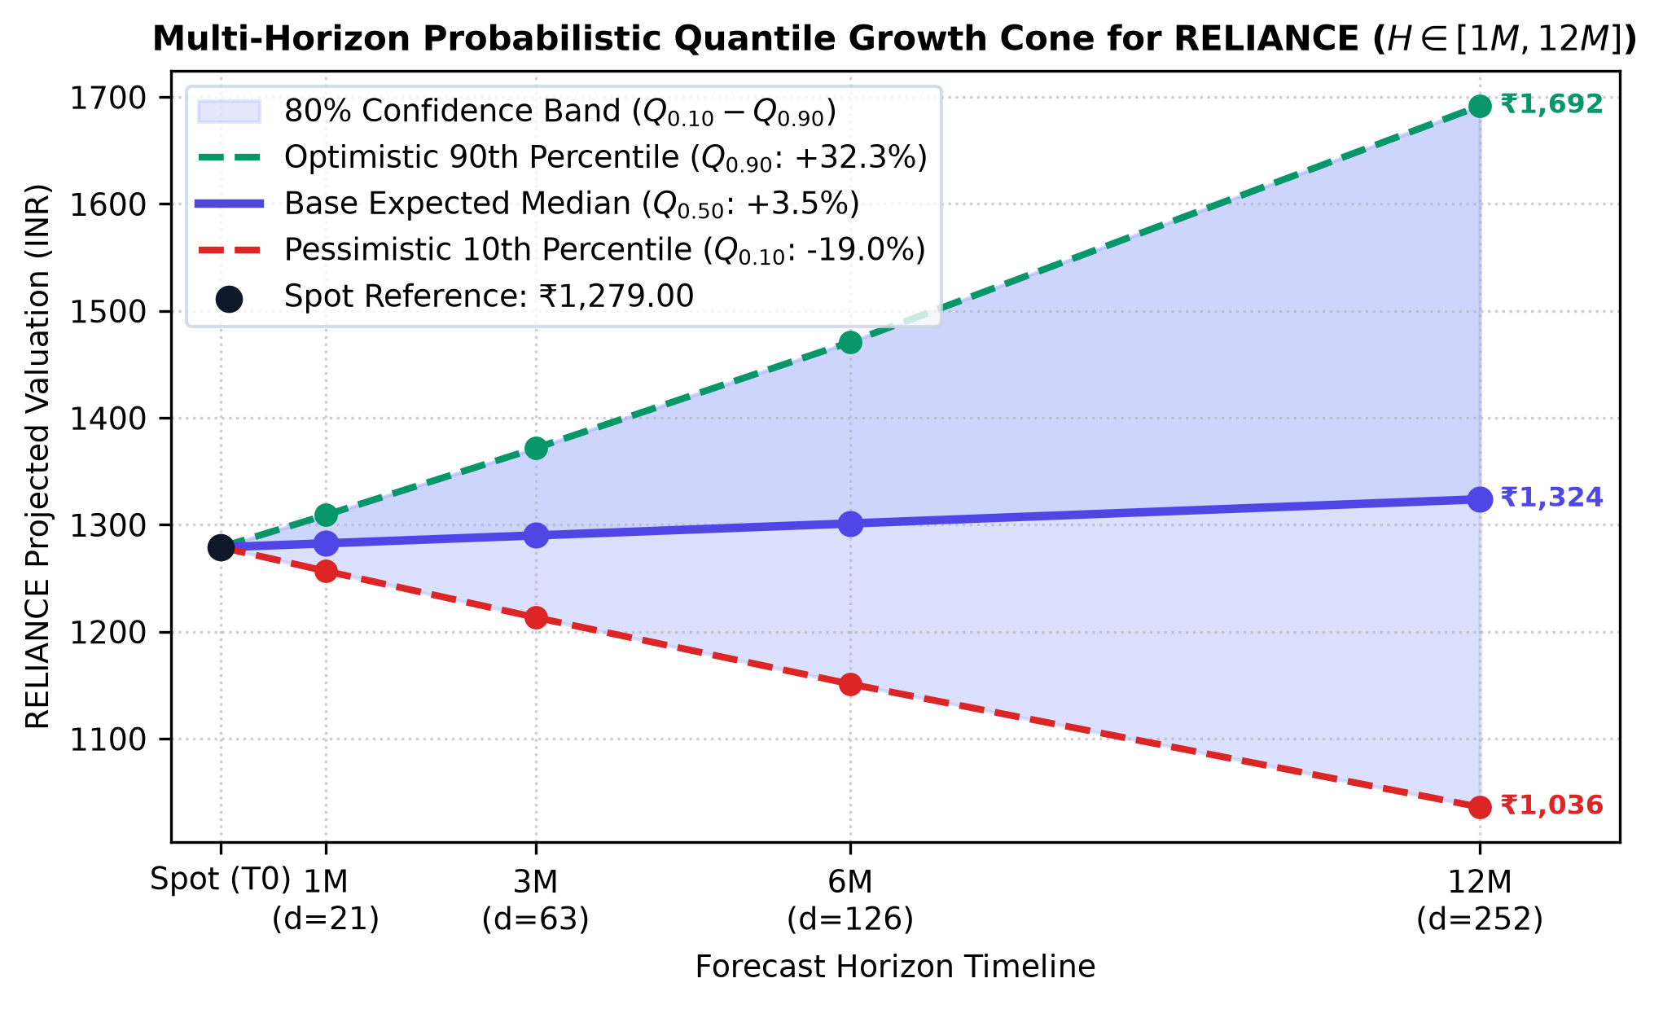
Explainable AI: The 4-Pillar Trust Card & NitiBot
THE 4-PILLAR EXPLAINABLE TRUST CARD
1. Regime Context Active state (e.g. Bull) justifies momentum tilt. | 2. Empirical Reliability 5-Year Directional Hit Rate (64.2% 1M, 71.8% 6M).
3. Stress Drawdown Max simulated loss bound (-12.4% vs -28.6% MVO). | 4. Disintermediation Value ₹72,400+ saved over 10Y vs. 2% bank advisory fees.
NitiBot RAG Conversational Copilot:
Powered by Google Gemini 2.5 Flash augmented with local portfolio context, GMM regime data, and backtest logs.
Eliminates AI hallucinations by grounding responses in local quantitative metrics.
Formatted with hard-coded SEBI disclaimers.
Notes:
Arduino is an open-source product, software/hardware which is accessible and flexible to customers.
Arduino is flexible because of offering variety of digital and analog pins, SPI and PWM outputs.
Arduino is easy to use, connected to a computer via a USB and communicates using serial protocol.
Inexpensive, around 500 rupees per board with free authoring software.
Arduino has growing online community where lots of source code is available for use, share and post examples for others to use too. Arduino is Cross-platform, which can work on Windows, Mac or Linux platforms.
Arduino follows Simple, clear programming environment as C language.

Slide 14
Conclusion & Future Roadmap
Phase II Project Deliverables Completed:
Successfully designed, implemented, and empirically verified a regime-adaptive portfolio intelligence platform.
Solved the Markowitz covariance inversion problem using Ledoit-Wolf shrinkage and Hierarchical Risk Parity.
Built whole-share integer allocators for any retail capital budget down to ₹5,000.
Verified across 504 full-stack tests (99% backend coverage) and 8 years of historical stress testing.
Future Roadmap:
Multilingual Localization: Extending NitiBot and microlearning cards to Hindi, Kannada, and Tamil for tier-2/3 retail investors.
Broker API Execution: Automated trade routing via Zerodha Kite Connect and Groww Trade APIs upon user consent.
Universe Expansion: Incorporating NIFTY Midcap 150, Sovereign Gold Bonds (SGBs), and REITs.
Notes:
Arduino is an open-source product, software/hardware which is accessible and flexible to customers.
Arduino is flexible because of offering variety of digital and analog pins, SPI and PWM outputs.
Arduino is easy to use, connected to a computer via a USB and communicates using serial protocol.
Inexpensive, around 500 rupees per board with free authoring software.
Arduino has growing online community where lots of source code is available for use, share and post examples for others to use too. Arduino is Cross-platform, which can work on Windows, Mac or Linux platforms.
Arduino follows Simple, clear programming environment as C language.

Slide 15
Academic References
Journal Papers:
[1] Alam K., Bhuiyan M.H., Haque I.U., Monir M.F., Ahmed T., "Enhancing Stock Market Prediction: A Robust LSTM-DNN Model Analysis on 26 Real-Life Datasets", in IEEE Access, ISSN: 2169-3536, Vol-12, pp. 45210-45228, July 2024.
[2] Wang M., Lin Y.H., Mikhelson I., "Regime-Switching Factor Investing with Hidden Markov Models", in Journal of Risk and Financial Management, ISSN: 1911-8074, Vol-15, Issue-11, pp. 1-19, November 2022.
Conference Paper:
[3] Mehtab S., Sen J., "Stock Price Prediction Using CNN and LSTM-Based Deep Learning Models", International Conference on Decision Aid Sciences and Applications (DASA 2020), University of Bahrain, Sakheer, Bahrain, November 8th and 9th 2020.
Book:
[4] "Advances in Financial Machine Learning", Marcos López de Prado, John Wiley & Sons Inc., published: 2018.
Website:
[5] https://www.sebi.gov.in/reports-and-statistics/
[6] https://www.ncfe.org.in/reports/
Notes:
Arduino is an open-source product, software/hardware which is accessible and flexible to customers.
Arduino is flexible because of offering variety of digital and analog pins, SPI and PWM outputs.
Arduino is easy to use, connected to a computer via a USB and communicates using serial protocol.
Inexpensive, around 500 rupees per board with free authoring software.
Arduino has growing online community where lots of source code is available for use, share and post examples for others to use too. Arduino is Cross-platform, which can work on Windows, Mac or Linux platforms.
Arduino follows Simple, clear programming environment as C language.

