Slide 1
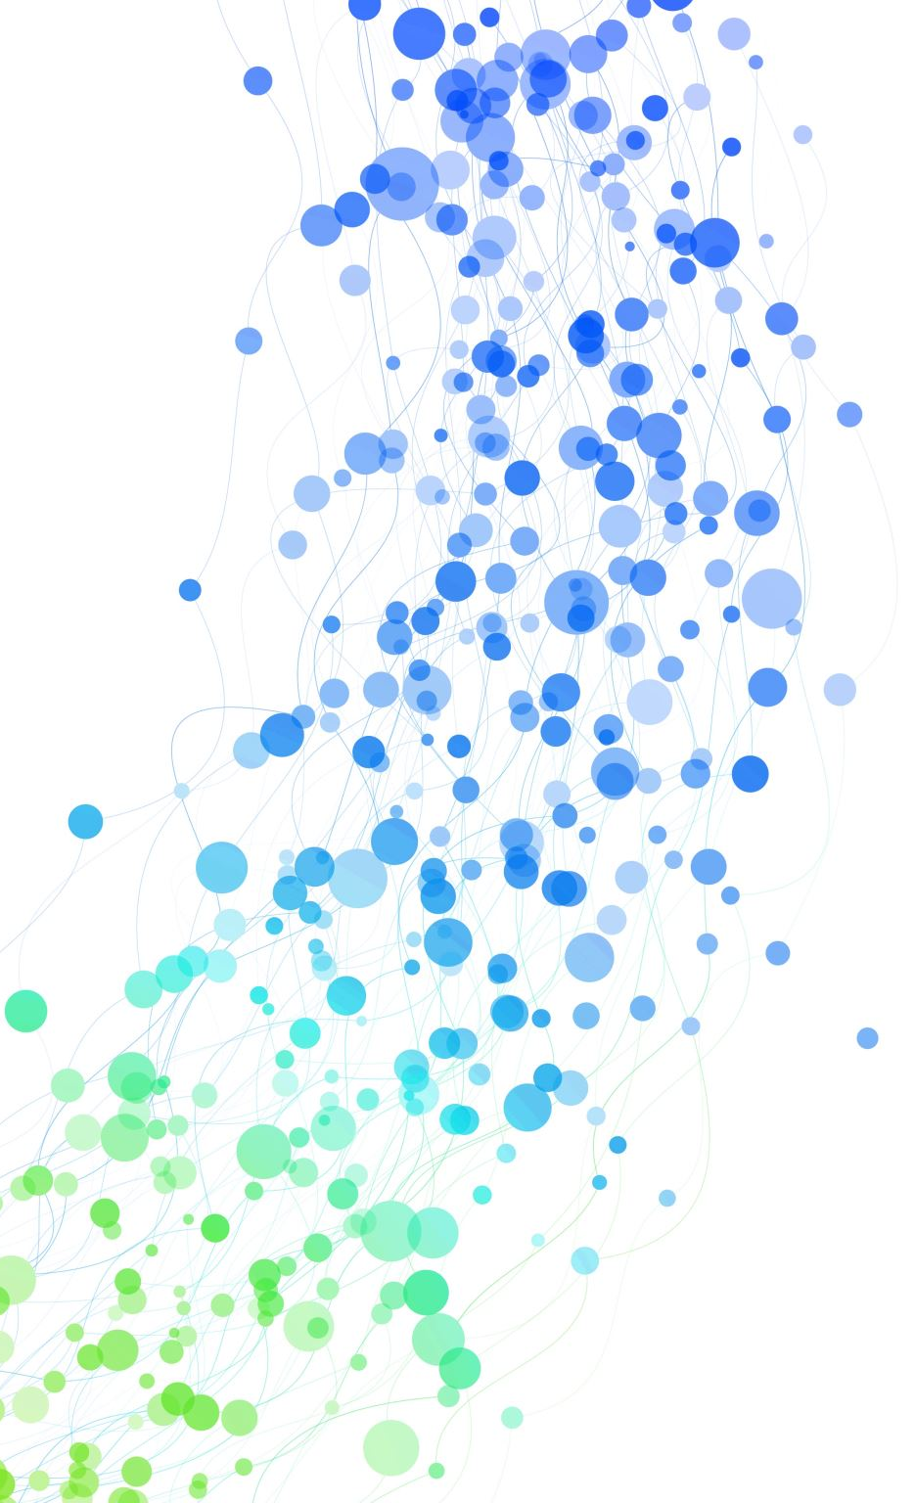
An attempt to Improve Transportation Dynamics through analysis of Transportation Networks CSCI-651-Applied Graph Theory
24Jayarani Emekar

Slide 2
Introduction
Project Goal
Conduct a comparative study of roads and intersections across all the cities, metropolitan areas to identify strengths and shortcomings for each of these networks
Purpose
Analyze transport networks by considering edge-list data and metadata files to evaluate parameters of interest in the network such as computing different centrality values of each node
Notes:
In a network to identify importance of each intersection in the city, detecting communities of intersections from the attributes point of view of the including travel time, cost of travel and toll by investigating their assortative values, among others.

Slide 3
Data
Transportation Networks is a networks repository for transportation research.
Data for this project is taken from the same GitHub repo
It has around 25 different metropolitan cities data around the world
This network represents roads junctions and traffic flow between the junctions
Some of the major cities I am looking for are Anaheim CA, Chicago IL, Philadelphia PA, Austin TX

Slide 4
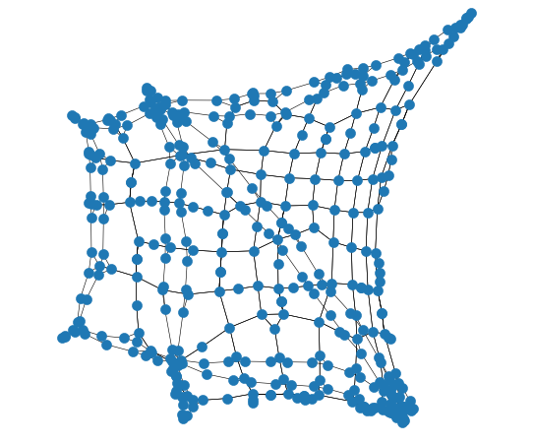
The Anaheim Network
The Anaheim network for 1992 has been provided by Jeff Ban and Ray Jayakrishnan.
Zones: 38
Nodes: 416
Links: 914
Trips: 104,694.40
Files
Anaheim-flow.tntp
Anaheim-net.tntp
Anaheim-trips.tntp

Slide 5
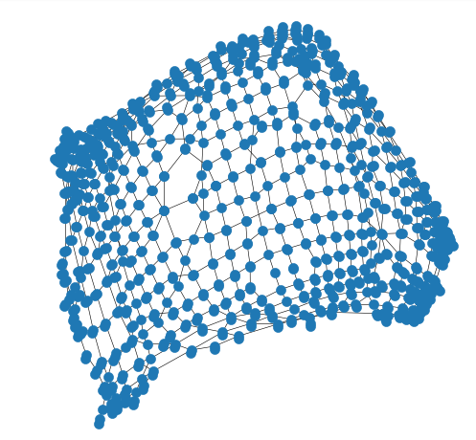
The Chicago Network
The Chicago network Developed and provided by the Chicago Area Transportation Study.
Zones: 387
Nodes: 933
Links: 2950
Trips: 1,260,907.44
Files
Chicago-flow.tntp
Chicago-net.tntp
Chicago-trips.tntp
Philadelphia PA- Zones: 1,525 Nodes: 13,389 Links: 40,003
Trips: 18,503,872 total; 14,336,062 interzonal
Austin TX - Zones: 7,388 Nodes: 7,388 Links: 18.961 Trips: 739351

Slide 6
Static Analysis Anaheim of Network
Measures of Clustering, Degree and Diameter
Conclusion From Static Analysis
Average degree of the network is less than average neighbor degree, which shows that the network exhibits the friendship paradox!
Triangles in the network, attributed to highway entries and exits
The number of squares, which has a count slightly below the number of triangles. The mesh/grid like structure of the network accounts for this.
Attribute | Value
Average Degree | 3.048
Average Neighbor Degree | 3.36
Number of triangles | 162
Clustering Coefficient | 0.108
Number of Squares | 114
Diameter | 26
Degree Assortativity | -0.049
Notes:
Average degree of the network is 3.048, the average neighbor degree is 3.36, which shows that the network
(although not a social network) exhibits the friendship paradox!
There are 162 triangles in the network, and these can be attributed to highway entries and exits, which are mostly
in the shape of triangles, or simply triangular loops of roads. These also contribute to the clustering coecient, which
stands at a modest 0.108.
What is more interesting to note is the number of squares, which has a count slightly below the number of triangles
at 114. The mesh/grid like structure of the network accounts for this.
The diameter of the network is 26, which does not scale logarithmically with the number of nodes in the network.
The property of logarithmic scaling for the diameter is typically for social networks, and hence it is something we do
not expect to observe here.
Finally, there is no assortative mixing by degree in the network, as indicated by the value of the degree assortativity,
which actually has a negative value but is very close to 0.

Slide 7
Static Analysis of Anaheim Network (continued)
Measures of Clustering, Degree and Diameter
Conclusion From Static Analysis
The diameter of the network is 26, which does not scale logarithmically with the number of nodes in the network.
There is no assortative mixing by degree in the network, as indicated by the value of the degree assortativity, which has a negative value but is very close to 0
Attribute | Value
Average Degree | 3.048
Average Neighbor Degree | 3.36
Number of triangles | 162
Clustering Coefficient | 0.108
Number of Squares | 114
Diameter | 26
Degree Assortativity | -0.049
Notes:
The diameter of the network is 26, which does not scale logarithmically with the number of nodes in the network.
The property of logarithmic scaling for the diameter is typically for social networks, and hence it is something we do
not expect to observe here.
Finally, there is no assortative mixing by degree in the network, as indicated by the value of the degree assortativity,
which actually has a negative value but is very close to 0.

Slide 8
Static Analysis of Chicago Network
Attribute | Value
Average Degree | 3.16
Average Neighbor Degree | 4.62
Number of triangles | 152
Clustering Coefficient | 0.108
Number of Squares | 501
Diameter | 32
Degree Assortativity | -0.061
Measures of Clustering, Degree and Diameter
Conclusions
You can find similar conclusion here like Anaheim city
Notes:
Average degree of the network is 3.048, the average neighbor degree is 3.36, which shows that the network
(although not a social network) exhibits the friendship paradox!

Slide 9
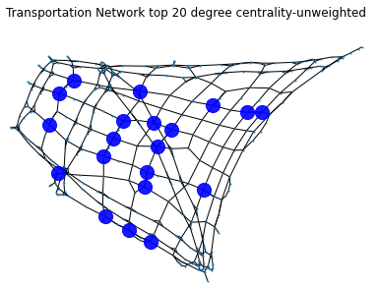
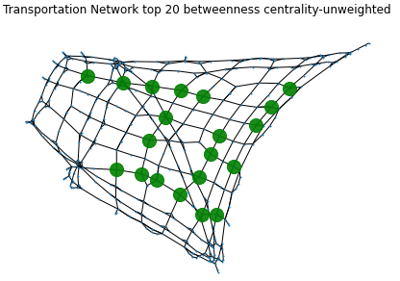
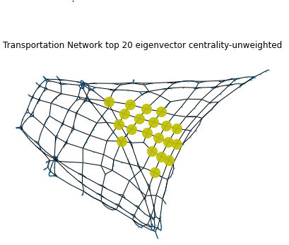
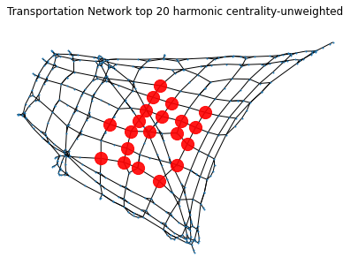
Centrality Analysis
The centrality for top 20 nodes in unweighted graph of Anaheim CA city shown in figure
Degree Centrality
Harmonic Centrality
Betweenness Centrality
Eigenvector Centrality
Notes:
The degree centrality of a node is simply the degree of node, or the number of edges a node has in the graph.
The betweenness centrality BC of a node i in a graph is given by where σst is the total number of shortest paths from node s to node t and σst(v) is the number of those paths that pass-through v.
Eigenvector centrality assigns relative scores to all vertices in a network given the fact that connections to high-scoring nodes contribute more to the score of the node in question than equal connections to low scoring nodes.

Slide 10
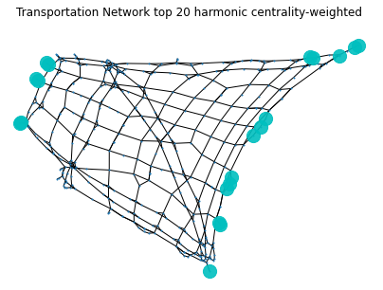
Centrality Analysis
Weighted vs Unweighted Network
Betweenness and eigenvector centralities remain unchanged from the un-weighted network.
The harmonic centralities changed drastically to the extent that there is no overlap between these and any of the other centralities for the weighted network.
Notes:
This might be here as there are some one way roots in real world

Slide 11
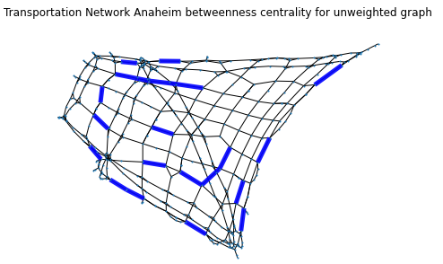
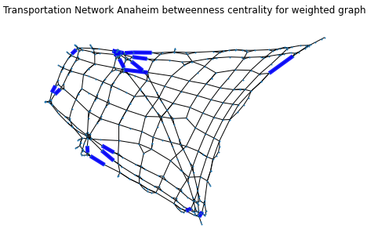
Betweenness Centrality of Edges
Unclear evidences for edges having highest betweenness centrality in unweighted graph
In weighted graph, Close observation reveals that these edges with the highest centralities are located near the entry and exit points of the highways.
This implies that highways play a crucial role in traffic flow when we consider them weights, as a large chunk of the traffic flows along the highways.

Slide 12
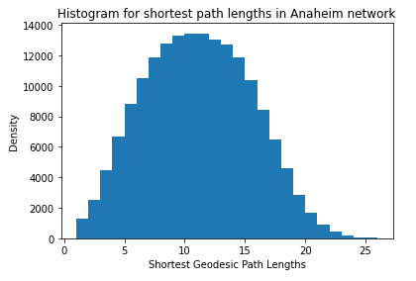
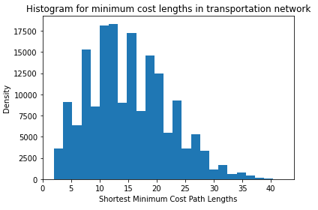
Shortest Path Length
Total Number of Shortest Path in a graph = N² – N
Where N is number of nodes, In this network 416 nodes are present
Total Number of shortest path = 172640 for n = 416.
For unweighted graph path lengths are evenly distributed from center, for weighted graph distribution is more uneven
When we consider the 'weights' of the edges, the shortest paths are sometimes larger than what they are when we do not consider the weights.
Notes:
This suggests that the shortest paths between two node pairs is not always the same (path, or of the same length) when we consider the unweighted and the weighted graph.

Slide 13
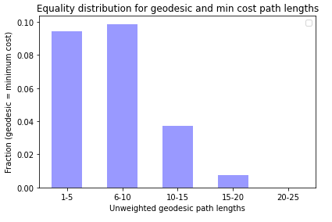
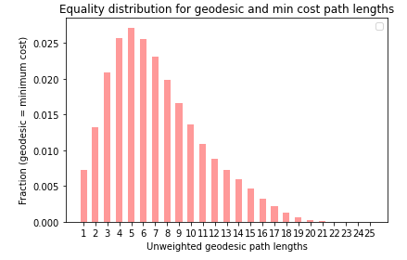
Equality of Shortest Path
How many of these shortest paths are identical for both the weighted and the unweighted network?
Algorithm:
Load graph (unweighted/weighted)
Calculate Shortest path (unweighted/weighted) for all pairs
Dijkstra’s algorithm
Count paths for which unweighted = weighted
Plot as a function of geodesic path length
Expectation
Large fraction equal for smaller geodesic path length
Fraction should decrease rapidly for larger path lengths
Notes:
A large fraction of node pairs are expected to have identical shortest paths when the separation between them is only 1, and the fraction should decrease when the distance between the nodes in the network grow.
This is slightly contrast to our expectation As maximum trend is observed in bin 6-10
This implies that the largest fraction of identical shortest paths is not for nodes that are separated by a single edge.

Slide 14
Equality of Shortest Path
A large fraction of node pairs are expected to have identical shortest paths when the separation between them is only 1, and the fraction should decrease when the distance between the nodes in the network grow.
This is slightly contrast to our expectation As maximum trend is observed in bin 6-10
This implies that the largest fraction of identical shortest paths is not for nodes that are separated by a single edge.
Notes:
A large fraction (possibly the largest) of node pairs are expected to have identical shortest paths when the separation between them (geodesic distance) is only 1, and the fraction should decrease when the distance between the nodes in the network grow.

Slide 15
Dynamic Analysis
Possible ways of performing the dynamic analysis the network
Including or removing nodes
Removing edges
Removing both nodes and edges
Altering the values of the attributes of nodes and/or edges.
Since transportation data-set consists of attributes associated explicitly with the edges and not the vertices, it made sense to remove the edges and not the vertices
Notes:
the network was changed perturbed from its original state, and analyses were made thereafter to compare
the network before and after the perturbation.
There are various possible ways of perturbing the network - including (but not restricted to) removing nodes,
removing edges, removing both nodes and edges, and altering the values of the attributes of nodes and/or edges. We
could also add nodes and/or edges to the network.
Since our data-set consists of attributes associated explicitly with the edges (and not the vertices), it made sense
to remove the edges and not the vertices.

Slide 16
Dynamic Analysis
Remove an edge
Block ALL traffic
Detour around that edge
Drop in overall transport speed
~ Increase in overall cost
Inspect shortest paths for all pairs before and after removing an edge
Fetch betweenness centrality of edge
Expectation : Higher the centrality of removed edge, higher the change (increase) in shortest path
This model can be compared to Current flow model using Kirchoff’s Law of current distribution
resistance =cost
current = traffic flow
Notes:
The dynamical importance of an edge is the drop in overall transport speed when we block all traffic along that edge.
This is equivalent to forcing everyone to detour around these two nodes.
We leverage the betweenness centrality of edges to explore this.
Few questions that springs to mind are:
Is betweenness a good predictor of the increase in overall cost from deleting that edge? How can we tell?
How can we estimate using betweenness centralities for nodes and/or edges, the increase in cost when an edge is removed?
Can we modify the mathematical estimates for cases when we use the weighted ('cost') network instead of the un-weighted ('adjacency') network with no weights?

Slide 17
Importance of Edges for geodesic based rerouting
Other Metrics
Clustering coefficient : Density of triangles in network
If the clustering coefficient is a small number, then a large detour is required when an edge is removed
Hence the greater the clustering coefficient, the lesser the change in overall shortest path length in the network
Diameter :
The more 'small world' the network, the more the existence of random connections in the network
Hence the higher the chance that the removal of an edge will not affect the overall shortest path length in the network by a substantial amount.
Notes:
Clustering coefficient = Density of triangles in network -- If the clustering coefficient is a small number, then a large detour is required when an edge is removed - Hence the greater the clustering coefficient, the lesser the change in overall shortest path length in the network when an edge is removed.
Diameter : The more 'small world' the network, the more the existence of random connections in the network, and hence the higher the chance that the removal of an edge will not affect the overall shortest path length in the network by a substantial amount.

Slide 18
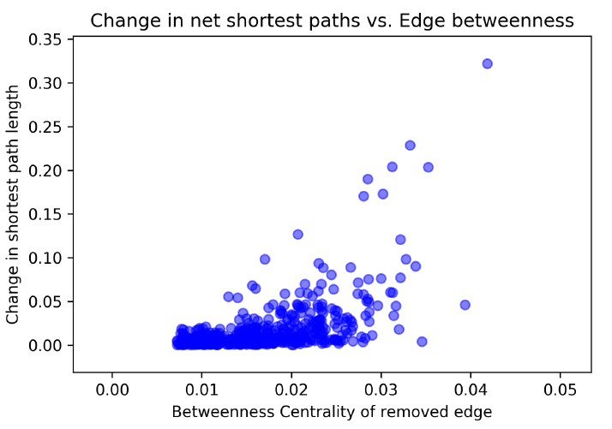
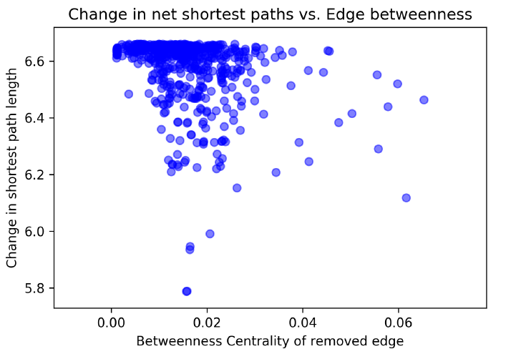
Edge removal – Unweighted vs Weighted
Unweighted Graph Weighted Graph
Notes:
We expected to see a strong correlation between the change in overall shortest path length due to the removal of an edge with the betweenness centrality of that edge. In other words, the higher the betweenness centrality of the removed edge, the more it should affect the transportation speeds (and hence cost) in the network - that is the higher the change in overall shortest path lengths in the network.
It was observed (from the first plot above) that in the network without weights, there is a (weak) positive correlation between change in overall shortest path length with the betweenness centrality of the removed edge. The overall cost in shortest path per node pair in the original network was 10.63. Most edges did not contribute drastically to the change in overall shortest path, even with moderately high values of betweenness, as is observed from the large chunk located towards the bottom left of the graph. There are a few points that are located slightly higher in the graph, and slightly more to the right, implying that they have a modest contribution to the change in overall shortest path.
Finally, only a few edges contribute linearly - and these are represented by the points placed on the straight line running at a 45-degree angle in the plot.
The correlation between the two quantities of interest in more interesting when we consider the weights, though. There is a positive correlation, like before, shown by the linear set of points in the graph. However, there are many points clustered toward the top right and center, indicating that most edges (with low or moderate betweenness) contribute to a large extent to the change in overall shortest path length.

Slide 19
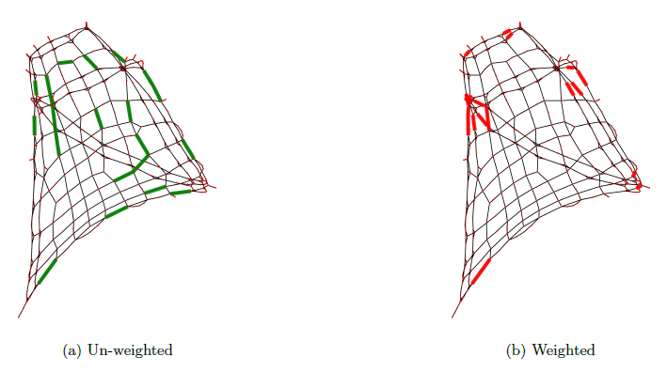
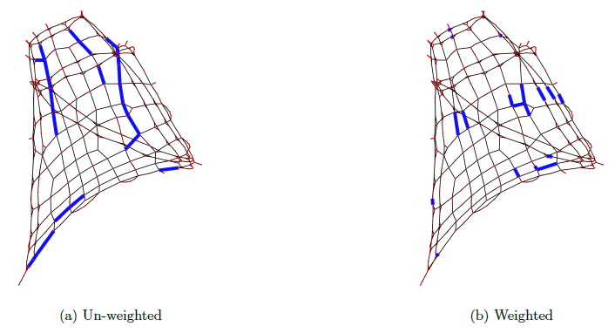
Correlation of dynamical importance with betweenness
Before removal of edge After removal of edge
Notes:
It is evident from the figure above that there is a clear difference in the edges that contribute to highest change in overall shortest path length of the network on their removal between the un-weighted and the weighted network. In the case for the weighted network, the edges seem to be grouped together, suggesting zones for high traffic flow. Some of these zones are on highways, while others are not

Slide 20
Conclusion
Network has a grid like structure representing blocks separated by roads, and highways on the borders
The degree distribution displays a slight amount of `friendship paradox', usually seen in social networks.
Most nodes have a degree of 4, with a few having degree 5 or 6.
The un-weighted network has some vertices which show up in top 20 rankings for different centrality measures. The weighted network does not have any such vertices.
The maximum shortest path length is 26 (hops) in the un-weighted network, and 42 (hops) in the weighted network.

Slide 21
Conclusion
Investigation of equality of shortest paths between un-weighted and the weighted network reveals an interesting distribution.
There exists a positive correlation between the change in overall shortest paths and the betweenness centrality of the edge removed, for both the un-weighted and weighted networks.
In the un-weighted network, most edges do not contribute drastically to the change the overall shortest path, while in the weighted network it is the other way around.
Apart from betweenness centrality, measures of clustering and diameter can be employed to estimate the change in overall cost on the removal of an edge from the network.

Slide 22
Future work
Improving the algorithm to calculate shortest path- Recalculating required almost 3 days of time for 500 nodes approximately
Try to correlate analysis with erdos-renyi random graphs as its more closely associated with these kind of networks
Notes:
Here around 400 nodes, and shortest path calculated are around 1lac, that took two days to time to run the analysis

Slide 23
References
Models and algorithms for road network design: a review and some new developments ; Hai Yang Michael,G. H. Bell; Pages 257-278;
A review of urban transportation network design problems; Reza Zanjirani Farahani, Elnaz Miandoabchi, W. Y. Szeto, Hannaneh Rashidi;
The Structure of Interurban Traffic: A Weighted Network Analysis; Andrea De Montis, Marc Barth ́elemy, Alessandro Chessa, Alessandro Vespignani;

Slide 24
Thank You !
Any Questions?

