Slide 1
BIG DATA
HADOOP
Aryahi - Learning

Slide 2
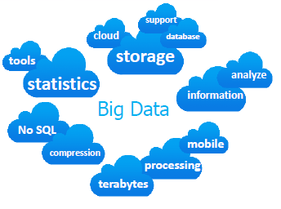
What is BIGDATA
Huge of data (TeraBytes/PetaBytes)
Extremely large data sets that may be analyzed computationally to reveal patterns, trends, and associations, especially relating to human behavior and interactions.
The challenges include capture, curation, storage, search, sharing, transfer, analysis, and visualization
Aryahi - Learning

Slide 3
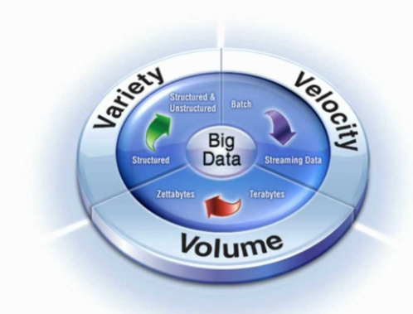
IBM’s Definition of Big Data
Aryahi - Learning

Slide 4
BIGDATA Customers
Web and e-Commerce
Telecommunications
Government
Healthcare and Life Sciences
Banks and Financial services
Retail
Aryahi - Learning

Slide 5

What is Hadoop?
Apache Hadoop is a framework that allows for the distributed processing of large data sets across clusters of commodity computers using a simple programming model.
It is an Open-source Data Management with scale-out storage and distributed processing.
Aryahi - Learning

Slide 6
Introduction to Hadoop
Apache Hadoop has been originated from Google’s Whitepapers:
Apache HDFS is derived from GFS (Google File System).
Apache MapReduce is derived from Google MapReduce
Apache HBase is derived from Google BigTable.
Key objectives:
Large Data Sets
Write Once, Read Many Model
Streaming Data Access
Commodity Hardware
Data Replication and Fault Tolerance
High Throughput
Aryahi - Learning

Slide 7
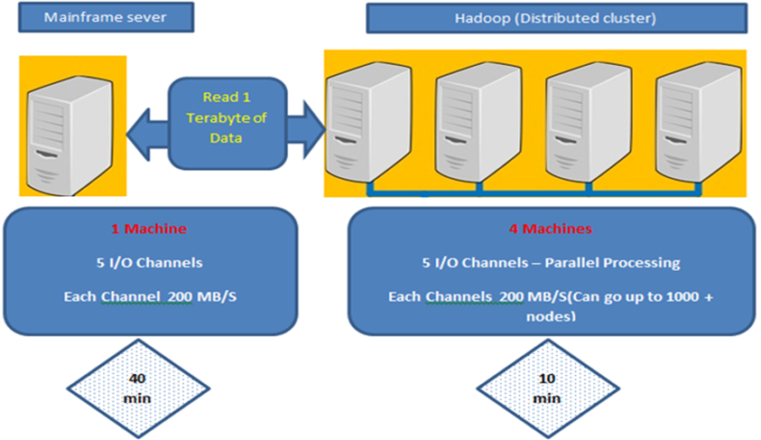
Efficiency
Aryahi - Learning

Slide 8
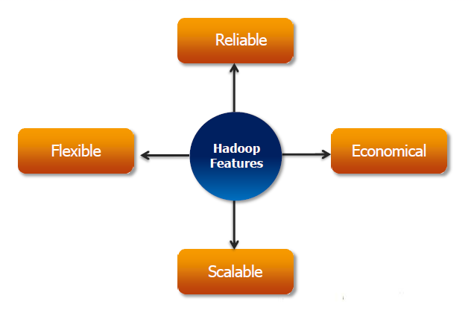
Hadoop Characteristics
Aryahi - Learning

Slide 9
Hadoop Characteristics Continues …
Reliable : It’s fault tolerant and having replication factor and high availability feature.
Flexible: It’s very flexible because it can handle structure data as well as unstructured data.
Economical: It can run in commodity hardware.
Scalable: it uses scale out approach (horizontal scaling).
Aryahi - Learning

Slide 10
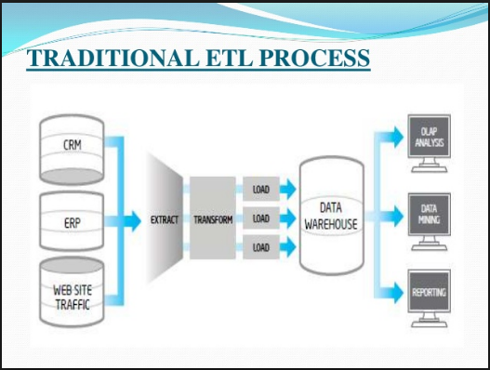
Traditional processing before Hadoop
Aryahi - Learning

Slide 11
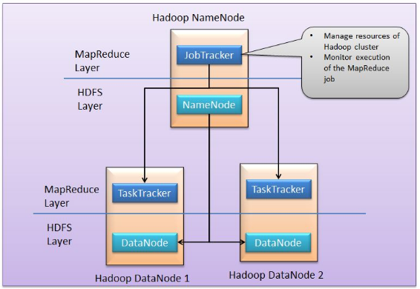
Hadoop Master/Salve Architecture
Hadoop framework consists on two main layers
Distributed file system (HDFS)
Execution engine (MapReduce)
Aryahi - Learning

Slide 12

Data Storage and Replication
NameNode
Job Tracker
Secondary NameNode
DataNode
TaskTracker
DataNode
TaskTracker
DataNode
TaskTracker
DataNode
TaskTracker
B1,B2,B3
B2,B3
B1,B2
B1,B2,B3
Aryahi - Learning

Slide 13

HDFS File Read/Write
Aryahi - Learning

Slide 14
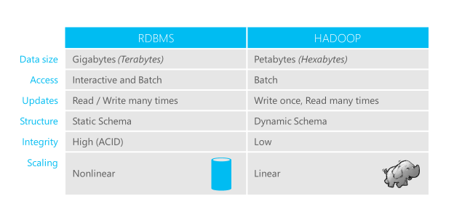
RDBM’s Vs Hadoop
Aryahi - Learning

Slide 15
Cont.…
Hadoop RDBMS Scale out Scale Up Key-Value Pair Record MapReduce (Functional Style) SQL (Declarative) De-normalized Normalized All varieties of Data Structured Data OLAP/Batch/Analytical Queries OLTP/Real time/Batch
Aryahi - Learning

Slide 16
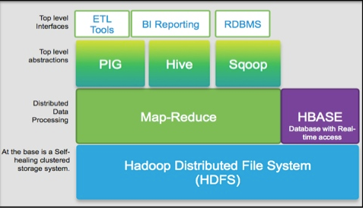
Hadoop Architecture
Aryahi - Learning

Slide 17
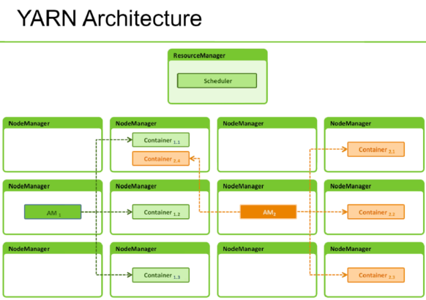
Yarn Architecture
Aryahi - Learning

Slide 18
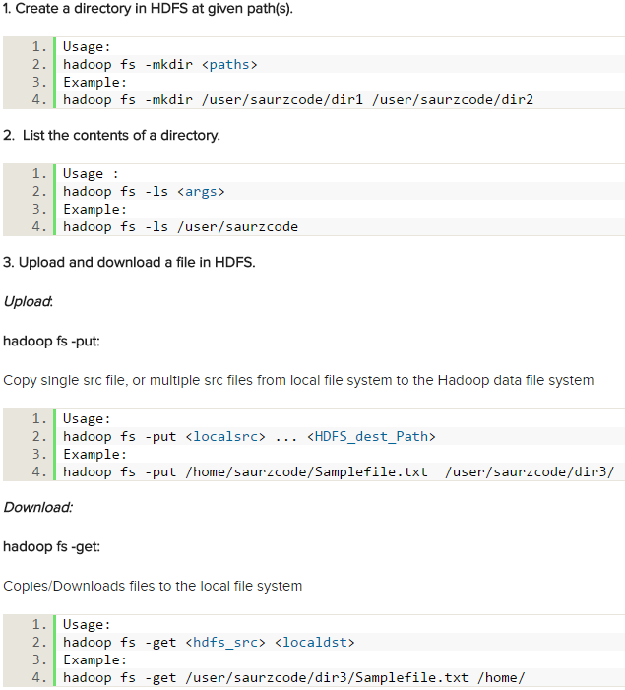
Hadoop FS Shell Guide
http://hadoop.apache.org/docs/current/hadoop-project-dist/hadoop-common/FileSystemShell.html
Aryahi - Learning

Slide 19
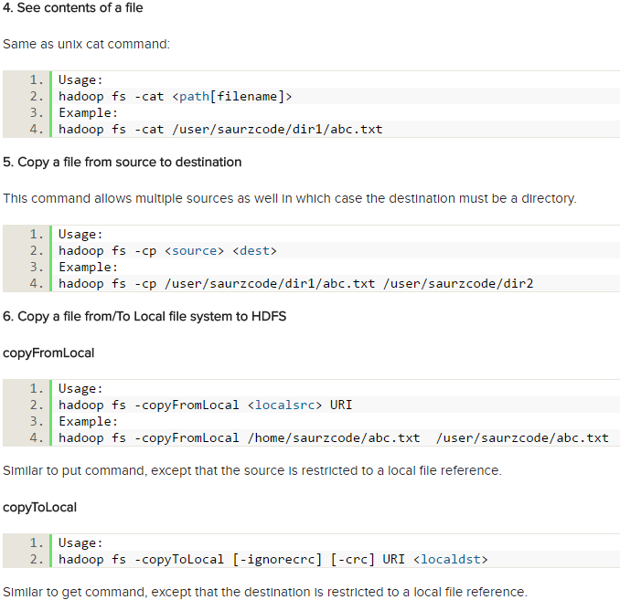
Hadoop FS Shell Guide continues
Aryahi - Learning

Slide 20
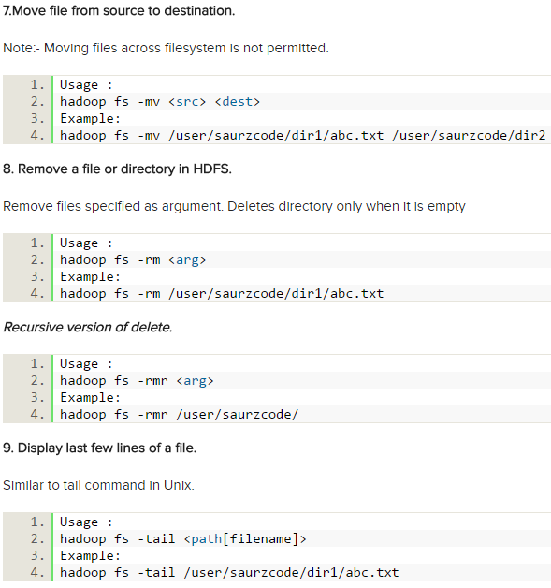
Hadoop FS Shell Guide continues
Aryahi - Learning

Slide 21
MAP-REDUCE
Aryahi - Learning

Slide 22
MapReduce Framework
MapReduce is a software framework for processing large data sets in adistributed system over a several machines. The core idea behind MapReduce is mapping your data set into a collection of Key and Value pairs, and then reducing over all pairs with the same key.
The framework is divided into two parts:
Map, a function that parcels out work to different nodes in the distributed cluster.
Reduce, another function that collates the work and resolves the results into a single value.
Aryahi - Learning

Slide 23
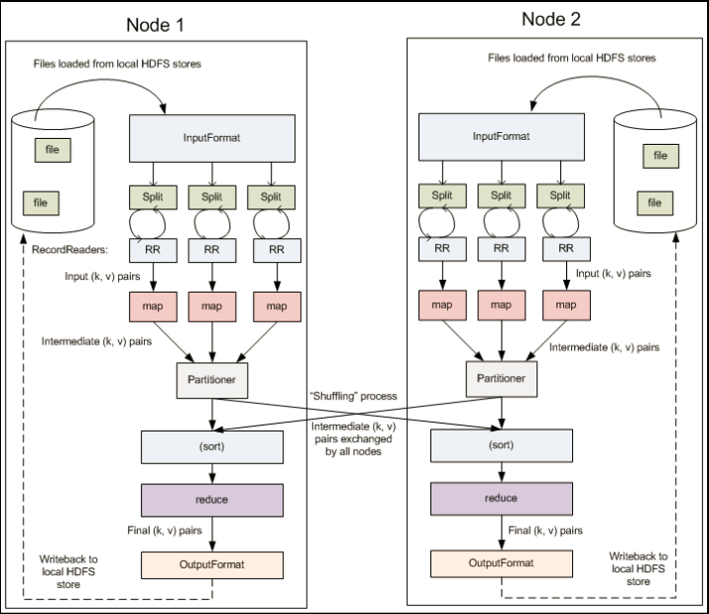
MapReduce Framework
Aryahi - Learning

Slide 24
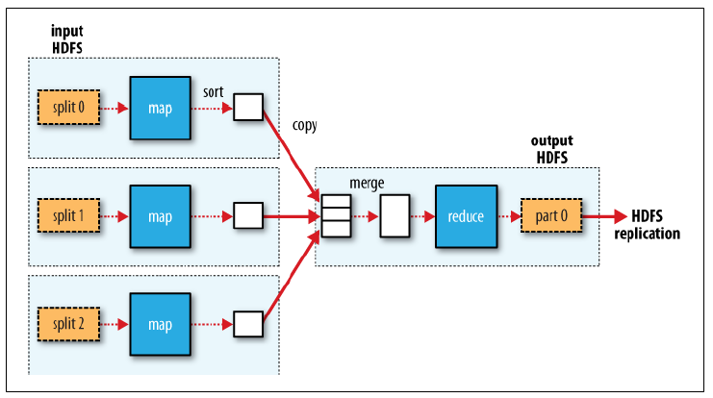
MapReduce data flow with a single reduce task
Aryahi - Learning

Slide 25
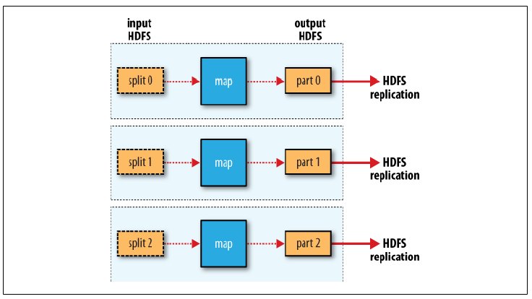
MapReduce data flow with NO reduce tasks
Aryahi - Learning

Slide 26
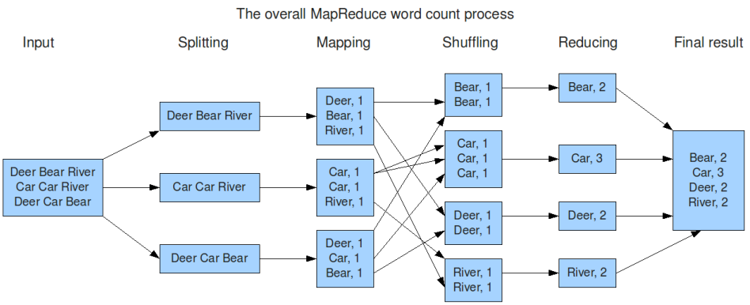
The overall MapReduce from word count process
Aryahi - Learning

Slide 27
H I V E
Aryahi - Learning

Slide 28
What and Why HIVE
What is Hive ?
Data warehouse system for hadoop
Run SQL-like queries that get compiled and run as Map Reduce jobs.
Displays the result back to the user
Data in hadoop even though generally unstructured has some vague structure associated with it
Why Hive ?
To ease the use of hadoop file system and Map Reduce for non-developers. Users like scientist, analysts etc just need to know SQL syntax
Writing SQL is faster than writing code
Aryahi - Learning

Slide 29
HIVE Data Types and Components
Hive Datatypes:
Hive supports all the common primitive data formats such as BIGINT, BINARY, BOOLEAN, CHAR, DECIMAL, DOUBLE, FLOAT, INT, SMALLINT, STRING, TIMESTAMP, and TINYINT.
Components:
Metastore :
Hive stores the schema of the Hive tables in a Hive Metastore. Metastore is used to hold all the information about the tables and partitions that are in the warehouse. By default, the metastore is run in the same process as the Hive service and the default Metastore is DerBy Database.
SerDe :
Serializer, Deserializer gives instructions to hive on how to process a record.
Aryahi - Learning

Slide 30
RDBMS VS HIVE
In RDBMS, a table's schema is enforced at data load time, if the data being loaded does not conform to the schema then it is rejected. This design is called schema on write. But in Hive does not verify the data when it is loaded, but rather when it's retrieved. This is called schema on read. So while loading, HIVE can be very fast.
In RDBMS, record level updates, inserts and deletion happens. But in HIVE it's not possible till version 0.14.
In RDBMS, maximum data size allowed will be in 1-7 TB data whereas HIVE can accommodate 100's petabytes very easily.
RDBMS, supports OLTP model (Online Transaction Processing) but HIVE is NOT and HIVE Suits for OLAP model (Online Analytical process) and best suits for BATCH processing
To overcome the limitations of HIVE, HBASE is being integrated with HIVE to support record level operations.
Hive is very easily scalable at low cost but RDBMS is not that much scalable that too. It is very costly scale up.
Aryahi - Learning

Slide 31
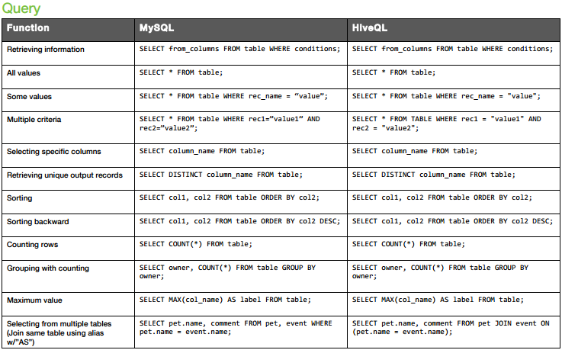
Hive for SQL User (Cheat sheet)
Aryahi - Learning

Slide 32
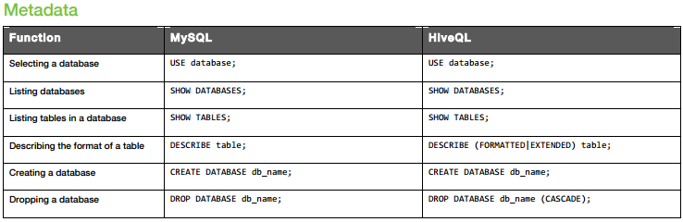
Hive for SQL User (Cheat sheet)
Limitations of HIVE:
You cannot update data after it is inserted
There is no "insert into table values ... " statement
You can only load data using bulk load
There is not "delete from " command
You can only do bulk delete
Correlated sub-queries are not allowed.
Aryahi - Learning

Slide 33
Hive Tables
Tables in HIVE:
Managed Table/Internal Table
External Table
Managed table (Internal Table)
By default hive create internal tables and store the data in warehouse.
On delete both metadata and data will be deleted.
External table
If the user wants to change the default directory to some specific existing directory in HDFS, following command can be used. Here only schema will be store and data reside outside.
On delete only metadata will be deleted.
Aryahi - Learning

Slide 34
Hive Partitioning and Bucketing
HIVE partitions:
Static Partition
Dynamic Partition
Use Case:
Partitioning a data set means dividing and splitting the data into smaller partitions using values of columns.
Hive partitions are stored in subdirectories of table directory
Allows hive to filter data at input path
Example every day’s files can be stored for each day in a directory based on dates.
Bucketing:
The table divide into number of partitions is calledHive Partition, The Hive Partition can be further subdivided into Clusters or Buckets
Aryahi - Learning

Slide 35
P I G
Aryahi - Learning

Slide 36
What and Why PIG
What is PIG ?
Apache Pig is a high-level platform for creating programs that run on Apache Hadoop. The language for this platform is called Pig Latin. ... Pig Latin abstracts the programming from the Java MapReduce idiom into a notation which makes MapReduce programming high level, similar to that of SQL for RDBMSs.
Why PIG ?
It will eat anything
Pig does more with less
Any one can ride PIG
Vastly use in project for semi structure data instead JAVA mapreduce
Aryahi - Learning

Slide 37
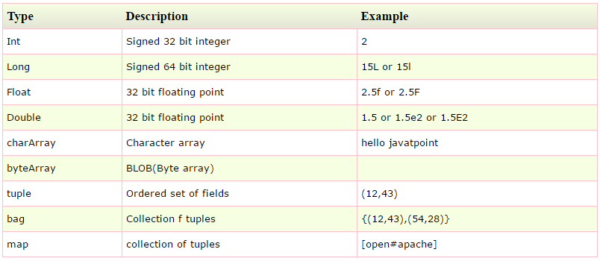
PIG data types
Aryahi - Learning

Slide 38
PIG data Models
Field/Atom: Each piece of data is called field, like any string or number.
Example: Raj, 10 etc
Tuple: Ordered set of fields, represented by "(" and ")".
Example: (10.4, 5, word, 4, field1)
Bag: Collection of tuple, represented by "{" and "}". Form RDBMS point of view, Bag is a table.
Example: { (10.4, 5, word, 4, field1), (this, 1, blah) }
Similar to Relational Database
Bag is a table in the database
Tuple is a row in a table
Aryahi - Learning

Slide 39
PIG Latin mode and execution
PIG Execution Mode:
local mode - $pig –x local
Mapreduce mode - $pig
PIG Processing:
First, Pig validates the syntax and semantics of all statements.
Next, if Pig encounters a DUMP or STORE, Pig will execute the statements.
PIG Operations for execution:
Use the DUMP operator to display results to a screen.
Use the STORE operator to write results to a file on the file system.
PIG Latin Diagnostic:
DESCRIBE
EXPLAIN
ILLUSTRATE
Aryahi - Learning

Slide 40
PIG Working with Data
Pig Latin allows you to work with data in many ways. In general, and as a starting point:
Use the FILTER operator to work with tuples or rows of data. Use the FOREACH operator to work with columns of data.
Use the GROUP operator to group data in a single relation. JOIN operator to group or join data in two or more relations.
Use the UNION operator to merge the contents of two or more relations. Use the SPLIT operator to partition the contents of a relation into multiple relations.
Important use cases of below functions:
FILLTER
GROUP BY
JOIN
REPLICATED JOIN
SPLIT
FLATTEN
LIMIT
AGGREGATE FUNCTION (SUM, AVG,COUNTetc)
Aryahi - Learning

Slide 41
PIG Vs HIVE
Pig is a procedural language and you can define your check points before storing the actual data.
When you are using HIVE then hive automatically optimize your data but in PIG you can control your flow and can write better optimize code.
HIVE is best suitable for structured data where less transformation required.
PIG is best suitable for semi structure data and where many transformation required.
Aryahi - Learning

Slide 42
SQOOP
Aryahi - Learning

Slide 43
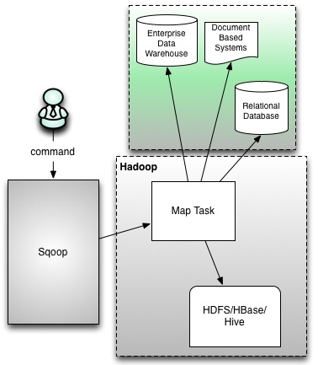
What is SQOOP
Apache Sqoop ("SQL to Hadoop") is a Java-based, console-mode application designed for transferring bulk data between Apache Hadoop and non-Hadoop data stores, such as relational databases, NoSQL databases and data warehouses.
Aryahi - Learning

Slide 44
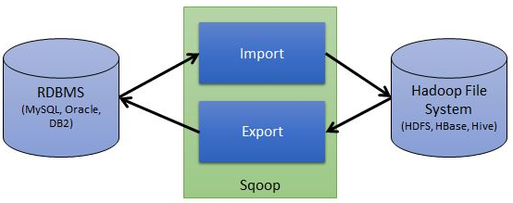
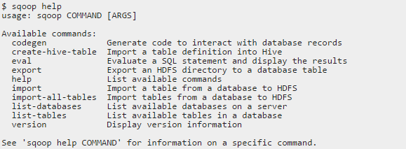
SQOOP Cont..
Sqoop import and export
Sqoop help
Aryahi - Learning

Slide 45
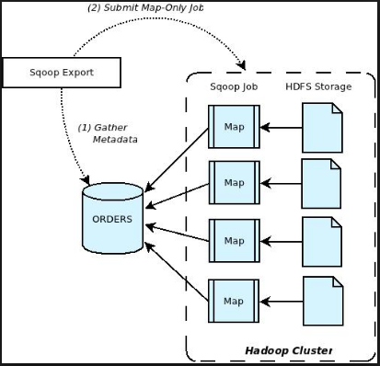
SQOOP Cont..
Sqoop workflow
Aryahi - Learning

Slide 46
SQOOP Cont..
Sample Import
sqoop import \
--connect jdbc:mysql://<IP ADDRESS>\<database name>
--table <Source table name (MYSQL/Oracle/TeraData etc)>
--username <username_for_source system> --password <Password>
-m <number of mappers to run>
--target-dir <HDFS Directory where data would be copied>
Aryahi - Learning

Slide 47
HBase
Aryahi - Learning

Slide 48
NoSQL
NoSQL, known as Not only SQL database, provides a mechanism for storage and retrieval of data and is the next generation database with schema less.
Most of the NoSQL are open source and it has a capability of horizontal scalability which means that commodity kind of machines could be added.
It is schema free and there is no requirement to design the tables and pushing the data to it.
The crucial factor about NoSQL is that it can handle huge amount of data and can achieve performance by adding more machines to your clusters and can be implemented on commodity hardware.
Aryahi - Learning

Slide 49
NoSQL databases
Document Database- It pairs each key with a complex data structure known as document. It can contain many different key value pairs, or key array pairs or even nested documents
Key value stores- They are the simplest NoSQL databases. Every single item in the database is stored as an attribute name or key together with its value.
Graph store- They are used to store information about networks, such as social connections.Graph stores include Neo4J and HyperGraphDB.
Wide column stores- Wide column stores such as Cassandra and HBase are optimized for queries over large datasets, and store columns of data together, instead of rows.
Aryahi - Learning

Slide 50
HBase
Apache HBase provides random, real time access to your data in Hadoop. It was created for hosting very large tables, making it a great choice to store multi-structured or sparse data.
HBase is a distributed column-oriented database built on top of the Hadoop file system. It is an open-source project and is horizontally scalable.
HBase is a data model that is similar to Google’s big table designed to provide quick random access to huge amounts of structured data. It leverages the fault tolerance provided by the Hadoop File System (HDFS).
Aryahi - Learning

Slide 51
HDFS and HBase
HDFS | HBase
HDFS is a distributed file system suitable for storing large files. | HBase is a database built on top of the HDFS.
HDFS does not support fast individual record lookups. | HBase provides fast lookups for larger tables.
It provides high latency batch processing | It provides low latency access to single rows from billions of records (Random access).
It provides only sequential access of data. | HBase internally uses Hash tables and provides random access, and it stores the data in indexed HDFS files for faster lookups.
Aryahi - Learning

Slide 52
HBase and RDBMS
HBase | RDBMS
Column oriented | Row oriented
It is built for wide tables. HBase is horizontally scalable. | It is thin and built for small tables. Hard to scale.
HBase is schema-less, it doesn't have the concept of fixed columns schema; defines only column families. | An RDBMS is governed by its schema, which describes the whole structure of tables.
It has de-normalized data. | It will have normalized data.
It is good for semi-structured as well as structured data. | It is good for structured data.
Aryahi - Learning

Slide 53
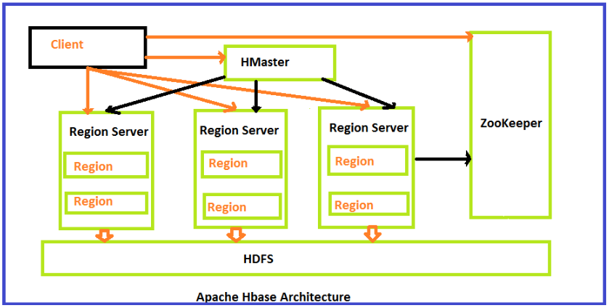
HBase Architecture
Aryahi - Learning

Slide 54
HBase components
Table made of regions
Region – range of rows stored together
Region Server – serves one or more regions
Master server – It’s responsible for managing HBase cluster
Zookeeper – Coordinates between Master and Salves.
Aryahi - Learning

Slide 55
HBase Write
The client doesn’t write data directly into HFile on HDFS
Firstly it writes data to WAL(Write Ahead Log), and Secondly, writes to MemStore shared by a HStore in memory.
MemStore is a write buffer(64MB by default). When the data in MemStore accumulates its threshold, data will be flush to a new HFile on HDFS persistently.
Each Column Family can have many HFiles, but each HFile only belongs to one Column Family.
WAL is for data reliability, WAL is persistent on HDFS and each Region Server has only on WAL. When the Region Server is down before MemStore flush, HBase can replay WAL to restore data on a new Region Server.
Aryahi - Learning

Slide 56
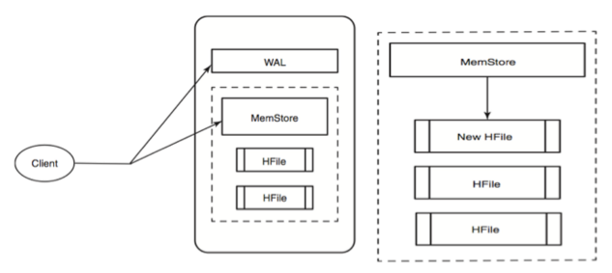
HBase Write Diagram
Aryahi - Learning

Slide 57
HBase Read
Client will query the MemStore in memory, if it has the target row.
When MemStore query failed, client will hit the BlockCache.
After the MemStore and BlockCache query failed, HBase will load HFiles into memory which may contain the target row info.
The MemStore and BlockCache is the mechanism for real time data access for distributed large data.
BlockCache is a LRU(Lease Recently Used) priority cache. Each RegionServer has a single BlockCache. It keeps frequently accessed data from HFile in memory to reduce disk data reads.
Aryahi - Learning

Slide 58
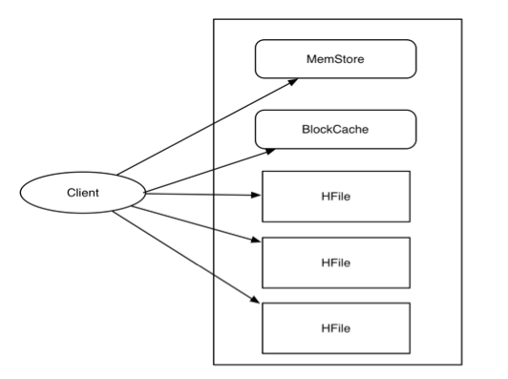
HBase Read Diagram
Aryahi - Learning

Slide 59
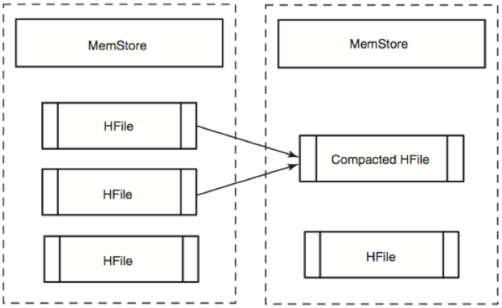
HBase House keeping and HFile Compaction
Minor Compaction: Merging small HFiles into large HFile and cleaning small HFiles.
Major Compaction:Major Compaction compact all HFiles in a HStore(Column Family) into one HFile. It is the only chance to delete records permanently.
When HBase client send delete request, the record will be marked “tombstone”, it is a “predicate deletion”
Therefore, HBase adopts major compaction to clean up deleted or expired records.
Aryahi - Learning

Slide 60
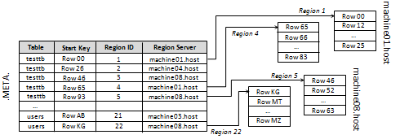
Finding RegionServer and RowKey
To put or get a row clients don’t have to contact the master, clients can directly contact the Region Server that handles the specified row, or in case of a client scan, can directly contact the set of Region Servers responsible for handling the set of keys:
To identify the Region Server, the client does a query on the META table.
META is a system table used to keep track of regions. It contains the server name and a region identifier comprising a table name and the start row-key. By looking at the start-key and the next region start-key clients are able to identify the range of rows contained in aa particular region.
Aryahi - Learning

Slide 61
Thank You
Aryahi - Learning

