Slide 1

Sqoop
Data Imports
Data Exports
Integration with Hadoop Ecosystem

Slide 2
SQOOP…
Overview
Why Sqoop so popular
How to get it working
Work-flow
Rdbms-Hdfs-Hive

Slide 3
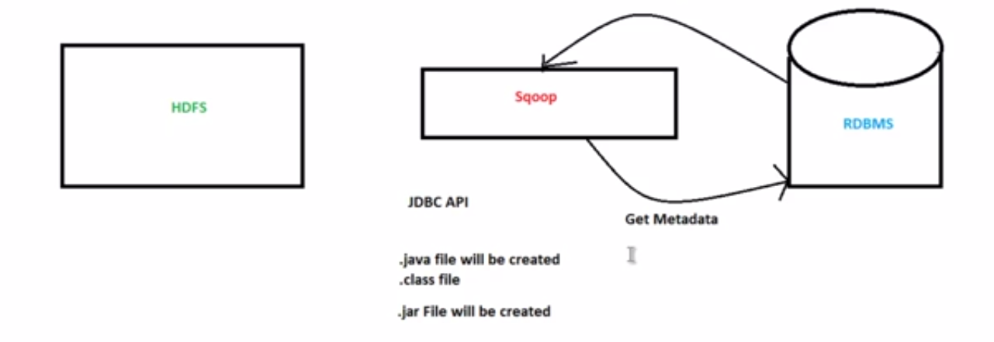
SQOOP…
Sqoop is used widely in industry as it is going to be your first apache product from the minute you have decided to move from relational DB to Hadoop ecosystem
Working

Slide 4
SQOOP…
Working in Step By Step:
Step 1:Sqoop send the request to Relational DB to send the return the meta data information about the table(Metadata here is the data about the table in relational DB)
Step 2: From the received information it will generate the java classes (Reason why you should have java configured before get it working-Sqoop internally uses jdbc API to generate data).
Step 3:Now sqoop (As its written in java –tries to package the compiled classes to be able to generate table structure) , post compiling creates jar file(Java packaging standard)

Slide 5
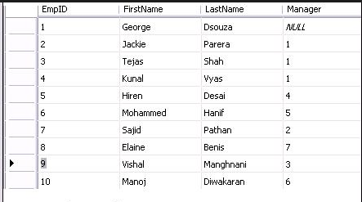
SQOOP…
Lets Dive in:
Say you had a table like
Now you have decided that you do not like relational structure any more as you expect this table to grow really-really large hence you want this to get moved to Hadoop ecosystem and get rid of licensing
PS: sqoop needs to have primary key t work best – but no worries if your table structure inherently doens’t have it , it will create that for you but without affecting your table metadata structure

Slide 6
SQOOP…
Internal Workflow:
Sqoop asks fro meta data information from Relation DB
Relational DB returns the required request
Based on meta data information sqoop generates java classes
Based on primary id partitioning happens in table as multiple mappers will importing data as the same time
Lets understand this line in more detail as this is crux of why sqoop works faster than any other importing technique and how come mapper comes in to picture

Slide 7
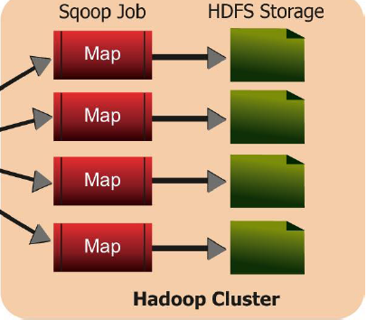
SQOOP…
1
2
3
4
This image is symbolic and of course you do not need 4 mappers to just import a row size of 10 and sqoop is intelligent enough to decide on optimum number of mappers required for the job

Slide 8
SQOOP…
Lets Understand it in terms of what would have happened technically
Sqoop fires and import request
Internally what it needs to know is what is min and max primary key value is in there
Select min(emp_id) as min_value ,max(emp_id) as max_value from employee
And then for each mapper
Select * from employee where emp_id between min_value and max_value(Scope of each mapper)

Slide 9
SQOOP…
Example: Where relation DB is present
sqoop import \
--connect jdbc:mysql://<ip address>\<database name>
--table <mysql_table name>
--username <username_for_mysql_user> --password <Password>
-m <number of mappers to run>
--target-dir <target directory where we need copied data>
If you do not want sqoop to decide on your behalf
Double “–” because its subcommand of import

