Slide 1

MongoDB
Nested Data Structures
Document Oriented Databases

Slide 2
Agenda
Limitations of RDBMS
NoSQL Databases
Document oriented databases; MongoDB
Architecture, advantages
Installation
Lab

Slide 3

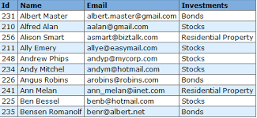

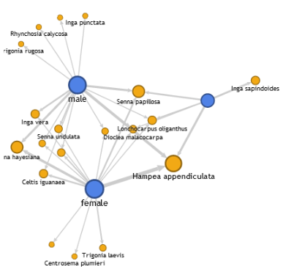
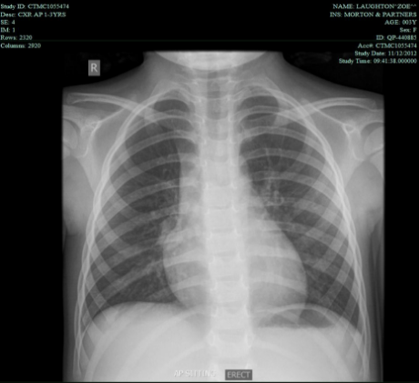
Challenges with traditional database?
Traditional databases are designed for holding structured data.
Can it hold the following data?
Semi structured data
Images
Network graphs
Documents
Human-Genome data
Health care multi media
GPS tracker data
HTML pages
Facebook likes, groups
Customer-Genome in banking, retail and any other sector
NASA astronomy logs
Think about this, can you create a table with 10000 columns? If yes, how will you manage it?
You might assume, this can be stored on RDBMS. But at what scale and what cost?

Slide 4
How can you handle this semi and unstructured datasets?
Definitely Not RDBMS!!!
Rise of NoSQL Database

Slide 5
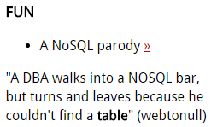
NoSQL databases
NoSQL refers to Not Only SQL databases
Next Generation Databases mostly addressing business problems; some of the points: being non-relational, distributed, open-source and horizontally scalable.
The movement began early 2009 and is growing rapidly.
Main Characterstics:
Schema free
Easy replication support
Simple API
Eventually Consistent( Referred as BASE – Basically Available Eventually Consistent properties)
Huge Amount data

Slide 6
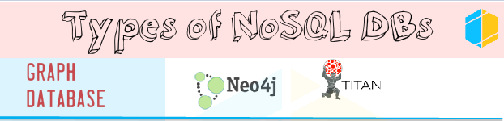



Types of NoSQL databases
Reference : http://www.vikramtakkar.com/2015/12/nosql-types-of-nosql-database-part-2.html

Slide 7
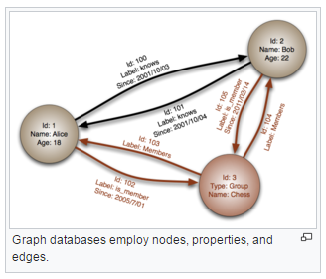
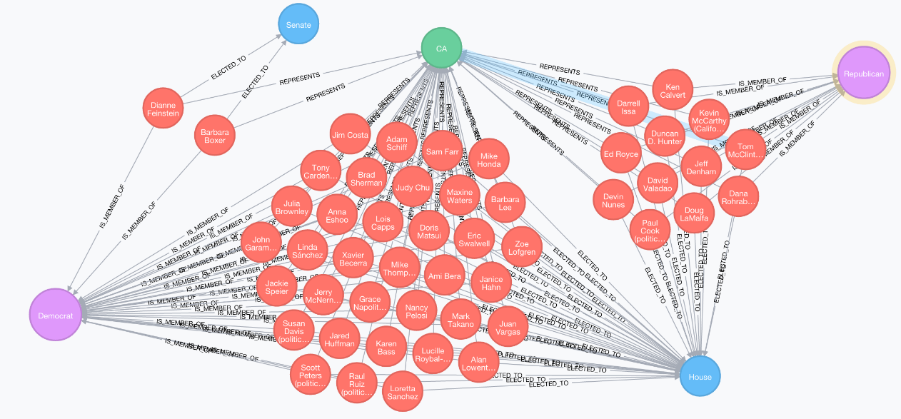
Graph Databases
A database, which uses graph structures for semantic queries with nodes, edges
Graph databases employ nodes, edges and properties:
Nodes: Represent entities such as people, businesses, accounts, or any other item you might want to keep track of.
Edges: Relationship between nodes
Properties: Refers to characteristics of nodes
Neo4j is one of the leading graph databases.
Source: wikipedia
Source: Neo4j

Slide 8
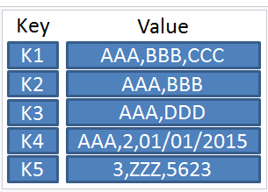
Key value databases
A key value store, is a simple DB where each key is associated with one and only one value in collection.
Values can hold any complex data, and can vary from record to record as it is schema free.
Key Features:
Scalability and Reliability
Portability and Lower Operational Costs
Source: wikipedia

Slide 9
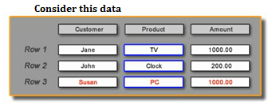
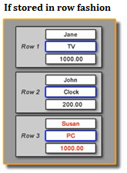
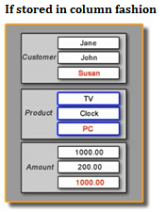

Column Databases
Column oriented databases store tables in columnar format, rather than rows.
Column oriented databases are faster in access compared to row oriented like RDBMS, as data retrieval becomes easy when stored as separate columns.

Slide 10
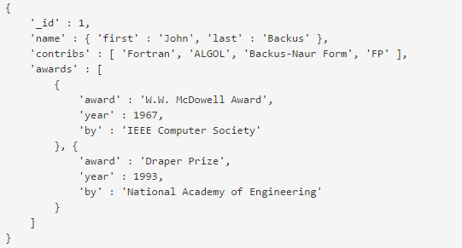
Document database
A document-oriented database will be the most suitable for Semi-structured data which is in document –oriented format.
MongoDB is the leading database.
Example :

Slide 11
JSON and BSON
JavaScript Object Notation (JSON) is an open, human and machine-readable standard that facilitates data interchange.
JSON data will be in the form of key value pairs. Key in general will be simple data type.
Values can be anywhere between simple datatype(int, string) to complex data structure(array, nested JSON document)
Document Databases such as MongoDB use JSON documents in order to store collections/ records, just as tables and rows store records in a relational database.
In the back ground, JSON data is stored in Binary JSON(BSON) format.
Like JSON, BSON supports complex nested documents.

Slide 12
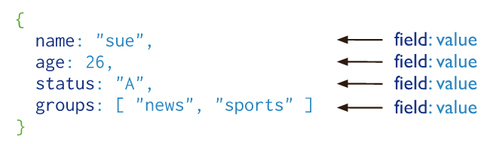
MongoDB document storage system
MongoDB stores documents in form of collections.
Collection can be compared to tables in RDBMS.
Documents can be compared to rows in RDBMS.
Documents have key and values.

Slide 13
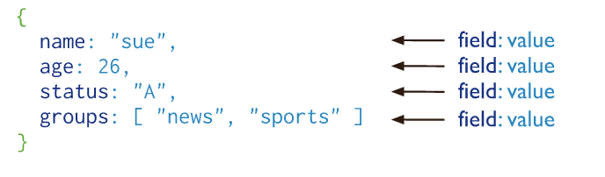
Advantages of using documents
Documents (i.e. objects) correspond to native data types in many programming languages.
Embedded documents and arrays reduce need for expensive joins.
Dynamic schema supports fluent polymorphism.

Slide 14
MongoDB installation modes
Standalone – Installation happens on a single machine
Distributed without Sharding – sharding not enabled
Distributed with Sharding – sharding enabled

Slide 15
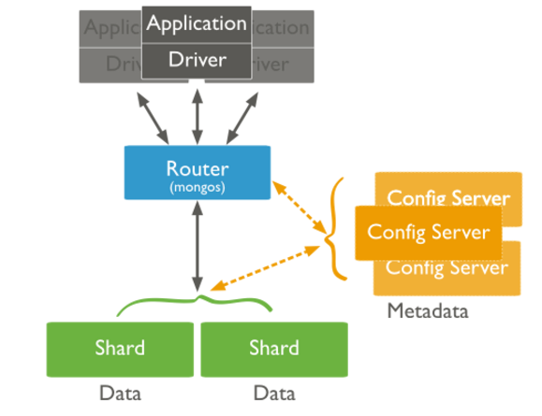
MongoDB Shard Architecture
A database shard is a horizontal partition of data held on a separate database instance, to spread load and make it scalable.
In mongoDB, shards refers to mongoDB instance that holds a subset of collections of data.
Config servers holds metadata about the cluster. This metadata maps chunks to servers.
MongoDB mongos instances route queries and write operations to shards in sharded cluster.
The mongos tracks what data is on which shard by caching the metadata from the config servers.

Slide 16
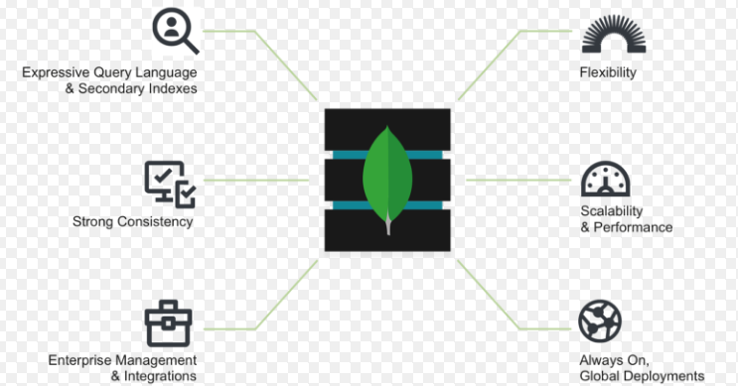
MongoDB Architecture
Expressive query language:
Users can access data through a query interface
Strong consistency:
Applications should be able to read what has been written to the database.
Enterprise management and integrations:
Organizations need a database that can be secured, monitored, automated, and integrated with their existing technology infrastructure, processes, and staff, including operations teams, DBAs, and data engineers.
Flexible data model:
Schema free, loosely coupled.
Scalability and performance:
Scale across commodity hardware.
Always-on global deployments:
They should work on geographically-dispersed data centers.

Slide 17
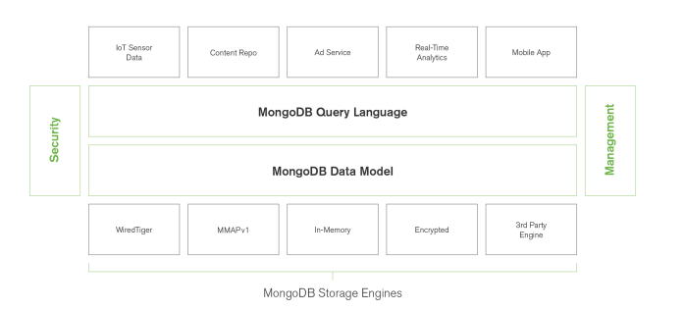
Flexible storage architecture
Will support different use cases in business, and certainly work on multiple storage engines

Slide 18
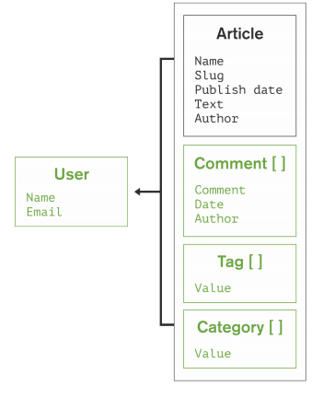
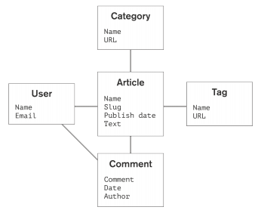
Flexible Storage Architecture
Relational data model for a blogging application
Data as documents: simple for developers, faster for users

Slide 19
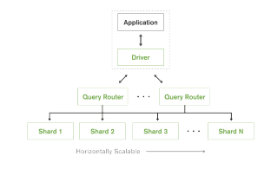
Automatic sharding provides horizontal scalability
Unlike relational databases, sharding is automatic and built into the database.
Range Sharding:
Documents are partitioned across shards according to the shard key value
Hash Sharding:
Documents are distributed according to an MD5 hash of the shard key value. This approach guarantees a uniform distribution of writes across shards, but is less optimal for range-based queries.

Slide 20
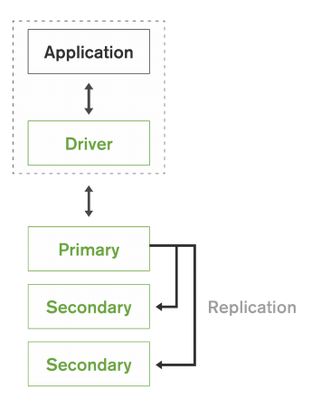
Self-Healing MongoDB Replica sets for High Availability
A replica set consists of multiple replicas. At any given time one member acts as the primary replica set member and the other members act as secondary replica set members.

Slide 21

Installation - Standalone
1. Install mongodb software, by following instructions as they guide you.
2. Install robomongo to access mongoDB.
Create the following folder structure C: drive.
3. Now start mongod application in program files directory, which relates to mongoserver.
Path: C:\Program Files\MongoDB\Server\3.4\bin
Keep this open for the entire session.
4. In the same folder, mongo is used to query mongo DB. But it is not user friendly
5. Let us use robomongo. Start robomongo.

Slide 22
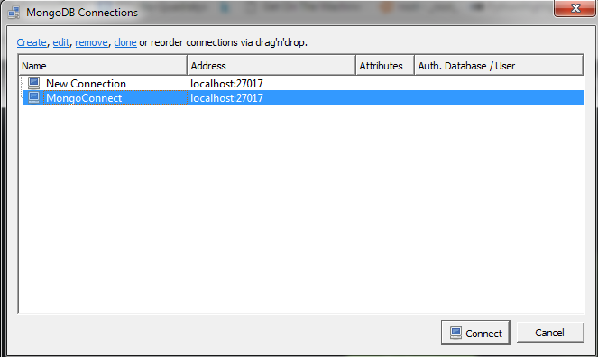
Robo Mongo
Create a new connection. Name it as a mongoconnect.
Click on connect.

Slide 23
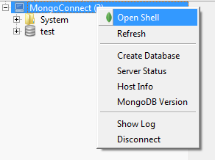
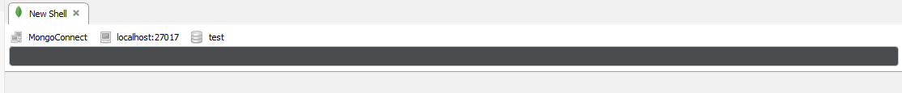
Screen shot
To query, right click on MongoConnect and click on open shell.

Slide 24
Lab Agenda
CRUD operations
Insert
Query
Update
Delete
Import
Aggregation Framework
Sort, count, distinct
Map reduce
Text Search
Indexing
Export

Slide 25
Instructions
To make the most use of this lab, students are requested to type the commands and understand the syntax. Copy and paste will make the lab so simple, but when you practice them, you might find more questions and the session becomes more interesting.
If the commands are very lengthy, we will mention “Copy and Paste”. Then you can do it.
All the lab commands will be executed on RoboMongo.
By the end of this session, you will learn the following:
How to query MongoDB. It includes simple queries like insert, to complex queries like find, aggregate.
Import data and export results.
Interacting MongoDB using python.
Map Reduce functionality on MongoDB

Slide 26
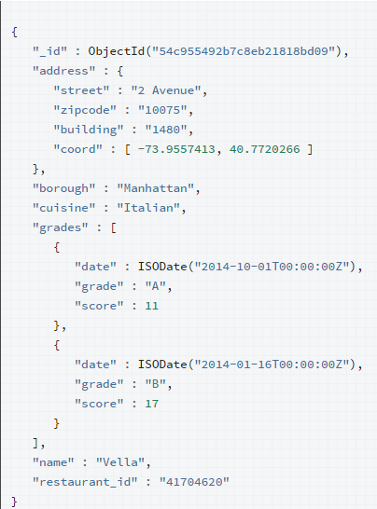
Document.
In RBDMS, records relate to rows of data.
In MongoDB, it relates to json structure document.
Here id is the key. MongoDB inserts a object key, if no key is provided.
Address is a key, value is nested/ embedded document.
Grades is array with embedded documents.
Rest all are simple key and value pairs.

Slide 27
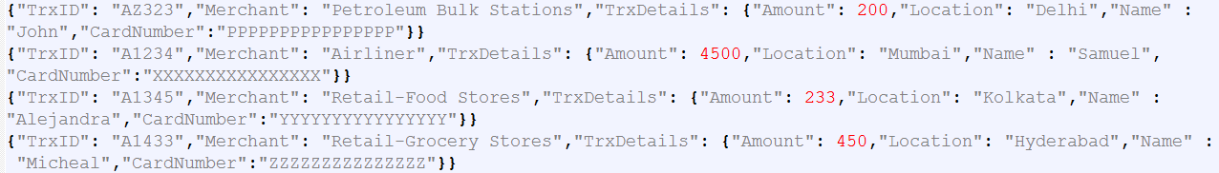
Collections
In RDBMS, bunch of rows make a table.
In MongoDB, bunch of documents make a collection.

Slide 28
Insert
In RDBMS, first table should be created.
In mongo, up on insertion of a document, if collection exists, it inserts in to existing collection or it creates a new collection.
For each document inserted, a unique key id will be automatically generated, as it is key value DB. If needed, key can be manually provided.
Operations:
Insert One
Insert Many
Insert

Slide 29
Insert One Lab
This query inserts a record with three fields name, age and status.
Id will be automatically created.
db.users.insertOne( { name: "sue", age: 19, status: "P" } )

Slide 30
Insert Many lab
db.users.insertMany(
[
{ name: "bob", age: 42, status: "A" },
{ name: "ahn", age: 22, status: "A” },
{ name: "xi", age: 34, status: "D"}
]
)
Inserting three documents.

Slide 31
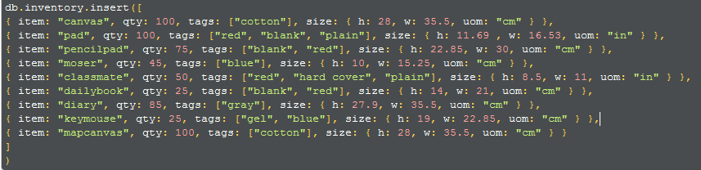
Insert lab
Insert can act as insert one or many.
If only one document is inserted, it acts as insertone.
db.users.insert(
{
name: "sue",
age: 19,
status: "P"
}
)
If array of docs are inserted, it acts as insert many.
db.users.insert(
[
{ name: "bob", age: 42, status: "A", },
{ name: "ahn", age: 22, status: "A", },
{ name: "xi", age: 34, status: "D", }
]
)

Slide 32
Query
Mongo DB provides find method to query data.
db.collection.find( <query filter>, <projection> )
For the db.collection.find() method, you can specify the following optional fields:
1. A query filter to specify which documents to return.
2. A query projection to specifies which fields from the matching documents to return. The projection limits the amount of data that MongoDB returns to the client over the network.

Slide 33
Query Lab
Refer to queryFind.json sheet.
Use notepad++ editor to open it.

Slide 34
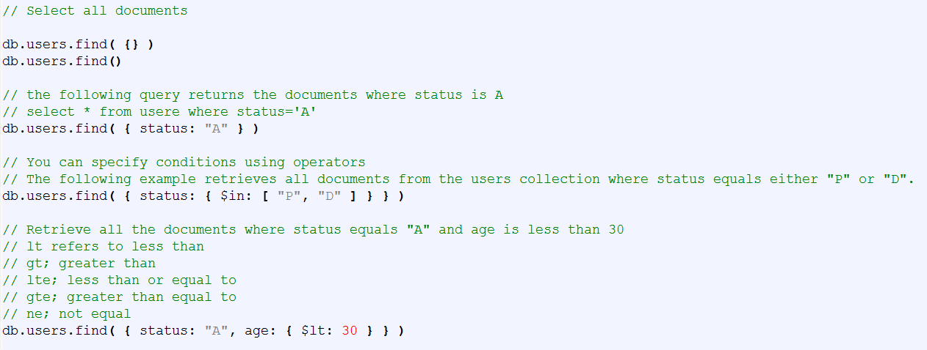
Select, where, in, and

Slide 35
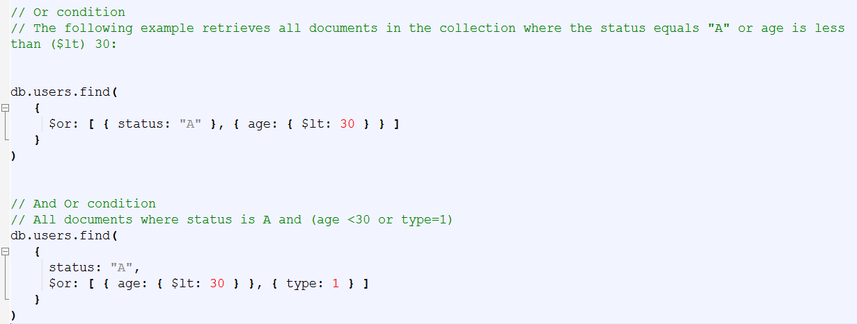
OR AND operators

Slide 36
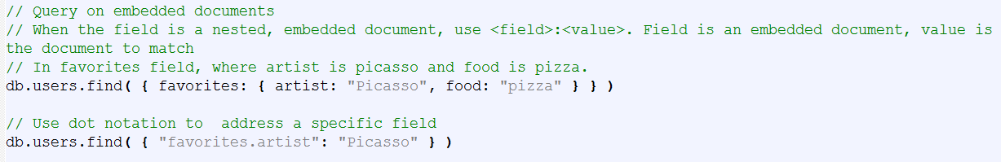
Query an embedded document

Slide 37
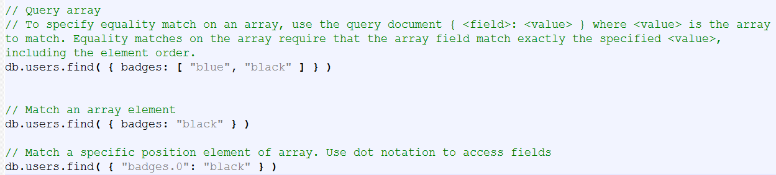
Query Array

Slide 38
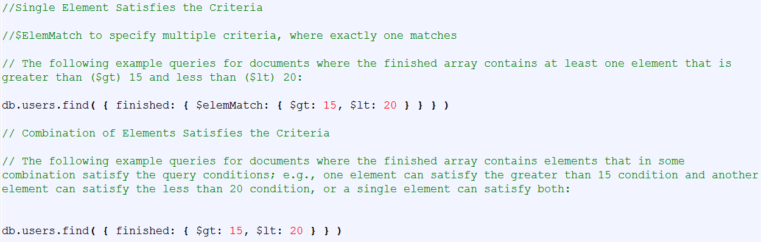
Specify Multiple Criteria for Array Elements

Slide 39
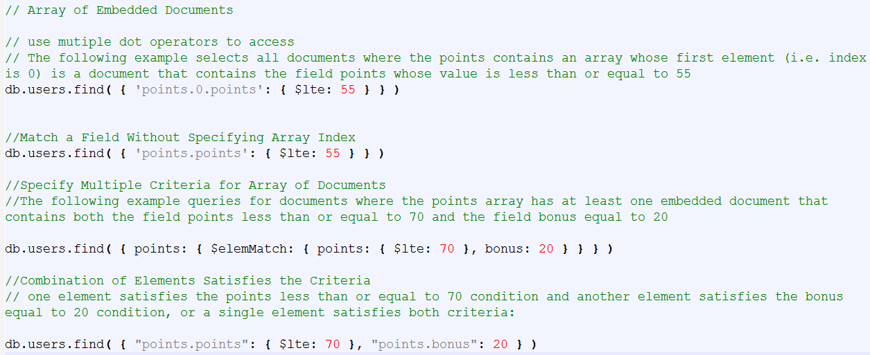
Query on array of embedded documents

Slide 40
summary
Find is used to query a collection.
Find one does a similar function, but returns only one result.

Slide 41
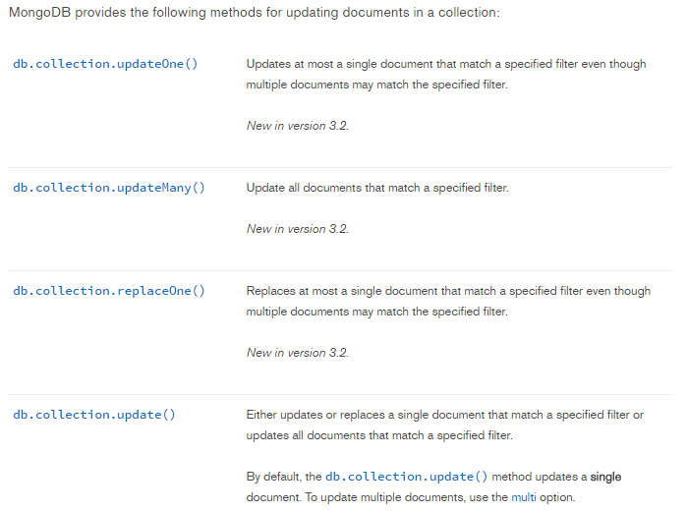
Update operation

Slide 42
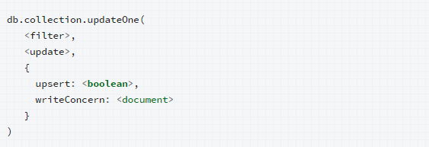
updateOne
Filter criteria
Update modifications
Upsert: if doc is available, update it else insert

Slide 43
Update lab
Check update.js lab sheet.

Slide 44

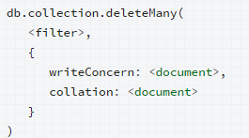
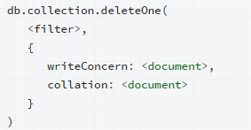
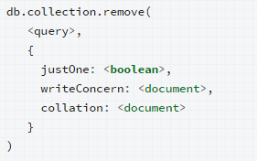
Delete
All the documents which matches the filter condition will be removed
The first document which matches the filter condition will be removed
All the documents (OR) only one document will be removed, based on the flag set to justOne
Check delete.js lab sheet

Slide 45
Drop the collection
In MongoDB, delete operations will only drop data, not indexes.
For large deletion operations, it may be more efficient to copy the documents that you want to keep to a new collection and then use db.collection.drop() on the original collection.
Drop will remove both data and indexes.
This method obtains a write lock on the affected database and will block other operations until it has completed.

Slide 46
Import data into mongodb
To import data into mongodb, use mongoimport command.
Syntax:
mongoimport -d dbname -c restaurants --file pathOfFile
Get into cmd
Change directory to bin directory of MongoDB
Run the following command by providing the path of the file, db name
mongoimport -d mongoday2 -c restaurantData --file D:\edu\MongoDB\LabSheets\restaurant.json
Check robomongo now

Slide 47
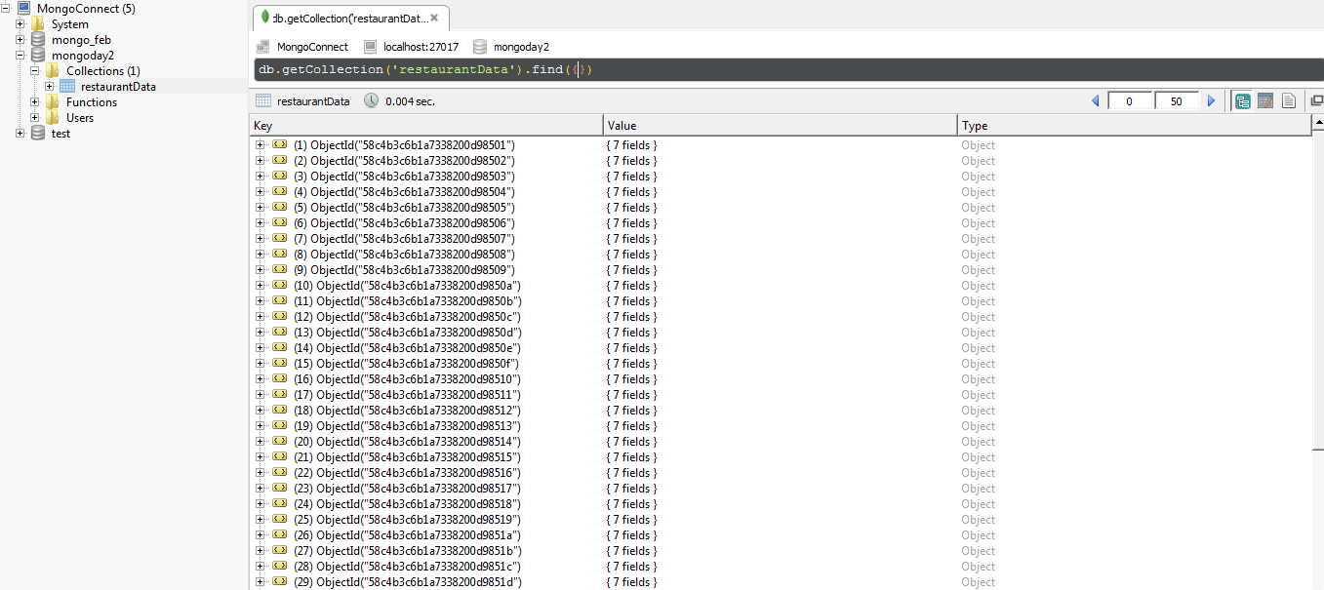
Import screenshot

Slide 48

aggregate
Calculates aggregate values for the data in a collection.
Pipeline refers to, passing output of one stage as input to next stage.
Aggregation operations:
Sum, avg, min, max etc..

Slide 49
Aggregate - project
Passes along the documents with the requested fields to the next stage in the pipeline. The specified fields can be existing fields from the input documents or newly computed fields.
1 refers to select
0 refers to exclude
https://docs.mongodb.com/manual/tutorial/aggregation-zip-code-data-set/

Slide 50
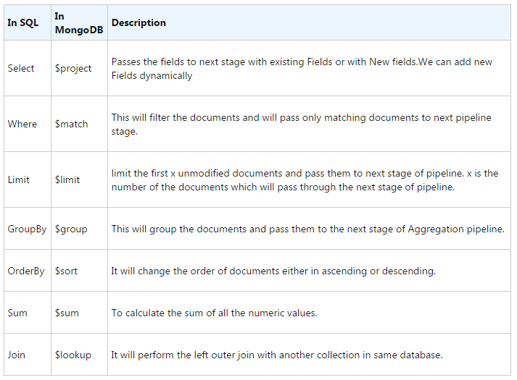
Aggregation Pipeline stages

Slide 51
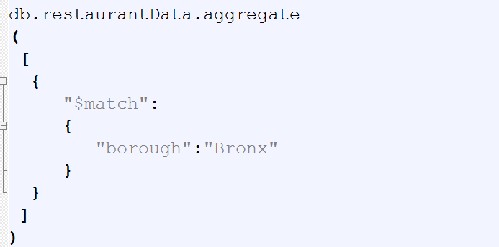
match
$match is similar to Where in SQL. In SQL we use Where to filter the data and same is here.If we need to pass only a subset of our data in next stage of Aggregation Pipeline then we use $match. $match filters the data and pass the matching data to the next stage of Pipeline.

Slide 52
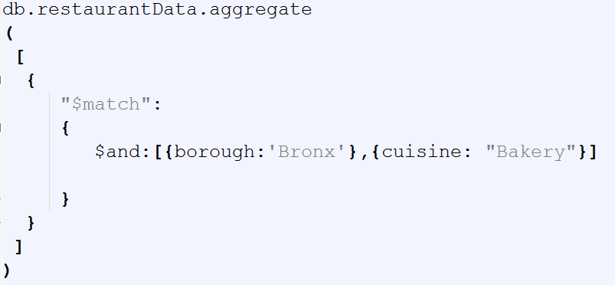
Suppose if want to find out all the records where borough is Bronx and cuisine is Bakery

Slide 53
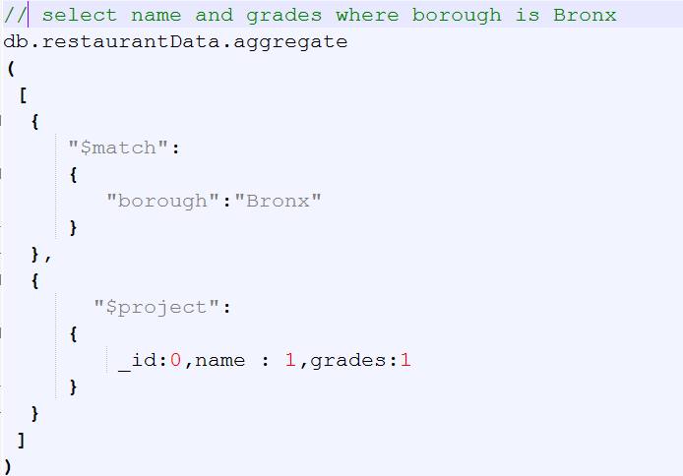
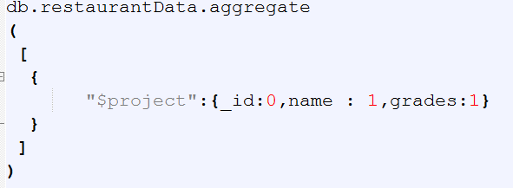
project
We can compare this clause with SELECT in SQL. We can select certain fields, rename Fields from documents though $project. In short $project reshape the documents by adding/removing or renaming the documents for the next stage of pipeline. In $project we use 1 or true if we want to include the Field and 0 or false if we want to exclude a particular field.

Slide 54
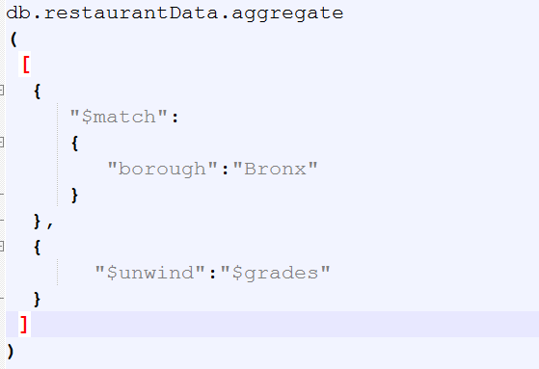
unwind
Unwind flattens the entire data, and creates multiple records for an array.

Slide 55
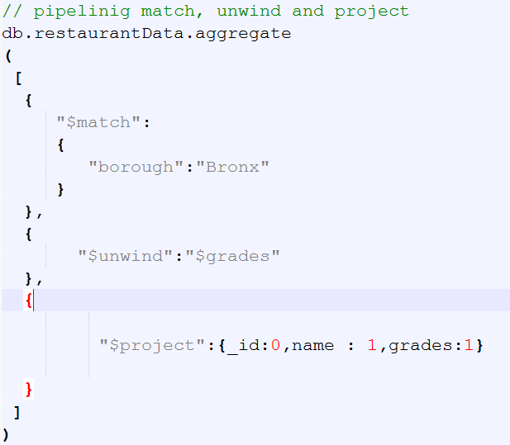
unwind contd

Slide 56
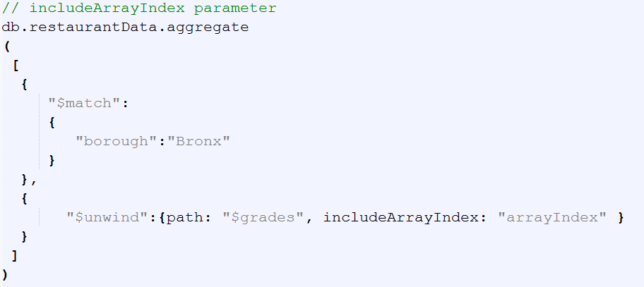
unwind contd

Slide 57
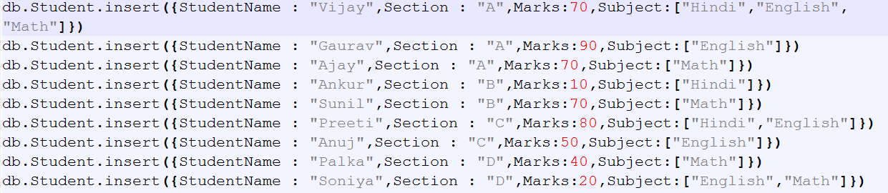
group
Group is similar to group by in SQL. Grouping operation is performed on a field followed by aggregation operations. For demonstrating this, we will create a sample dataset
Aggregation.js lineno: 112-121

Slide 58
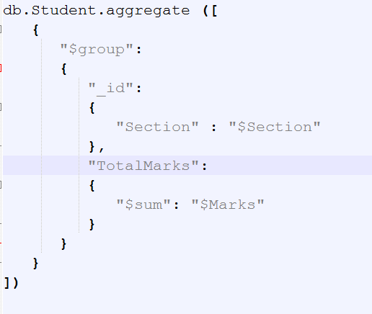
group contd

Slide 59
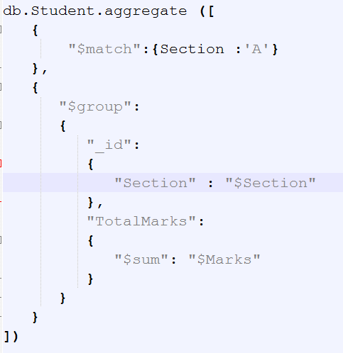
group contd

Slide 60

group contd

Slide 61

group contd

Slide 62
sort
Sort operator to sort the results.
By default, ascending operation is done.
If value is set to 1, ascending operation.
If value is set to -1, descending operation.

Slide 63

sort contd

Slide 64

limit
$limit operator use to pass n documents to next pipe line stage where n is the limit.n is the number of documents

Slide 65

skip
$skip is use to skip first n documents and remaining will be passed in next pipeline.n is the number of documents which we want to skip

Slide 66

lookup
Lookup enables joins in mongodb. Introduced in version 3.2

Slide 67

lookup contd

Slide 68

Map reduce
In map reduce, mongodb extracts key value pairs in map phase.
In reduce phase, the actual reduction happens.
In this example, emit function choose cust_id as key, amount as value.
Input to reducer is cust_id, array of amount values.
Output of reducer is cust_id and sum(values)
For most aggregation operations, the Aggregation Pipeline provides better performance and more coherent interface. However, map-reduce operations provide some flexibility that is not presently available in the aggregation pipeline.
Advanced.js
39-56

Slide 69
SQL Aggregation Comparison
https://docs.mongodb.com/manual/reference/sql-aggregation-comparison/

Slide 70

count
db.collection.count(query, options)
Returns the count of documents that would match a find() query. The db.collection.count()method does not perform the find() operation but instead counts and returns the number of results that match a query.
Example:

Slide 71

Indexes
Indexes are used for faster retrieval.
If indexing is not done, mongodb scans the entire document to fetch the results of condition.
Indexes in MongoDB is similar to indexing in other Databases.
Default indexing is created on id column.

Slide 72



Index types
Single Field; indexing on a single field.
`
Compound Index; indexing on multiple fields
Multikey indexing: To index arrays:

Slide 73

Text Search
MongoDB support query operations that perform text search of string content.

Slide 74

Text Index
MongoDB provides text indexes to support text search queries on string content. text indexes can include any field whose value is a string or an array of string elements.
To perform text search queries, you must have a text index on your collection. A collection can only have one text search index, but that index can cover multiple fields.
For example you can run the following in a mongo shell to allow text search over the name and description fields:

Slide 75

Exact Phrase

Slide 76

Term Exclusion

Slide 77

Sorting

Slide 78
Export results to JSON or CSV
mongoexport will be used to export a collection in to a jsong or csv file.
mongoexport --db dbname --collection collection name --out filename --type=csv

Slide 79
Aggregation in detail
https://docs.mongodb.com/manual/reference/operator/aggregation/

Slide 80
References
https://docs.mongodb.com/
http://www.codeproject.com/

