Slide 1
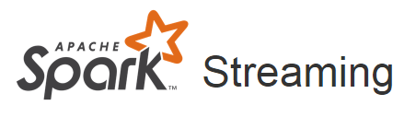
SparkStreaming

Slide 2
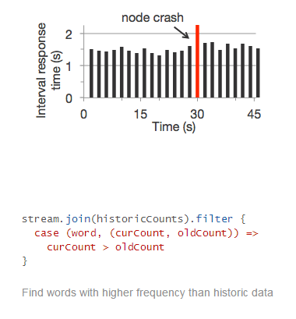
Spark Streaming Features
Ease of Use
Fault Tolerance
Spark Integration

Slide 3
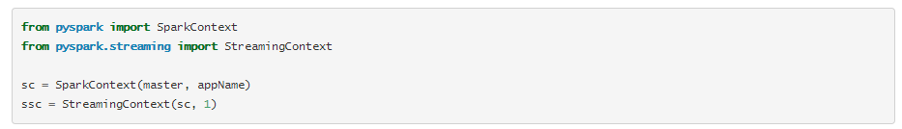
Initializing StreamingContext

Slide 4
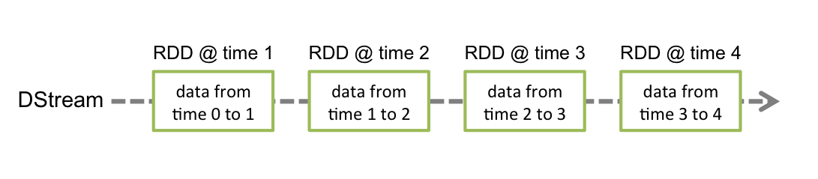
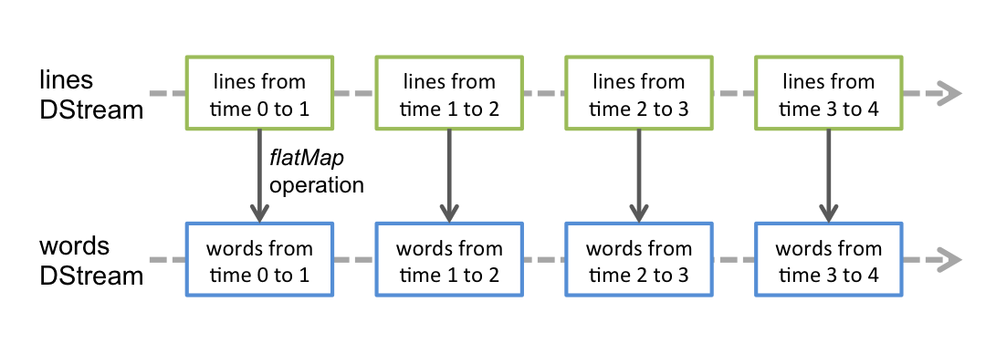
Discretized Streams (DStreams)

Slide 5
Input DStreams and Receivers
Spark Streaming provides two categories of built-in streaming sources.
Basic sources: Sources directly available in the StreamingContext API. Examples: file systems, socket connections, and Akka actors.
Advanced sources: Sources like Kafka, Flume, Kinesis, Twitter, etc. are available through extra utility classes.

Slide 6
Transformations on DStreams
Transformation | Meaning
map(func) | Return a new DStream by passing each element of the source DStream through a function func.
flatMap(func) | Similar to map, but each input item can be mapped to 0 or more output items.
filter(func) | Return a new DStream by selecting only the records of the source DStream on which func returns true.
repartition(numPartitions) | Changes the level of parallelism in this DStream by creating more or fewer partitions.
union(otherStream) | Return a new DStream that contains the union of the elements in the source DStream and otherDStream.
count() | Return a new DStream of single-element RDDs by counting the number of elements in each RDD of the source DStream.
reduce(func) | Return a new DStream of single-element RDDs by aggregating the elements in each RDD of the source DStream using a function func (which takes two arguments and returns one). The function should be associative so that it can be computed in parallel.
countByValue() | When called on a DStream of elements of type K, return a new DStream of (K, Long) pairs where the value of each key is its frequency in each RDD of the source DStream.
reduceByKey(func, [numTasks]) | When called on a DStream of (K, V) pairs, return a new DStream of (K, V) pairs where the values for each key are aggregated using the given reduce function. Note: By default, this uses Spark's default number of parallel tasks (2 for local mode, and in cluster mode the number is determined by the config property spark.default.parallelism) to do the grouping. You can pass an optional numTasks argument to set a different number of tasks.
join(otherStream, [numTasks]) | When called on two DStreams of (K, V) and (K, W) pairs, return a new DStream of (K, (V, W)) pairs with all pairs of elements for each key.
cogroup(otherStream, [numTasks]) | When called on a DStream of (K, V) and (K, W) pairs, return a new DStream of (K, Seq[V], Seq[W]) tuples.
transform(func) | Return a new DStream by applying a RDD-to-RDD function to every RDD of the source DStream. This can be used to do arbitrary RDD operations on the DStream.
updateStateByKey(func) | Return a new "state" DStream where the state for each key is updated by applying the given function on the previous state of the key and the new values for the key. This can be used to maintain arbitrary state data for each key.

Slide 7
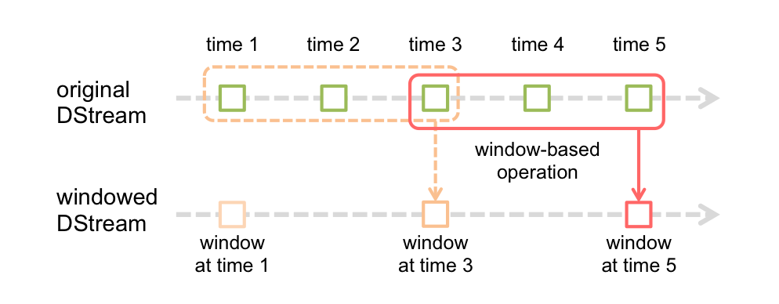
Window Operations
Spark Streaming also provides windowed computations, which allow you to apply transformations over a sliding window of data. The following figure illustrates this sliding window.

Slide 8
Functions
Transformation | Meaning
window(windowLength, slideInterval) | Return a new DStream which is computed based on windowed batches of the source DStream.
countByWindow(windowLength, slideInterval) | Return a sliding window count of elements in the stream.
reduceByWindow(func, windowLength, slideInterval) | Return a new single-element stream, created by aggregating elements in the stream over a sliding interval using func. The function should be associative so that it can be computed correctly in parallel.
reduceByKeyAndWindow(func, windowLength, slideInterval, [numTasks]) | When called on a DStream of (K, V) pairs, returns a new DStream of (K, V) pairs where the values for each key are aggregated using the given reduce function func over batches in a sliding window. Note: By default, this uses Spark's default number of parallel tasks (2 for local mode, and in cluster mode the number is determined by the config property spark.default.parallelism) to do the grouping. You can pass an optional numTasks argument to set a different number of tasks.
reduceByKeyAndWindow(func, invFunc, windowLength, slideInterval, [numTasks]) | A more efficient version of the above reduceByKeyAndWindow() where the reduce value of each window is calculated incrementally using the reduce values of the previous window. This is done by reducing the new data that enters the sliding window, and “inverse reducing” the old data that leaves the window. An example would be that of “adding” and “subtracting” counts of keys as the window slides. However, it is applicable only to “invertible reduce functions”, that is, those reduce functions which have a corresponding “inverse reduce” function (taken as parameter invFunc). Like in reduceByKeyAndWindow, the number of reduce tasks is configurable through an optional argument. Note that checkpointing must be enabled for using this operation.
countByValueAndWindow(windowLength,slideInterval, [numTasks]) | When called on a DStream of (K, V) pairs, returns a new DStream of (K, Long) pairs where the value of each key is its frequency within a sliding window. Like in reduceByKeyAndWindow, the number of reduce tasks is configurable through an optional argument.

Slide 9
Lab

