Slide 1
CitiBike Availability
Technical Presentation
Jaya K
Nazima K
Sushil B

Slide 2
Problem Statement
Whether a bike is available in the station
Analysis of users who bike most
The data set was downloaded from (https://www.citibikenyc.com/system-data)

Slide 3
Exploration of the data
The data has 6 million obs. of 15 variables.
The data was extracted into in memory table of R.
Used 1.7 million data for analysis
Used h2o to build the models.
Split data into 60% training, 20% test and 20% valid data

Slide 4
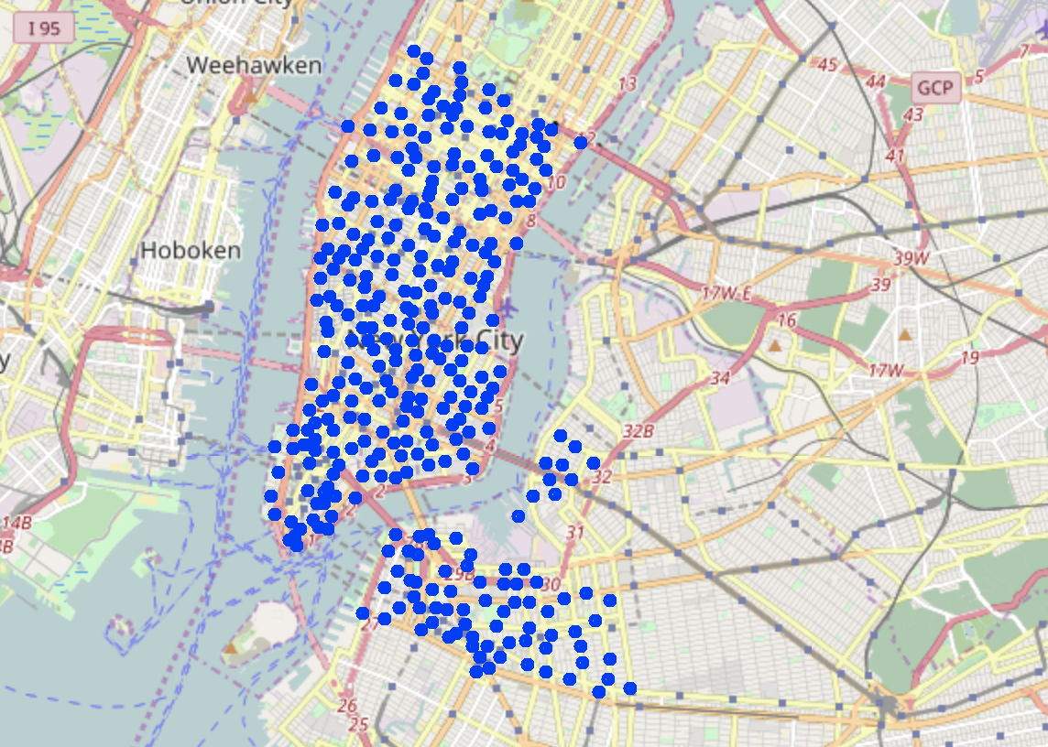
Bike Stations
The bikes were available at the stations locations indicated by blue circles.

Slide 5
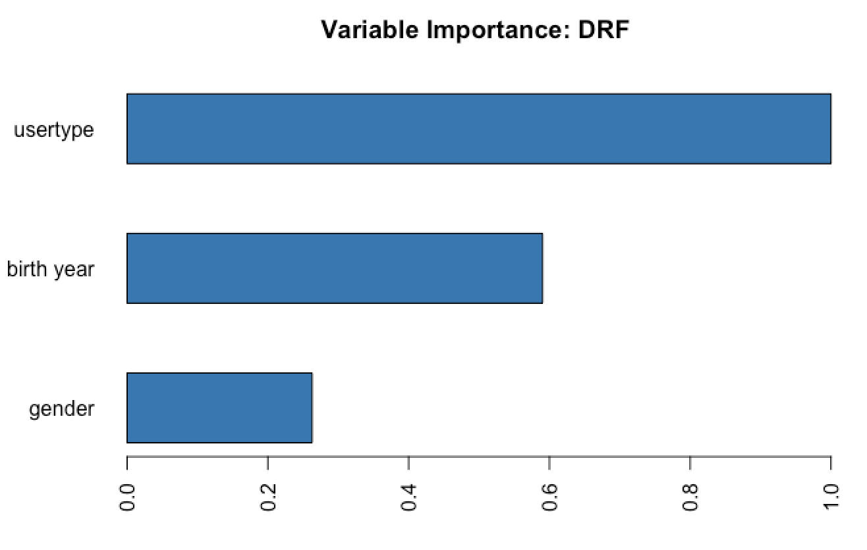
Random Forrest
Analyzed trip duration with respect to
1. User Type
Customer
Subscriber
2. Birth Year
3. Gender
Male (1)
Female (2)

Slide 6
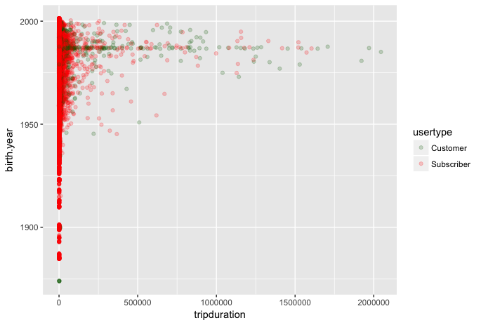
Who bikes most ?
Subscriber (annual members)
seem to be bike more than
Customers (having 24 hr or 7 day pass)
We have people 50+ years biking regularly

Slide 7
Conclusion
Most users seem to bike for regular activities.
They seem to live in NY as they don’t bike too much.
Some of the customers seem to have biked 130 hrs. They could be the tourists.

