Slide 1
QueryGenie: A Self-Correcting Natural Language to SQL Interface
Capstone Project – I (Review – III)
Presented by — Team 18
2320090050 : N V V S S Jayakanth Kamisetti
2320090009 : Boddupally Narendar
2320090018 : M Praneeth Reddy
M Parameswar
Associate Professor
Dept of Computer Science & Information Technology
KLEF

Slide 2
Outline
Problem Statement
Related Research Papers
Research Gap
Proposed Methodology
  Dataset(s), if any (detailed analysis)
  Architecture
  Experimental Results
Limitations
Conclusion and Future work
References
GitHub URL

Slide 3
Problem Statement
Problem: people who don't know SQL can't get answers out of a database without help.
Text-to-SQL translates a plain-English question into SQL, runs it and returns the result.
The risk: these systems answer every question with the same confidence, so a wrong table looks exactly like a right one.
  Even CodeS, a strong open model, is wrong on about 1 in 5 Spider questions (77.9% accuracy).
Most strong systems use closed models (GPT-4, …): the database schema goes to a third party.
Our goal: reproduce CodeS, an open model that runs locally, and make it say when it is unsure instead of answering wrongly.

Slide 4
Related Research Papers
Papers 1–4 of 16 (all from arXiv); results as stated in each paper's abstract.
Paper Title | Problem Addressed | Dataset(s) if any | Methodology | Results
Seq2SQL (Zhong et al., 2017) | Querying databases without knowing SQL | WikiSQL (80,654 examples; introduced) | Seq2seq with RL rewards from query execution | Execution accuracy 35.9% → 59.4%
Spider (Yu et al., 2018) | Complex, cross-domain text-to-SQL | Spider: 10,181 questions, 200 databases, 138 domains | Human-annotated benchmark; unseen databases at test time | Best model then: 12.4% exact match
RAT-SQL (Wang et al., 2019) | Generalising to unseen schemas | Spider | Relation-aware self-attention for schema encoding and linking | 57.2% exact match; 65.6% with BERT
Test-suite accuracy (Zhong et al., 2020) | Metrics misjudge equivalent queries | Spider and 10 other datasets | Distilled test suites of databases | Spider metric: 2.5% false negatives on average

Slide 5
Related Research Papers
Papers 5–8 of 16 (all from arXiv); results as stated in each paper's abstract.
Paper Title | Problem Addressed | Dataset(s) if any | Methodology | Results
StruG / Spider-Realistic (Deng et al., 2020) | Questions rarely name the columns | Spider-Realistic (introduced) + 8 datasets | Structure-grounded pre-training | Beats all baselines on the realistic sets
BRIDGE (Lin et al., 2020) | Linking questions to database contents | Spider, WikiSQL | Schema + matched cell values encoded with BERT | Spider 71.1% dev, 67.5% test
PICARD (Scholak et al., 2021) | Language models produce invalid SQL | Spider, CoSQL | Constrained decoding by incremental parsing | Fine-tuned T5 → state of the art
Self-consistency (Wang et al., 2022) | Unreliable single (greedy) answers | GSM8K, SVAMP, AQuA, StrategyQA, ARC | Sample several reasoning paths, keep the most consistent answer | GSM8K +17.9%

Slide 6
Related Research Papers
Papers 9–12 of 16 (all from arXiv); results as stated in each paper's abstract.
Paper Title | Problem Addressed | Dataset(s) if any | Methodology | Results
RESDSQL (Li et al., 2023) | Schema linking and SQL skeleton parsed together | Spider, Spider-DK, -Syn, -Realistic | Ranking-enhanced encoder, skeleton-aware decoder | Strong accuracy and robustness
DIN-SQL (Pourreza & Rafiei, 2023) | Prompting lags fine-tuned models | Spider, BIRD | Decomposed prompting with self-correction | Spider test 85.3% EX; BIRD 55.9%
BIRD (Li et al., 2023) | Benchmarks ignore large, dirty databases | BIRD: 12,751 pairs, 95 databases, 33.4 GB | Benchmark with external knowledge and values | ChatGPT 40.08% vs human 92.96%
DAIL-SQL (Gao et al., 2023) | No systematic study of LLM prompting | Spider | Prompt engineering comparison; DAIL-SQL prompt | Spider leaderboard 86.6% EX

Slide 7
Related Research Papers
Papers 13–16 of 16 (all from arXiv); results as stated in each paper's abstract.
Paper Title | Problem Addressed | Dataset(s) if any | Methodology | Results
MAC-SQL (Wang et al., 2023) | Huge databases, multi-step questions | BIRD, Spider | Multi-agent: decomposer, selector, refiner | BIRD test 59.59% EX (GPT-4)
CodeS (Li et al., 2024) — reproduced | Dependence on closed LLMs | Spider, BIRD, robustness sets | Open 1B–15B models, incremental pre-training on SQL | CodeS-1B 77.9% EX (Spider dev)
CHESS (Talaei et al., 2024) | Large catalogs and schemas | BIRD | Four LLM agents: retrieve, prune, generate, test | BIRD test 71.10%
CHASE-SQL (Pourreza et al., 2024) | Choosing among SQL candidates | BIRD | Multi-path generation + learned candidate selection | BIRD test 73.0%

Slide 8
Research Gap
No confidence. Every system reviewed answers every question; none says when it is unsure or reports an accuracy–coverage trade-off.
Closed models. The strongest systems send the schema to GPT-4-class services: cost, privacy and reproducibility problems.
Benchmark-to-reality gap. Results are reported on Spider, whose questions often name the columns and whose databases are small; how the same model does on realistic wording and real databases is rarely measured.
Our answer: use the 4 candidate queries CodeS already generates — if they agree, answer; if they disagree, ask the user.

Slide 9
Proposed Methodology
All data from Hugging Face (approved source); no Kaggle.
Spider dev — xlangai/spider: 1,034 questions, 20 unseen databases (2–11 tables). Reproduction, ablation, enhancement.
  39.5% need a JOIN, 26.8% GROUP BY, 8.0% nested queries; difficulty: 248 easy, 446 medium, 174 hard, 166 extra hard.
Spider-Realistic — 508 Spider questions reworded without column names (same databases and answers).
BIRD Mini-Dev — 500 questions on 11 real-world databases (finance, medicine, sport…), up to 571 MB, dirty values.

Slide 10
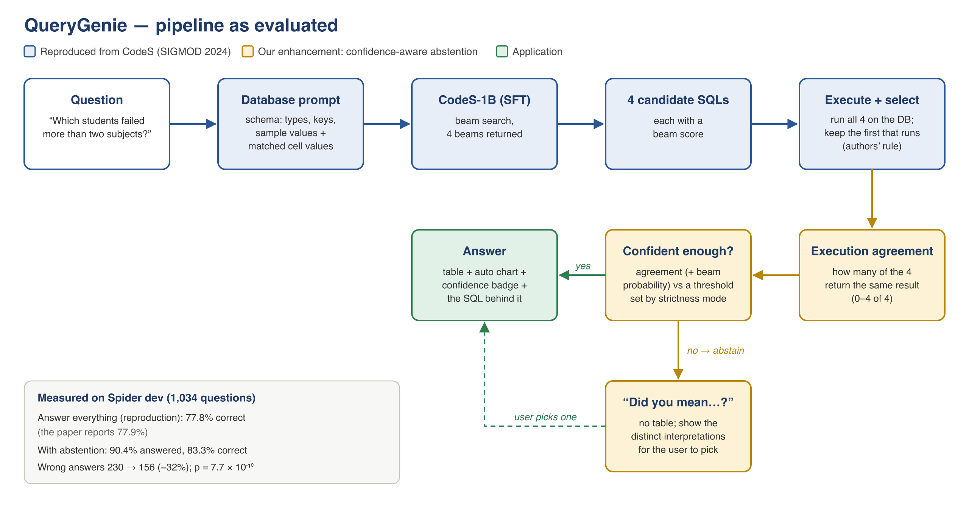
Proposed Methodology
Reproduced CodeS (blue)
  Prompt: schema, keys, sample values, matched values
  4 candidate queries (beam search)
  Pick first query that runs
Enhancement (amber)
  Run all 4, count how many agree
  Low agreement → ask the user
Application (green)
  Desktop app, runs locally
  Table, chart, SQL, self-correction

Slide 11
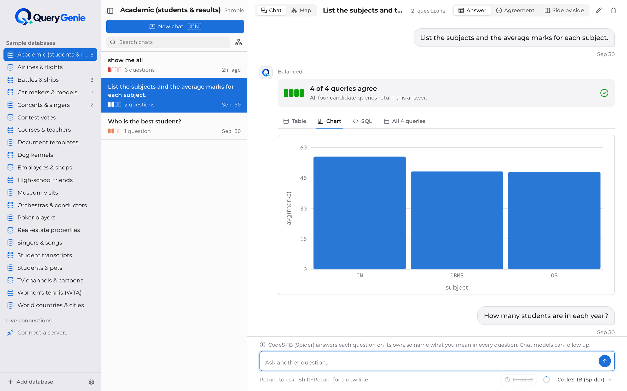
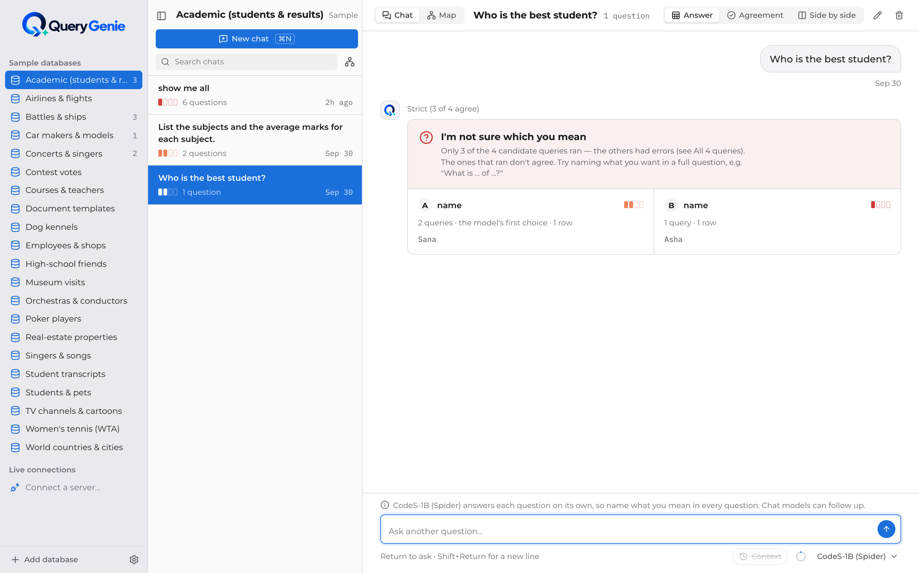
Proposed Methodology — the QueryGenie app
Confident answer: 4 of 4 queries agree → table, chart, SQL
Abstention: queries disagree → it asks which reading you meant
Desktop app (macOS, Windows) · runs locally on open weights · chats, schema map, charts, self-correction · SQLite, PostgreSQL, MySQL · optional Ollama / cloud models

Slide 12
Experimental Results
Reproduction — Execution Accuracy, Spider dev (official evaluator)
Enhancement — same 1,034 questions
 | EX
CodeS-1B, paper | 77.9%
Our reproduction (T2-006) | 77.8% (804/1,034)
Difference | −0.1 pts ✓ within ±5%
System | Answered | Correct when answering | Wrong
Original CodeS-1B | 100% | 77.8% | 230
Enhanced, tested setting | 90.4% | 83.3% | 156
3 of 4 must agree | 62.8% | 86.1% | 90
All 4 must agree | 39.8% | 88.3% | 48
Ablation — each component removed
Removed | EX | Change
Foreign keys | 76.9% | −0.9
Sample column values | 76.4% | −1.4
Candidate selection | 76.0% | −1.8
Value retriever | 75.9% | −1.9
Significant: paired t-test p = 7.7×10⁻¹⁰, Wilcoxon p = 9.8×10⁻⁴, bootstrap 95% CI +4.5 to +6.7 pts.
Wrong answers −32% (230 → 156) by declining 9.6% of questions.
Calibrated: 1 of 4 agree → 56.8% right; 4 of 4 → 88.3%.

Slide 13
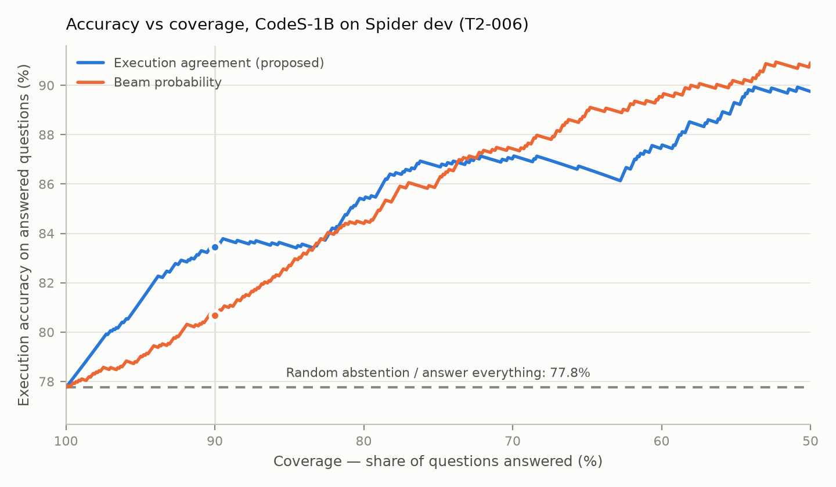
Experimental Results (continued)
Accuracy vs coverage: declining the least-agreed questions raises accuracy on the rest.
Self-correction (app feature), measured on Spider dev
 | Without | With repair
EX | 77.76% | 77.85%
Failed queries repaired | — | 61 of 377 now run
Benchmark-to-reality gap (CodeS-1B, unchanged)
Set | EX (paper) | Answered / correct
Spider dev | 77.8% (77.9%) | 90.4% / 83.3%
Spider-Realistic | 69.5% (70.9%) | 86.2% / 76.7%
BIRD Mini-Dev | TBD | TBD

Slide 14
Limitations
Overall accuracy is unchanged: the system is right more often when it answers, by declining ~10% of questions; plain EX stays 77.8%.
Agreement is not proof: 11.7% of answers where all 4 queries agree are still wrong.
One calibration: the threshold was tuned on Spider with CodeS-1B; other models in the app are not measured.
Single questions: CodeS was trained on one question at a time, so follow-ups need a chat model.
Reproduction scope: inference only (pre-training needs 8× A800 GPUs); test-suite accuracy TBD.

Slide 15
Conclusion and Future work
Reproduced CodeS-1B: 77.8% vs 77.9% (−0.1 pts) on a free Colab T4, after auditing our own evaluation.
Enhanced with confidence-aware abstention: 83.3% correct when answering, 32% fewer wrong answers, statistically significant.
Delivered QueryGenie, a desktop app that runs locally and asks when it isn't sure.
Future work — research: test-suite accuracy; CodeS-3B; a learned reranker (a correct query is among the 4 for 83.1% of questions); calibration on real-world data.
Future work — from app to platform (local, so no data leaves the company):
  Any database: SQL Server, Snowflake, Apache Spark; MongoDB and other NoSQL through a SQL gateway
  Per-database adaptation: value index per database; optional one-time fine-tuning (CodeS data augmentation)
  Access control: users and roles per database / table / column, with an audit log
  Serving at scale: quantised larger models on laptops; a shared server for many users

Slide 16
References
Deng, X., Awadallah, A. H., Meek, C., Polozov, O., Sun, H., & Richardson, M. (2020). Structure-grounded pretraining for text-to-SQL. arXiv:2010.12773.
Gao, D., et al. (2023). Text-to-SQL empowered by large language models: A benchmark evaluation. arXiv:2308.15363.
Geifman, Y., & El-Yaniv, R. (2017). Selective classification for deep neural networks. arXiv:1705.08500.
Li, H., et al. (2023). RESDSQL: Decoupling schema linking and skeleton parsing for text-to-SQL. arXiv:2302.05965.
Li, H., et al. (2024). CodeS: Towards building open-source language models for text-to-SQL. arXiv:2402.16347.
Li, J., et al. (2023). Can LLM already serve as a database interface? A big bench for large-scale database grounded text-to-SQLs. arXiv:2305.03111.
Lin, X. V., Socher, R., & Xiong, C. (2020). Bridging textual and tabular data for cross-domain text-to-SQL semantic parsing. arXiv:2012.12627.
Pourreza, M., & Rafiei, D. (2023). DIN-SQL: Decomposed in-context learning of text-to-SQL with self-correction. arXiv:2304.11015.
Pourreza, M., et al. (2024). CHASE-SQL: Multi-path reasoning and preference optimized candidate selection in text-to-SQL. arXiv:2410.01943.
Scholak, T., Schucher, N., & Bahdanau, D. (2021). PICARD: Parsing incrementally for constrained auto-regressive decoding from language models. arXiv:2109.05093.
Talaei, S., et al. (2024). CHESS: Contextual harnessing for efficient SQL synthesis. arXiv:2405.16755.
Wang, B., Shin, R., Liu, X., Polozov, O., & Richardson, M. (2019). RAT-SQL: Relation-aware schema encoding and linking for text-to-SQL parsers. arXiv:1911.04942.
Wang, B., et al. (2023). MAC-SQL: A multi-agent collaborative framework for text-to-SQL. arXiv:2312.11242.
Wang, X., et al. (2022). Self-consistency improves chain of thought reasoning in language models. arXiv:2203.11171.
Yu, T., et al. (2018). Spider: A large-scale human-labeled dataset for complex and cross-domain semantic parsing and text-to-SQL task. arXiv:1809.08887.
Zhong, R., Yu, T., & Klein, D. (2020). Semantic evaluation for text-to-SQL with distilled test suites. arXiv:2010.02840.
Zhong, V., Xiong, C., & Socher, R. (2017). Seq2SQL: Generating structured queries from natural language using reinforcement learning. arXiv:1709.00103.

Slide 17
GitHub URL
https://github.com/jayakanthh/QueryGenie

Slide 18
Thank you

