Slide 1
QueryGenie: A Self-Correcting Natural Language to SQL Interface
2320090050 : N V V S S Jayakanth Kamisetti
2320090009 : Bodupally Narendar
Project Review II · 29 August 2026
Supervisor : M Parameswar

Slide 2
Outline
Problem statement
Anchor paper & related work
Dataset — Spider
System architecture (CodeS pipeline)
Environment, GitHub & reproduction results
Contributions & enhancements (next-review work)
References

Slide 3
Problem Statement
Natural-language-to-SQL lets non-technical users query a database in plain English (e.g. “which students failed more than two subjects?” → SQL → results). State-of-the-art systems rely on closed-source LLMs (GPT-4), which bring unclear architectures, data-privacy risk (the schema is sent to a third party) and high inference cost. QueryGenie reproduces CodeS — a fully open-source model that runs locally — and adds trustworthiness: execution-guided self-correction and confidence-aware abstention.

Slide 4
Related Research Papers
Papers most relevant to QueryGenie: the anchor (reproduced), a backup anchor, the enhancement source, and the visualization layer.
Paper Title | Problem Addressed | Dataset(s) if any | Methodology | Results
CodeS (SIGMOD 2024) | Open-source text-to-SQL vs closed GPT-4 | Spider, BIRD | StarCoder + incremental pre-training + schema filter + SFT | New SOTA; CodeS-1B = 77.9% EX on Spider dev
RESDSQL (AAAI 2023) | Schema linking & skeleton parsing | Spider | Ranking-enhanced encoder + NatSQL decoding | Strong Spider EX; our backup anchor
DIN-SQL (NeurIPS 2023) | Hard text-to-SQL via decomposition | Spider, BIRD | Decomposed in-context learning + self-correction | SOTA with GPT-4; source of our self-correction
LIDA (ACL 2023) | Automatic visualization from data | — | LLM grammar-agnostic visualization generation | Auto chart selection in the QueryGenie UI

Slide 5
Dataset(s)
Spider (Yu et al., EMNLP 2018) — a large-scale, cross-domain text-to-SQL benchmark. Train 7,000 / development 1,034 examples across 166 databases; train and dev use disjoint databases, so the model must generalise to unseen schemas. Metrics: Execution Accuracy (EX) and Test-suite accuracy (TS).
Source: Hugging Face Datasets (xlangai/spider) — an approved source; Kaggle is not used. Provenance is recorded in results/dataset_provenance.json.

Slide 6
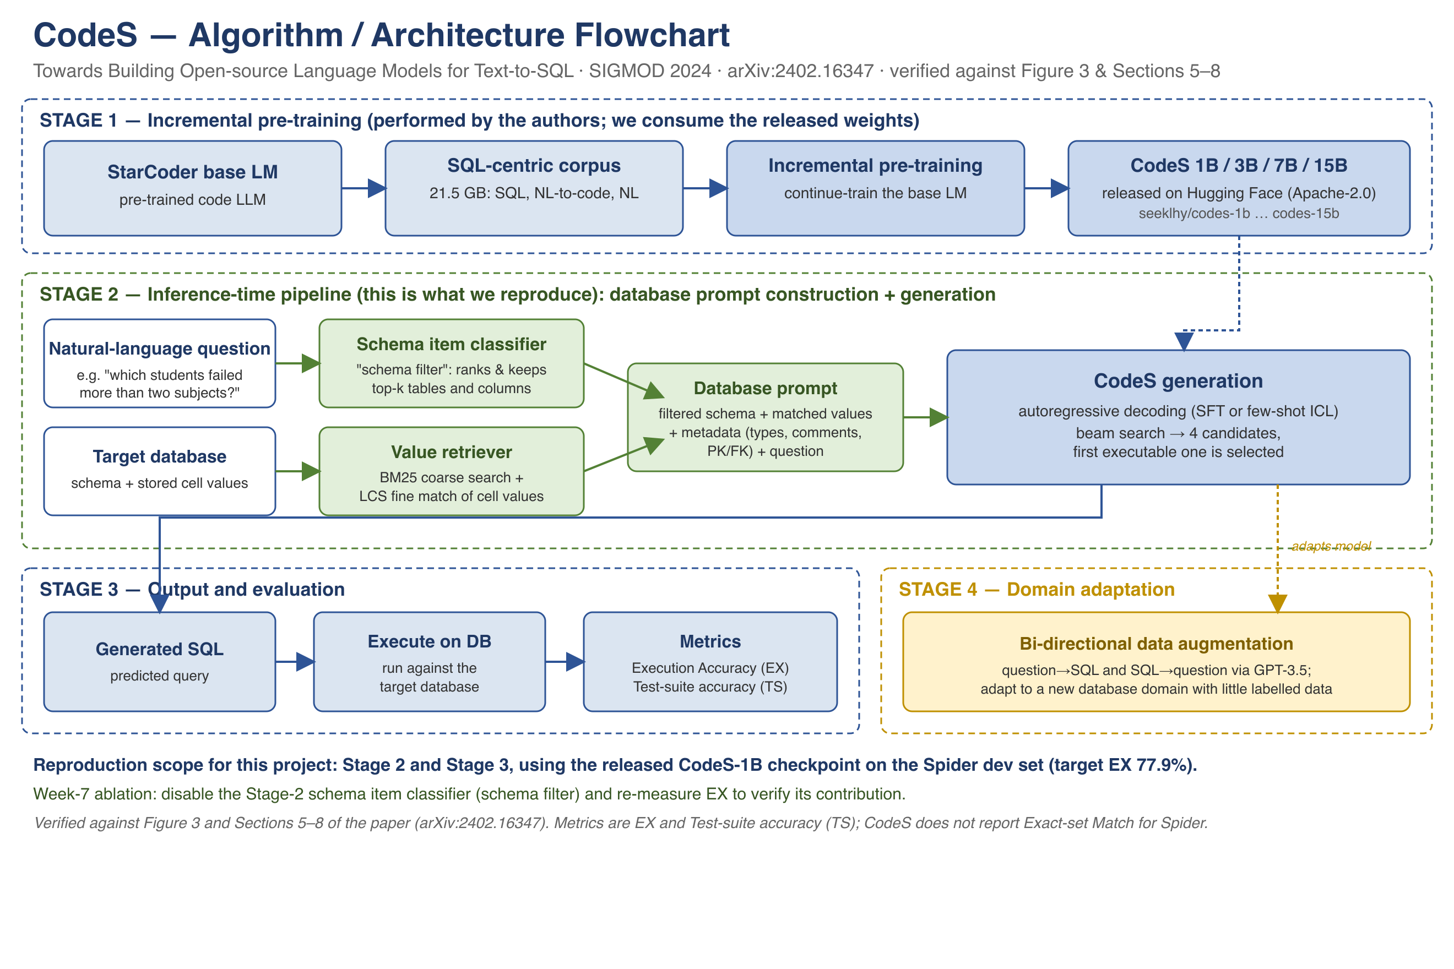
Architecture Diagram / Workflow

Slide 7
Environment setup
Two-tier reproduction. Tier 1 (liveness) — CLEARED: the released codes-1b loaded on a Colab T4, generated valid SQL and executed it on SQLite (run T1-001). Tier 2 (faithful): Spider-dev Execution-Accuracy evaluation with the released CodeS-1B checkpoint (inference-only — no CUDA training libraries needed). Preliminary EX: 73.3% (30 dev examples, 100% executed); the full 1034-example run is completing — paper target 77.9%, within the ±10% tolerance. A working local prototype (Gradio) turns a question into SQL, executes it, self-corrects on failure, and shows a results table + auto chart, running fully on-device (MLX / GGUF). GitHub: github.com/jayakanthh/QueryGenie (supervisor added as collaborator).

Slide 8
Expected Outcome
Planned enhancements (each measured vs the reproduced baseline; significance via t-test / Wilcoxon): (1) Execution-guided self-correction — repair SQL that fails to execute (prototype built). (2) Confidence-aware abstention (novel) — generate multiple candidates and abstain with a clarifying question when they disagree; report an accuracy-vs-coverage curve. (3) Benchmark-to-reality gap — evaluate on a custom academic schema alongside Spider and narrow the drop real databases show. Next-review work: complete the full Spider-dev run and log three runs; Week-7 schema-filter ablation; Reproducibility Report v2 with measured numbers.

Slide 9
References
Li, H., et al. (2024). CodeS: Towards Building Open-source Language Models for Text-to-SQL. SIGMOD. arXiv:2402.16347
Li, H., et al. (2023). RESDSQL: Decoupling Schema Linking and Skeleton Parsing for Text-to-SQL. AAAI. arXiv:2302.05965
Pourreza, M., & Rafiei, D. (2023). DIN-SQL: Decomposed In-Context Learning of Text-to-SQL with Self-Correction. NeurIPS. arXiv:2304.11015
Dibia, V. (2023). LIDA: Automatic Generation of Grammar-Agnostic Visualizations and Infographics using LLMs. ACL. arXiv:2303.02927
Yu, T., et al. (2018). Spider: A Large-Scale Human-Labeled Dataset for Complex and Cross-Domain Semantic Parsing and Text-to-SQL. EMNLP. arXiv:1809.08887
Li, R., et al. (2023). StarCoder: may the source be with you! arXiv:2305.06161

Slide 10
Thank you

