Slide 1
















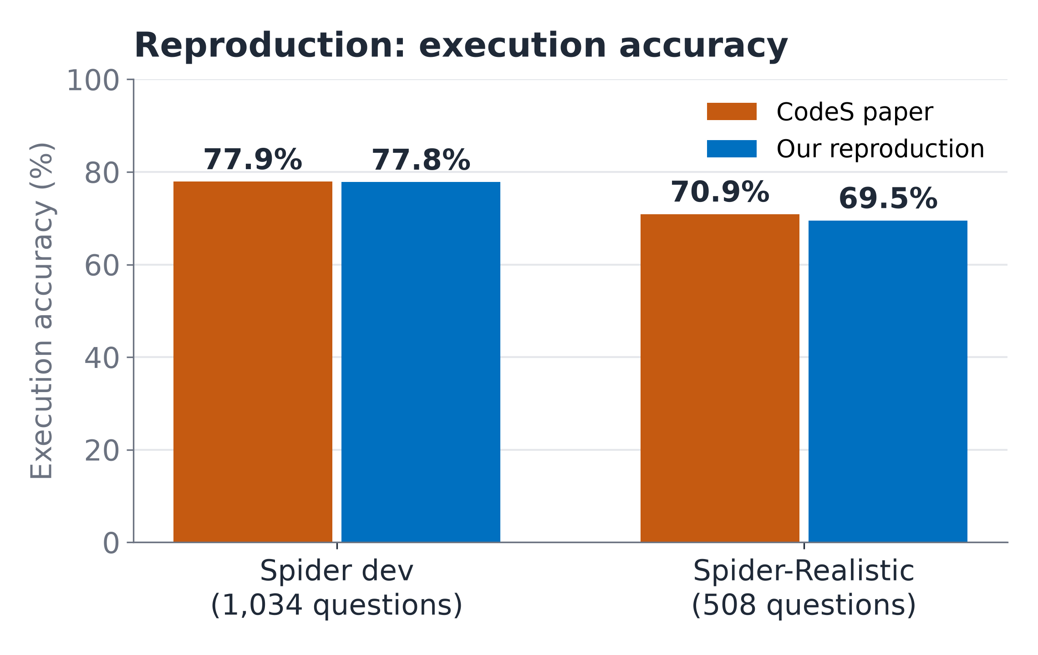
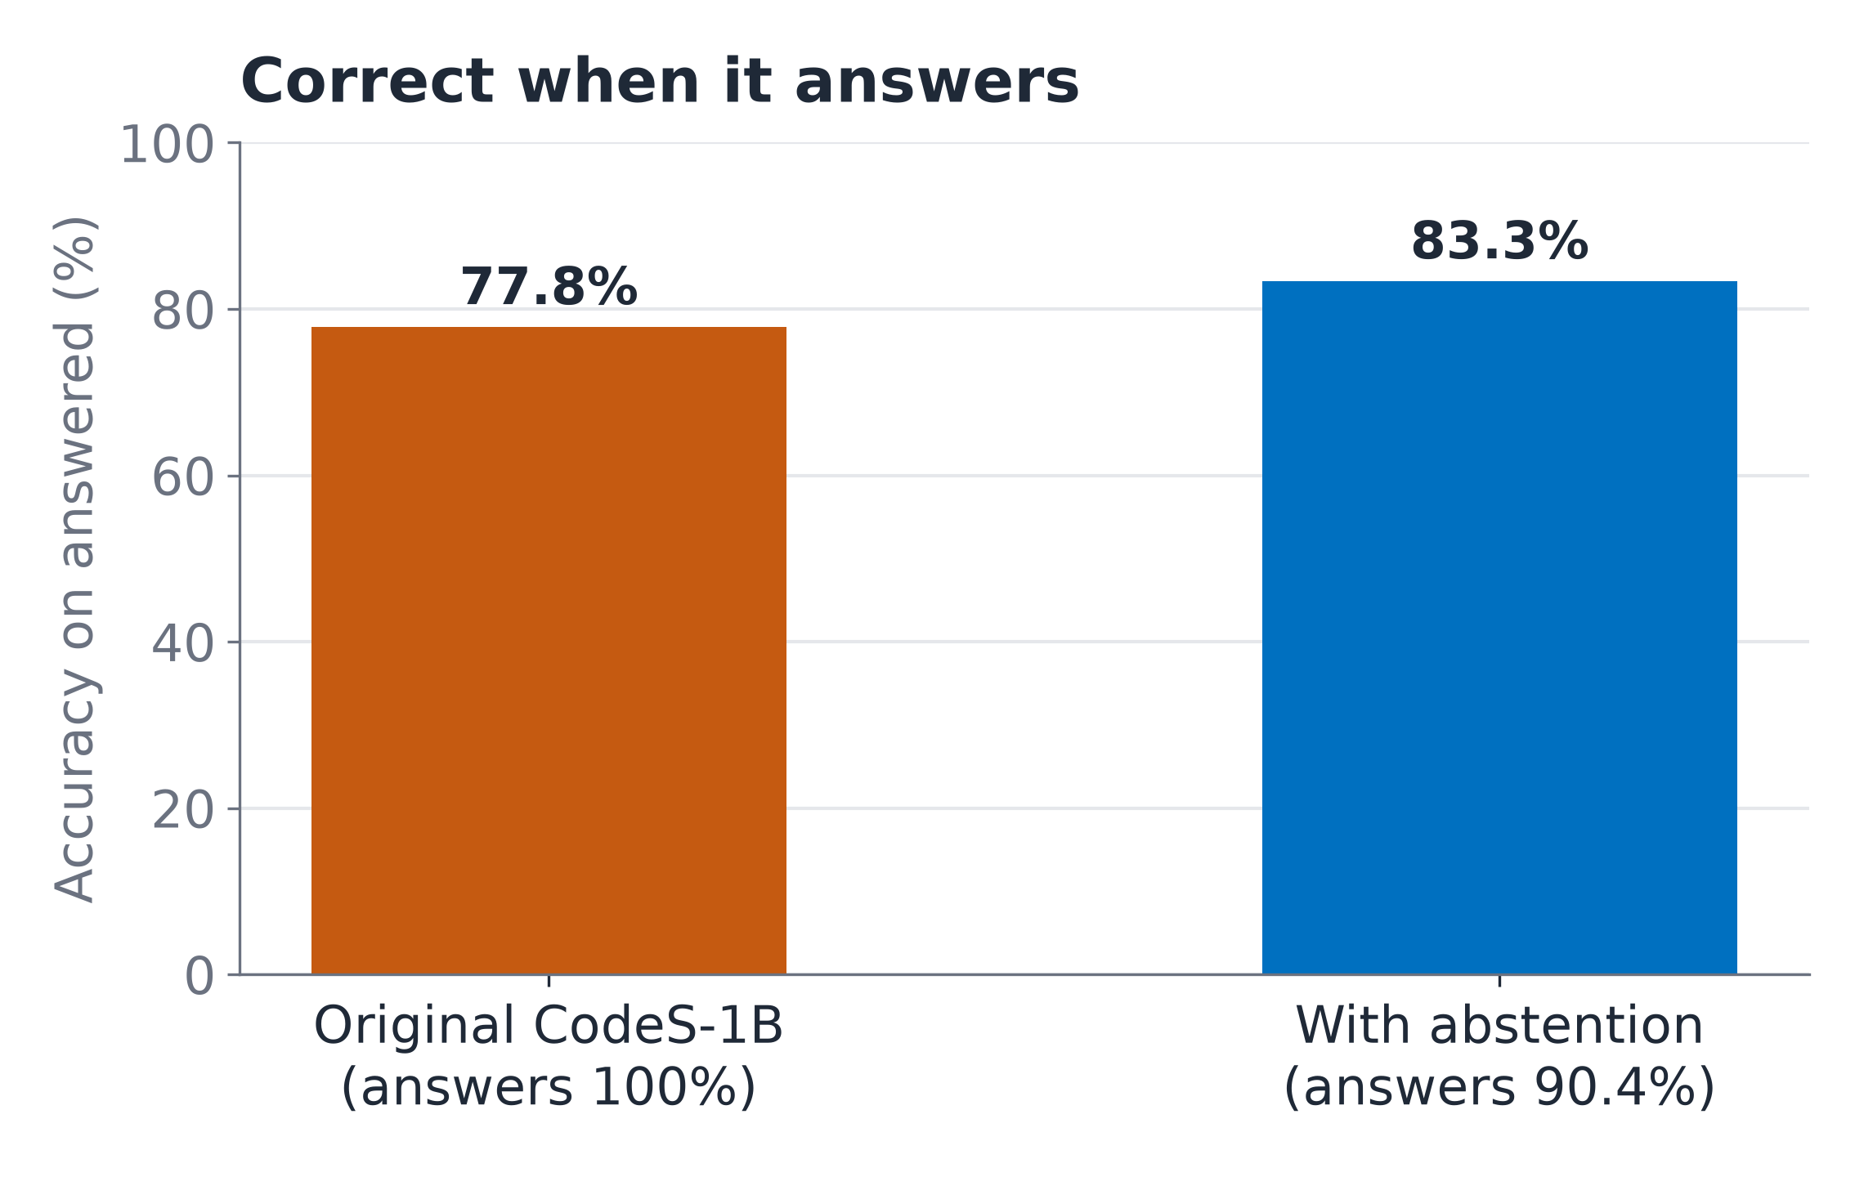
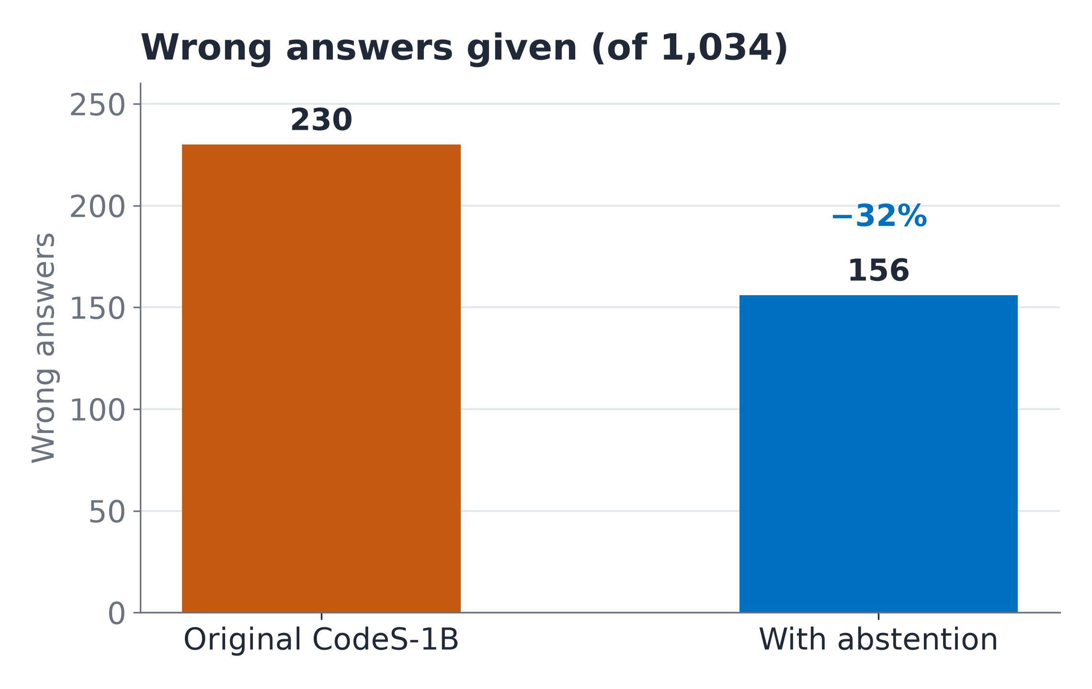
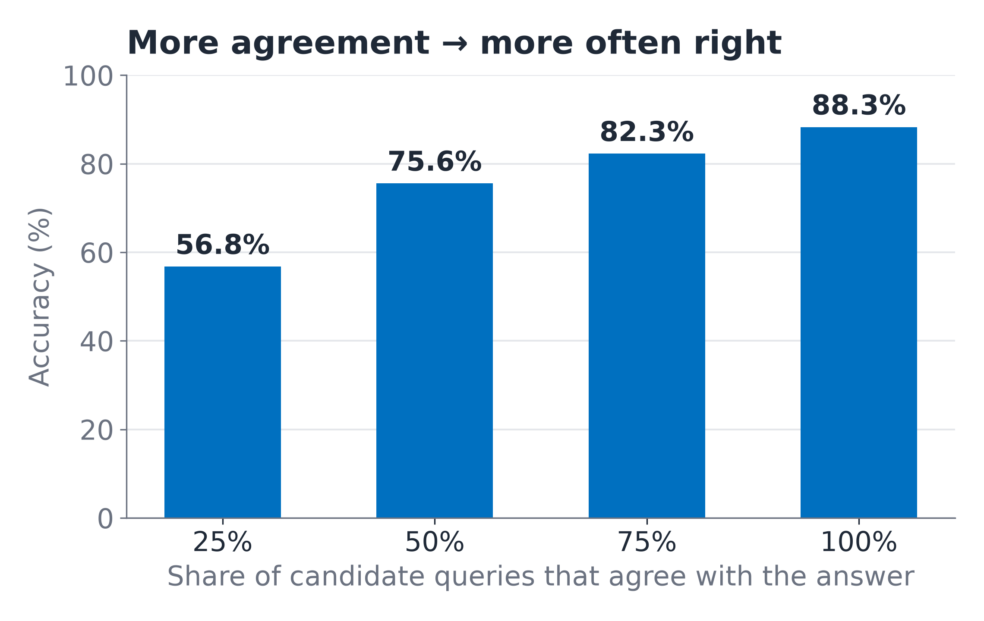
QueryGenie
A Self-Correcting, Confidence-Aware Natural Language to SQL Interface
STUDENTS
INNOVATION
RESEARCH
IMPACT
Abstract
Proposed Methodology / System Architecture
QueryGenie lets anyone ask a database questions in plain English. Text-to-SQL models answer every question with the same confidence, so a wrong answer looks exactly like a right one. We reproduce CodeS (SIGMOD 2024), an open-source text-to-SQL model, to 77.8% execution accuracy on Spider (paper: 77.9%), and add confidence-aware abstention: the system runs every candidate query the model writes and checks whether they agree. When they don't, it asks the user instead of guessing. It answers 90.4% of questions and is right on 83.3% of them, with a third fewer wrong answers — a statistically significant gain. It runs fully locally in a desktop app.
USER QUESTION
“Which student scored the
highest marks in DBMS?”
YOUR DATABASE
SQLite · PostgreSQL · MySQL
opened read-only
DATABASE PROMPT BUILDER
Tables, columns, types, keys, 2 sample values each
Value retriever: stored values that match the question
Objectives
1
Reproduce CodeS-1B on Spider within the ±5–10% tolerance
CODES-1B (FINE-TUNED ON SPIDER)
Beam search → several candidate SQL queries, each scored
2
Find which parts of the CodeS pipeline matter (ablation)
3
Make the system say when it is unsure — tested statistically
4
Measure accuracy on realistically worded questions
EXECUTE ALL CANDIDATES
Read-only; keep the first
valid query (paper's rule)
SELF-CORRECTION
Failed query + error →
the model repairs it
5
Deliver a desktop app that runs fully locally
Key Innovations & Contributions
EXECUTION AGREEMENT · OUR ENHANCEMENT
Share of the different queries that return the same result
1. Confidence-aware abstention
Run all candidate queries, count how many agree; ask “Did you mean…?” when they don't
2. Faithful, audited reproduction
77.8% vs 77.9% with the official evaluator, after auditing our own harness
3. Execution-guided self-correction
A failed query goes back to the model with the database error
CONFIDENT ENOUGH?
Agreement vs a threshold calibrated on Spider (strictness mode)
4. Private by design
Open weights, runs on the user's computer — no schema sent to a third party
yes
no → ask
ANSWER
Table + automatic chart
SQL + how many queries agree
“DID YOU MEAN…?”
No guess: shows the different
readings to choose from
Datasets (Hugging Face — approved source)
Benchmark | Questions | Used for
Spider dev | 1,034 · 20 databases | Reproduction, ablation, enhancement
Spider-Realistic | 508 | Questions without column names
BIRD Mini-Dev | 500 · 11 databases | Real-world databases (future work)
Reproduced from CodeS
Our enhancement
Application
Desktop app (macOS · Windows) · runs locally on open weights
Experimental Results
References
Team Details
[1] Li, H., et al. (2024). CodeS: Towards building open-source language models for text-to-SQL. arXiv:2402.16347.
[2] Yu, T., et al. (2018). Spider: A large-scale human-labeled dataset for complex and cross-domain semantic parsing and text-to-SQL task. arXiv:1809.08887.
[3] Deng, X., et al. (2020). Structure-grounded pretraining for text-to-SQL. arXiv:2010.12773.
[4] Li, J., et al. (2023). Can LLM already serve as a database interface? A big bench for large-scale database grounded text-to-SQLs. arXiv:2305.03111.
[5] Pourreza, M., & Rafiei, D. (2023). DIN-SQL: Decomposed in-context learning of text-to-SQL with self-correction. arXiv:2304.11015.
[6] Wang, X., et al. (2022). Self-consistency improves chain of thought reasoning in language models. arXiv:2203.11171.
[7] Geifman, Y., & El-Yaniv, R. (2017). Selective classification for deep neural networks. arXiv:1705.08500.
[8] Zhong, R., Yu, T., & Klein, D. (2020). Semantic evaluation for text-to-SQL with distilled test suites. arXiv:2010.02840.
❖ Project Guide: M Parameswar, Associate Professor
❖ Project Coordinator: Dr. Jagan Mohan Reddy Danda, Associate Professor
❖ Students (Team 18):
N V V S S Jayakanth Kamisetti
2320090050
Boddupally Narendar
2320090009
M Praneeth Reddy
2320090018
Future Work
• CodeS-3B and more, more diverse candidate queries
• Real-world databases (BIRD)
• A platform for any database (Spark, Snowflake, NoSQL) with access control
Significant: paired t-test p = 7.7×10⁻¹⁰, Wilcoxon p = 9.8×10⁻⁴, bootstrap 95% CI +4.5 to +6.7 points.
Robust: counting each different query only once, accuracy at 90% coverage is still 83.5%.
Department of Computer Science and Information Technology

