Slide 1










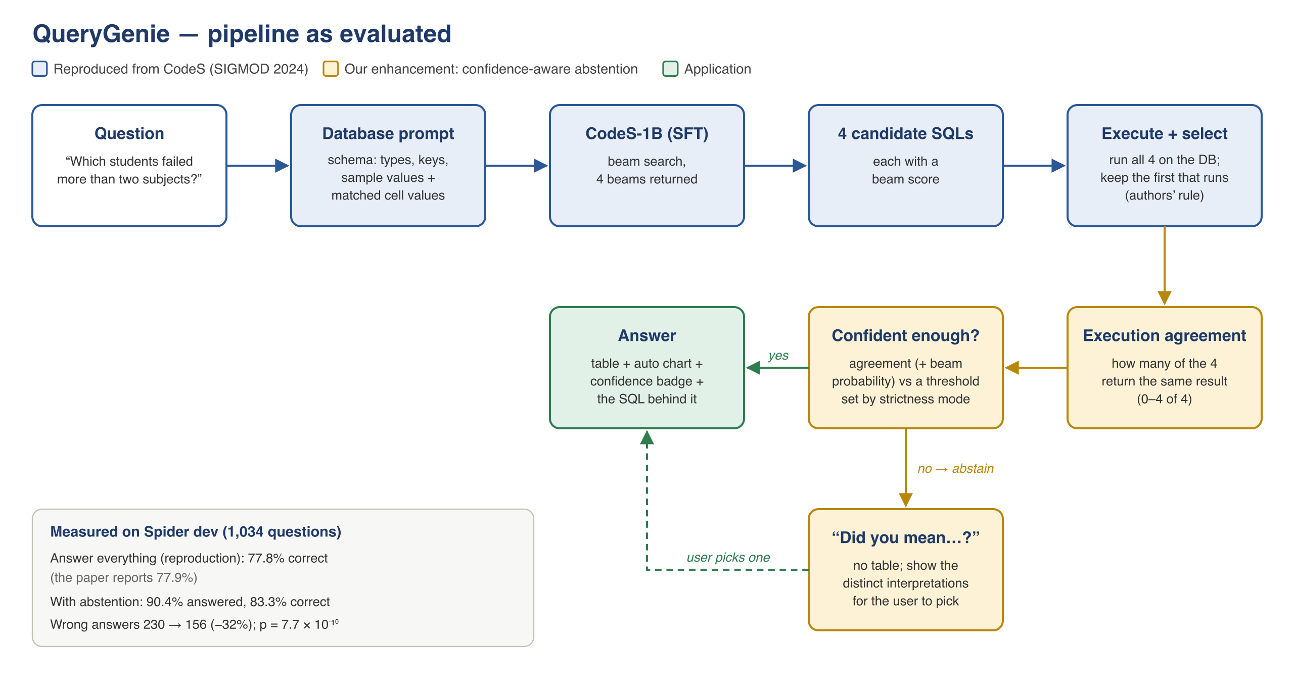

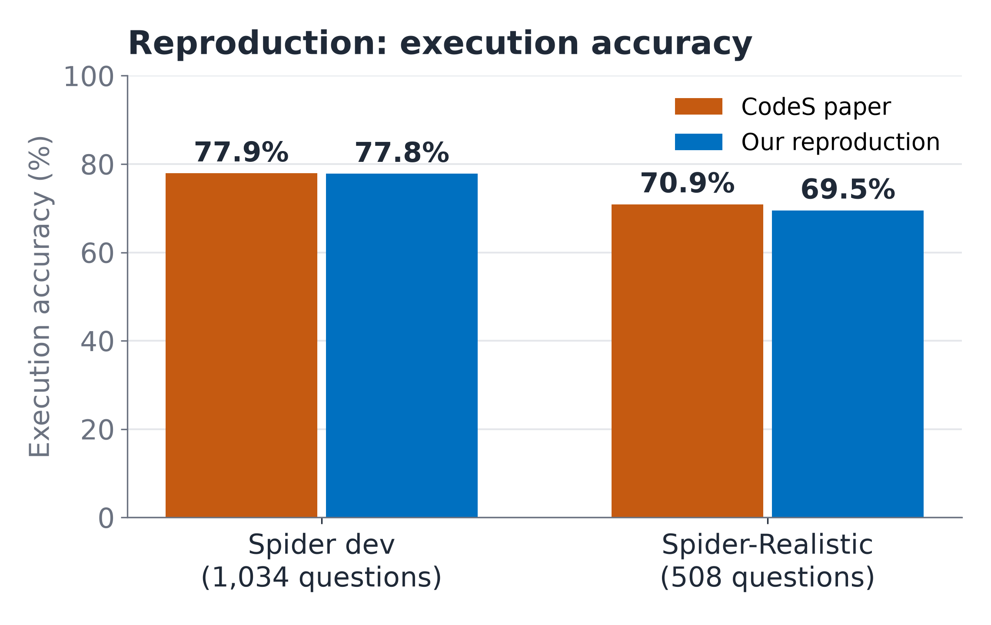
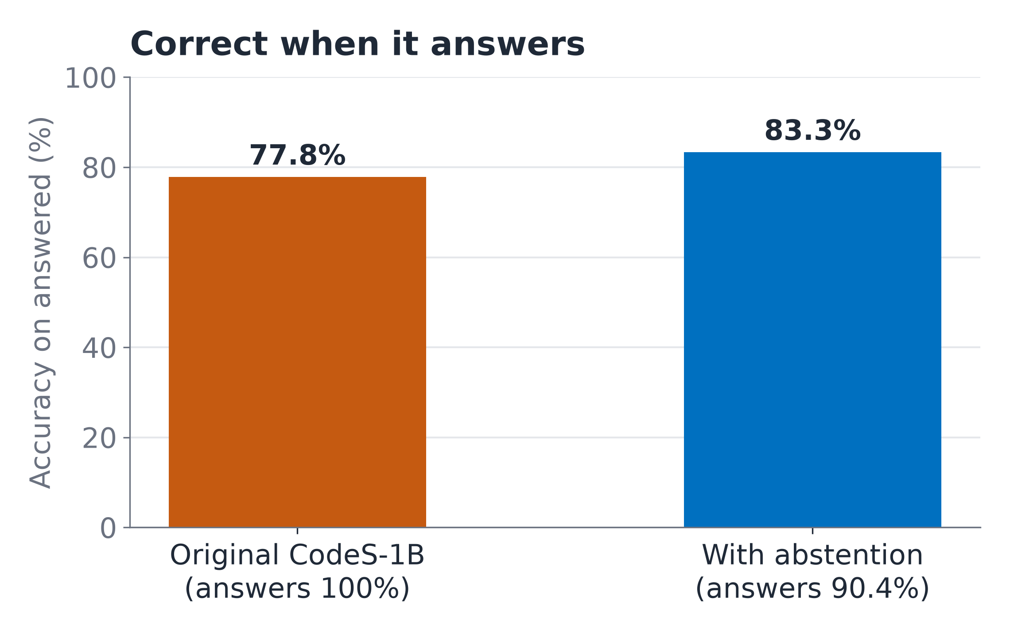



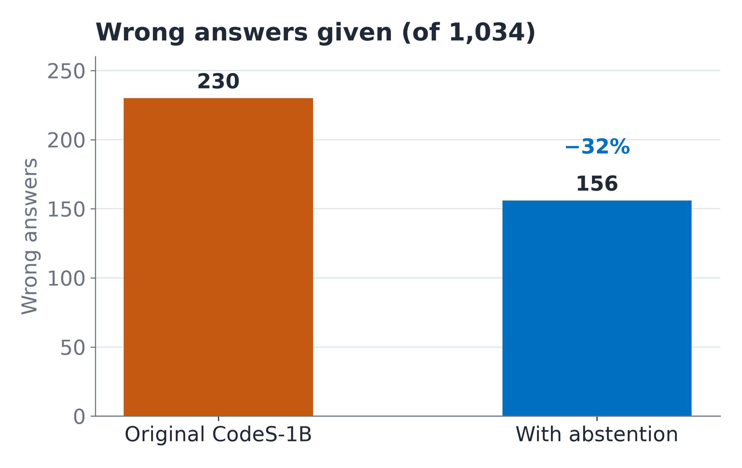
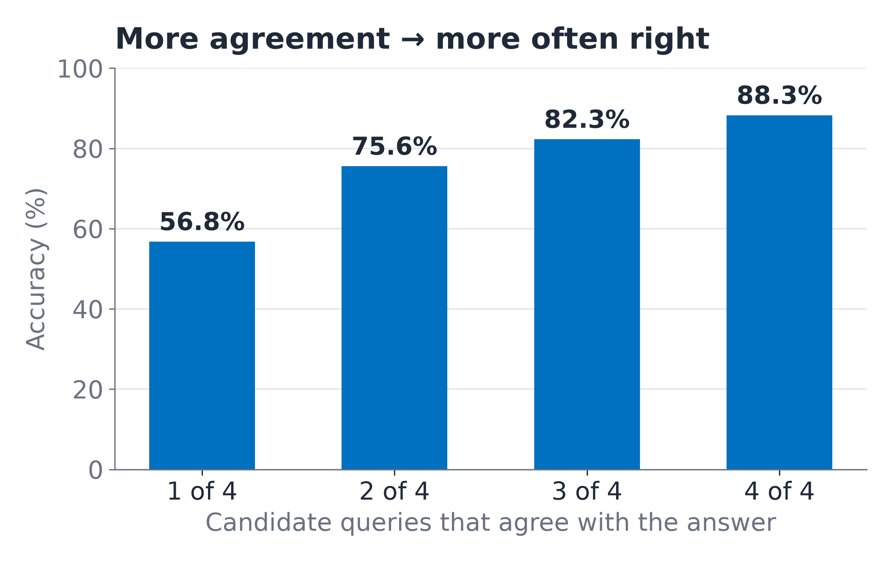
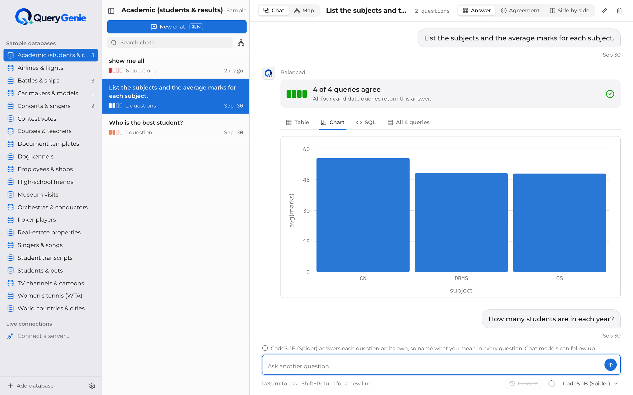
QueryGenie
A Self-Correcting, Confidence-Aware Natural Language to SQL Interface
Ask a database in plain English — and get told when the answer can't be trusted
STUDENTS
INNOVATION
RESEARCH
IMPACT
B.Tech CSIT
Team 18
Confidence-aware abstention
Self-correction
CodeS · SIGMOD 2024
Spider benchmark
Desktop app
Runs locally
Abstract
Proposed Methodology / System Architecture
Text-to-SQL models let people who do not know SQL ask a database questions in plain English, but they answer every question with the same confidence, so a wrong answer looks exactly like a right one. QueryGenie reproduces CodeS (SIGMOD 2024, arXiv:2402.16347), an open-source text-to-SQL model, and makes it say when it is unsure. We reproduce CodeS-1B to 77.8% execution accuracy on Spider (paper: 77.9%) and 69.5% on Spider-Realistic (paper: 70.9%). Our enhancement, confidence-aware abstention, runs the candidate queries the model already generates and checks whether they agree: when they don't, it asks the user instead of guessing. It answers 90.4% of questions and is right on 83.3% of them, with a third fewer wrong answers — a statistically significant gain. Everything runs locally in a desktop app, on open weights.
Objectives
1
Reproduce CodeS-1B on Spider within the ±5–10% tolerance, logging every run.
2
Ablate the CodeS pipeline to find which components matter.
3
Make the system say when it is unsure: confidence-aware abstention, tested statistically.
Datasets — all from Hugging Face (approved source; no Kaggle)
4
Measure the benchmark-to-reality gap on realistically worded questions.
Set | Questions | Used for
Spider dev | 1,034 · 20 databases | Reproduction, ablation, enhancement
Spider-Realistic | 508 | Realistic wording (no column names)
BIRD Mini-Dev | 500 · 11 databases | Real-world databases (set up; future work)
5
Deliver a working desktop application that runs fully locally.
Key Innovations & Contributions
Confidence-aware abstention
Runs every candidate query, counts how many agree, and asks “Did you mean…?” when they don't.
Experimental Results
Faithful, audited reproduction
77.8% vs 77.9% with the official evaluator, after an audit that fixed our own scoring and a value-retriever bug.
Execution-guided self-correction
Failed queries go back to the model with the database error; measured honestly (77.76 → 77.85%).
Local desktop application
Chats, schema map, charts, SQLite / PostgreSQL / MySQL — schema and data never leave the computer.
The Application
Key results
Reproduced: 77.8% EX on Spider (paper 77.9%), 69.5% on Spider-Realistic (paper 70.9%) — within tolerance.
Enhanced: answers 90.4% of questions, correct on 83.3% (vs 77.8%); wrong answers 230 → 156.
Significant: paired t-test p = 7.7×10⁻¹⁰, Wilcoxon p = 9.8×10⁻⁴, bootstrap 95% CI +4.5 to +6.7 pts.
Robust: counting each different query once, it still reaches 83.5% at 90% coverage.
A confident answer: all four candidate queries agree, so QueryGenie shows the table and a chart.
Conclusion & Future Work
References
CodeS reproduced within 0.1 points; abstention makes its answers more trustworthy, running locally.
Next: CodeS-3B and more, more diverse candidate queries; then a platform that plugs into any database (Spark, Snowflake, NoSQL via a SQL gateway) with access control.
[1] Li, H., et al. (2024). CodeS: Towards building open-source language models for text-to-SQL. arXiv:2402.16347.
[2] Yu, T., et al. (2018). Spider: A large-scale human-labeled dataset for complex and cross-domain semantic parsing and text-to-SQL task. arXiv:1809.08887.
[3] Deng, X., Awadallah, A. H., Meek, C., Polozov, O., Sun, H., & Richardson, M. (2020). Structure-grounded pretraining for text-to-SQL. arXiv:2010.12773.
[4] Li, J., et al. (2023). Can LLM already serve as a database interface? A big bench for large-scale database grounded text-to-SQLs. arXiv:2305.03111.
[5] Pourreza, M., & Rafiei, D. (2023). DIN-SQL: Decomposed in-context learning of text-to-SQL with self-correction. arXiv:2304.11015.
[6] Wang, X., et al. (2022). Self-consistency improves chain of thought reasoning in language models. arXiv:2203.11171.
[7] Geifman, Y., & El-Yaniv, R. (2017). Selective classification for deep neural networks. arXiv:1705.08500.
[8] Zhong, R., Yu, T., & Klein, D. (2020). Semantic evaluation for text-to-SQL with distilled test suites. arXiv:2010.02840.
Team Details
Supervisor: M Parameswar, Associate Professor
Team 18
2320090050 – N V V S S Jayakanth Kamisetti
2320090009 – Boddupally Narendar
2320090018 – M Praneeth Reddy
Department of Computer Science and Information Technology

