Slide 1
QueryGenie: A Self-Correcting Natural Language to SQL Interface
2320090050 : N V V S S Jayakanth Kamisetti
2320090009 : Bodupally Narendar
Project Review III
Project Supervisor : M Parameswar

Slide 2
Outline
Abstract
Introduction — problem, objectives, contributions
Literature review
Methodology — reproduction pipeline and the enhancement
Experimental results — reproduction, ablation, enhancement
Final implementation — the QueryGenie application
Code review
GitHub & documentation
Conclusion, lessons learned and future work
References
Notes:
Walk through the order: what the problem is, what others have done, what we built and measured, the working system, the code, and where everything lives.

Slide 3
Abstract
Text-to-SQL systems answer every question with the same confidence — a wrong table looks as authoritative as a right one.
We reproduced CodeS (SIGMOD 2024), an open-source text-to-SQL model: 77.8% execution accuracy on Spider dev vs 77.9% reported.
We added confidence-aware abstention: execute the model's 4 candidate queries, and when they disagree, ask the user instead of answering.
Result: 83.3% accuracy on the 90.4% of questions it answers; wrong answers 230 → 156 (−32%); significant (t-test p = 7.7 × 10⁻¹⁰).
Delivered as a local web application — runs on open weights, no data leaves the machine.
Notes:
Say this in 30 seconds: we reproduced CodeS to within 0.1 points, and our enhancement lets the system say when it isn't sure — which cuts wrong answers by a third, with a significant result.

Slide 4
Introduction
Problem. Much institutional data lives in relational databases, but querying it needs SQL. Language models can write the SQL — yet never say when they might be wrong.
Objectives
  Reproduce the published CodeS results within the SOP tolerance (±5–10%), documenting every deviation
  Identify which parts of the pipeline matter (ablation study)
  Propose, build and statistically test one enhancement: confidence-aware abstention
  Deliver it as a working application, not a notebook
Contributions: faithful reproduction with an audited evaluation harness · ablation study · abstention with a pre-registered hypothesis · the QueryGenie app
Notes:
Problem → objectives → contributions. Emphasise the trust angle: a non-SQL user cannot tell a wrong answer from a right one.

Slide 5
Literature Review (44 papers, 5 themes)
Theme | Representative work | What we took from it
Surveys | Hong et al. 2025 (TKDE); Liu et al. 2025 (TKDE); Qin et al. 2022 (TKDE) | LLM era; execution accuracy preferred over exact match
Benchmarks | Spider (2018), BIRD (2023), Spider-Syn/-DK/-Realistic | Spider dev as the reproduction target
Pre-LLM methods | RAT-SQL, BRIDGE, PICARD, RESDSQL (backup anchor) | Schema linking is the main bottleneck
LLM methods | DIN-SQL, DAIL-SQL, MAC-SQL, CHESS, CHASE-SQL, CodeS (anchor) | Self-correction and multi-candidate selection improve EX; most rely on closed GPT-4
Visualisation | LIDA (ACL 2023) | Automatic charts for query results
Added for the enhancement: selective classification (Geifman & El-Yaniv, 2017), self-consistency (Wang et al., 2022), test-suite evaluation (Zhong et al., 2020).
Gap: CodeS reports accuracy only when every question is answered — it gives no signal of when an answer may be wrong.
Notes:
From the Review-1 survey. The key point: the field moved to LLMs; schema linking and multi-candidate selection help; closed models raise privacy/cost concerns — CodeS answers that with open weights. None of the accuracy numbers we compared come with a confidence estimate.

Slide 6
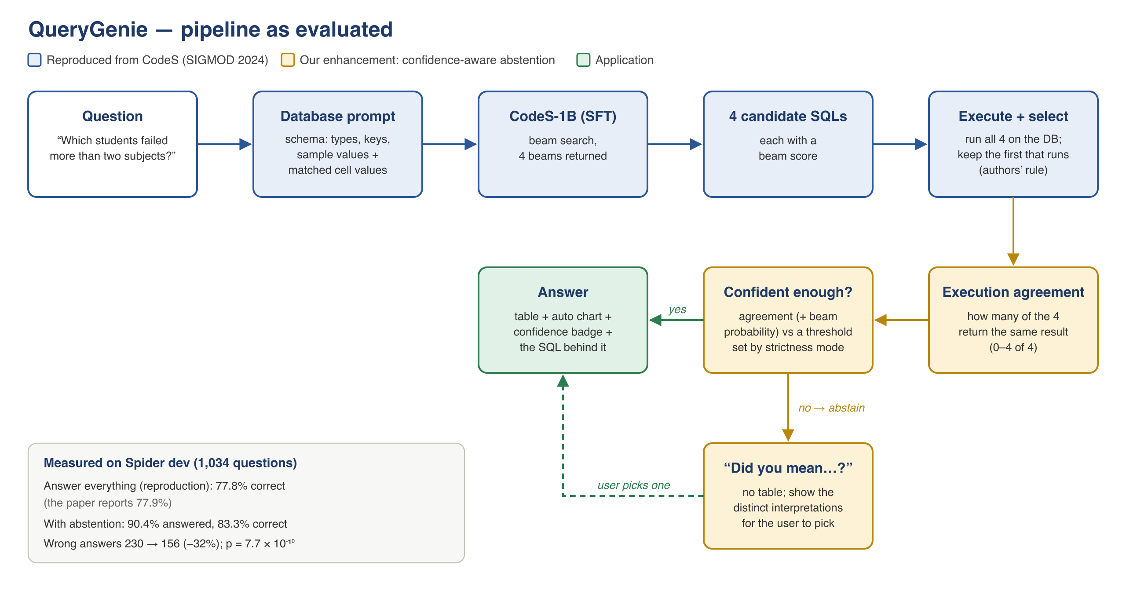
Methodology — Pipeline as Evaluated
Notes:
Blue = reproduced from the paper; amber = our enhancement; green = the app. The same code runs in the evaluation and in the app, so what we measured is what we ship.

Slide 7
Methodology — Reproduction
Scope: released fine-tuned checkpoint seeklhy/codes-1b-spider; inference-only (the authors' pre-training used 8 × A800 80 GB)
Environment: Colab Tesla T4, fp16, batch size 1 (as the authors); PyTorch 2.11 / transformers 5.16 (paper: 1.13.1 / 4.28.1)
Pipeline: authors' database prompt (schema + values + matched cells), 4 beams, first candidate that SQLite accepts
Scoring: the official Spider test-suite evaluator — what the authors call
Audit of our harness against the authors' code found and fixed:
  a value-retriever bug — numbers never matched (12.4% of prompts)
  a scoring mismatch — our early metric was 4.4 points stricter than the paper's
Every run logged with seed, hardware, runtime and versions; decoding is deterministic
Notes:
Inference-only, because pre-training needs 8×A800. Stress the audit: we compared our harness line by line with the authors' code and found two real problems — that is why the number went from 73.8 to 77.8.

Slide 8
Experimental Results — Reproduction
Run | Configuration | Metric | Execution accuracy | vs paper 77.9%
T2-001 | schema + foreign keys only (Apple M4) | simple | 64.8% | not comparable
T2-002 | authors' full database prompt (Colab T4) | simple | 71.7% | not comparable
T2-003 | + authors' candidate selection | simple | 73.8% | not comparable
T2-005 | audited harness (v2) | official | 77.8% | −0.1 pts ✓
T2-006 | fresh re-run (Week-10 baseline) | official | 77.76% (804/1034) | −0.14 pts ✓
Spider development set, 1,034 questions. Within the SOP's ±5% band. Test-suite accuracy (paper 72.2%): TBD.
Notes:
Only T2-005/T2-006 use the paper's metric. The earlier runs are real but measured with our simplified metric — we keep them in the log and explain them rather than hiding them.

Slide 9
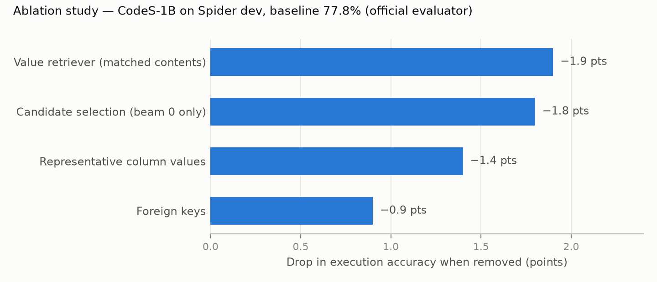
Experimental Results — Ablation Study
Without the value retriever, 97.2% of queries still execute — they return wrong rows. Silent errors motivate abstention.
Notes:
Every component helps. The value retriever matters most — and without it the queries still run, they are just wrong. That observation is what motivated the enhancement.

Slide 10
Methodology — Confidence-Aware Abstention
Why: 97.3% of queries already execute — self-correction could recover ≤ 2.7 points. The real errors run but are wrong.
Method: execute all 4 beam candidates; confidence = how many return the same result (beam probability breaks ties)
Below the threshold → abstain: no table, show the distinct interpretations — “Did you mean…?”
Hypothesis (fixed before results): at equal coverage, accuracy on answered questions beats random abstention and the 77.8% baseline
Protocol: 10 random 50/50 splits — threshold tuned on one half (≥ 90% coverage), tested on the other; paired t-test + Wilcoxon (α = 0.05); plus a question-level bootstrap
Notes:
Why not self-correction? Only 2.7% of queries fail to run, so repairing them can gain at most 2.7 points. The errors are queries that run but are wrong — so we measure agreement instead.

Slide 11
Experimental Results — Enhancement
System | Answered | Accuracy on answered | Wrong answers
Original (reproduced CodeS-1B) | 1,034 (100%) | 77.76% | 230
Enhanced — tested setting | 935 (90.4%) | 83.32% | 156
Enhanced — 3 of 4 agree | 649 (62.8%) | 86.13% | 90
Enhanced — all 4 agree | 412 (39.8%) | 88.35% | 48
Test (10 splits) | Gain | Statistic | p-value
Paired t-test | +5.46 pts | t = 24.44 (df 9) | 7.7 × 10⁻¹⁰
Wilcoxon signed-rank | all 10 positive | W = 55 | 9.8 × 10⁻⁴
Bootstrap over questions | +5.68 pts | 95% CI [+4.51, +6.71] | 0 of 5,000 ≤ 0
Notes:
Read the bold row. Then the trade-off: it declines 99 questions, 74 of which would have been wrong. Always say the coverage with the accuracy.

Slide 12
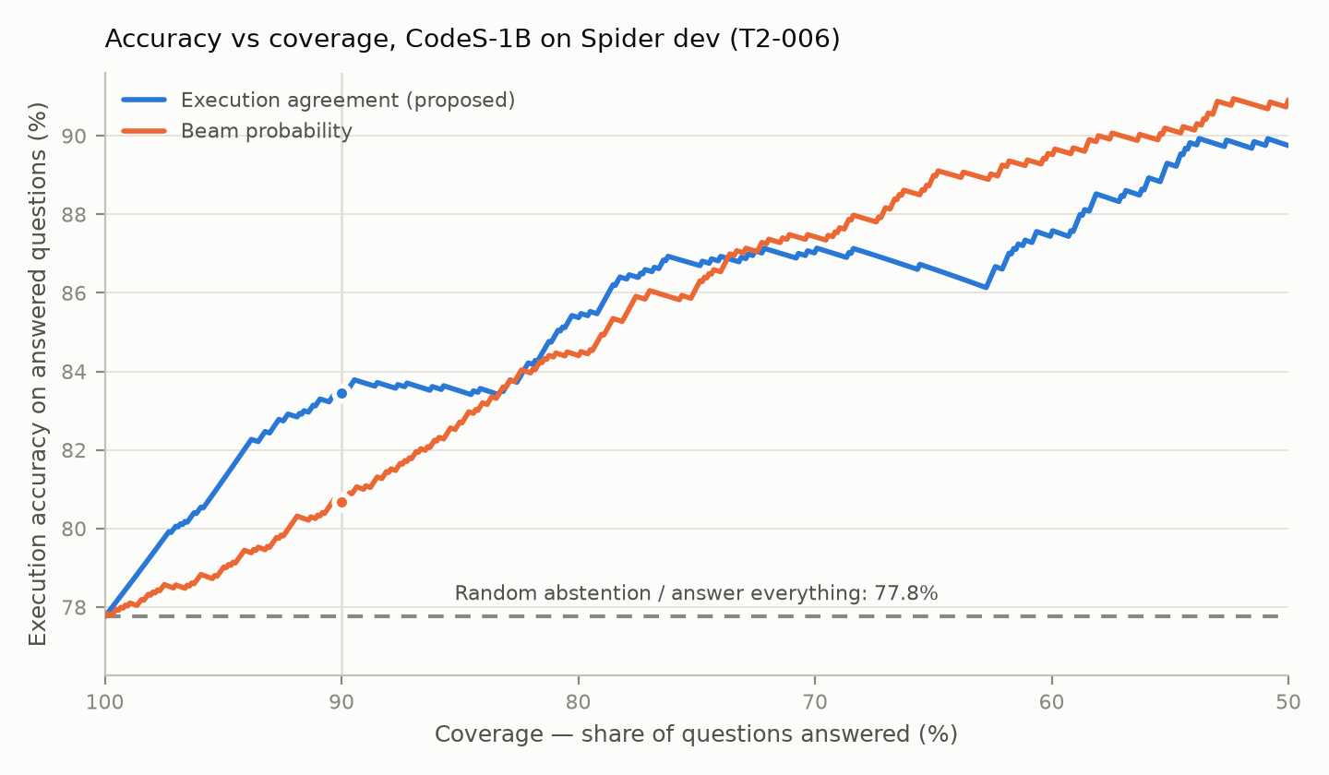
Experimental Results — Accuracy vs Coverage
Agreement is calibrated: 57% / 76% / 82% / 88% accurate when 1 / 2 / 3 / 4 candidates agree. Beam probability wins below ~74% coverage.
Notes:
Honest point: beam probability (orange) is better when abstaining on more than a quarter of questions; agreement (blue) wins in the region a usable assistant operates in, which is where we set the operating point in advance.

Slide 13
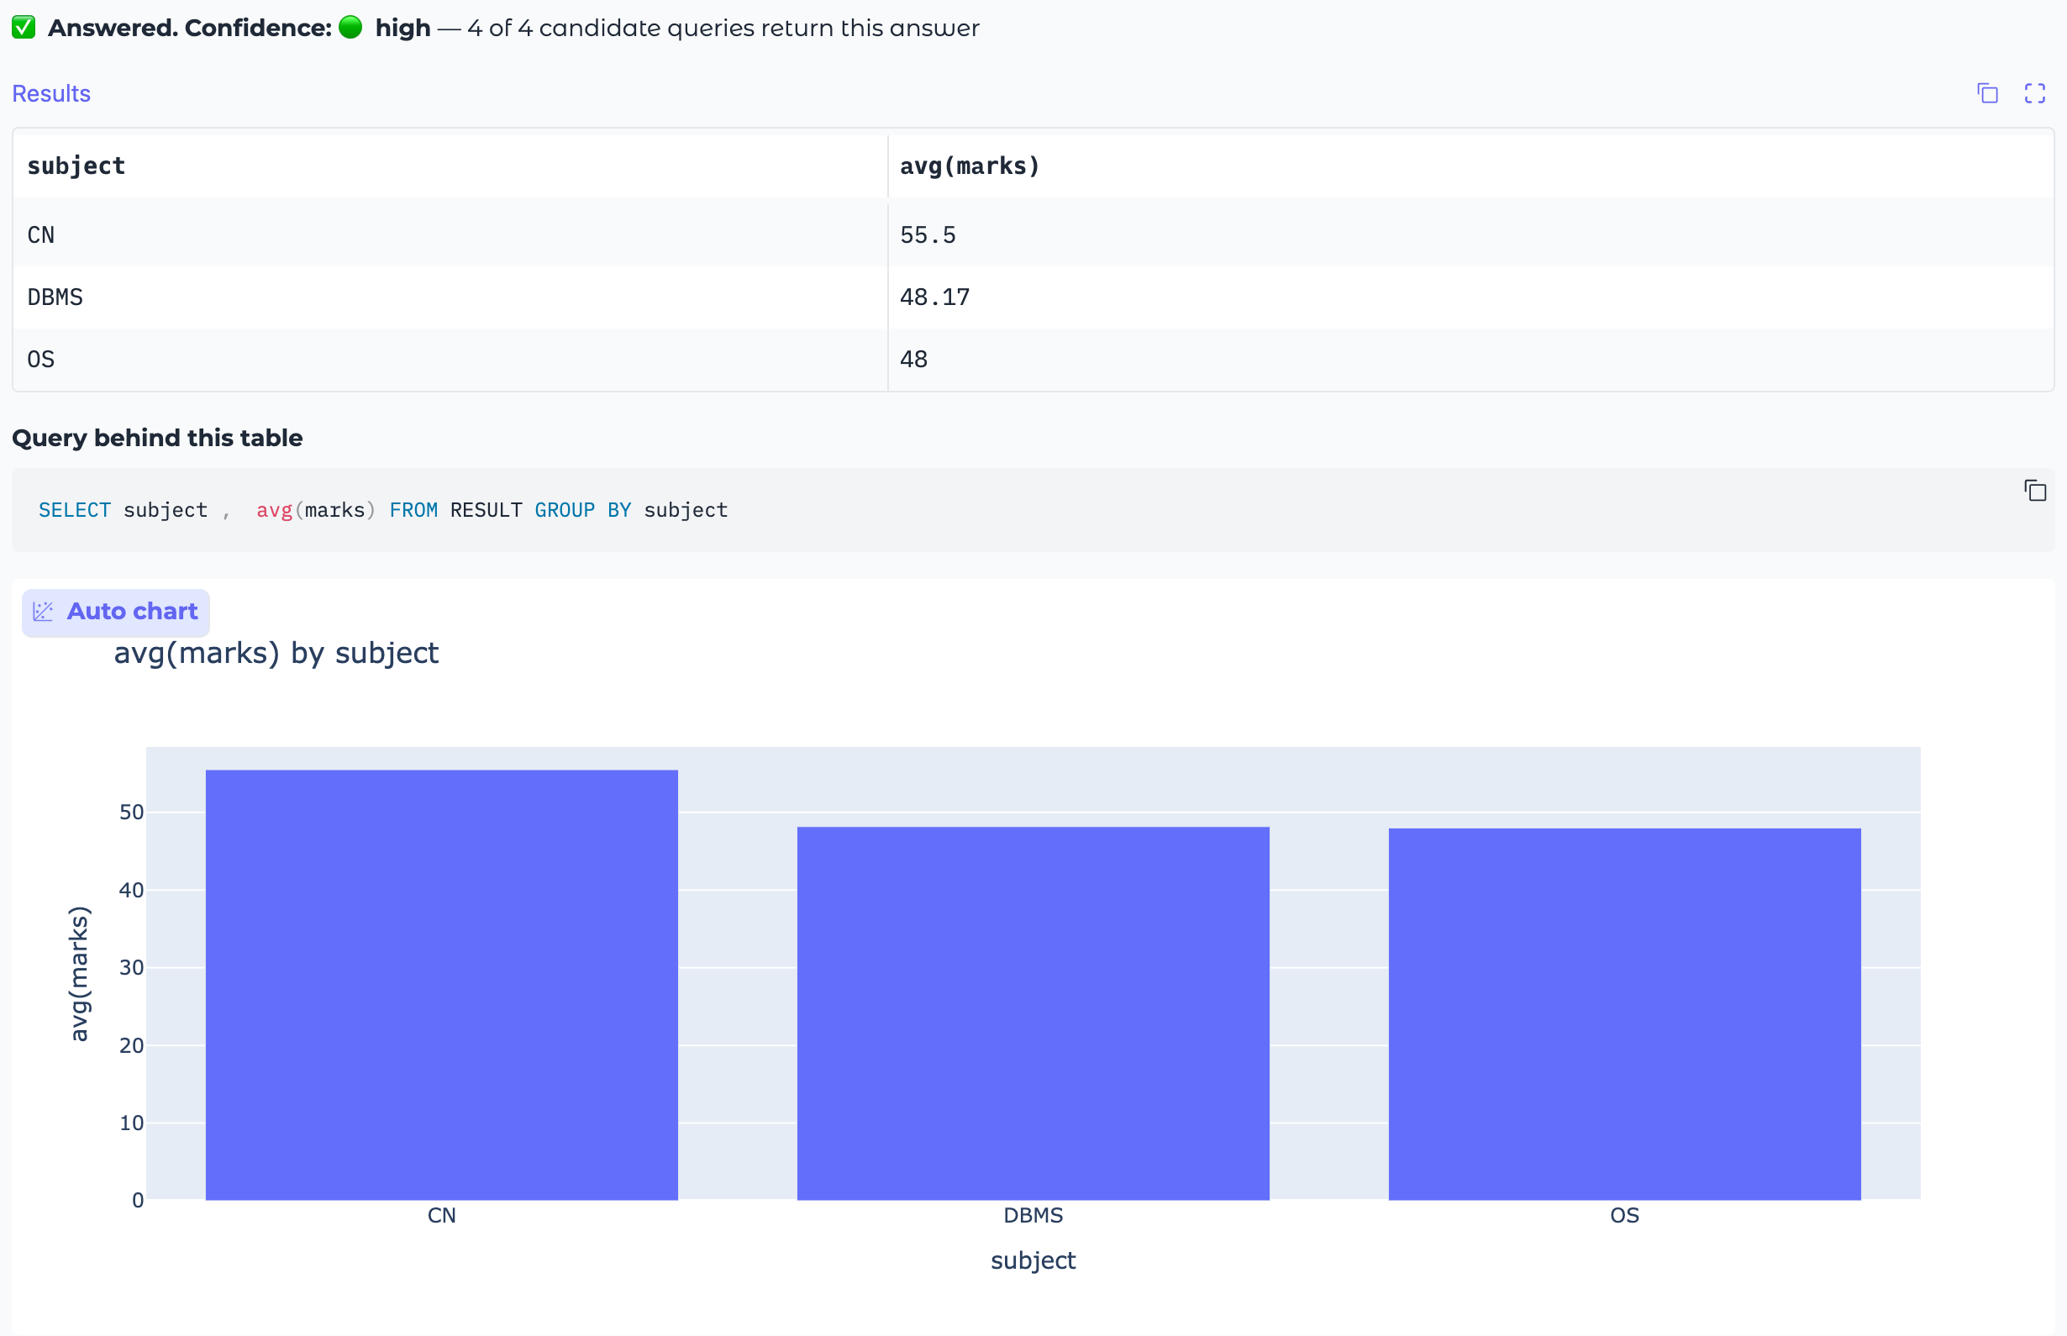
Final Implementation — QueryGenie App
Gradio web app · evaluated pipeline (CodeS-1B/3B) · confidence badge · SQL behind every table · automatic chart · optional 4-bit MLX / GGUF models
Notes:
Live demo here if possible. Point at the confidence badge, the SQL behind the table, and the automatic chart. Everything runs locally.

Slide 14
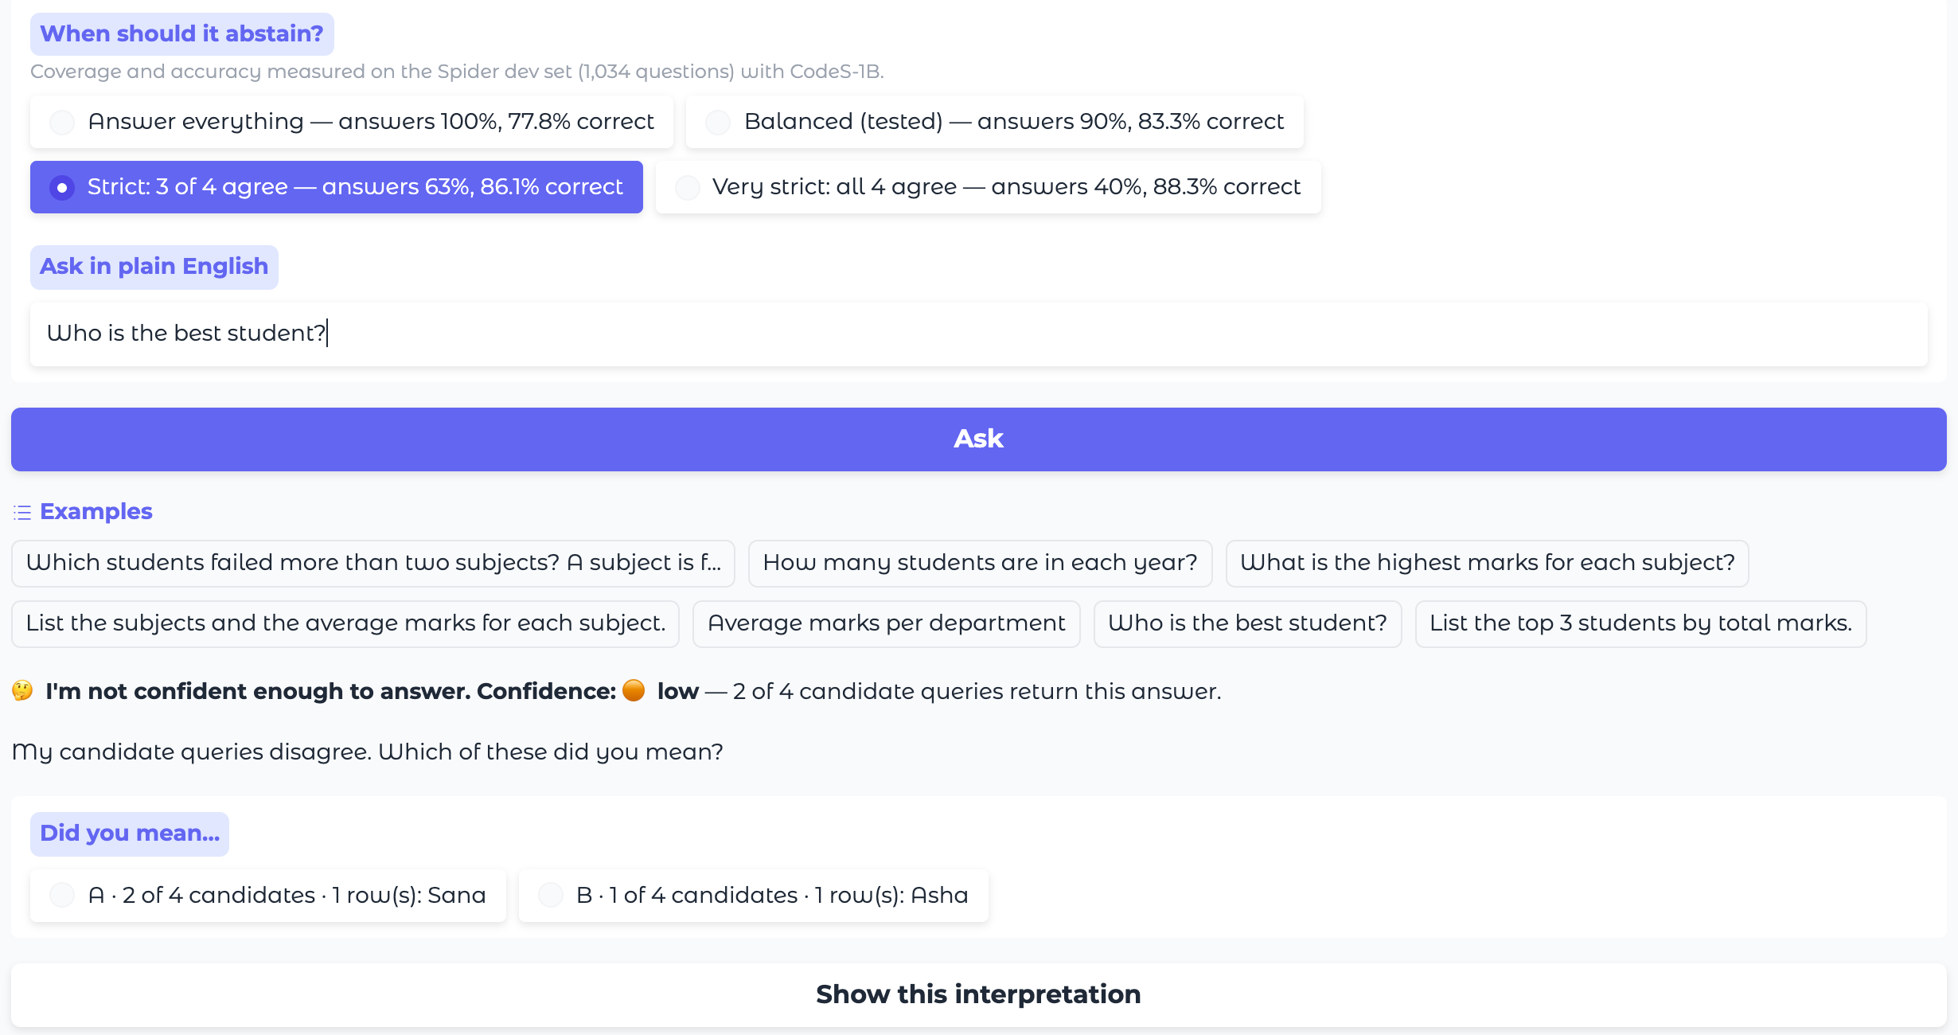
Final Implementation — “Did you mean…?”
Strict mode: the candidates disagree, so no table is shown — the user picks the intended reading.
Notes:
“Who is the best student?” is genuinely ambiguous. In strict mode the app refuses to guess and offers the two readings. The strictness options show accuracy measured on Spider, not marketing numbers.

Slide 15
Code Review
Structure: src/codes_prompt.py (evaluated pipeline) · engine.py (answer/abstain) · model.py (backends) · app.py (UI) · abstention.py (statistics)
One pipeline, two uses: the same code is measured on Spider and served in the app
Faithful by construction: authors' utilities vendored unmodified (Apache-2.0); prompts verified identical after refactoring (104 questions)
Tests: 9 model-free tests of selection, agreement, abstention and modes — pytest, < 1 s
Reproducible: Colab notebook reruns every number; candidate record committed; every run in the log with seed, hardware and versions
Safe to run: local weights, query timeouts, no data sent to third parties
Notes:
Key design decision: one shared module (codes_prompt.py) is used by both the evaluation and the app. The prompts were checked identical on 104 questions after refactoring. Tests run in under a second without the model.

Slide 16
GitHub & Documentation
Repository: github.com/jayakanthh/QueryGenie (supervisor added as collaborator)
README: how to run the app, how to reproduce every result, how to run the enhancement analysis, requirements, licence (Apache-2.0)
Reports: final report (Abstract → Introduction → Literature → Methodology → Results → Discussion), reproducibility report v2, enhancement proposal, Week-12 comparative results
Evidence: reproduction log (CSV + Excel), harness audit, ablation study, abstention results, figures
Weekly reports: Weeks 1–12
Notes:
Show the README and the results folder. The LaTeX documentation will follow the department template.

Slide 17
Conclusion, Lessons Learned & Future Work
Reproduced CodeS-1B to within 0.1 points of the paper (77.8% vs 77.9%)
Enhanced it to say when it isn't sure: 83.3% accuracy at 90% coverage, wrong answers −32%, significant
Lesson: reproducing a result means reproducing its evaluation — 4.4 points of our early gap was our own metric
Limits: one model, one benchmark; candidates can agree on a wrong answer (11.7% of 4/4 answers)
Future work: test-suite accuracy · CodeS-3B · combined confidence signal · real institutional schemas · PostgreSQL/MySQL connectors and NoSQL via a SQL gateway
Notes:
The lesson that matters most: reproducing a result means reproducing the evaluation, not only the model — 4.4 points of our apparent gap was our own scoring.

Slide 18
References
Li, H., et al. (2024). CodeS: Towards building open-source language models for text-to-SQL. SIGMOD. arXiv:2402.16347
Yu, T., et al. (2018). Spider: A large-scale human-labeled dataset for complex and cross-domain semantic parsing and text-to-SQL task. EMNLP. arXiv:1809.08887
Zhong, R., Yu, T., & Klein, D. (2020). Semantic evaluation for text-to-SQL with distilled test suites. EMNLP. arXiv:2010.02840
Pourreza, M., & Rafiei, D. (2023). DIN-SQL: Decomposed in-context learning of text-to-SQL with self-correction. NeurIPS. arXiv:2304.11015
Wang, X., et al. (2023). Self-consistency improves chain of thought reasoning in language models. ICLR. arXiv:2203.11171
Geifman, Y., & El-Yaniv, R. (2017). Selective classification for deep neural networks. NeurIPS. arXiv:1705.08500
Li, H., et al. (2023). RESDSQL: Decoupling schema linking and skeleton parsing for text-to-SQL. AAAI. arXiv:2302.05965
Dibia, V. (2023). LIDA: A tool for automatic generation of grammar-agnostic visualizations and infographics using large language models. ACL. arXiv:2303.02927

Slide 19
Thank you
Notes:
Open for questions. Likely ones: why not self-correction (2.7-point ceiling); how is this different from ChatGPT (knows when it doesn't know, runs locally); why 77.8 not 78+ (we reproduce, not tune; abstention gives 83.3 at 90% coverage).

