Slide 1
FINAL PROJECT
JAYAKRISHNAA KALIKI

Slide 2
AGENDA
Sign language has indelibly become the ultimate panacea and is a very powerful tool for individuals with hearing and speech disability to communicate their feelings and opinions to the world. It makes the integration process between them and others smooth and less complex. However, the invention of sign language alone, is not enough . There are many strings attached to this soon. The sign gestures often get mixed and confused for someone who has never learnt it or knows it in a different language. However, this communication gap which has existed for years can now be narrowed with the introduction of various techniques to automate the detection of sign gestures using Convolutional Neural Network.

Slide 3
PROBLEM STATEMENT
To design a real time software system that will be able to recognize Sign Language hand-gestures using machine and deep learning techniques. This project aims to predict the 'alphanumeric' gesture of the Sign Language System.

Slide 4
PROJECT OVERVIEW
Artificial Intelligence is a tool that has the potential to make our lives easier and, in some cases, remove obstacles. For example, artificial intelligence could be used to take video feeds of people using sign language and translating the signs into words. This could help remove communication obstacles with sign language users with their coworkers and personal relationships.
Such an application would consist of computer vision and natural language processing, but the first step would be to accurately detect and classify sign language signs using computer vision.
In this notebook we will be applying a convolutional neural network to classify a dataset of Sign Language alphabet images.

Slide 5
WHO ARE THE END USERS ?
Most commonly used by deaf & dumb people who have hearing or speech problems to communicate among themselves or with normal people.
According to the World Federation of the Deaf, there are more than 70 million deaf people worldwide. More than 80% of them live in developing countries.

Slide 6
YOUR SOLUTION AND IT’S VALUE PREPOSITION
We were able to take images of the Sign Language alphabet and use a CNN model to learn the alphabet and make predictions on new images. When training our CNN model, the training results were 95% accuracy but the validation results had an accuracy of 98%. When applying the CNN model on our test images we got the result of 98% accuracy.

Slide 7
THE WOW IN YOUR SOLUTION
I am able to get an accuracy of 90% according to the classification report. The biggest take away for me was that the Batch Normalization and Dropout layers really helped with increasing the accuracy. The Dropout layers seemed to really smooth out the training results as well.

Slide 8
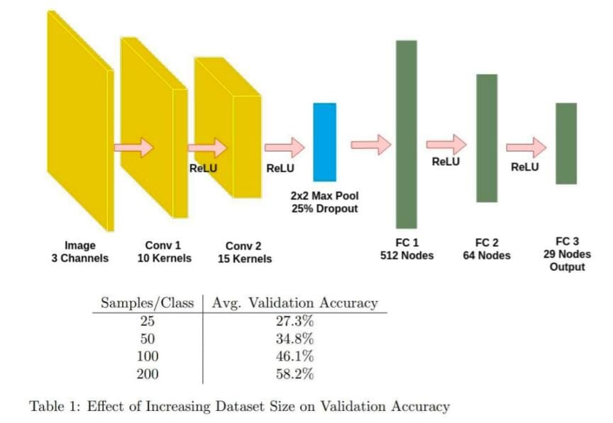
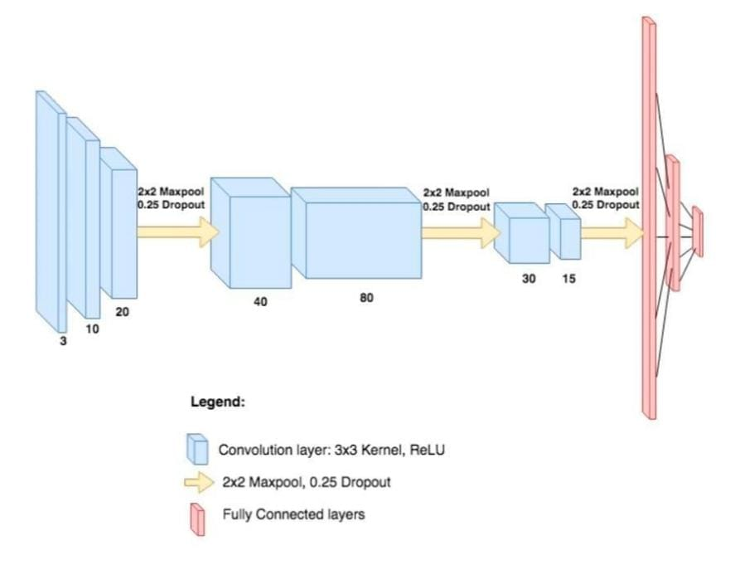
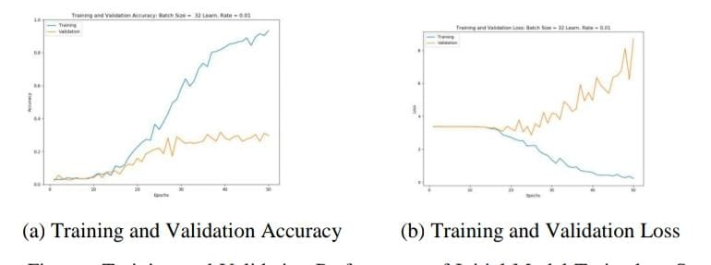
MODELING
We will take the images in the Train set and we will split them into training and validation sets. While training the model, we will use the new train set to train the model and the validation set to validate the results.
Once the model has been trained, we will take the pixel data from the test set and predict the labels for each test image.
Then we will evaluate the model's performance by looking at a classification report.

Slide 9
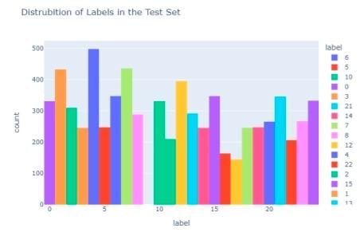
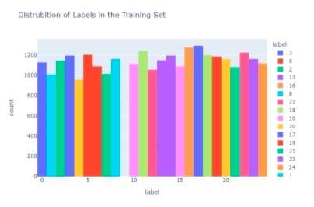
RESULTS
Sign Language Recognition has long since advanced beyond classifying isolated signs or alphabet forms for finger spelling. While the field may continue to draw on the advances in GR he focus has shifted to approach the more linguistic features associated with the challenge. Work has developed on extracting signs from continuous streams and using linguistic grammars to aid recognition.
Finally, to compound all these challenges, there is the issue of signer independence. While larger data sets are starting to appear, few allow true tests of signer independence over long continuous sequences. Maybe this is one of the most urgent problems in SLR that of creating data sets which are not only realistic, but also well annotated to facilitate machine learning. Despite these problems recent uses of SLR include translation to spoken language, or to another sign language when combined with avatar technology

Slide 10
THANK YOU

