Slide 1
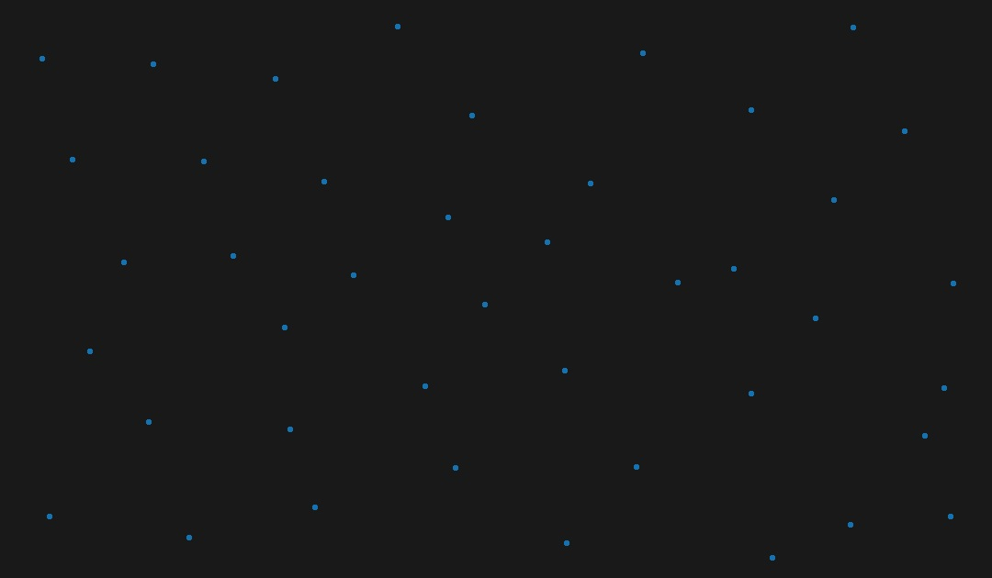
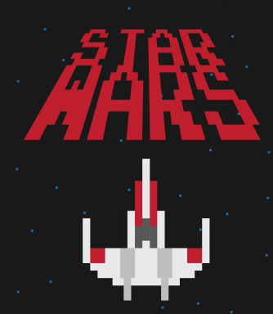
Drone-X
how do we teach a robot to learn?
- Jayaram J
- Jayakrishnan Nampoothiri C.N.
- Aadil Jayasy

Slide 2
Objective
To evolve a neural network from scratch to control a drone to evade randomly generated obstacles.
Neural Network is evolved using an algorithm called NeuroEvolution through Augmenting Topologies.

Slide 3
Modules
Our project has mainly 2 modules.
The Drone Simulation Module which displays and controls the graphics of the drone traversing a random environment
The Artificial Intelligence module which implements the N.E.A.T algorithm from scratch and uses it to control the drone.

Slide 4
The Simulation Module
The purpose of this module is to handle the various graphics and physics simulations of the drone traversing a randomly generated environment.
Made in C++ using OpenGL, SOIL and SDL libraries.
OpenGL for graphics
SOIL for image and texture rendering.
SDL for other media like sound effects if any.

Slide 5
The Artificial Intelligence Module
The purpose of this module is to take in the inputs to the neural network from the simulation module, compute the output and relay it back to the simulation for the drone to make the appropriate move.
In this module, we implement the “NeuroEvolution through Augmenting Topologies” algorithm from scratch.
Completely made in pure C++14

Slide 6
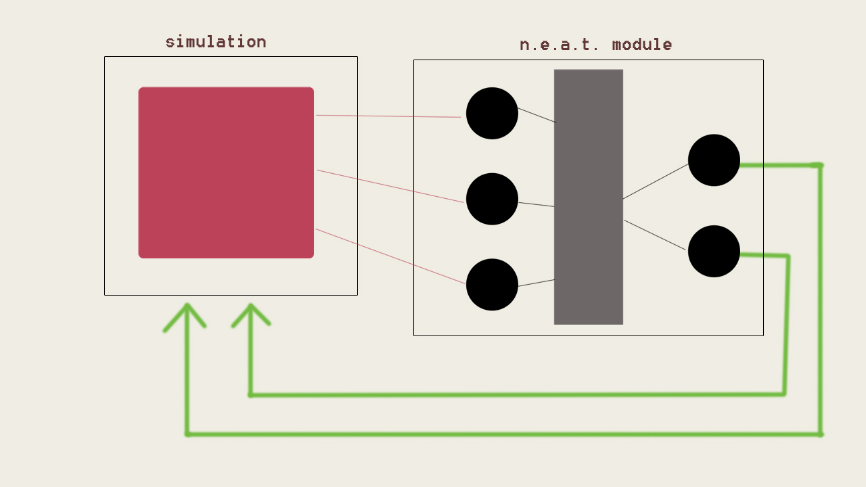
Data Flow

Slide 7
The N.E.A.T. Algorithm

Slide 8
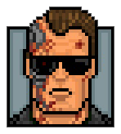
What are genetic algorithms?
A genetic algorithm is a search heuristic which mimics the process of natural selection in evolution.
It is routinely used to generate useful solutions to optimization and search problems.
Genetic algorithms use techniques inspired by natural evolution, such as inheritance, mutation, selection and crossover.

Slide 9
Main operations of a GA
Most genetic algorithms have mainly 3 operations in common:
Reproduction/Selection
Crossover
Mutation

Slide 10
N.E.A.T.
NEAT is a method to evolve a neural network that is optimal to perform a certain task.
The neural network starts with minimal structure (no nodes in hidden layer) and is built up.
Here, our task is to control a drone to evade random obstacles in its path.

Slide 11
How we apply NEAT to control our drone
Our neural network has 7 inputs and 1 output:
Bias node
The normalized x-coordinate of the drone.
The normalized y-coordinate of the drone.
The normalized x-coordinate of the 1st obstacle.
The normalized y-coordinate of the 1st obstacle.
The normalized x-coordinate of the 2nd obstacle.
The normalized y-coordinate of the 2nd obstacle.
The output is:
Node which outputs value between 0 and 1.
If(value >= 0.5) → GO UP
If(value < 0.5) → GO DOWN

Slide 12
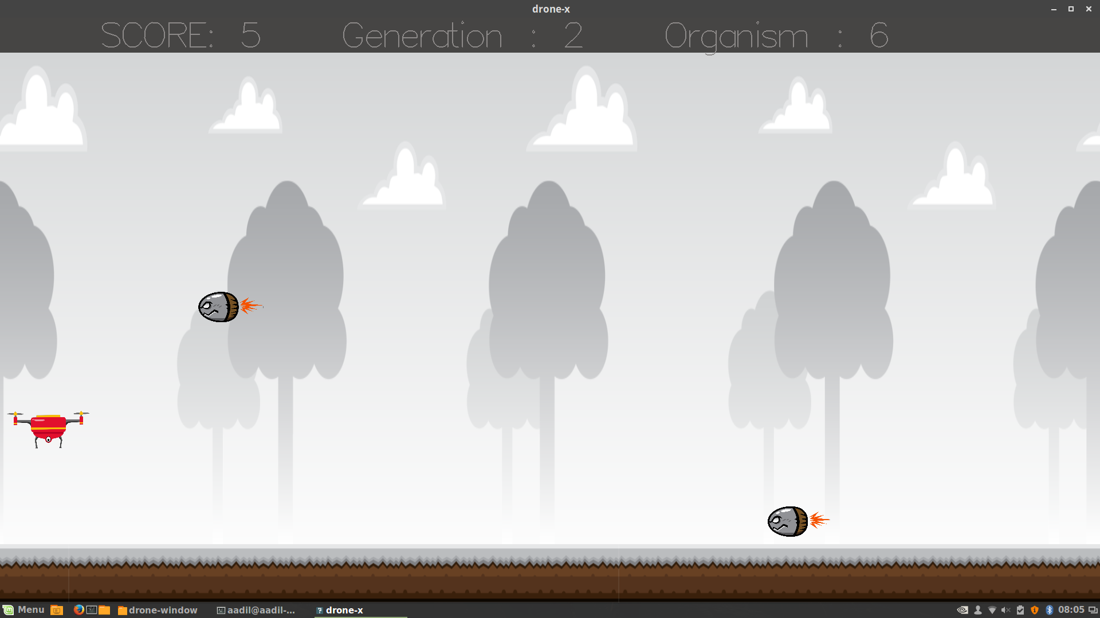
Inputs to AI module

Slide 13
Example of how the NN controls the drone
INPUTS
bias
“UP” move is made
x-drone
>= 0.5
y-drone
OUTPUT
x- ob1
Value between 0 and 1
y-ob1
< 0.5
x-ob2
“DOWN” move is made
y-ob2

Slide 14
Steps of evolution
Randomly generate a starting population of neural networks (20 organisms).
Evaluate each Neural Network(organism) at the task and assign a fitness value.
Mark the winners (highest fitness scores).
Perform Crossover.
Perform Mutation.
By doing steps 4 and 5, we have generated a new population of neural networks.
Repeat from step 2.

Slide 15
Initial Random Population of Neural Networks

Slide 16
Initial Random Population of Neural Networks
0.5
0.1
0.9
0.6
0.4
0.2
1.0
0.8
0.2
0.7

Slide 17
Initial Random Population of Neural Networks
ASSIGNING FITNESS VALUES
0.5
50
0.1
70
0.9
0
0.6
0.4
0.2
1.0
10
0.8
15
0.2
0.7

Slide 18
Initial Random Population of Neural Networks
MARKING WINNERS FOR REPRODUCTION
0.5
50
0.1
70
0.9
0
0.6
0.4
0.2
1.0
10
0.8
15
0.2
0.7

Slide 19
CROSSOVER
We simply retain the winners to the next generation.
Two winners are selected at selected at random to crossover using NEAT’s special crossover function.
This crossover function ensures that there’s no loss in information.
Here, the link weights can be increased or perturbed depending on probability.

Slide 20
MUTATION : Two Types
Add new node
Add new link

Slide 21
Next generation

Slide 22
EVOLUTION
This process is repeated again and again to produce better and better neural networks that is good at performing our task.
Every generation, a new set of population is generated.
We are essentially building/evolving an optimum neural network from scratch that is best suited to perform our task.

Slide 23
Future scope
The algorithm can be applied in real world scenarios for terrain traversal.
Areas of application include mining, exploration etc.
A fully trained drone can be used to serve military purposes.

Slide 24
References
Evolving Neural Networks through Augmenting Topologies ( Kenneth O. Stanley)
Angeline, P. J., Saunders, G. M., and Pollack, J. B. (1993). An evolutionary algorithm that constructs recurrent neural networks
Goldberg, D. E. (1989). Genetic Algorithms in Search, Optimization and Machine Learning. Addison Wesley, Reading, Massachusetts.

Slide 25
thank you.

