Slide 1
What is java ?
Object oriented, platform independent , programming language to develop
Desktop applications: Runs in computer eg: Microsoft Word
Web applications : Runs in browser eg: Gmail
Distributed applications: Runs on multiple systems eg: Banking systems

Slide 2
In Java, both a compiler and an interpreter are used to execute a program.
compiler What it does
A compiler converts Java source code (.java) into bytecode (.class) file.
interpreter What it does
The JVM uses an interpreter to execute the bytecode line by line and convert it into machine code the OS understands.
bytecode is the intermediate code generated by the Java compiler (javac)

Slide 3
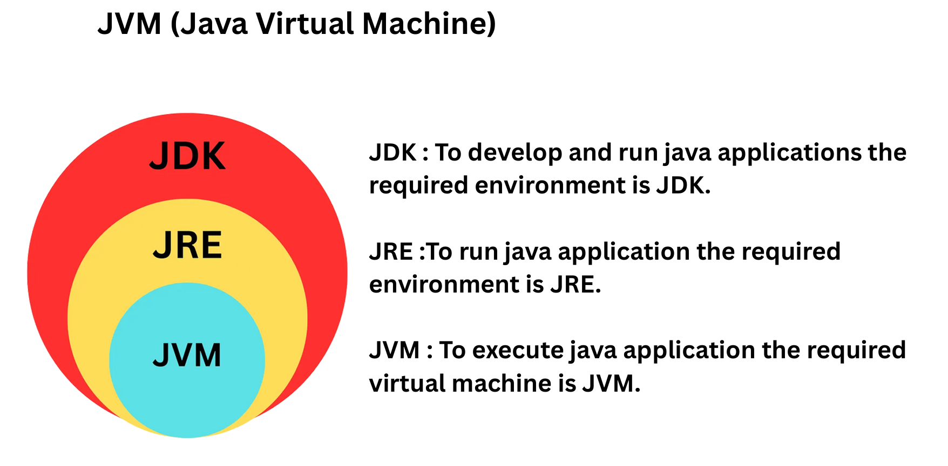

Slide 4
JVM
The heart of Java — it executes Java bytecode.
It converts bytecode (.class file) into machine code for your OS.
Makes Java platform independent.
Java is platform-independent and JVM is platform-dependent
Bytecode (.class) → JVM → Machine Code (OS Specific)
Platform independent:
Java programs can run on any operating system (Windows, Linux, Mac, etc.) without changing the code
JVM Responsibilities:
1.Loading: Loads class files into memory.
2.Verification: Checks bytecode for security and errors.
3.Execution: Uses Interpreter and JIT Compiler to execute bytecode efficiently.
4.Memory Management: Uses Garbage Collector to free unused objects automatically

Slide 5
JRE
To run java application the required environment is JRE
JRE provides everything needed to run a Java program.
Contains JVM + libraries + runtime files.
It provides libraries, JVM, and other files necessary to run Java applications.
It does not include development tools like compiler (javac).
In short: JRE = JVM + Java Class Librarie
JRE = JVM + Java Libraries
Java Virtual Machine (JVM): The execution engine
Java class libraries: Standard libraries for common functionality

Slide 6
JDK
To develop and run java applications the required environment is JDK.
It’s the complete package required to develop and Execute Java Applications.
JDK = JRE + JVM + Development Tools (like compiler)
Development tools (compiler, debugger, jar, etc.)
Main Tools in JDK:
javac → Java Compiler (Converts Java source code into bytecode)
java → Launches JVM
javadoc → Generates documentation
jar → Packages files into JARs

Slide 7
Major concepts
OOPs
Arrays, Strings
Interface, Abstract class
Exceptions
Threads
Collection framework

Slide 8
OOPS
Class
Object
Inheritance
Polymorphism
Encapsulation
Abstraction

Slide 9
Class and Object
Class : collection data members/properties and methods/ behaviors.
Example :
class Car {
String color; // property
void drive() { // behavior
System.out.println("Car is driving");
}
}
Object An object is an instance of a class
Car myCar = new Car(); // creating an object
myCar.color = "Red";
myCar.drive(); // calling method

Slide 10
Inheritance
acquires the properties and behaviours of another class (parent).
It promotes code reusability and method overriding (polymorphism).
class Animal {
void eat() {
System.out.println("Animal eats food");
}
}
// Child class (inherits Animal)
class Dog extends Animal {
void bark() {
System.out.println("Dog barks");
}
}

Slide 11
Abstraction
hiding implementation details and showing only the required functionality.
To Achieve 100 % abstraction
interface Shape {
void draw(); // behavior only
}
abstract class Animal {
abstract void sound(); // abstract method
void sleep() { // concrete method
System.out.println("Sleeping");
}

Slide 12
Polymorphism: In Java the ability of one reference to behave in different forms.
In Java Polymorphism is mainly divided into two types:
Compile-Time Polymorphism (method overloading)
Runtime Polymorphism (method overriding)

Slide 13
Overloading? Method name is same signature will be different
In same class
Overriding? when a subclass provides a specific implementation of a method that is already defined in its superclass.
In Inheritance

Slide 14
Encapsulation
data (variables) and methods (functions) together into a single unit (a class) and restricting direct access to the data from outside the class.
Encapsulation = data hiding + controlled access through method

Slide 15
Data hiding (using private variables)
Access only through public methods (getters/setters)
Improves security and maintainability
Prevents unauthorized modification

Slide 16
class Employee {
// private data member (hidden)
private double salary;
// setter method to modify salary
public void setSalary(double salary) {
if (salary > 0) {
this.salary = salary;
}
}
// getter method to access salary
public double getSalary() {
return salary;
}
}

