Slide 1
CKD Classification using Machine Learning
A data-driven approach to predict Chronic Kidney Disease
Presented by: Jaikumar
Problem Statement:
Stage 1:
Input = Numbers and categorical - so Domain will be Machine Learning-
Stage 2:
Supervised Learning- It's a Clear requirement and we have IP/OP data.
Stage 3:
classification data with yes/No values (Target features) - so we can go Classificationssion

Slide 2
Project Objective
Goal: Predict CKD based on clinical features using ML models.
Importance: Early detection of CKD can reduce risk and improve outcomes.

Slide 3
Dataset Overview
Source: CKD dataset (400 records × 25 features)
Target variable: 'class' → CKD or not CKD
Features: Age, Blood Pressure, Albumin, etc.

Slide 4
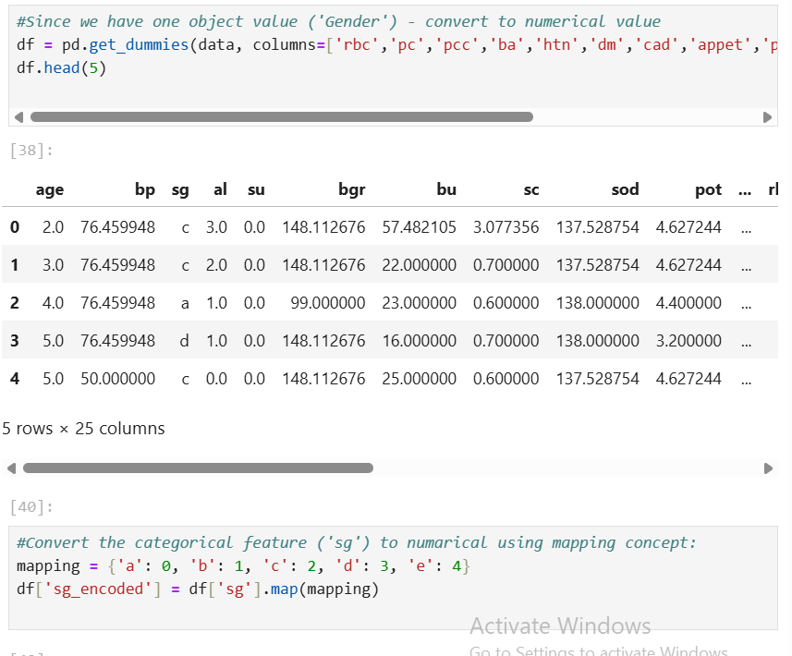
Data Preprocessing
Converted categorical data to numerical using One-Hot Encoding and Mapping concept.
Scaled numerical features using StandardScaler

Slide 5
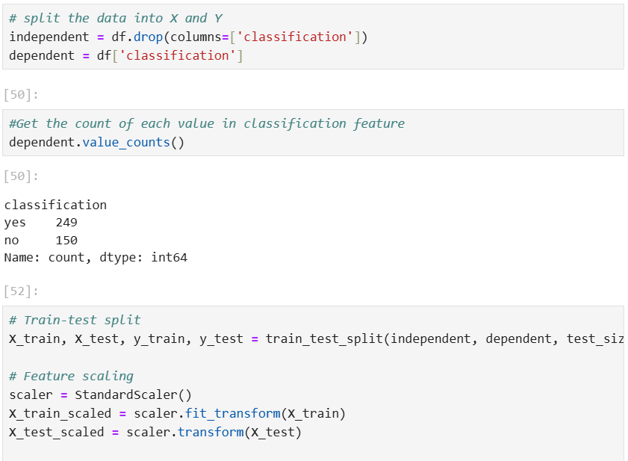
After Encoded - Split the data
Split the data into Independent and Dependent(target feature) data.
Then checked Dependent data with value_counts.
Using train_test_split – Split the data with randomness as 43.
Then scaled the data using StandardScaler().

Slide 6
Model Building
Models Used:
• Logistic Regression
• Decision Tree
• Random Forest
• SVM
• KNN
Train-Test Split: 80:20

Slide 7
Model Evaluation
Evaluation Metrics:
Accuracy
Precision
Recall
• F1-Score
Best Performing Model: Random Forest
Test Results on Next Slide =>

Slide 8
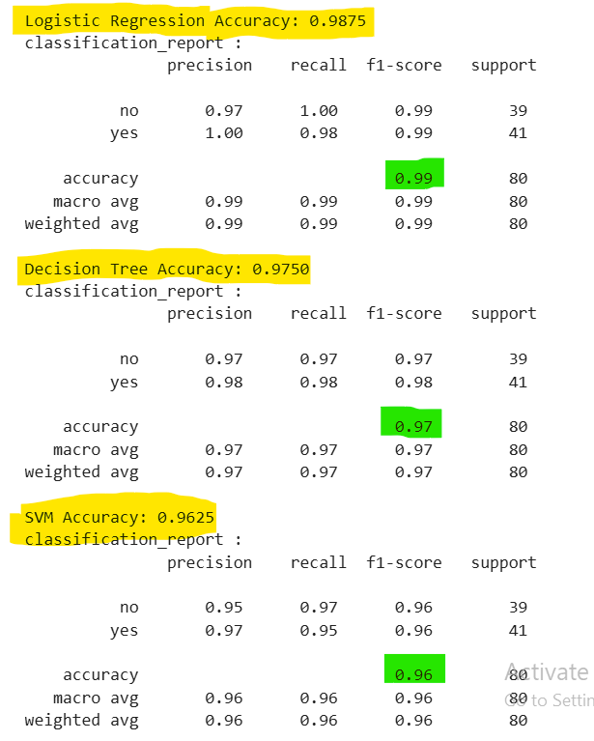
Test Results for each model:

Slide 9
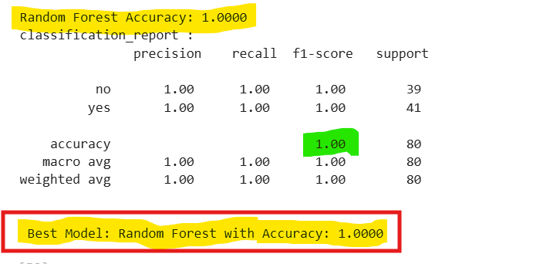
Final Best model

Slide 10
Conclusion & Model Selection Justification
Among all the models tested (Logistic Regression, Decision Tree, SVM, KNN), Random Forest performed the best in terms of accuracy, precision, recall, and F1-score.
It handled class imbalance and feature importance better than other models, making it more reliable for clinical prediction tasks like CKD classification.
Even before hyperparameter tuning, Random Forest delivered strong and consistent results.
Hyperparameter tuning was performed, but no significant improvement was observed—model still maintained high performance.
The trained Random Forest model was saved using Pickle for deployment.

Slide 11
Q&A
Thank you!
Questions and discussions are welcome.

