Slide 1
ADA Boost Regression
Version one

Slide 2
Ada Boost Regression:
In machine learning, Boosting is an ensemble meta-algorithm for primarily reducing bias and also variance in supervised learning.
Adaptive Boosting are Ensemble technique only
It is a sequential Learning process.
It learns from the previous results.
Here depth of the tree not beyond one leaves. Max_Depth = 1 (Stumps)
Multiple stumps will create along with one root node and two leafs.

Slide 3
General Boosting Methods :
Stumps
Root
node
s.no | F1 | F2 | F3 | o/p | Weights
1 |  |  |  |  | 1/3
2 |  |  |  |  | 1/3
3 |  |  |  |  | 1/3
W=1/n
BL1
Incorrect Classifier
Leaf Nodes
BL2
Incorrect Classifier
BL3
O/P
Steps to follow – On next slide

Slide 4
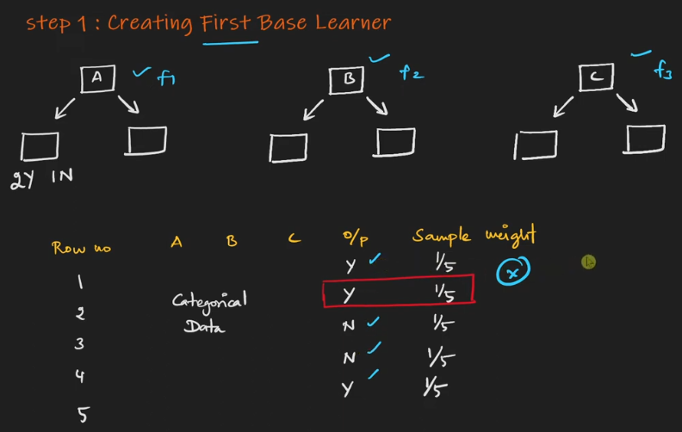
Ada Boosting
Step 1. Creating First Base Learner
We have 3 categorical feature.
Find the best gini index or Info gain
for suppose F2 was the best Gini or Entropy
For that entropy with each O/P – we need to assign sample weight based on no of rows
Then, it will classify the o/p and find correct and error prediction
Now it found one miss classify 2nd row
Now again we need to add weight for that miss classified data
So, here we found 1 error then I’ll will take 1/5 as total error. If suppose I got 3 error then I need to take 3/5 as total error.
Follow step 2- next slide

Slide 5
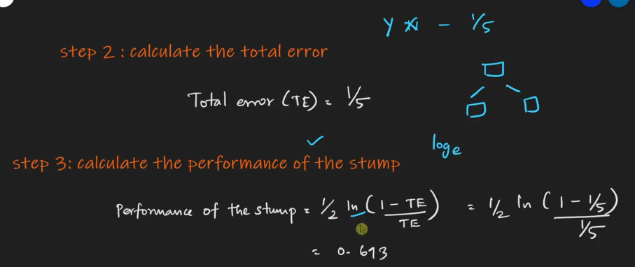
Ada Boosting :
Step 2. Calculate the total error
Step 3. Calculate the performance of the stump.
Step 2:
Found total error
Now step 3: we need to calculate the performance of the stump
Once we got the result
Then, step 4: Nxt slide.

Slide 6
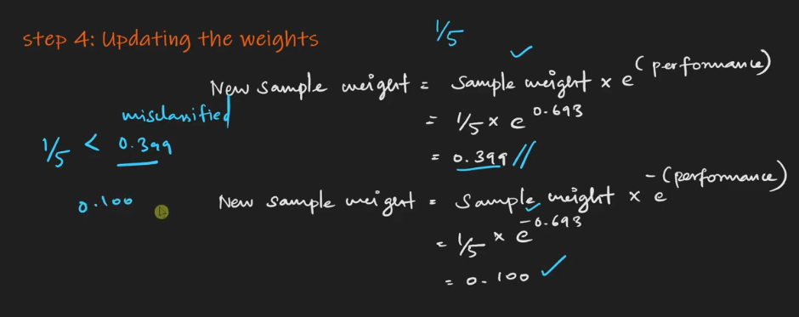
Ada Boosting
Step 4. Updating the weights
Step 4. Here, we need to find the updated weight (by cal sample veight * log e. = new sample wight (misclassified weight)
Now we need to find correctly classified data by same formula but instead of + performance here we use –(performance) to find correctly classified weight.

Slide 7
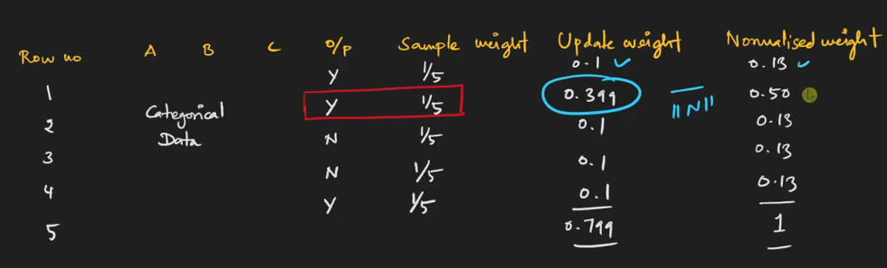
Ada Boosting
Ada Boosting
Step 6: we need add the weights for miss classified and correct one.
Updated weight – after adding all weight 0.799 but we need 1. so we need to normalized the data.
Like = 0.1/0.799 = 0.13 – Normalized weight

Slide 8
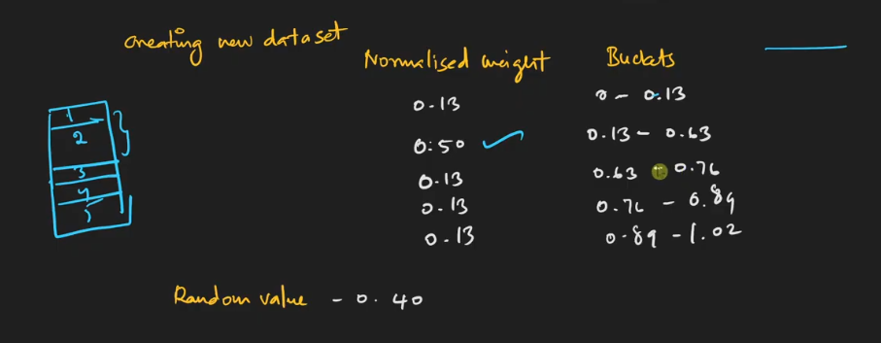
Ada Boosting
Ada Boosting
Note : After taking maximum observation it will check for the maximum results and it will conclude that majority number.

Slide 9
Gradient Boosting Regression
Version one

Slide 10
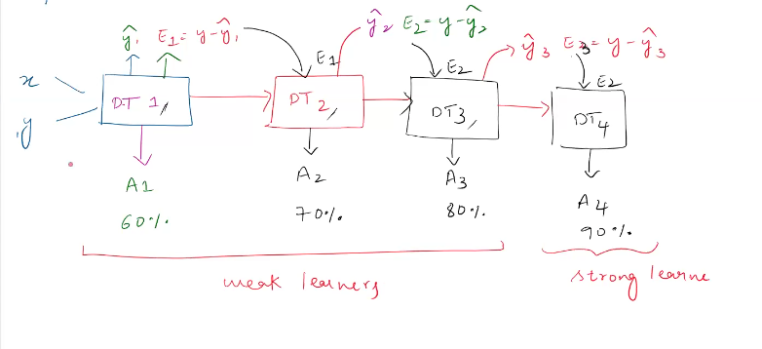
Gradient Boosting Work flow:

Slide 11
Gradient Boosting
Gradient boosting is an ensemble technique which constructs multiple base learners sequentially to get the best possible strong learner by reducing the mistakes made by the previous models.
An ensemble learning technique that builds models sequentially.
Each model corrects errors made by previous models.
Uses gradient descent optimization to minimize the loss.
Helps in reducing bias and variance effectively.

Slide 12
Gradient Boosting
Key Features of GBR
✅ Handles Non-Linearity – Captures complex patterns. ✅ Reduces Bias & Variance – More robust than single models. ✅ Feature Importance – Identifies key predictors. ✅ Works with Missing Data – Handles NaNs effectively. ✅ Highly Customizable – Offers multiple tuning parameters.

Slide 13
Gradient Boosting:
How GBR Works?
1️. Start with a simple model (weak learner, usually a Decision Tree). 2️. Compute the error (residuals) of the predictions. 3️. Fit a new model to correct these residuals. 4️. Repeat the process iteratively. 5️. Combine all models for the final output.

Slide 14
Gradient Boosting:
Advantages: ✔ High predictive accuracy. ✔ Works well with structured/tabular data. ✔ Handles missing values effectively. ✔ Supports feature selection via importance ranking.
Disadvantages:
Can be slow for large datasets.
More prone to overfitting in n_estimators is too high.
Require carefull tuning of hyperparameters.

Slide 15
XG Boosting: What is XGBoost? Extreme Gradient Boosting (XGBoost) is an advanced ensemble learning method. Designed for high performance and efficiency. Uses gradient boosting framework with additional optimizations. Works well with large datasets and missing values.

Slide 16
Key Features of XGBoost ✅ Faster than Gradient Boosting – Efficient memory usage and parallel computation. ✅ Handles Missing Values – Automatically learns the best path for NaNs. ✅ Regularization (L1 & L2) – Prevents overfitting effectively. ✅ Tree Pruning & Shrinkage – Reduces complexity while maintaining accuracy. ✅ Highly Scalable – Works well with large datasets.

Slide 17
Advantages: ✔ Extremely fast and efficient. ✔ Handles missing values automatically. ✔ Works well with large datasets. ✔ Reduces overfitting using regularization. ✔ Provides feature importance ranking.
❌ Disadvantages: ✘ Requires tuning for best performance. ✘ Can be computationally expensive for very large datasets. ✘ More complex compared to simpler models like Linear Regression.

