Slide 1
SE 215 Presentation
Jessy Ayala

Slide 2
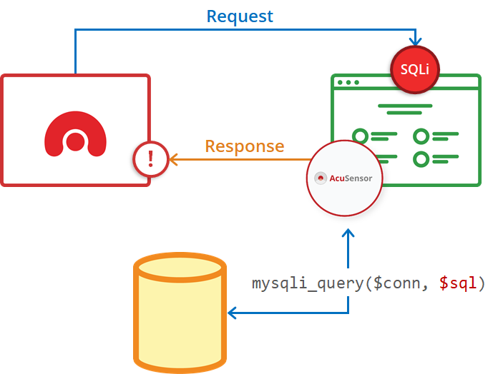
Problem domain
Dynamic application security testing (DAST)
Time consuming, usually manual
Involves running an app, not just performing static analysis
How can automation be introduced?

Slide 3

Problem focus
Checking for usable security and common appsec concerns
Unintentionally accessible screens
SQL injection capabilities
Ability to control broadcast receivers & services

Slide 4
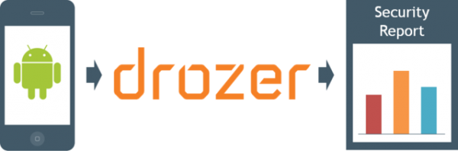
Drozer
A comprehensive security + attack Android framework
Capabilities for automating dynamic analysis
Built-in modules for performing exploits
Covers a wide range of appsec concerns

Slide 5
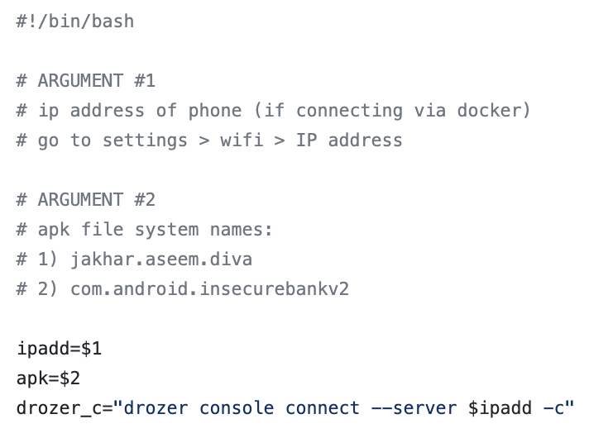
Setup
Two vulnerable apps for PoC
Docker container to run Drozer
Android A32 device with Drozer agent APK installed
Bash script to control testing sequence (generalizable)

Slide 6
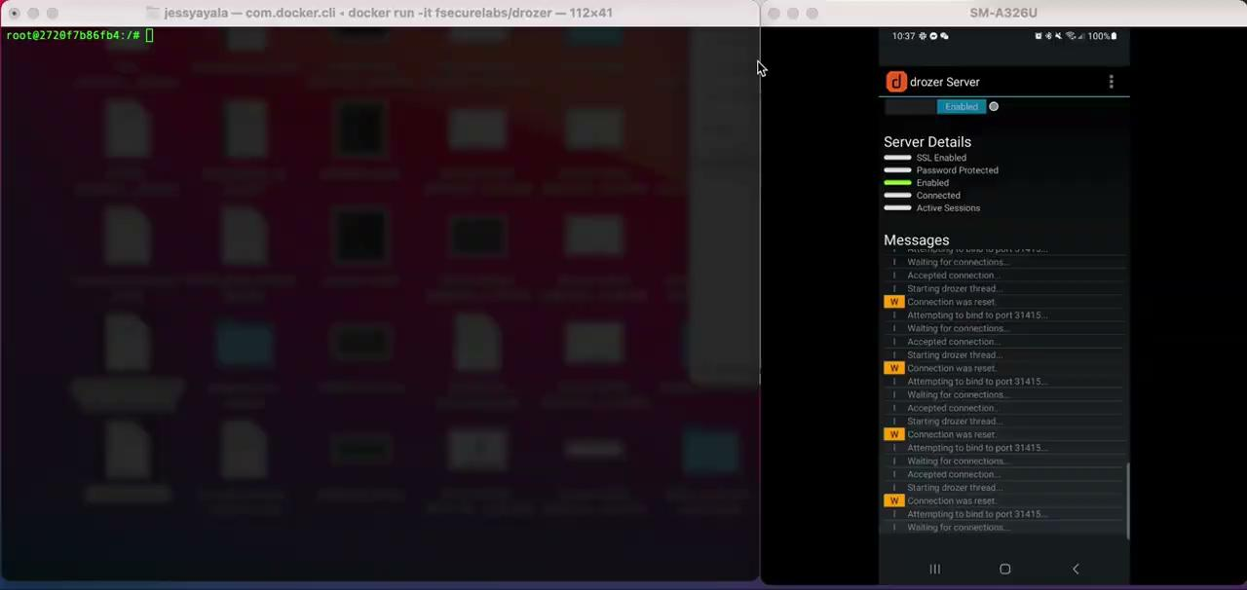
Demo 1: Damn Insecure and Vulnerable App (DIVA)

Slide 7
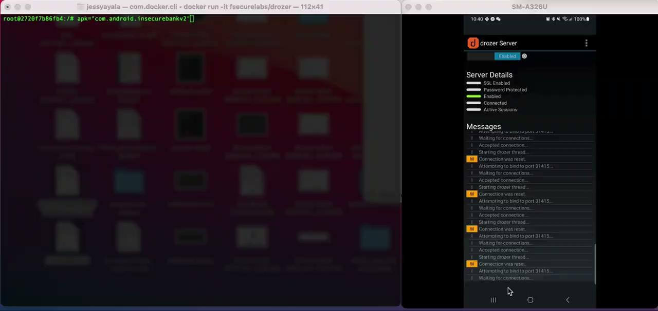
Demo 2: Insecure Bank v2

Slide 8
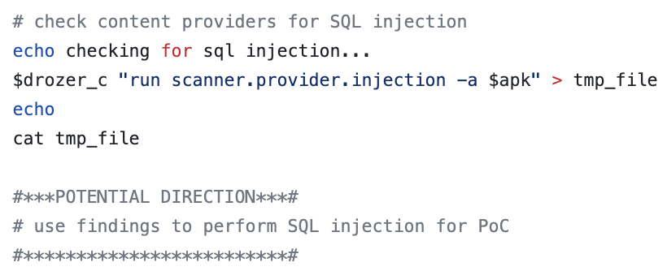
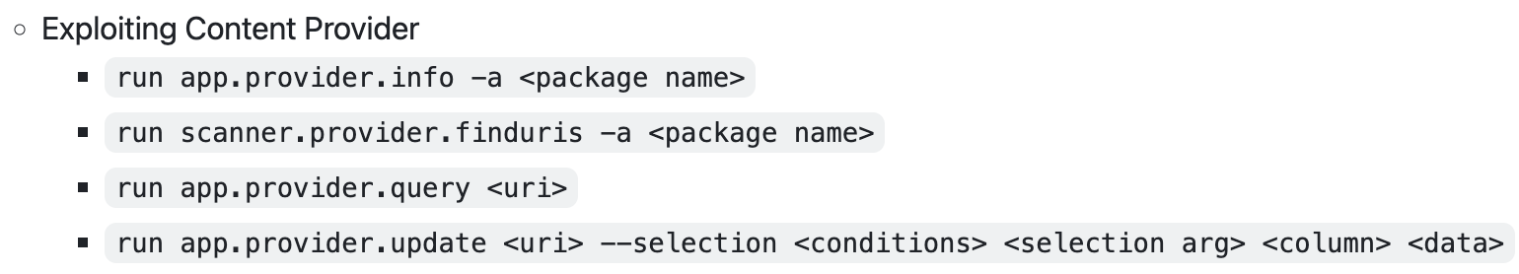
Challenges, Limitations, Future Work…
Time
Generating exploits
Wider coverage

Slide 9
Thank you :)
Questions?
Notes:
https://github.com/jayala-29/SE215-SP23/tree/main

