Slide 1
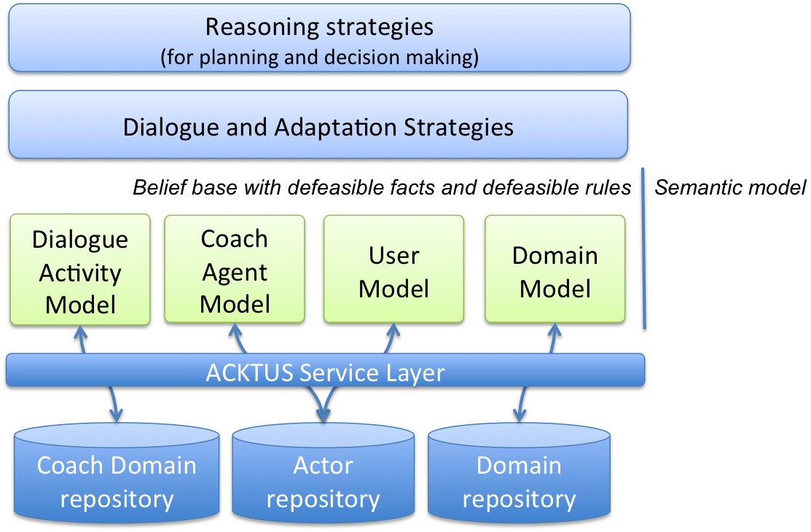
Paper V
Paper II
Paper IV
Paper VI
Paper III
Paper I

Slide 2
Paper VI
Paper I
Paper III
Paper V
Paper II
Paper IV
Paper VII

Slide 3
Paper I
Paper III
Paper IV
Paper II

Slide 4
Paper I
Paper II
Paper III

