Slide 1

Final year Capstone Project– 2nd Review
Web Application Security Testing: A NIDS-based Penetration Testing Approach
By
SHREYA MALSHETTY |  | ID No.: 20211CCS0061
JAYALAKSHMI D |  | ID No : 20211CCS0064
CHAITHRA BANGER |  | ID No : 20211CCS0114
SRUJANA MNAJUNATH |  | ID No : 20211CCS0116
Under the supervision of
Dr. Sharmasth Vali Y
Associate Professor
Department of Computer Science Engineering
November,2024

Slide 2
Content
1.Abstract
2.Literature Survey – Minimum 10 research papers must be referred.
3.Objectives
4. Existing Methods-Drawbacks
5. Proposed Method
6. Architecture Diagram
7. Modules
8.Hardware and Software Details
9.Timeline by Gantt Chart
10.References
11.Acknowledgement

Slide 3
Abstract
The goal of this project is to improve web application security by using a penetration testing methodology based on Network Intrusion Detection Systems (NIDS). A wide range of cyberthreats are drawn to web applications as they get more common and complex. This project intends to mimic actual attack situations on online applications in order to find security vulnerabilities. By including NIDS in penetration testing, a dual strategy is offered: not only does it enable the identification of possible attacks, but it also makes it easier to assess how resilient the online application is to different attack methods.

Slide 4
Literature Survey
Web application security testing is essential for identifying vulnerabilities in digital platforms, with penetration testing playing a critical role in this process. A NIDS (Network Intrusion Detection System)-based approach enhances security testing by monitoring network traffic for suspicious activity, integrating seamlessly into various testing frameworks.
"Impact and Research Challenges of Penetrating Testing and Vulnerability Assessment on Network Threat” -the author makes the point that security is a significant problem and to overcome that they have proposed vulnerability assessment and penetration testing for network-based vulnerability. Vulnerability threats (such as viruses, trojans, and worms), network problems (such as false positives, negatives, and system complexity), and pen testing risks (such as disruption, ethical and legal issues). Additionally, they have contained future work that can be done in an IoT, cloud, or aiml-based manner.

Slide 5
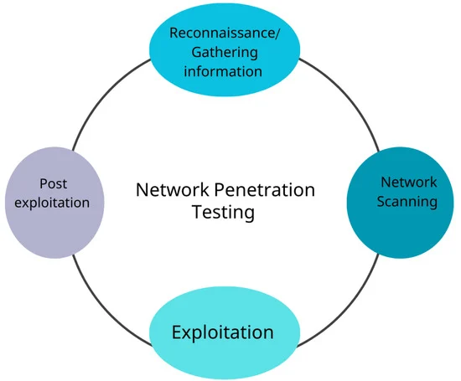
Literature Survey
"Network Intrusion Detection System using Deep Learning“- This paper proposes the use of deep learning architectures to develop an adaptive and resilient network intrusion detection system (IDS) to detect and classify network attacks they used the UNSW-NB15 dataset. Their suggested method achieved 95.4% and 95.6% total accuracy. Future work calls for transfer learning along with boot strapping techniques.
“A Comprehensive Analysis of Network Security Challenges and Vulnerabilities”- article tells us about the penetration testing methodology cycle:

Slide 6
Objectives
Identify vulnerabilities
Test detection capabilities
Analyse network traffic
Evaluate incident response
Continuous improvement
Documentation and reporting

Slide 7
Proposed Method
Planning and Preparation
Setup NIDS
Traffic Analysis
Vulnerability Scanning
Exploitation
Post-Exploitation
Reporting

Slide 8
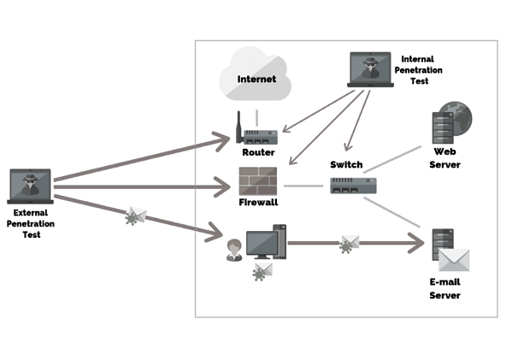
Architecture Diagram

Slide 9
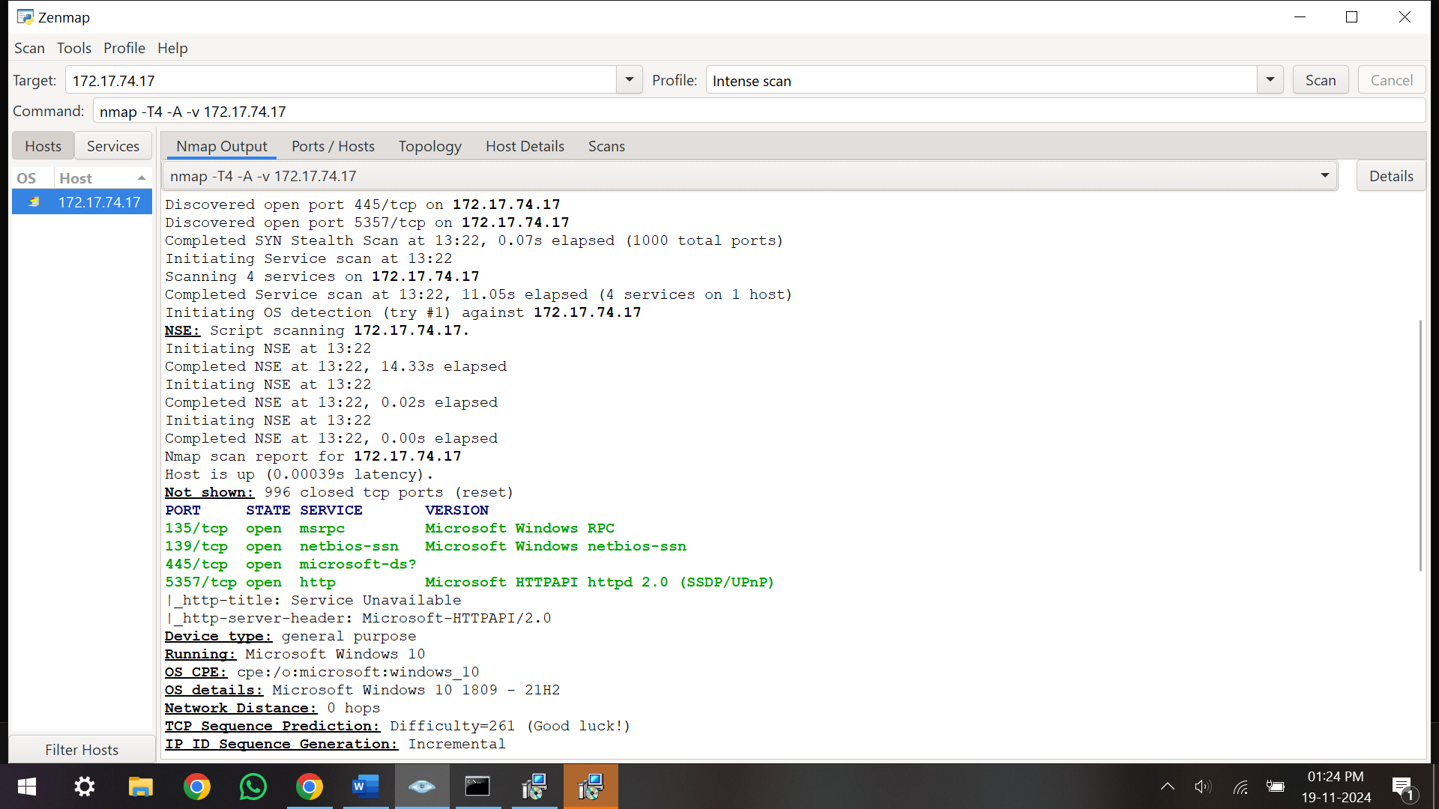
Implementation
Nmap
Nmap (Network Mapper) is a powerful open-source tool used for network discovery and security auditing. It is mainly used to:
- Discover devices on a network
- Scan for open ports on a device
-Detect services running on those ports
-Identify operating systems and device characteristics
-Check for vulnerabilities using scripts (NSE)

Slide 10
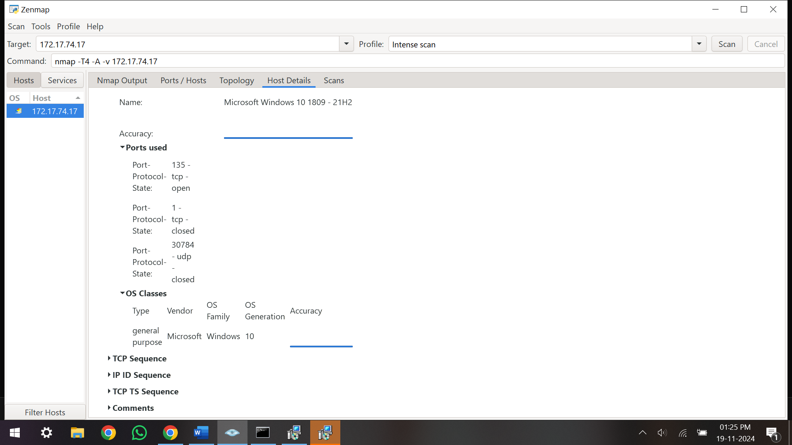
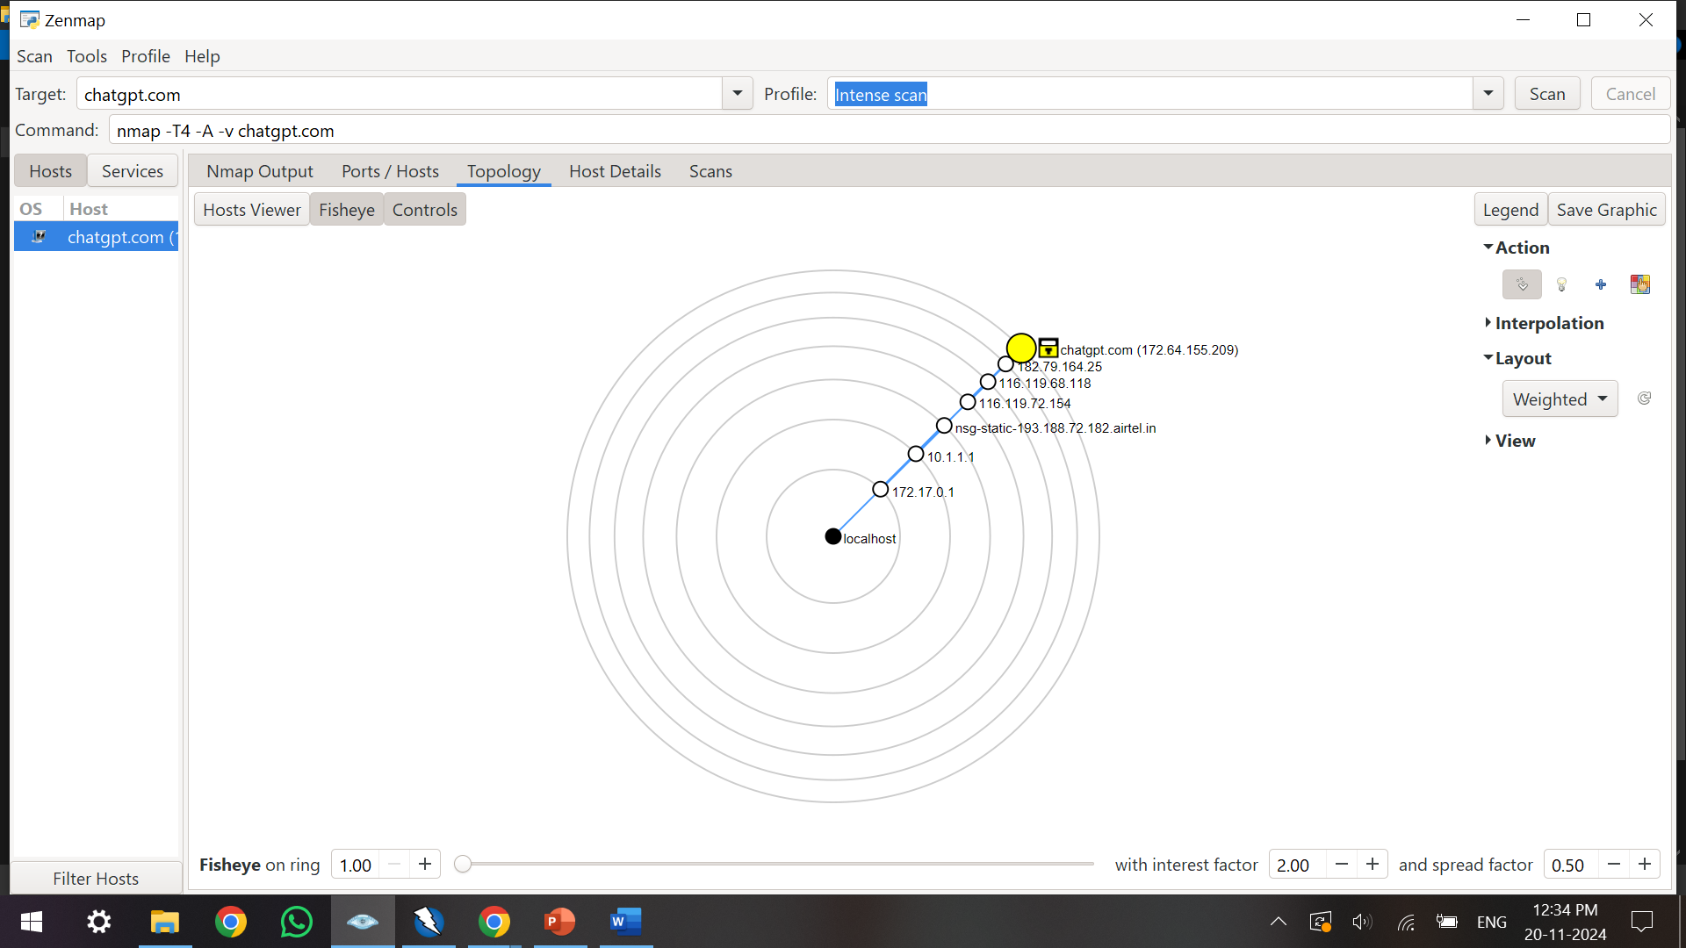
Implementation

Slide 11
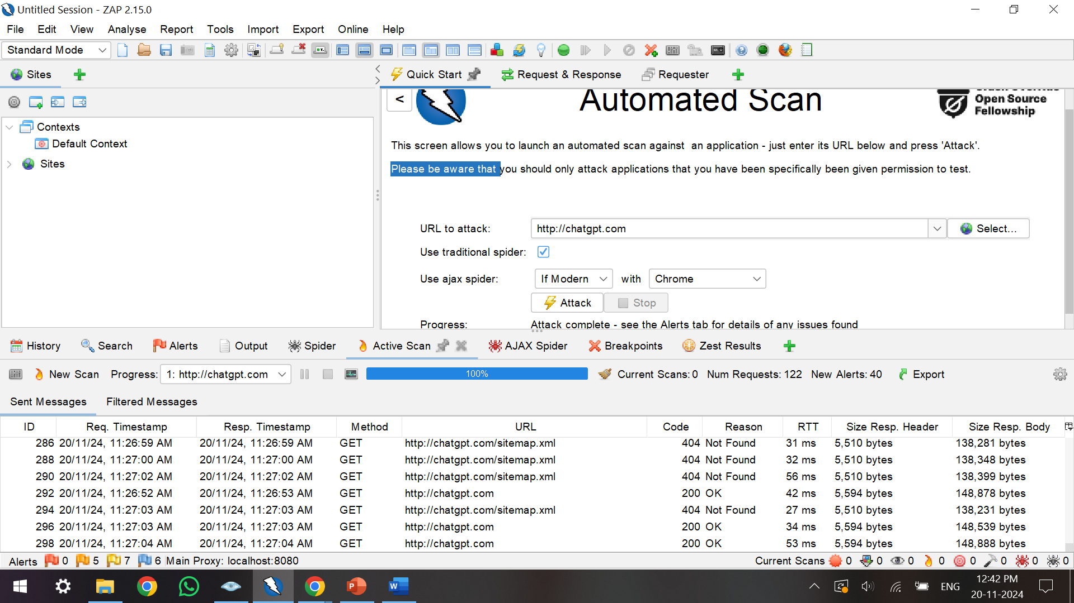
Implementation
OWASP ZAP
OWASP ZAP (Zed Attack Proxy) is an open-source web application security testing tool. It helps find security vulnerabilities in web applications and APIs through features like:
-Automated Scanning: Detects common vulnerabilities like SQL injection and XSS.
-Intercepting Proxy: Allows manipulation of HTTP requests and responses.
-Spidering: Crawls web applications to discover hidden pages.
-Fuzzing: Sends varied inputs to test for unexpected behaviors.
-API Testing: Tests REST and SOAP APIs for security flaws.

Slide 12
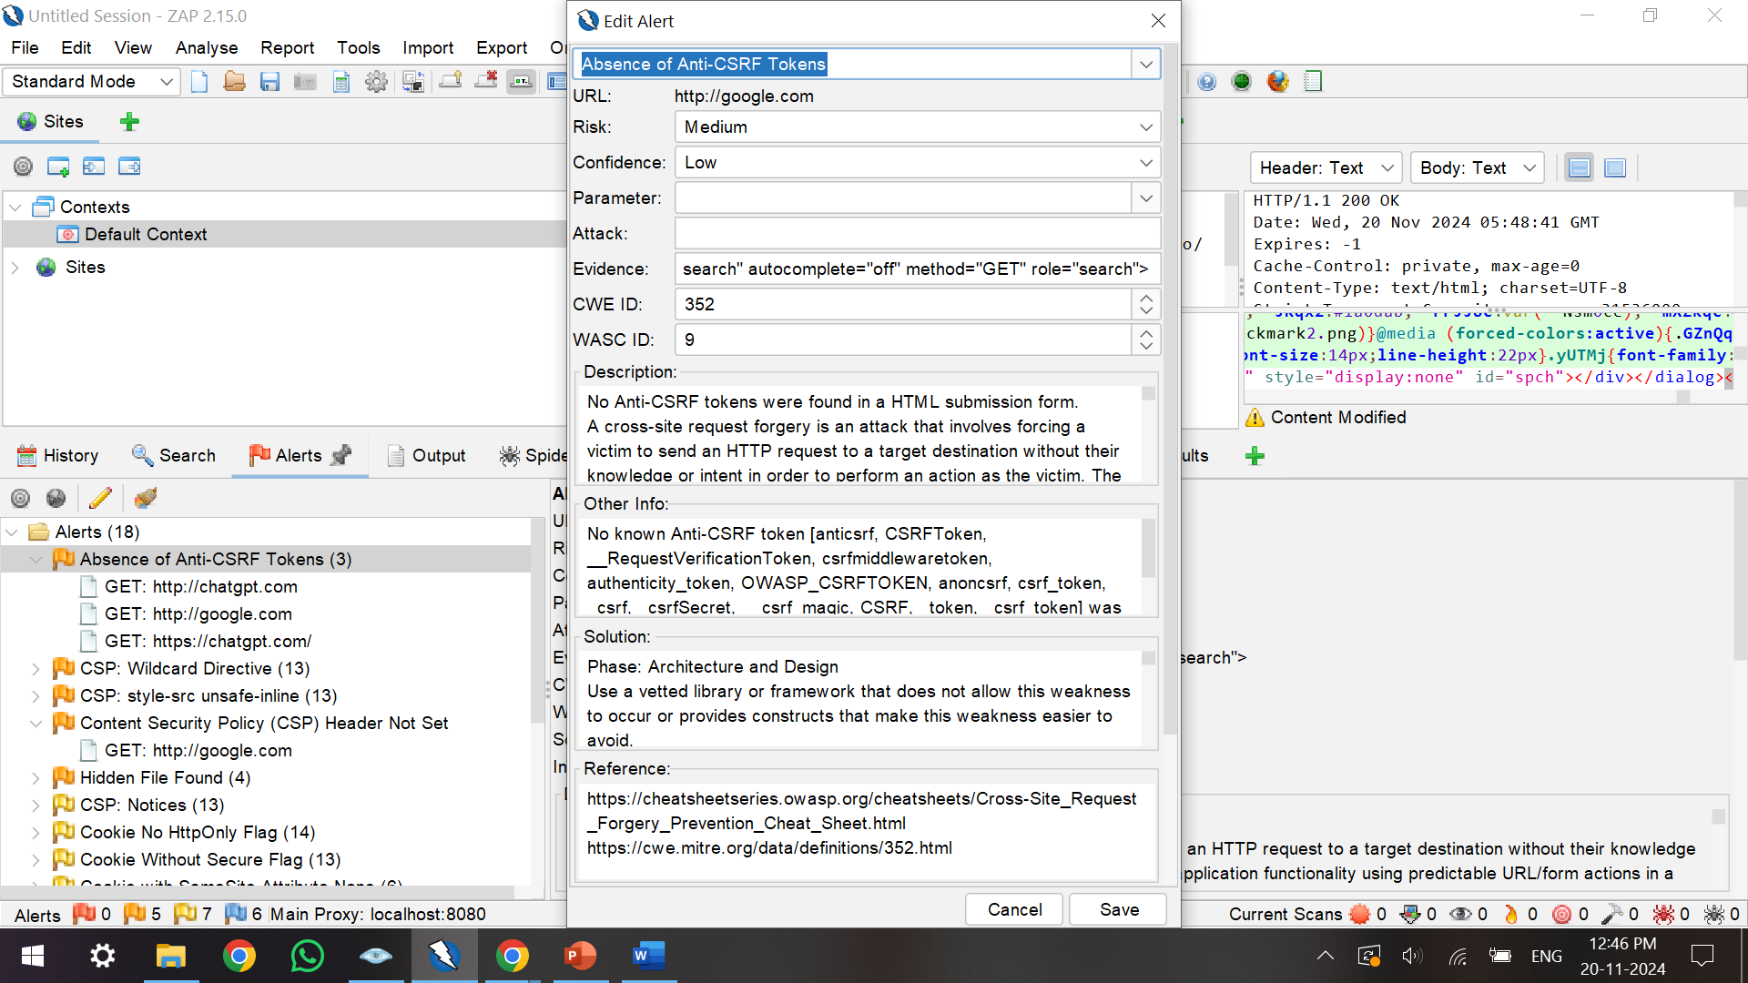
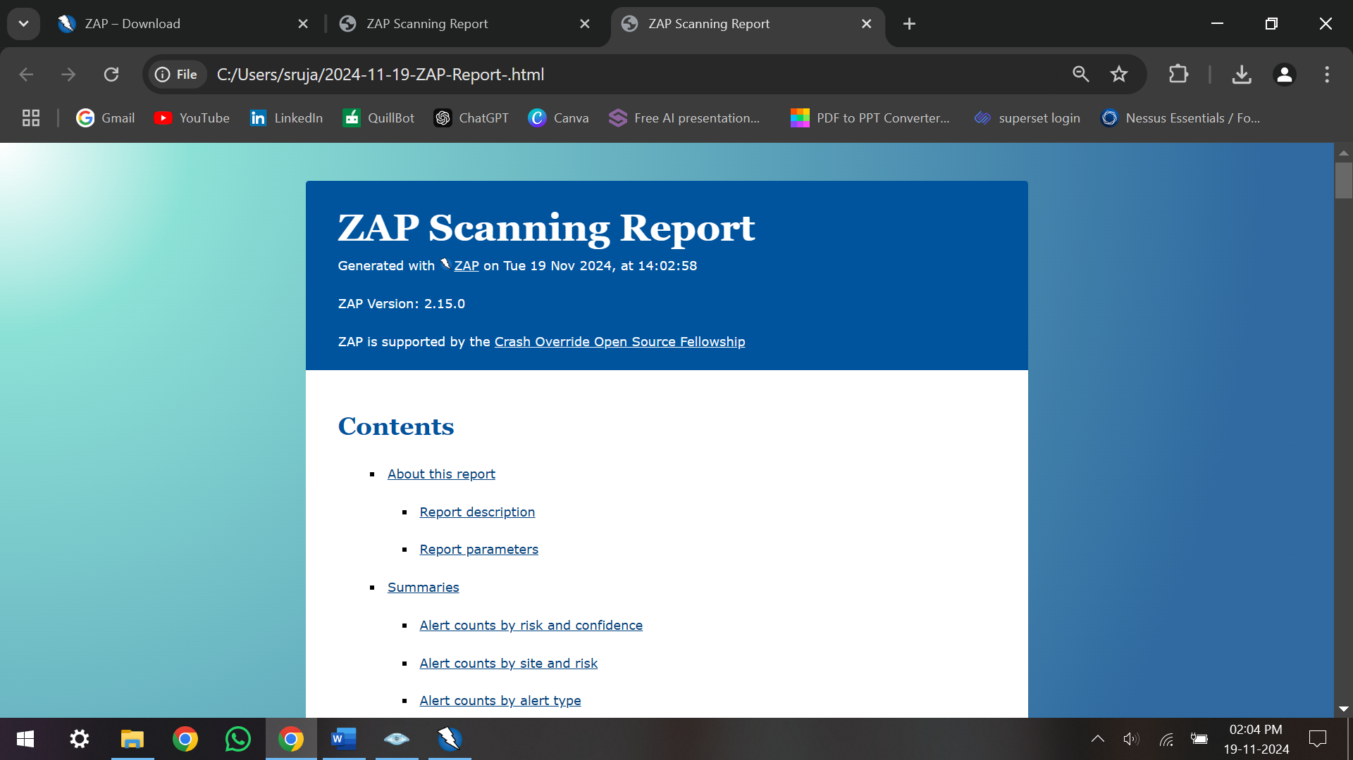
Implementation

Slide 13
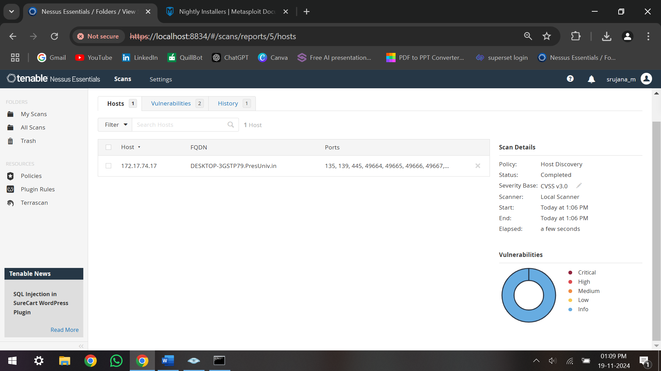
Implementation
Nessus
Nessus is a popular vulnerability scanner developed by Tenable, used for identifying security vulnerabilities in systems, networks, and applications.
-Vulnerability Scanning: Detects missing patches, misconfigurations, and outdated software.
-Compliance Checking: Ensures systems meet security standards like PCI-DSS, HIPAA.
-Risk Assessment: Rates vulnerabilities based on severity to prioritize remediation.
-Detailed Reporting: Provides in-depth reports with recommendations for fixing issues.
Nessus is commonly used for penetration testing, vulnerability management, and compliance audits to improve system security.

Slide 14
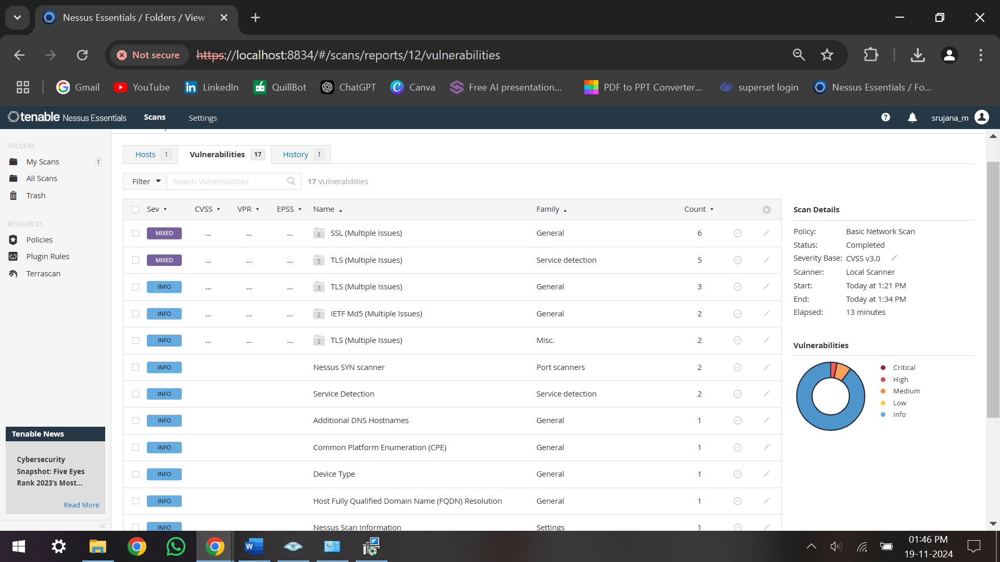
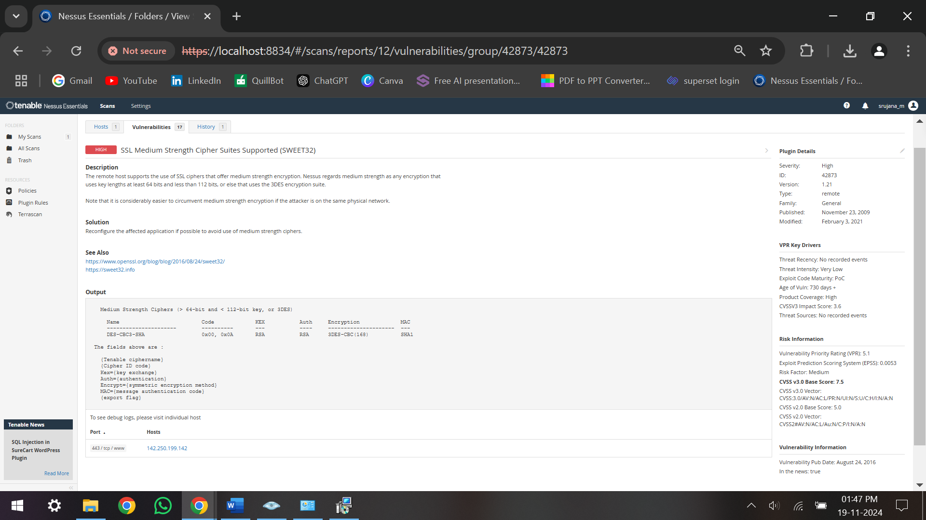
Implementation

Slide 15
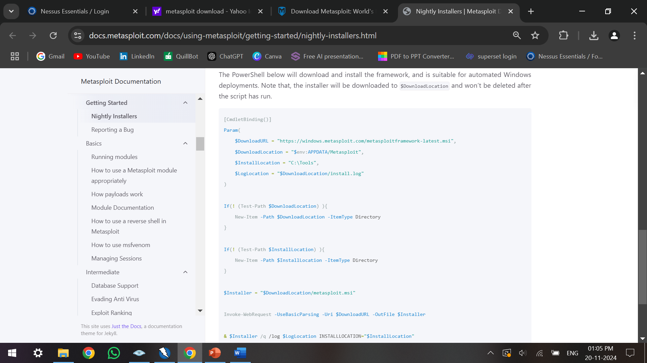
Implementation
Metasploit
Metasploit is an open-source penetration testing framework used for exploiting vulnerabilities and security research.
-Exploit Library: Pre-built exploits for various vulnerabilities.
-Meterpreter: A powerful command-and-control shell for compromised systems.
-Post-Exploitation: Tools to gather data, escalate privileges, or maintain access.
-Auxiliary Modules: Additional tools for scanning and vulnerability enumeration.
Metasploit is widely used for penetration testing, vulnerability research, and security audits to identify and exploit security weaknesses.

Slide 16
Timeline by Gantt Chart
REVIEW 2:
Referred 20-30 conference papers
The objectives methodologies are discussed
Architecture diagram
Vulnerabilities report
Implementation of 3 tools
60% of the work completed
Review 2 report

Slide 17
References
[1] Alhamed M, Rahman MMH. A Systematic Literature Review on Penetration Testing in Networks: Future Research Directions. Applied Sciences. 2023; 13(12):6986. https://doi.org/10.3390/app13126986
[2] Altulaihan EA, Alismail A, Frikha M. A Survey on Web Application Penetration Testing. Electronics. 2023; 12(5):1229.
https://doi.org/10.3390/electronics12051229
[3] Vladimir Ciric, Marija Milosevic, Danijel Sokolovic, Ivan Milentijevic,
Modular deep learning-based network intrusion detection architecture for real-world cyber-attack simulation, Simulation Modelling Practice and Theory, Volume 133,2024,102916,ISSN 1569-190X,
https://doi.org/10.1016/j.simpat.2024.102916
[4] Saputra FA, Salman M, Hasim JAN, Nadhori IU, Ramli K. The Next-Generation NIDS Platform: Cloud-Based Snort NIDS Using Containers and Big Data. Big Data and Cognitive Computing. 2022; 6(1):19. https://doi.org/10.3390/bdcc6010019
[5] S. Kumar, S. Gupta and S. Arora, "Research Trends in Network-Based Intrusion Detection Systems: A Review," in IEEE Access, vol. 9, pp. 157761-157779, 2021. https://doi:10.1109/ACCESS.2021.3129775
[6] Heather Lawrence, Uchenna Ezeobi, Orly Tauil, Jacob Nosal, Owen Redwood, Yanyan Zhuang, Gedare Bloom,
CUPID: A labeled dataset with Pentesting for evaluation of network intrusion detection, Journal of Systems Architecture, Volume 129,2022,102621,ISSN13837621; https://doi.org/10.1016/j.sysarc.2022.102621

Slide 18
References
[7] Kumar, Satish & Gupta, Sunanda & Arora, Sakshi. (2021). Research Trends in Network-Based Intrusion Detection Systems: A Review. IEEE Access. PP. 1-1; https://doi.org/10.1109/ACCESS.2021.3129775
[8] Lirim Ashiku, Cihan Dagli, Network Intrusion Detection System using Deep Learning, Procedia Computer Science, Volume 185, 2021, Pages 239247, ISSN 1877-0509; https://doi.org/10.1016/j.procs.2021.05.025
[9] Vanin P, Newe T, Dhirani LL, O’Connell E, O’Shea D, Lee B, Rao M. A Study of Network Intrusion Detection Systems Using Artificial Intelligence/Machine Learning. Applied Sciences. 2022; 12(22):11752. https://doi.org/10.3390/app122211752
[10] Vegesna, Vinod Varma, Utilising VAPT Technologies (Vulnerability Assessment & Penetration Testing) as a Method for Actively Preventing Cyberattacks (October 25, 2023). International Journal of Management, Technology And Engineering | Volume XII, Issue VII, JULY 2022, Available at SSRN: ssrn.com/abstract=4612524
[11] Ke Chen, Man Zhang, Rufeng Liang, Junhan Chen, Jin Peng, Xun Huang, Research on the Application of Penetration Testing Frameworks in Blockchain Security, Computational and Experimental Simulations in Engineering, https://doi.org/10.1007/978
[12] Fredrik Heiding, Emre Süren, Johannes Olegård, Robert Lagerström,
Penetration testing of connected households,Computers & Security,Volume 126, 2023,103067,ISSN 0167-4048; https://doi.org/10.1016/j.cose.2022.103067

Slide 19
References
[13] Altulaihan, E.A.; Alismail, A.; Frikha, M. A Survey on Web Application Penetration Testing. Electronics 2023, 12, 1229. https://doi.org/10.3390/electronics12051229
[14] A. Goutam and V. Tiwari, "Vulnerability Assessment and Penetration Testing to Enhance the Security of Web Application," 2019 4th International Conference on Information Systems and Computer Networks (ISCON), Mathura, India, 2019, pp. 601-605, doi: 10.1109/ISCON47742.2019.9036175.
[15] P. Vats, M. Mandot and A. Gosain, "A Comprehensive Literature Review of Penetration Testing & Its Applications," 2020 8th International Conference on Reliability, Infocom Technologies and Optimization (Trends and Future Directions) (ICRITO), Noida, India, 2020, pp. 674-680, doi: 10.1109/ICRITO48877.2020.9197961.
[16] Abdulghaffar, K.; Elmrabit, N.; Yousefi, M. Enhancing Web Application Security through Automated Penetration Testing with Multiple Vulnerability Scanners. Computers 2023, 12, 235. https://doi.org/10.3390/computers12110235
[17] Soroush M. Sohi, Jean-Pierre Seifert, Fatemeh Ganji, RNNIDS: Enhancing network intrusion detection systems through deep learning,Computers & Security,Volume 102,2021,102151,ISSN 0167-4048, https://doi.org/10.1016/j.cose.2020.102151
[18] Ms Khushnaseeb Roshan, Aasim Zafar, Boosting robustness of network intrusion detection systems: A novel two phase defense strategy against untargeted white-box optimization adversarial attack, Expert Systems with Applications,Volume 249, Part A,2024,123567,ISSN 09574174, https://doi.org/10.1016/j.eswa.2024.123567.

Slide 20
Acknowledgement
We would like to express our sincere thanks to the supervisor, Dr. Sharmasth Vali Y, Associate Professor, Department of Computer Science Engineering for his morale boosting, meticulous guidance, co-operation and supervision throughout this project work.

Slide 21
Thank You !!!

