Slide 1
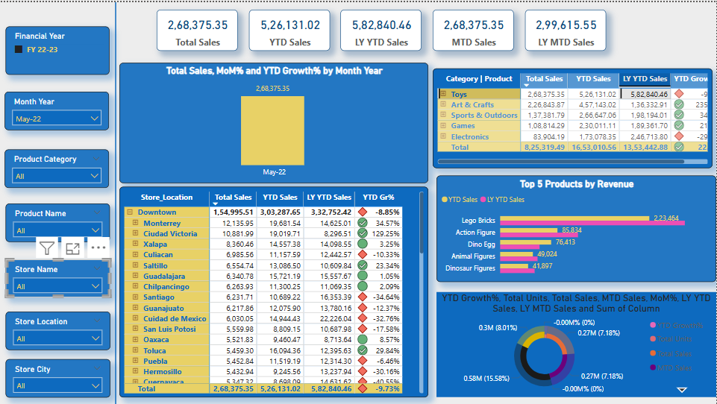
Sales Dashboard Summary - FY 22-23 (May 2022)

Slide 2
Key Metrics:
- Total Sales: ₹2,68,375.35
- YTD Sales: ₹5,26,131.02
- LY YTD Sales: ₹5,82,840.46
- MTD Sales: ₹2,68,375.35
- LY MTD Sales: ₹2,99,615.55

Slide 3
Monthly Sales Performance
Total Sales for May 2022: ₹2,68,375.35
YTD Growth vs. LY: -9.70%

Slide 4
Sales by Store Location
Top Performing Stores:
1. Downtown: ₹1,54,595.51
2. Monterrey: ₹12,185.95
3. Ciudad Victoria: ₹9,511.51
Lowest Performing Stores:
- Puebla: ₹5,442.98
- Hermosillo: ₹5,328.94
- Guaymas: ₹4,979.51

Slide 5
Category & Product Breakdown
Top Product Categories:
1. Toys: ₹2,68,375.35
2. Art & Crafts: ₹2,26,843.87
3. Sports & Outdoors: ₹2,04,813.05
Top Products:
- Lego Bricks: ₹2,23,464
- Action Figure: ₹85,834
- Dino Egg: ₹76,413

Slide 6
YTD Growth Summary
YTD Growth by Category:
- Toys: -9%
- Art & Crafts: -11%
- Sports & Outdoors: -5%
- Games: -6%
- Electronics: -4%
Donut Chart Key:
- YTD Growth: 0.58M (15.58%)
- Total Sales: 0.27M (7.18%)
- MoM%: -0.00%

